Slide 1
Data mining project – dbmd2
Mateusz Winnicki

Slide 2

Agenda
Introduction
Clustering task – KYM memes dataset
Classification task – car purchases dataset

Slide 3


Introduction
2 tasks perfmormed for 2 different datasets
- Clustering with K-means on memes dataset
- Classification with Random Forest on car purchases dataset
EDA + preprocessing performed for memes dataset before clustering
EDA performed for cars purchases dataset before classification + classification results comparison with RF implementation from scractch

Slide 4
KYM memes
Clustering task

Slide 5
Preprocessing
Initial dataset size – 28799 rows, 16 columns
Most interesting data for the following study: description, tags, type
Description and type needed to be preprocessed – they were part of dictionaries in columns content and details
Removed rows with empty values of description/type
Removed rows with duplicated values of description

Slide 6
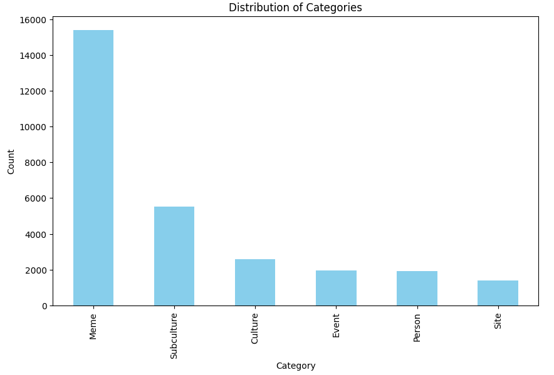
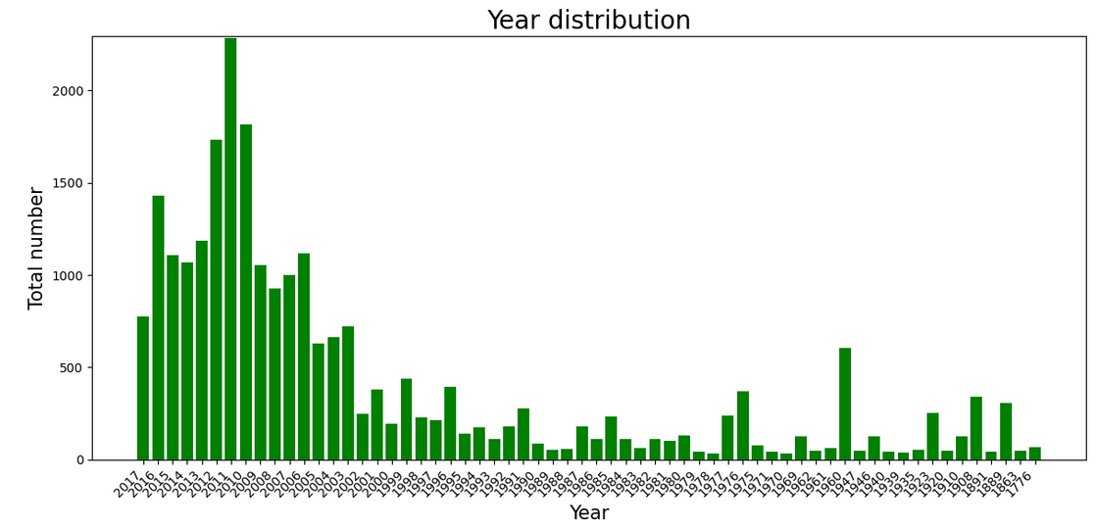
Exploratory data analysis

Slide 7
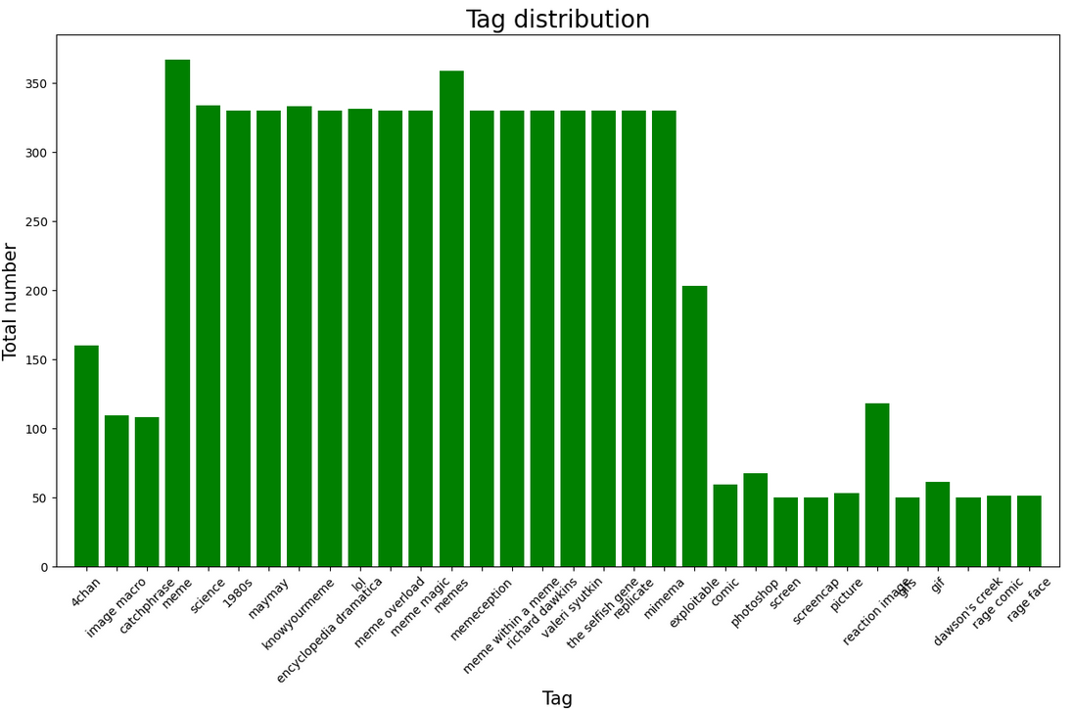
Exploratory data analysis

Slide 8
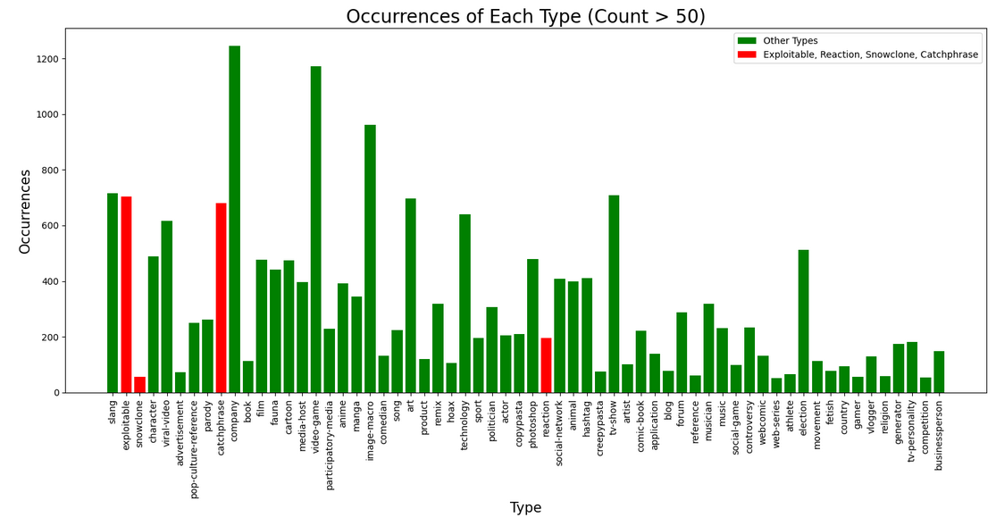
Exploratory data analysis

Slide 9
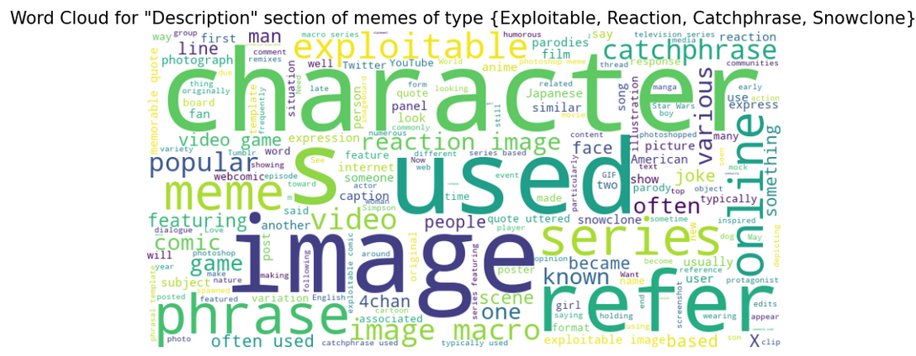
Exploratory data analysis

Slide 10
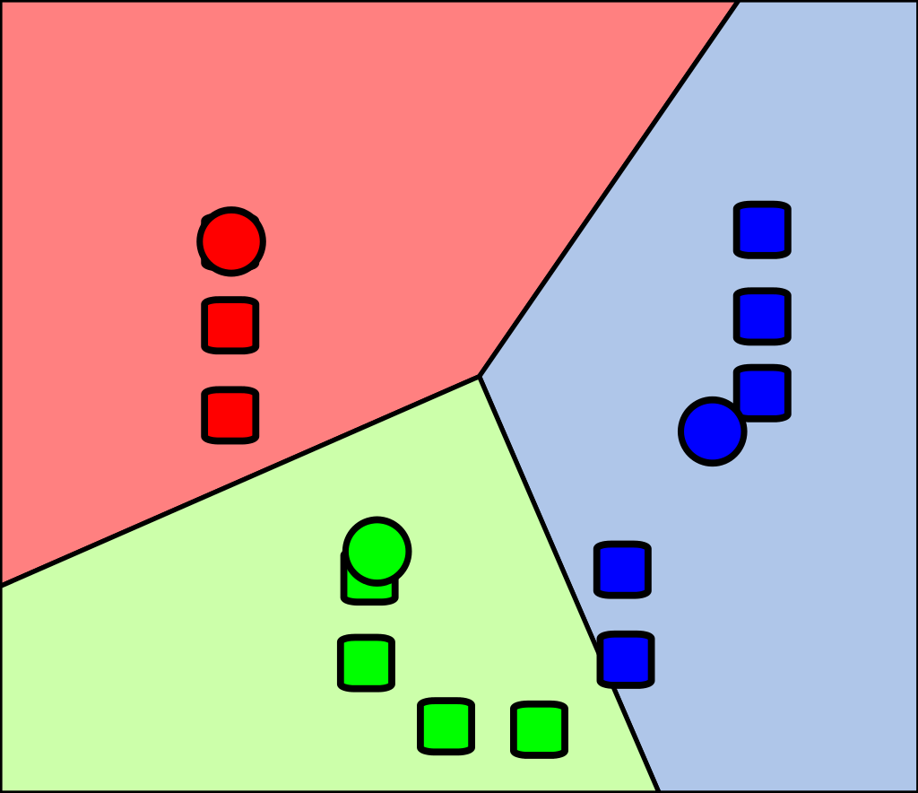
Clustering
Technique used – K-means clustering
Size of dataset after preprocessing: 740 (not too big)
Clustering by: cleaned_description
Aimed to find correlation between clusters of given descriptions and one of the following types: {Exploitable, Reaction, Snowclone, Catchphrase}
To cluster descriptions vectorized them with TF-IDF technique

Slide 11
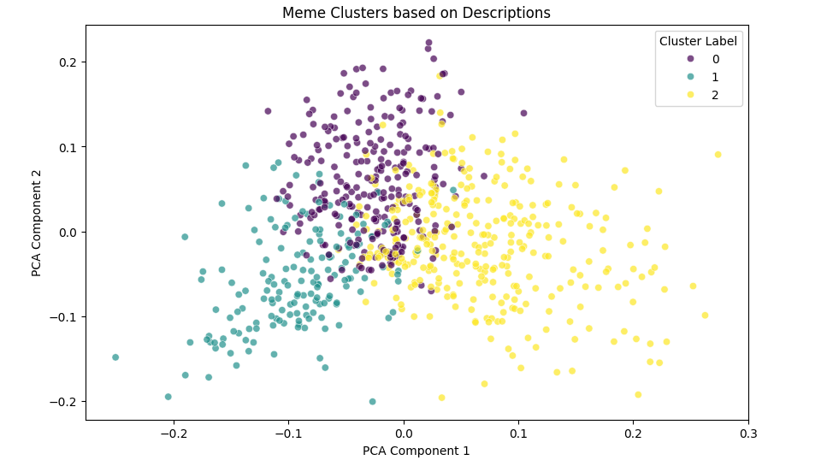
Clustering results

Slide 12
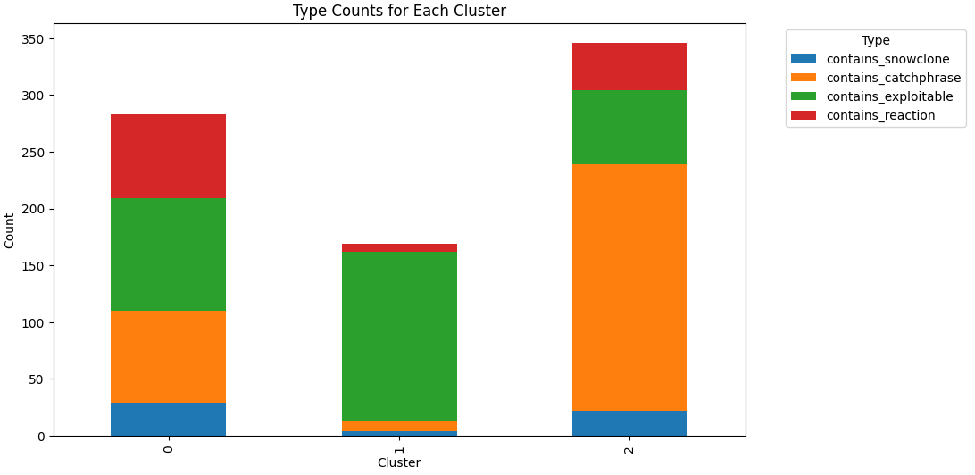
Clustering results

Slide 13
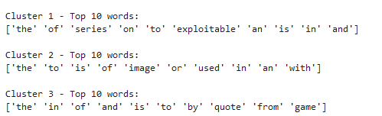
Evaluation
Preprocessing not good enough!
Should have think about removing words like the/of/an/a
Still somewhat distinguishable clusters with correlation to type of a meme – word „quote” will be more correlated with catchphrase, word „image” with exploitable etc
A lot of memes had combinations of several types from {Exploitable, Reaction, Snowclone, Catchphrase} set
Final dataset quite small – but wanted it to go in pair with the Reasearch Project

Slide 14
Cars purchases
Classification task

Slide 15
Assumptions
Dataset rating purchase of a car based on features like buying cost, maintenance cost, size of luggage
Initial dataset size – 1728 rows, 7 columns
Feature vector with 6 features {buying, maintenance, doors, persons, lug_boot, safety}, 4 classes of purchase rating {„unacc”, „acc”, „good”, „vgood”}
No need for preprocessing – dataset already cleaned

Slide 16
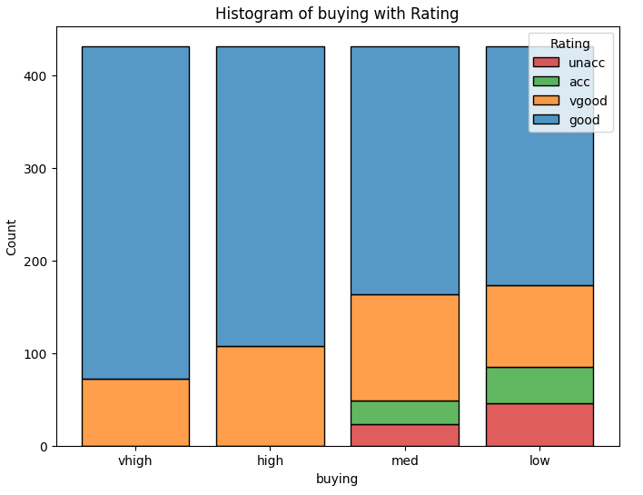
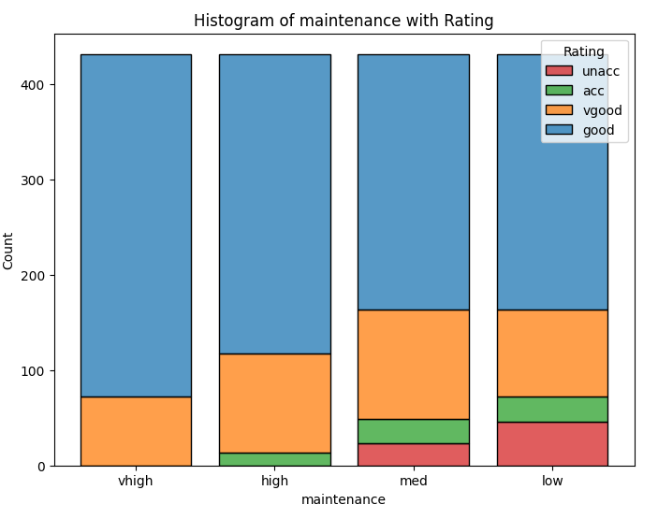
Exploratory data analysis

Slide 17
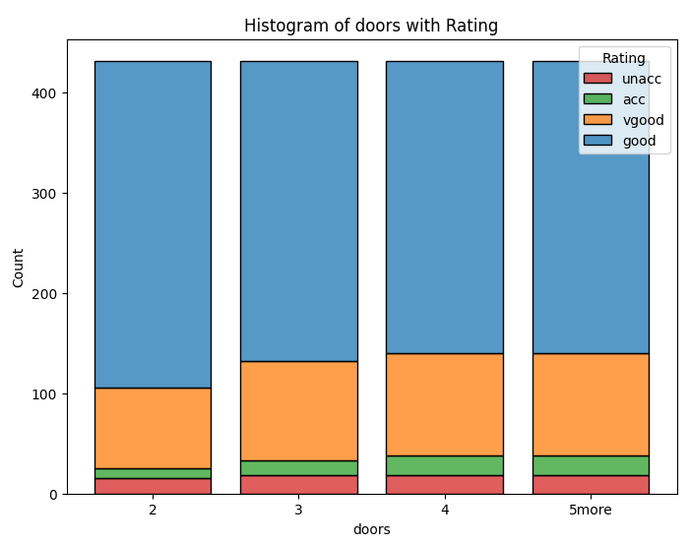
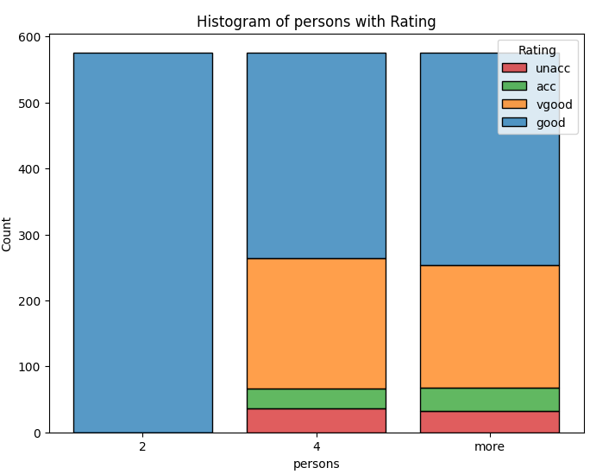
Exploratory data analysis

Slide 18
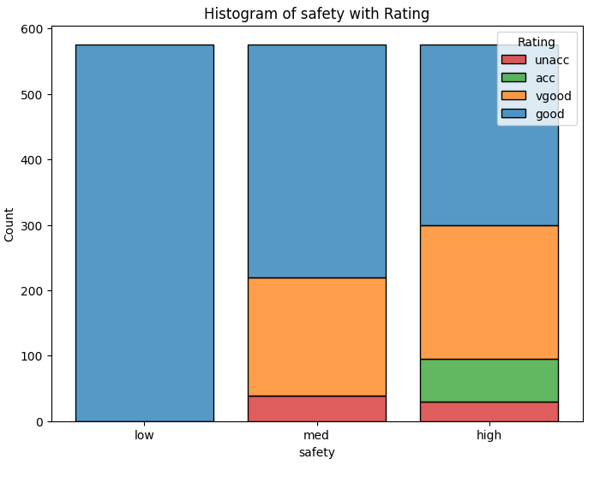
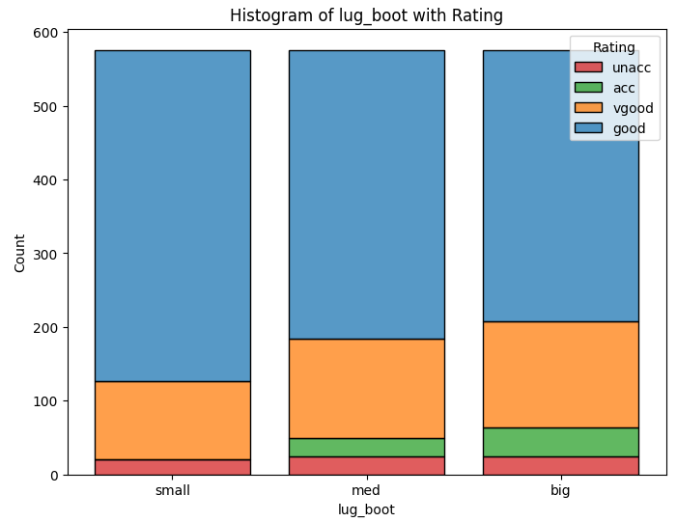
Exploratory data analysis

Slide 19
Assumptions
Dataset rating purchase of a car based on features like buying cost, maintenance cost, size of luggage
Initial dataset size – 1728 rows, 7 columns
Feature vector with 6 features {buying, maintenance, doors, persons, lug_boot, safety}, 4 classes of purchase rating {„unacc”, „acc”, „good”, „vgood”}
No need for preprocessing – dataset already cleaned

Slide 20
Cars purchases
Classification task

Slide 21




Dziękujemy!
Imię i nazwisko osoby prowadzącej
Adres e-mail
Witryna internetowa

