Slide 1
Data mining project – dbmd2
Mateusz Winnicki

Slide 2

Agenda
Introduction
Clustering task – KYM memes dataset
Classification task – car purchases dataset

Slide 3
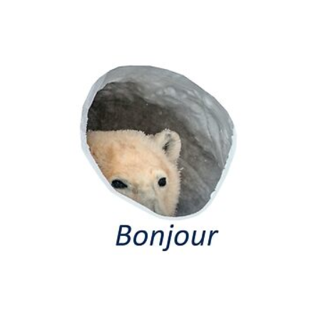
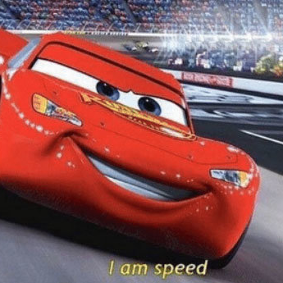
Introduction
2 tasks perfmormed for 2 different datasets
- Clustering with K-means on memes dataset
- Classification with Random Forest on car purchases dataset
EDA + preprocessing performed for memes dataset before clustering
EDA performed for cars purchases dataset before classification + classification results comparison with RF implementation from scractch

Slide 4
KYM memes
Clustering task

Slide 5
Preprocessing
Initial dataset size – 28799 rows, 16 columns
Most interesting data for the following study: description, tags, type
Description and type needed to be preprocessed – they were part of dictionaries in columns content and details
Removed rows with empty values of description/type
Removed rows with duplicated values of description

Slide 6
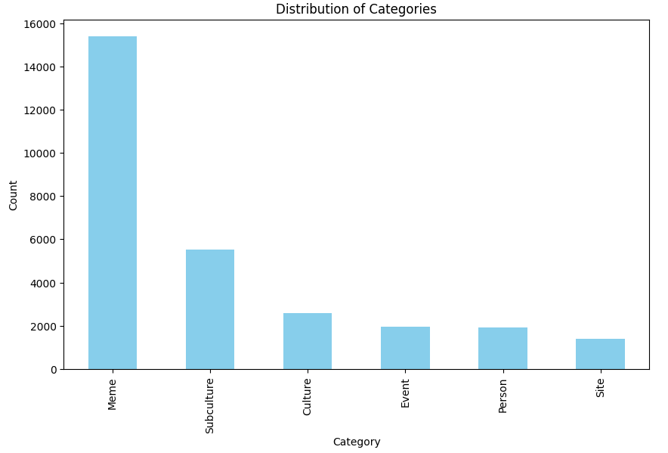
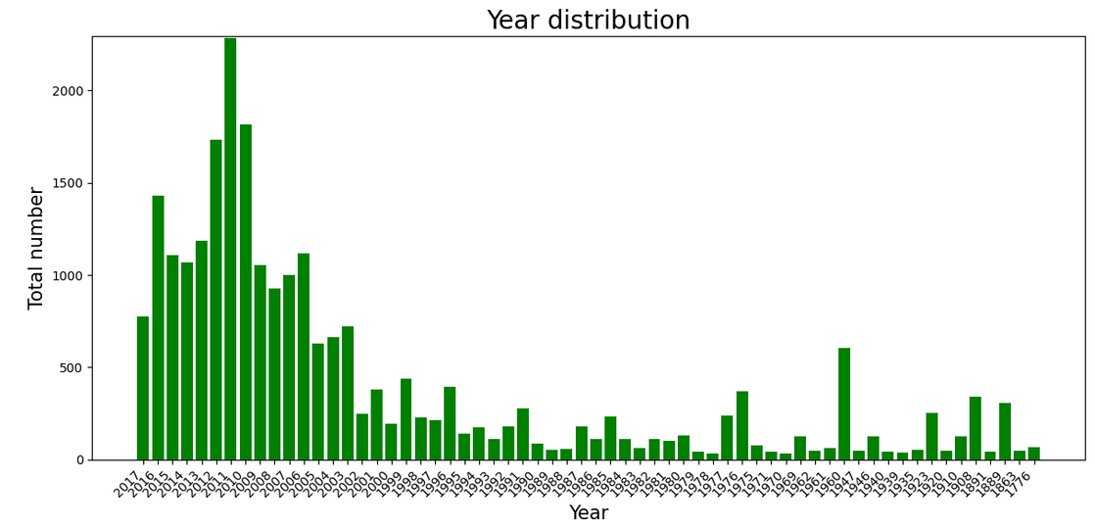
Exploratory data analysis

Slide 7
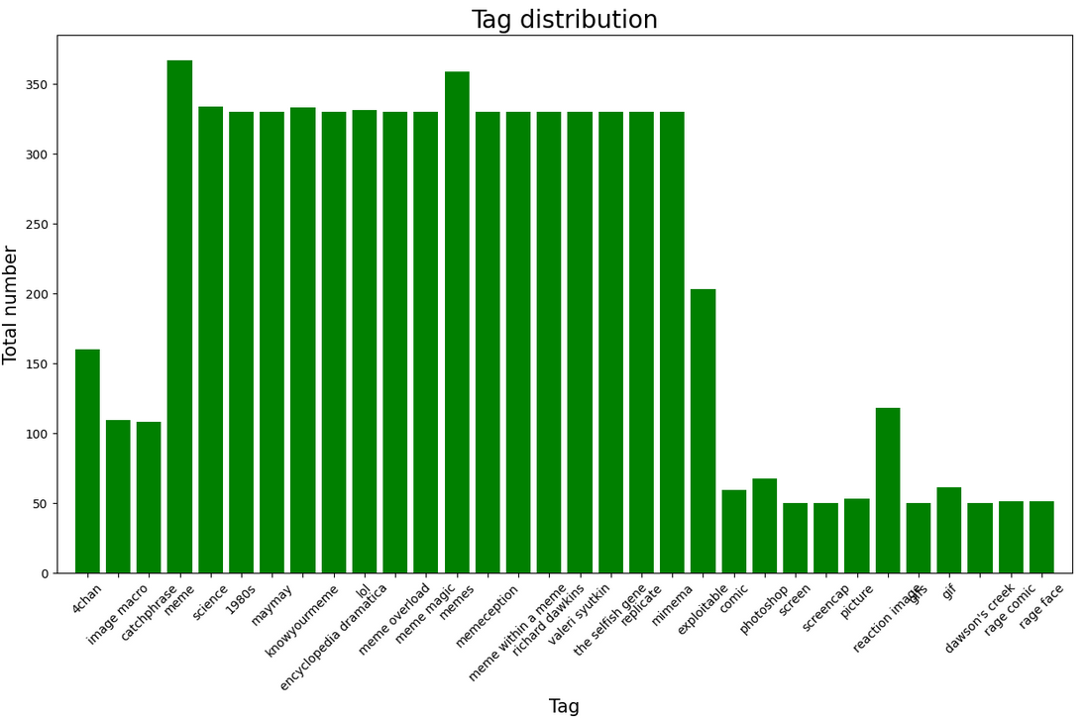
Exploratory data analysis

Slide 8
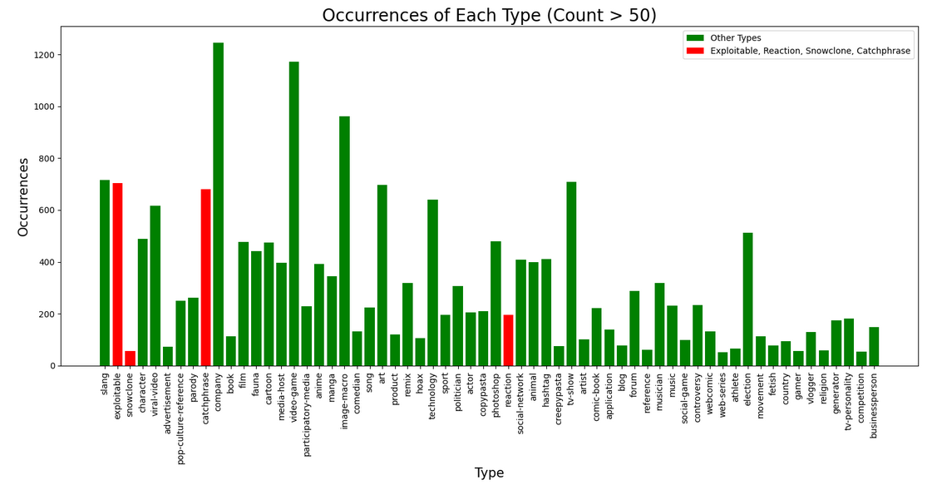
Exploratory data analysis

Slide 9
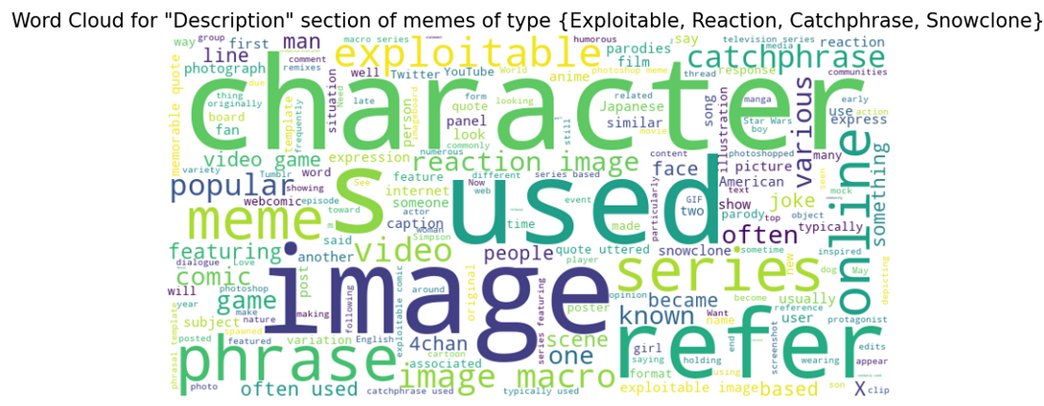
Exploratory data analysis

Slide 10
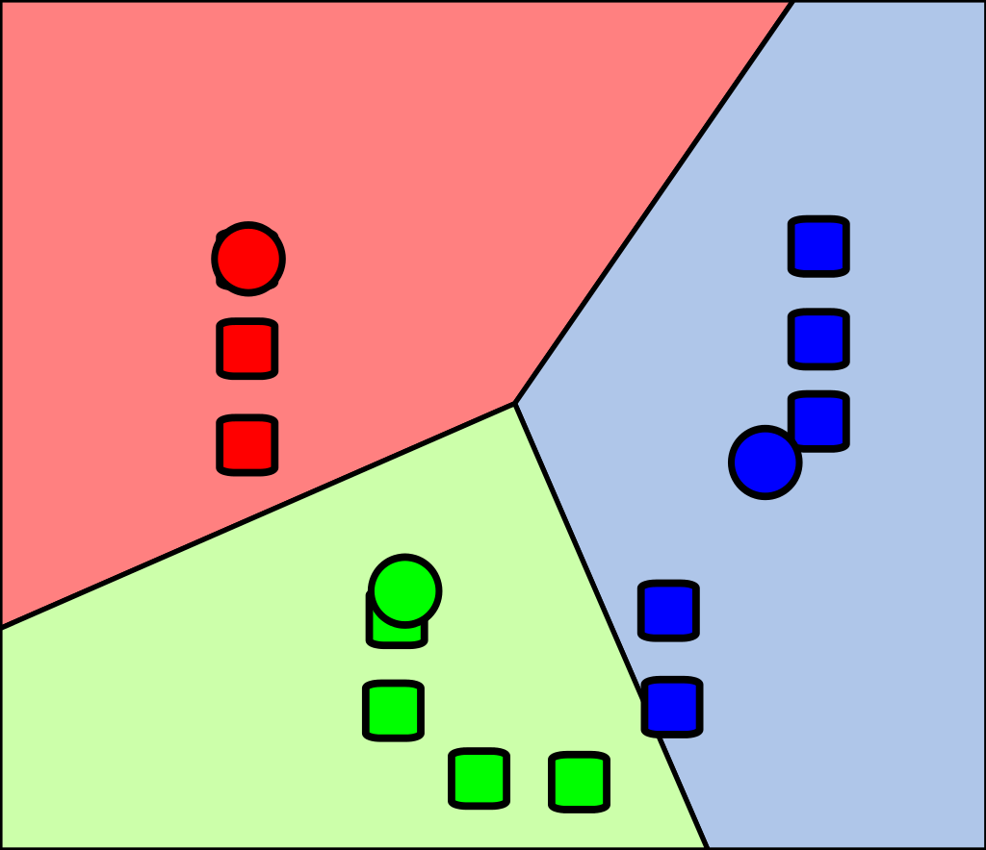
Clustering
Technique used – K-means clustering
Size of dataset after preprocessing: 740 (not too big)
Clustering by: cleaned_description
Aimed to find correlation between clusters of given descriptions and one of the following types: {Exploitable, Reaction, Snowclone, Catchphrase}
To cluster descriptions vectorized them with TF-IDF technique

Slide 11
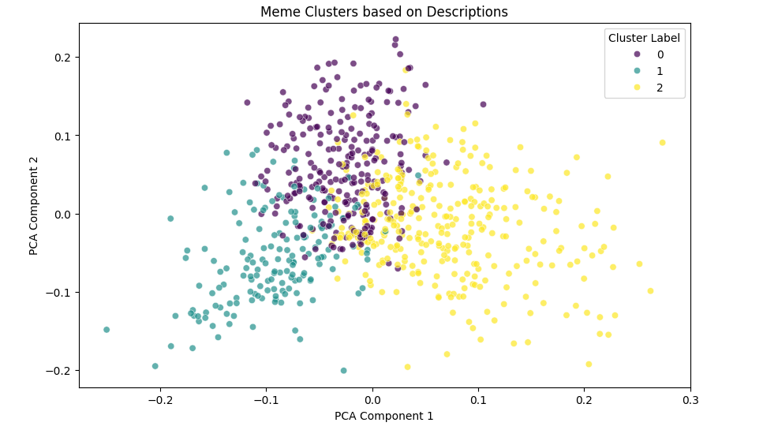
Clustering results

Slide 12
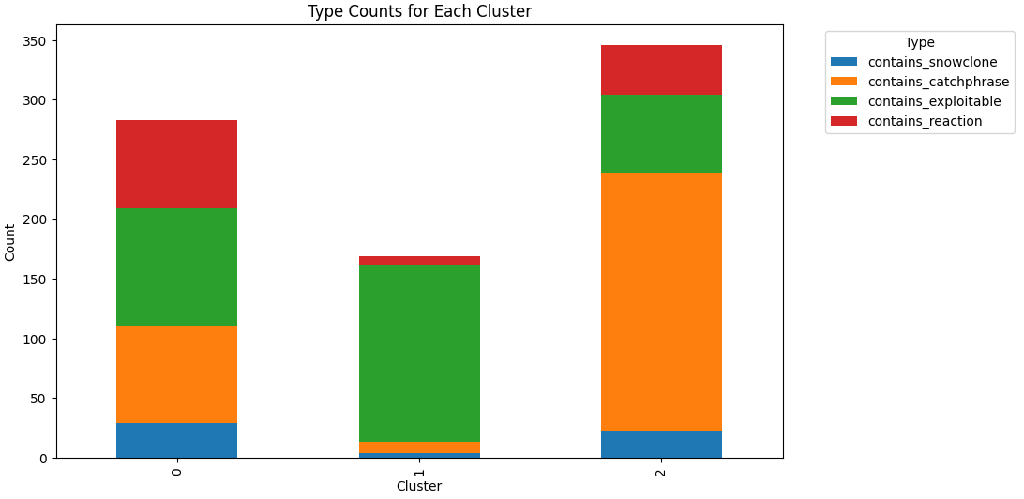
Clustering results

Slide 13
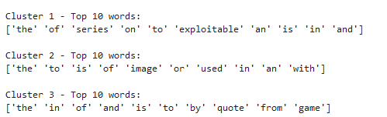
Evaluation
Preprocessing not good enough!
Should have think about removing words like the/of/an/a
Still somewhat distinguishable clusters with correlation to type of a meme – word „quote” will be more correlated with catchphrase, word „image” with exploitable etc
A lot of memes had combinations of several types from {Exploitable, Reaction, Snowclone, Catchphrase} set
Final dataset quite small – but wanted it to go in pair with the Reasearch Project

Slide 14
Cars purchases
Classification task

Slide 15
Assumptions
Dataset rating purchase of a car based on features like buying cost, maintenance cost, size of luggage
Initial dataset size – 1728 rows, 7 columns
Feature vector with 6 features {buying, maintenance, doors, persons, lug_boot, safety}, 4 classes of purchase rating {„unacc”, „acc”, „good”, „vgood”}
No need for preprocessing – dataset already cleaned

Slide 16
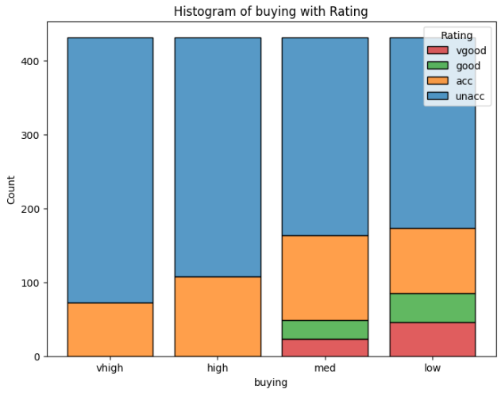
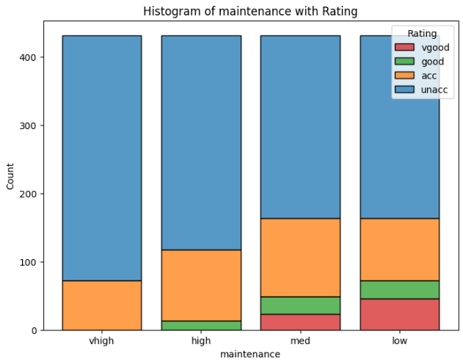
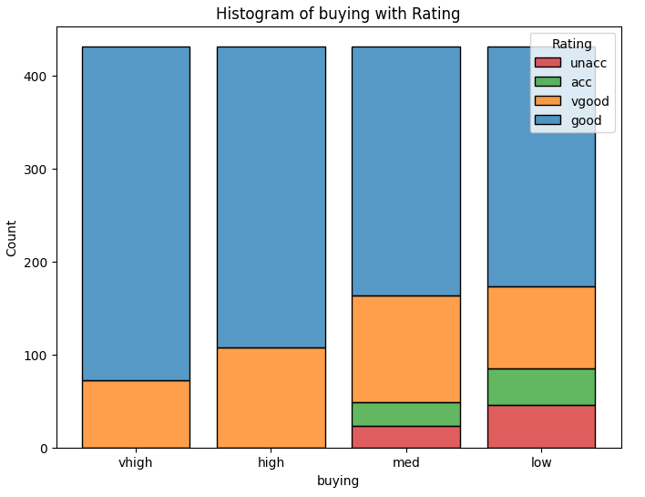
Exploratory data analysis

Slide 17
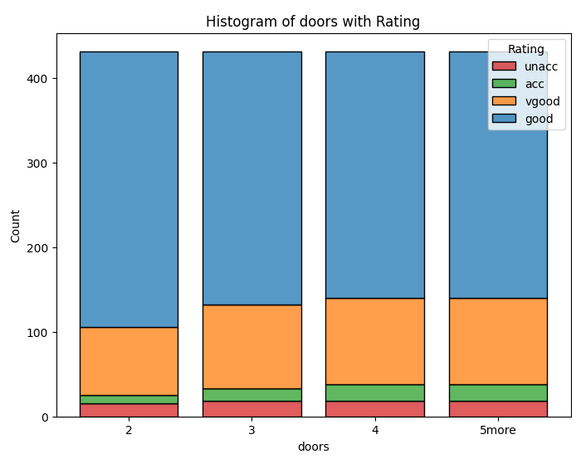
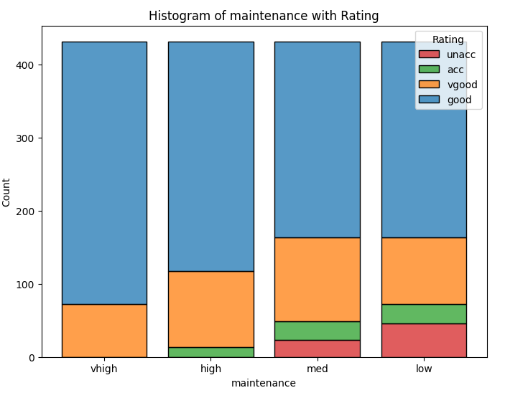
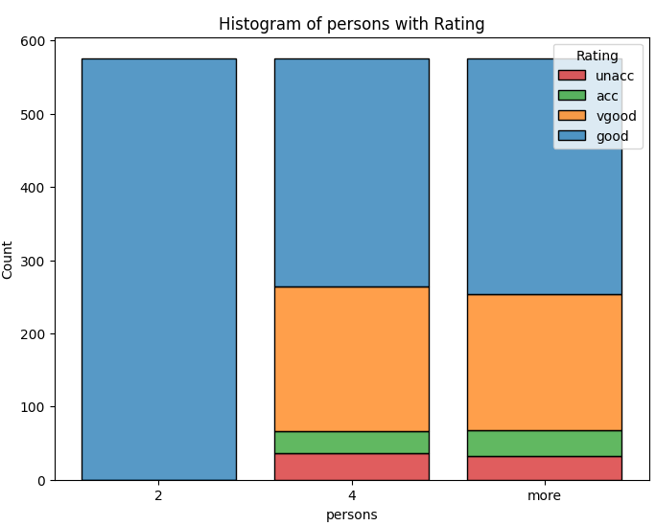
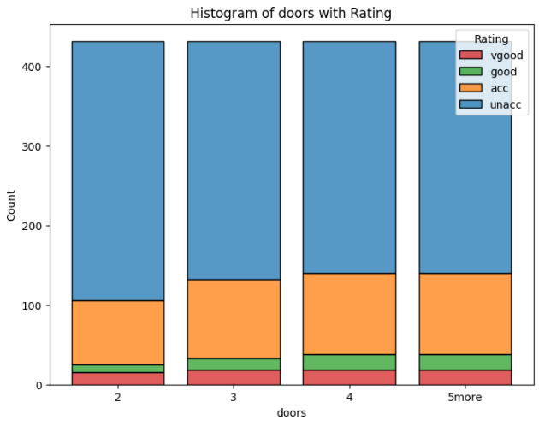
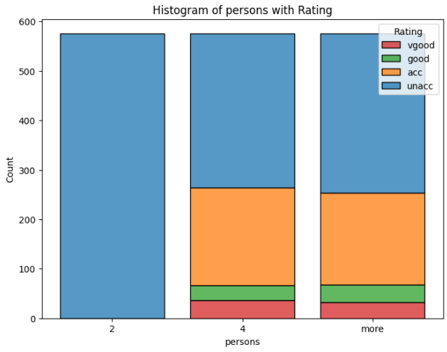
Exploratory data analysis

Slide 18
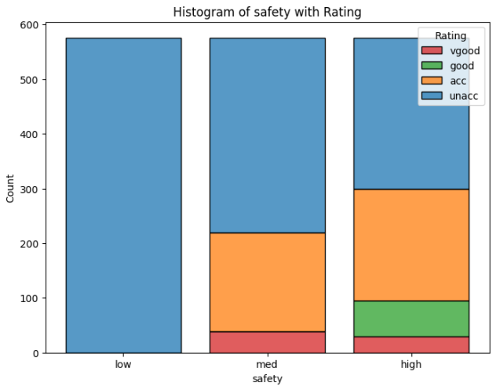
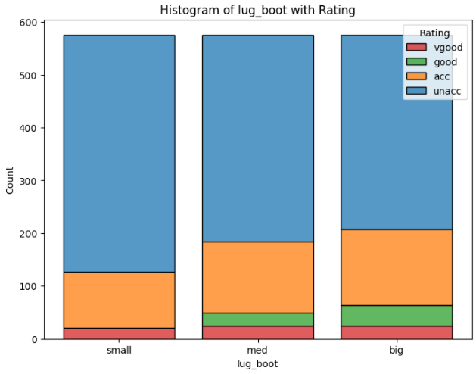
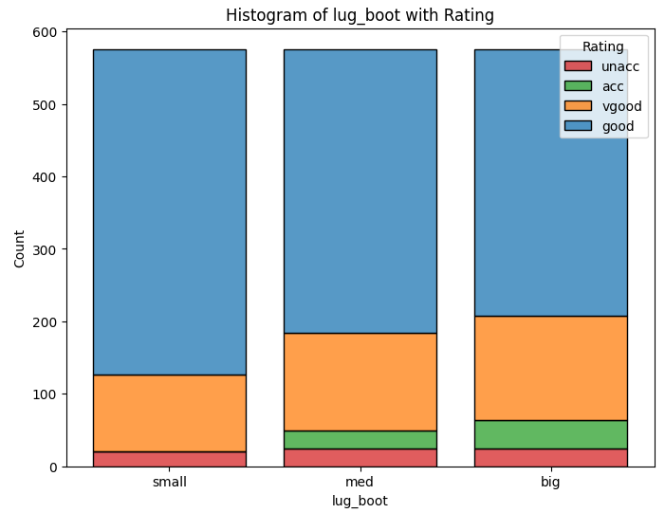
Exploratory data analysis

Slide 19
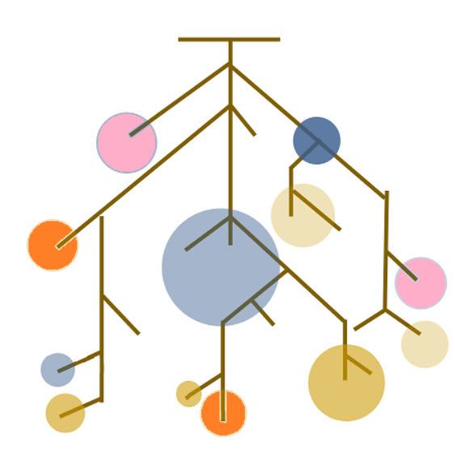
Classification
Technique used – Random Forest
Comparing 2 measures of split quality: Gini impurity and entropy
Comparing results of sklearn implementation with implementation from scratch
Train-test split: 70-30

Slide 20
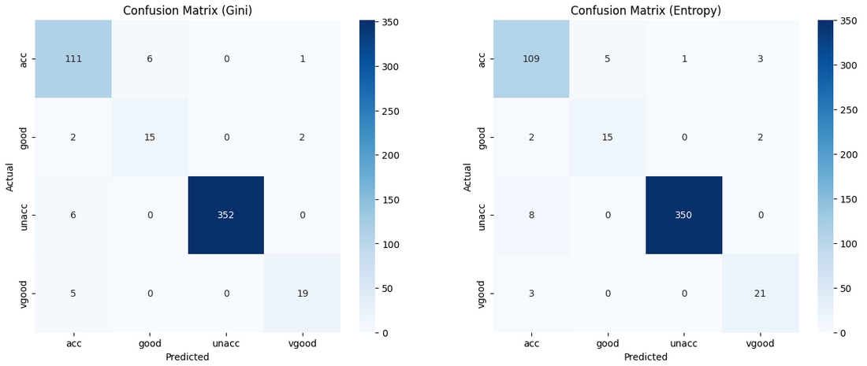
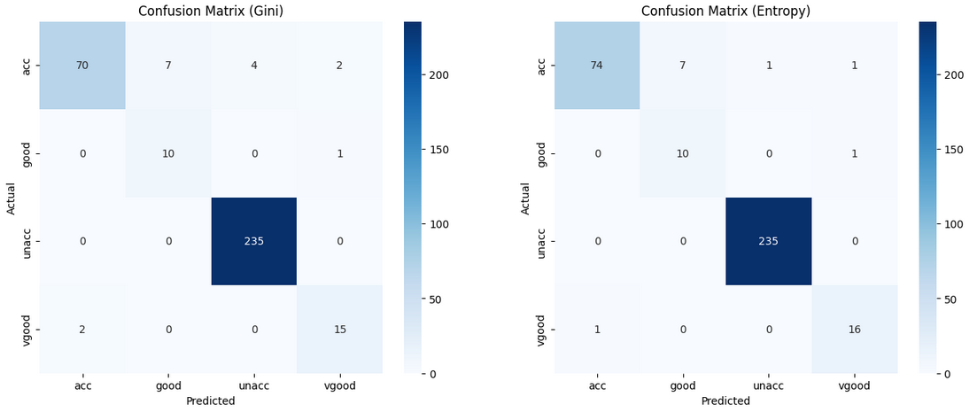
Classification results – sklearn

Slide 21
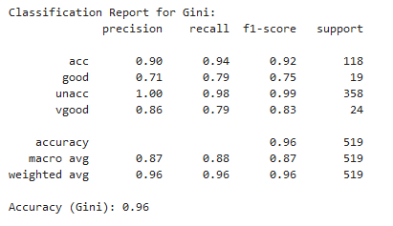
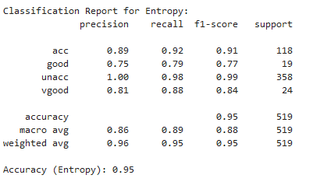
Classification results – sklearn
Perfect precision for class unacc, lowest (0.71) for class good
Recall highest for acc and unacc, lowest for good, vgood
Both Gini and Entropy classifiers perform well, with high precision and recall for most classes.
The class counts show that the dataset is imbalanced, with 'unacc' having significantly more instances. The weighted average considers this imbalance.

Slide 22
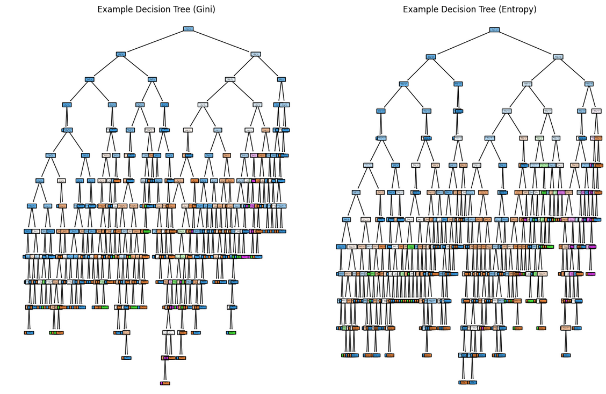

Slide 23
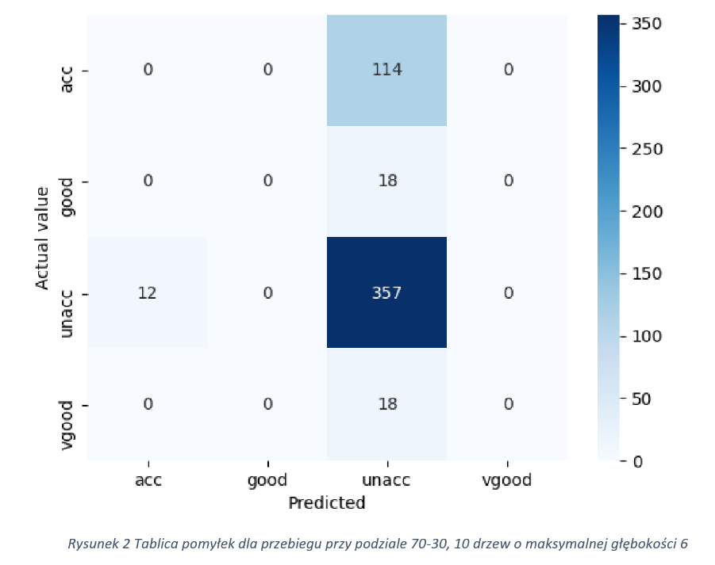
Classification results – mine
Gini impurity based
Random forest with 10 trees of max depth 6
Accuracy: 0.84
Precision of unacc: 0.69
Sensitivity of unacc: 0.93
Source: https://github.com/batmatt/wsi-course-labs/blob/master/random_forest/classifier.py

Slide 24
Evaluation
Implementation from scratch significantly worse.
Although we could blame the hyperparameters (lower numer of voters, lower max depth) I think there were some lacks in implementation.
Both cases face similar problem of dataset being imbalanced, leading to one class having abnormally high sensitivity

Slide 25




Thank you
Mateusz Winnicki

