Slide 1

Evolutionary Computation
made by Bartosz Paulewicz

Slide 2


Slide 3


Slide 4
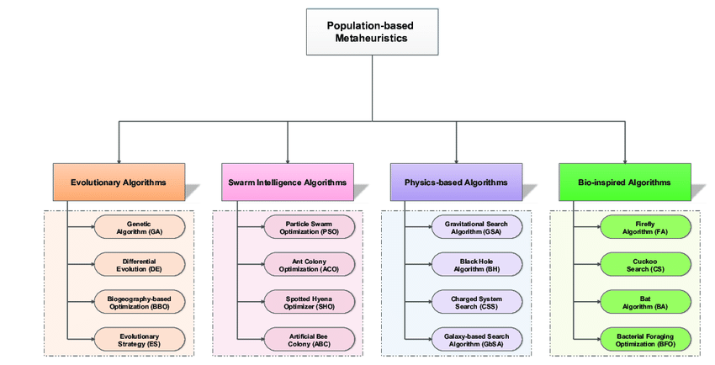

Slide 5
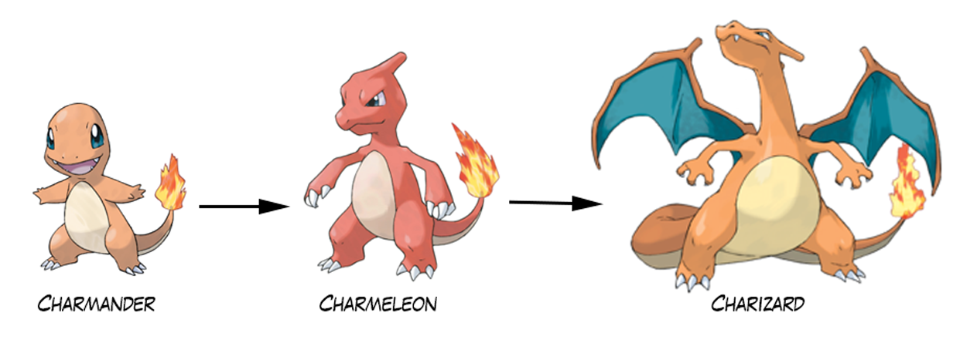

Slide 6
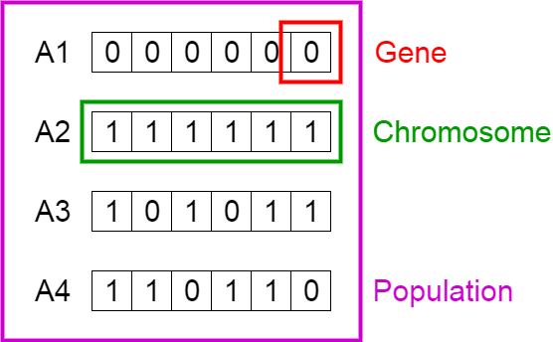

Slide 7
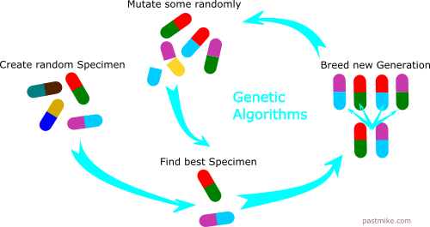

Slide 8
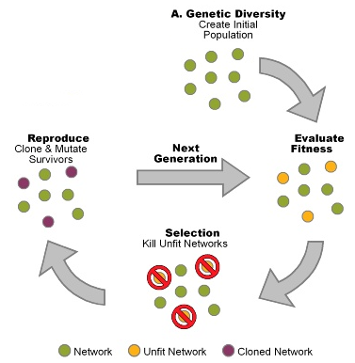

Slide 9
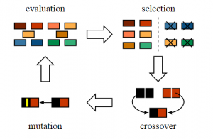

Slide 10


Slide 11


Slide 12
Short description of the task
“You’ve just bought a house and discover that the attic is full of wasps' nests. You’ve decided to kill the wasps, before you move into your new home so you visit your local store featuring insecticides but found only 3 "insect-bomb" which have a specific effect range and must be placed very close to the nest to kill the wasps inside. Unfortunately the 3 containers are not enough to kill all the wasps in the attic. Fortunately, luck helps you find

Slide 13
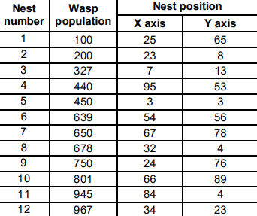
a map left by the previous owner, showing the location of the nests as well as the number of wasps that each nest has (using an array of 100x100)”

Slide 14
Preparation
from numpy import argmax, argmin, argsort, array,
from numpy import concatenate, empty, floor, sqrt
from numpy.random import seed, uniform, normal
from numpy.linalg import norm
seed(0)

Slide 15
Generating the initial population (first generation)
nBombs = 3
populationSize = 100
population = uniform(low=0, high=100, size=(populationSize, nBombs, 2))

Slide 16
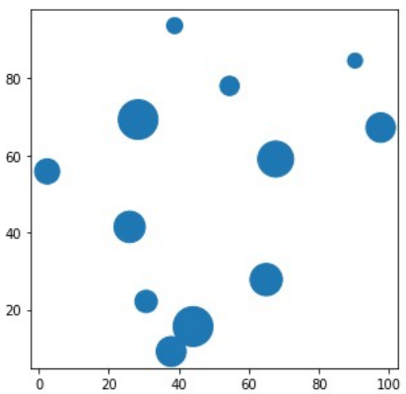

Slide 17
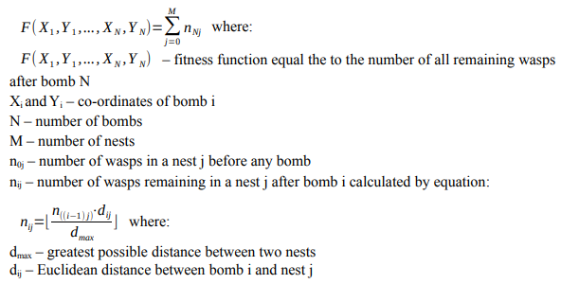
Evaluating the fitness of each individual in population.

Slide 18
Evaluating the fitness of each individual in population.
#greatest possible distance between two nests
dMax = sqrt(20000)
#all bomb coordinates of currently processed solution
for i, bombs in enumerate(population):
#temporary numbers of wasps in each nest
tmpWasps = wasps[:]
#co-ordinates of currently processed bomb
for coords in bombs:
#distances between each nest and currently processed bomb
distances = norm(positions-coords, axis=1)
#information about what part of wasps in each nest will remain after the bomb
parts = distances/dMax
#updating numbers of wasps in each nest
tmpWasps = floor(parts*tmpWasps)
#fitness of currently processed solution
fitness[i] = sum(tmpWasps)

Slide 19
Selecting the parents
#number of parents used for reproduction
nParents = 20
#indices that would sort an array
indices = argsort(fitness)
#indices of the nParents best solutions
parentIds = indices[:nParents]
#nParents best solutions indicated by parentIndices
parents = population[parentIds]

Slide 20
Breeding new individuals through crossover and mutation operations

Slide 21
Simple Evolution strategy

Slide 22
#nOffspring clones
clones = repeat(parents[newaxis], nOffspring, 0)
#offspring created by adding noise to clones
offspring = clones + normal(size=(nOffspring, nBombs, 2))

Slide 23
Simple
Genetic strategy

Slide 24
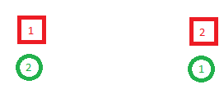

Slide 25
#container for nOffspring solutions derived from-parents
offspring = empty((nOffspring,nBombs,2))
for offspringId in range(nOffspring):
#parents used to create new offspring solution
mom = parents[offspringId%nParents]
dad = parents[(offspringId+1)%nParents]
#temporary container for offspring solution
tmpOffspring = empty((nBombs, 2))
#co-ordinates of currently processed mom bomb
for i, coords in enumerate(mom):
#distances between each dad bomb and currently processed mom bomb
distances = norm(coords-dad, axis=1)
#index of the dad bomb nearest to the currently processed mom bomb
nearestId = argmin(distances)
#dad bomb nearest to the currently processed mom bomb
nearest = dad[nearestId]
#child bomb derived from crossover between parent bombs
childBomb = ( nearest + coords)/2
#child bomb mutated by adding sample from a normal (Gaussian) distribution
mutated = childBomb + normal(size=2)
#filling temporary offspring container with bombs
tmpOffspring[i] = mutated
#filling offspring container with ready solutions
offspring[offspringId] = tmpOffspring

Slide 26
Covariance-Matrix Adaptation Evolution strategy (CMA-ES)

Slide 27
#cotainer for bomb groups
clusters = empty((nBombs, nOffspring, 2))
#nParents best solutions indicated by parentIndices
parents = population[parentIds]
#flattened population, co-ordinates of all bombs
flatPopulation = reshape(parents, (-1, 2))
#tool used to group bombs according to their co-ordinates
kMeans = KMeans(n_clusters=nBombs).fit(flatPopulation)
#centers of each group
centers = kMeans.cluster_centers_
#labels of bombs
labels = pairwise_distances_argmin(flatPopulation, centers)
for i in range(nBombs):
#all bomb belonging to the group i
cluster = flatPopulation[labels == i]
#covariance matrix within cluster
covMatrix = cov(cluster, rowvar=False)
#new bomb co-ordinates sampled from a multivariate normal distribution
clusters[i] = multivariate_normal(centers[i], covMatrix, nOffspring)
#container for nOffspring solutions from combining bomb groups
population = empty((nOffspring, nBombs, 2))
#each new individual takes one bomb from each group
for i, bombs in enumerate(zip(*clusters)):
population[i] = bombs

Slide 28

Updating population

Slide 29
Experiments

Slide 30
Simple Evolution strategy

Slide 31
Simple Genetic strategy

Slide 32
Covariance-Matrix Adaptation Evolution strategy (CMA-ES)

Slide 33


