Slide 1
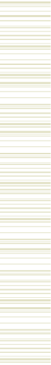


When Knowledge Distillation meets AI for Securing Internet of Intrusion Detection Things
Marianna Rezk
November 9, 2024

Slide 2
Generated Engagement Question
When Knowledge Distillation meets AI for Securing Internet of Intrusion Detection Things
What is the main topic of this unit?
  - Knowledge Distillation
  - AI for Securing Internet of Things
  - Intrusion Detection
  - Data Security
Generated Engagement Question

Slide 3

Internet of Things: Introduction
a network of physical devices, vehicles, appliances, and other physical objects that are embedded with sensors, software, and network connectivity, allowing them to collect and share data.
This can include:
  monitoring environmental conditions in farms
  managing traffic patterns with smart cars and other smart automotive devices
  controlling machines and processes in factories
  tracking inventory and shipments in warehouses

Slide 4
Generated Engagement Question
Internet of Things: Introduction
What type of data can be collected and shared by the devices in an IoT network?
  - A. Only environmental conditions
  - B. Traffic patterns, inventory levels, and machine control signals
  - C. User-generated content and social media updates
  - D. Financial transactions and personal identification information
Generated Engagement Question

Slide 5
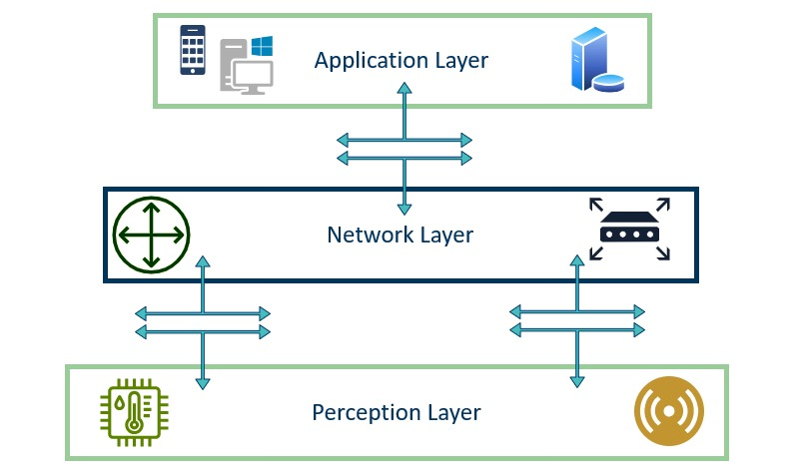
Internet of Things: Architecture

Slide 6
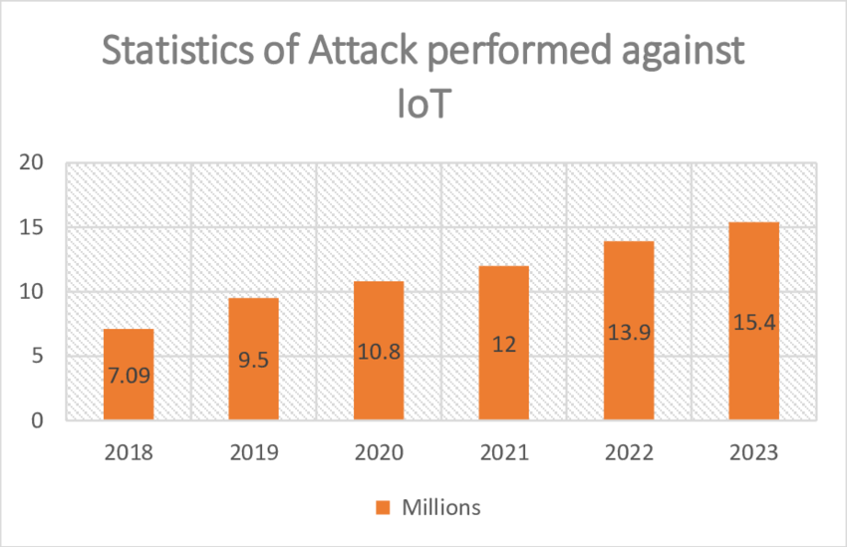
Internet of Things: Security
Security issues: IoT connects numerous devices (e.g., thermostats, cameras, smart locks), increasing potential targets for attacks.
Common Attack Types: Man in the Middle (Mitm), Denial of Service (DoS), Malware Injection…

Slide 7
Generated Engagement Question
Internet of Things: Security
What are some common security risks associated with the Internet of Things?
Generated Engagement Question

Slide 8
Internet of Intrusion Detection System
Generation of Internet of intrusion detection things IOIDT.
A specialized IoT framework that integrates intrusion detection systems (IDS) within IoT networks to actively monitor, detect, and respond to cyber threats.
Purpose: To safeguard IoT devices and networks from unauthorized access, intrusions, and data breaches.
Main Components:
  Real-Time Monitoring: Continuously tracks IoT device activities.
  Threat Detection: Identifies abnormal patterns or known attack signatures.
  Automated Response: Initiates defense mechanisms (e.g. alerting admins) upon detecting intrusions.

Slide 9
Generated Engagement Question
Internet of Intrusion Detection System
What is the main purpose of an Internet of Intrusion Detection System (IOIDT)?
  - A. To monitor IoT device activities in real-time.
  - B. To safeguard IoT devices and networks from unauthorized access, intrusions, and data breaches.
  - C. To generate a specialized IoT framework that integrates intrusion detection systems within IoT networks.
  - D. All of the above.
Generated Engagement Question

Slide 10
IoIDS: Types of Detection
Location-based detection
On-Node Detection:
On-Server Detection:
Detection is performed directly on the IoT device (node).
Detection is performed on a central server, which collects and analyzes data from multiple IoT devices.
It provides real-time threat monitoring and response locally, reducing latency.
It is often limited by the device's computational power and battery life.
This approach has higher processing capabilities and can detect complex threats.
May introduce latency and relies on stable connectivity.

Slide 11
IoIDS: Types of Detection
Attacks-Type based detection
  Signature based detection: It relies on a database of predefined attack patterns or "signatures" that correspond to specific malicious activities or known vulnerabilities.
  Anomaly based detection: Pinpoint unknown attacks and adapt to them on the fly using machine learning techniques.
  Hybrid intrusion detection: use both signature-based as well as anomaly-based detection system and enable it to detect potential threats with a minimum error rate.

Slide 12
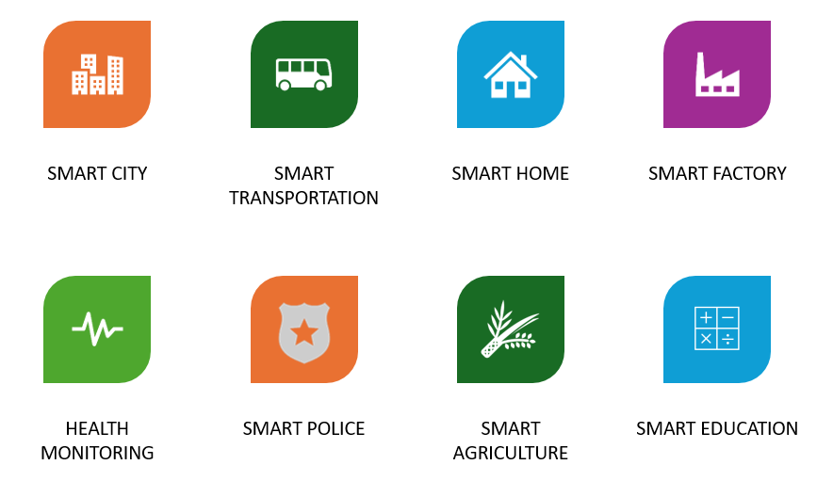
IoIDS: Applications

Slide 13
IoIDS Challenges
Densely Deployment of IoT devices
Limited Resources of IoT devices (Low CPU, Low Power)
Large number of existing attack types on IoT
Big Data Collected
False Alarm Rate
Response Time

Slide 14

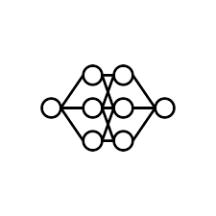
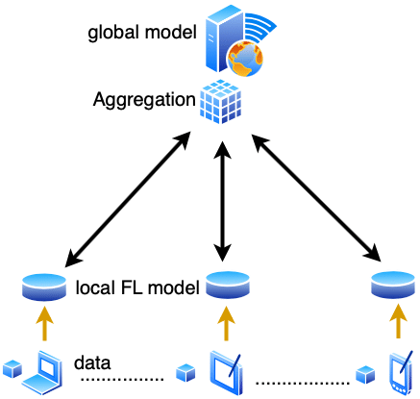

AI in IoIDS
AI is a field of computer science that enables machines to perform tasks requiring human-like intelligence, such as learning from data, recognizing patterns, and making decisions.
Multiple Approaches:
Machine Learning
Deep Learning
Federated Learning
Reinforcement Learning

Slide 15
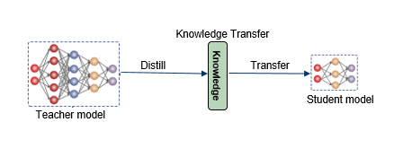
KD in IoIDS
Knowledge Distillation is a technique in which a large, complex model (teacher) transfers its knowledge to a smaller, simpler model (student) to achieve similar performance with lower resource requirements

Slide 16
State of The Art

Slide 17
AI in IoIDT
Notes:
As we go deep into the world of IDS, it’s important to explore the main studies and papers that contribute to our understanding in this field. So we took into consideration about 10 papers, we will talk about in the next few minutes

Slide 18
A novel optimized probabilistic neural network approach for intrusion detection and categorization (1)
Main Objectives and Contributions:
  Proposing a responsive ensemble learning model that can integrate the benefits of each technique for various types of data recognition and utilize ensemble learning to produce the best outcomes.
  Using the firefly optimization technique to detect the intrusions in the system.
  Using the Probabilistic Neural Network to categorize the database into anomalous and normal circumstances.

Slide 19
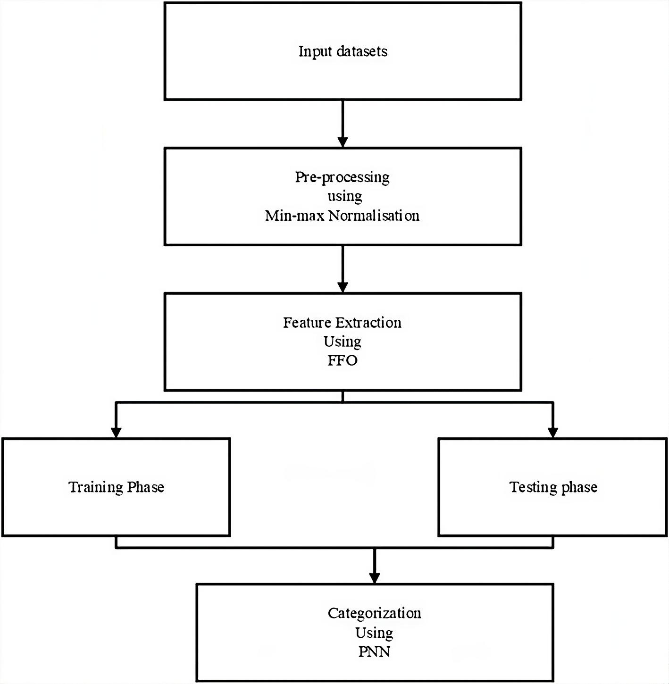
A novel optimized probabilistic neural network approach for intrusion detection and categorization (1)
  Methodology:
    Dataset: KDD-CUP 99 with 41 attributes.
    Normalization using Min-Max algorithm.
    Feature extraction using Firefly Algorithm.
    Categorizing networks into normal and abnormal using the probabilistic neural network classifier.

Slide 20
Fusion of statistical importance for feature selection in Deep Neural Network-based Intrusion Detection System (2)
Main Objectives and contributions:
  Designing a DNN-based intrusion detection and classification system by applying fusion of statistical importance by considering statistical measures for feature engineering on intrusion detection datasets.
  A process that selects features based on statistical interpretation of features for the underlying intrusion detection datasets.
  For fusion of statistical importance of features, statistical measures, namely, standard deviation, mean, and median are taken into consideration.

Slide 21
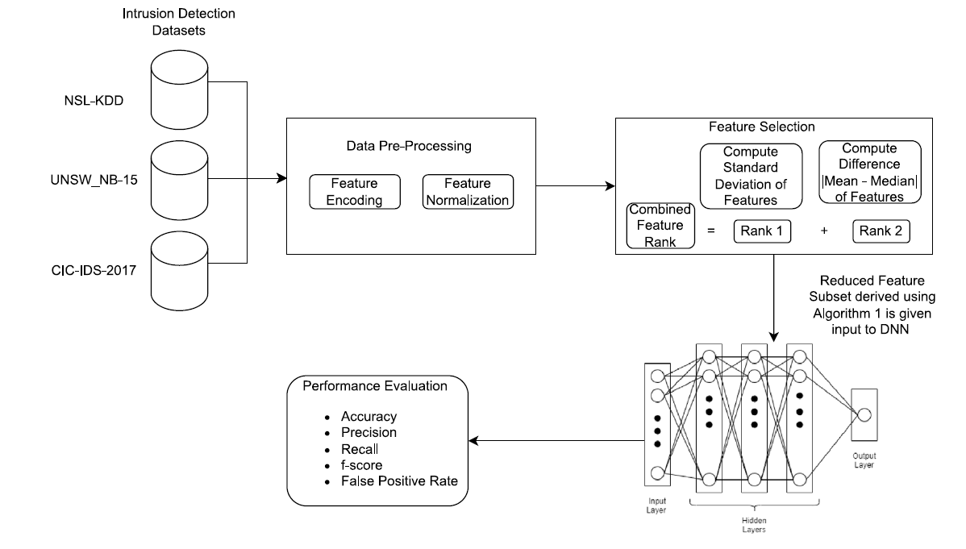
Fusion of statistical importance for feature selection in Deep Neural Network-based Intrusion Detection System (2)
  Methodology:
    Selection of 3 datasets
    Feature encoding: convert categorical features into numerical features by applying one-hot encoding technique.
    Feature Normalization: standard scalar technique.
    Feature Selection in two phases.
    Deep Neural Network: input layer, three hidden layers, and output layer for binary classification

Slide 22
A deep learning approach for intrusion detection in Internet of Things using focal loss function (3)
Main Objectives and contributions:
  Overcoming the data imbalance problem for intrusion detection systems in IoT.
  Training DL-based models using focal loss function to overcome imbalanced data in IoT datasets.
  Implementing focal loss function in two well-studied Deep Learning (DL) neural network architectures: Feed Forward Neural Networks (FNNs) and Convolutional Neural Networks (CNNs)

Slide 23
A deep learning approach for intrusion detection in Internet of Things using focal loss function (3)
Methodology:
  Modeling the input data as two-dimensional matrix. As a result there is a dataset of N samples with L distinct attack categories.
  Using of two DL classification algorithms: Feed-forward Neural Network (FNN) and Convolutional Neural Network (CNN).
  FNN consists of three layers: input layer, output layer, and H number of hidden layers.
  The input features of CNN are transformed into meaningful information by convolutions, which are then used to construct the subsequent layers of neural network

Slide 24
Cross-Layer Federated Learning for Lightweight IoT Intrusion Detection Systems (4)
Main Objectives and contributions:
  Developing a cross-layer federated learning system tailored for lightweight IoT nodes, utilizing cluster-based sampling and employing lightweight IDS.
  Sharing only the model’s statistics with the aggregator.
  Reducing both the risk of adversarial jamming and noise-induced errors.

Slide 25
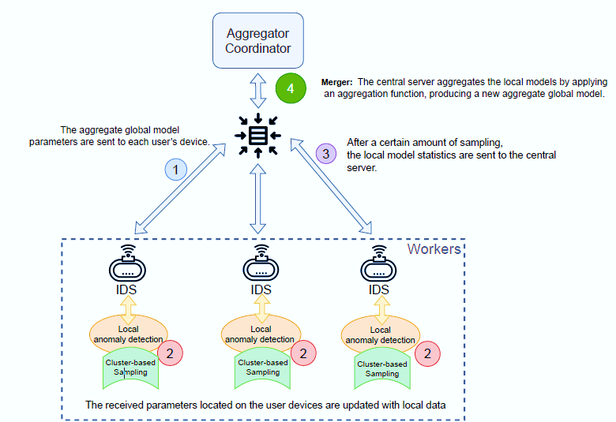
Cross-Layer Federated Learning for Lightweight IoT Intrusion Detection Systems (4)
Methodology:

Slide 26
A stacked ensemble learning model for intrusion detection in wireless network (5)
Main Objectives and contributions:
  Combining multiple machine learning algorithms called stacked ensemble learning, to detect the attacks in a better manner than conventional learning, where a single algorithm is used to identify the attacks.
  Using gradient boosting machine (GBM) and random forest (RF) algorithms by integrating the features of both GBM and RF classifiers.
  Using GBM and RF as base learners.

Slide 27
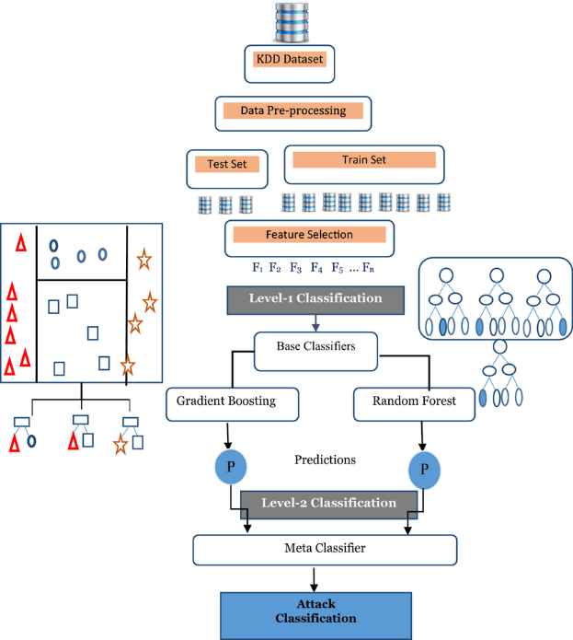
A stacked ensemble learning model for intrusion detection in wireless network (5)
Methodology:

Slide 28
Knowledge distillation selected articles

Slide 29
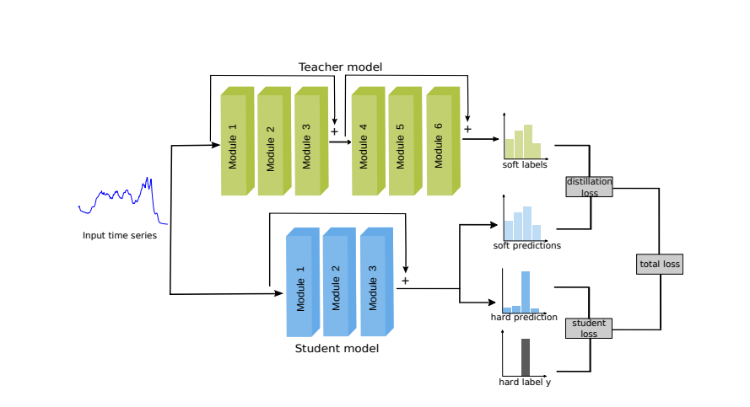
Knowledge Distillation for Robotics Time Series Classification (6)
Proposed knowledge distillation architecture for time series classification:

Slide 30
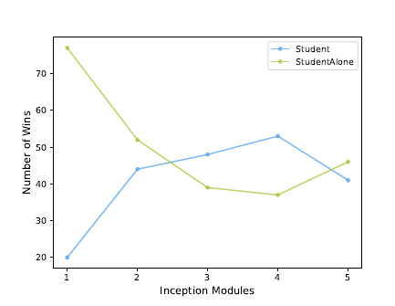
Knowledge Distillation for Robotics Time Series Classification (6)
UCR Archive: large repository of 128 time series datasets. (112 used datasets are used in the experiments)
Results:

Slide 31
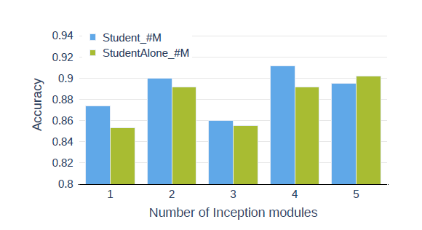
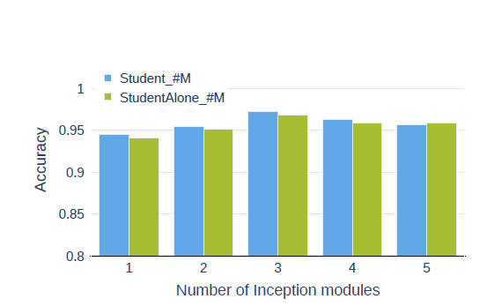
Knowledge Distillation for Robotics Time Series Classification (6)
Results:
SonyAIBORobotSurface1 dataset
SonyAIBORobotSurface2 dataset

Slide 32
Distilling the Knowledge in a Neural Network (7)
Main Purpose: distilling the knowledge in an ensemble of models into a single model in different experiments such as handwriting recognition, speech recognition, and handling large datasets.
Challenges:
  Keeping the same knowledge while changing the form of the model.
  Successful results on different experiments with big datasets.
  The amount of computation required at training time is excessive.

Slide 33
Distilling the Knowledge in a Neural Network (7)
Cumbersome Model: A large, complex model that is powerful but slow and it takes too much resources. It can make very accurate predictions.
Experiments on MNIST:
Training a single large neural net with two hidden layers of 1200 rectified linear hidden units on all 60000 training cases.
This net achieved 67 test errors whereas a smaller net with two hidden layers of 800 rectified linear hidden units and no regularization achieved 146 errors.
Close Results after distillation.

Slide 34
Distilling the Knowledge in a Neural Network (7)
Experiments on Speech Recognition:
Investigating the effects of ensembling Deep Neural Network acoustic models that are used in Automatic Speech Recognition
an architecture with 8 hidden layers each containing 2560 rectified linear units and a final softmax layer with 14,000 labels.
test frame accuracy: 60.8% and WER: 10.7%.

Slide 35
Distilling the Knowledge in a Neural Network (7)
Experiments on ensembles of specialists on very big datasets:
training one generalist model on all the types of data and many specialist models where each one of them is trained
JFT DATASET: an internal Google dataset that has 100 million labeled images with 15,000 labels
after training 61 specialist models, there is a 4.4% relative improvement in test accuracy overall

Slide 36
Distilling the Knowledge in a Neural Network (7)
Using Soft Targets instead of Hard Targets:
A lot of helpful information can be carried in soft targets that could not possibly be encoded with a single hard target
Soft targets allow a new model to generalize well from only 3% of the training set.
A specialist is trained on data that is highly enriched in its special classes.
Train Frame Accuracy: 65.4% - Test Frame Accuracy: 57%

Slide 37
Deep knowledge distillation: A self-mutual learning framework for traffic prediction (8)
Main Purpose: proposing a hybrid network, called deep knowledge distillation, based on the graph neural network that combines self-distillation with mutual learning, to capture the complex interaction between various traffic variables.
Goals:
  Reducing model complexity and improving prediction accuracy.
  Employing encoder-decoder structure to capture temporal dependencies.
  Integrating the GNN architecture with mutual learning and self distillation techniques.

Slide 38
Deep knowledge distillation: A self-mutual learning framework for traffic prediction (8)
Architecture of deep knowledge distillation:

Slide 39
Deep knowledge distillation: A self-mutual learning framework for traffic prediction (8)
Architecture of mutual learning:

Slide 40
Deep knowledge distillation: A self-mutual learning framework for traffic prediction (8)
Architecture of self distillation:

Slide 41
Deep knowledge distillation: A self-mutual learning framework for traffic prediction (8)
Used Metrics:
MAE - Mean absolute error : the average absolute error between the predicted value and the ground truth
MAPE - Mean Absolute Percentage Error: represents the average absolute percentage error between the predicted value and the true value
RMSE – Root Mean Squared Error: represents the root mean square error between the predicted value and the true value

Slide 42
Deep knowledge distillation: A self-mutual learning framework for traffic prediction (8)
Results:
Compared to the latest prediction graph model GWN: higher prediction error at 15mins, then it decreases beyond 30mins.
Compared to benchmark model - 1st dataset: lower MAE by 0.19 - lower MAPE by 0.7% - lower RMSE by 0.49
Compared to benchmark model – 2nd dataset: lower MAE by 0.18 - lower MAPE by 0.40% - lower RMSE by 0.41

Slide 43
Knowledge Distillation on Spatial-Temporal Graph Convolutional Network for Traffic Prediction (9)
Main Purpose: employing a spatio-temporal graph neural network (ST-GNN) to model a real-time traffic data as temporal graphs with using knowledge distillation (KD) as a solution to enhance the execution time
Definitions:
  Spatio-Temporal Graph Neural Networks (ST-GCN): The ST-GCN is a type of neural network used for analyzing and predicting traffic patterns by understanding both spatial and temporal correlations.
  Pruning Algorithm: removing unimportant parameters from the teacher network. This reduces the size of the network and improves computational efficiency.

Slide 44
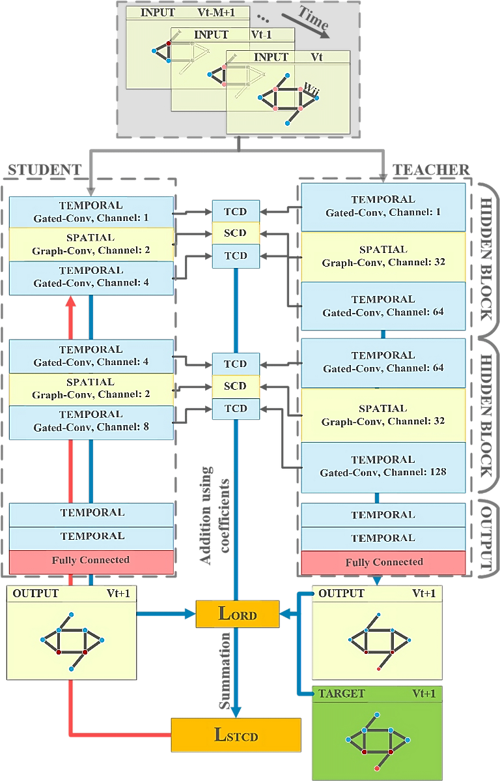
Knowledge Distillation on Spatial-Temporal Graph Convolutional Network for Traffic Prediction (9)
Neural Architecture:

Slide 45
Knowledge Distillation on Spatial-Temporal Graph Convolutional Network for Traffic Prediction (9)
Methodology:
Modelling the traffic network as graphs defined across time steps.
Designing a neural architecture containing two blocks with temporal and spatial layers and output block transforms information into the final output.
Using two knowledge distillation techniques, response-based distillation, and feature-based knowledge distillation.
Based on the student model from knowledge distillation, using a cost function to train this student network to reduce the number of parameters.

Slide 46
Knowledge Distillation on Spatial-Temporal Graph Convolutional Network for Traffic Prediction (9)
Results:
Knowledge distillation: execution time of student has reduced by approximately 83% - 84% compared to teacher. Compared to another approaches, almost in all cases the model has shown improvement
Pruning: RMSE is improved to 4.398. The pruning algorithm leads to better model performance compared to the non-pruned.

Slide 47
COMPARATIVE STUDY – Selected AI in IoIDT Articles
 | Accuracy | Recall | Precision | F1-score | FPR | Specificity
(1) | 98.99% | 96.97% | 96.97% | 96.97% | 0.61% | 99.39%
(2) | 66% | 65.7% | 65.7% | 73.3% | 1.1% | 98.9%
(3) | 98.95% | 66.5% | 88.54% | 70.5% | 1.05% | 98.95%
(4) | 92.58% | 97% | 76% | 85% | 7.42% | 92.58%
(5) | 91.06% | 97.75% | 98.1% | 98.9% | 1.01% | 98.99%

Slide 48
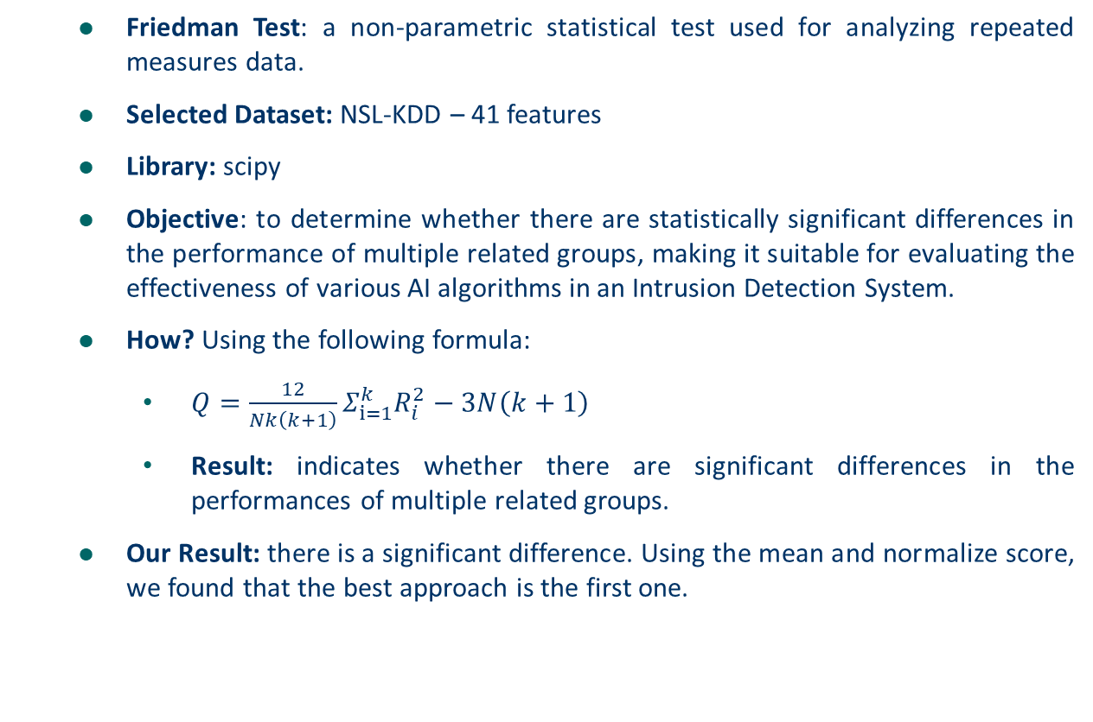
COMPARATIVE STUDY – Suitable Approach
  Friedman Test: a non-parametric statistical test used for analyzing repeated measures data.
  Selected Dataset: NSL-KDD – 41 features
  Library: scipy
  Objective: to determine whether there are statistically significant differences in the performance of multiple related groups, making it suitable for evaluating the effectiveness of various AI algorithms in an Intrusion Detection System.
  How? Using the following formula:
    $Q=\frac{12}{Nk\left(k+1\right)}Σ_{ⅈ=1}^{k}R_{i}^{2}−3N\left(k+1\right)$
    Result: indicates whether there are significant differences in the performances of multiple related groups.
  Our Result: there is a significant difference. Using the mean and normalize score, we found that the best approach is the first one.

Slide 49
Limitations
  Higher Resource Requirements:
    IoT devices often have limited computational power, memory, and energy capacity.
    Larger models increase the demand for CPU and memory, making it challenging to deploy effective IDS on resource-constrained IoT devices.
  Challenges with Model Updating and Maintenance: Larger models are harder to update and maintain on distributed devices, especially in environments where frequent updates are required to keep up with new attack patterns.
  Increased Latency and Lower Efficiency: Real-time intrusion detection is essential for IoT systems, and any delay due to processing overheads can compromise system security and responsiveness.

Slide 50
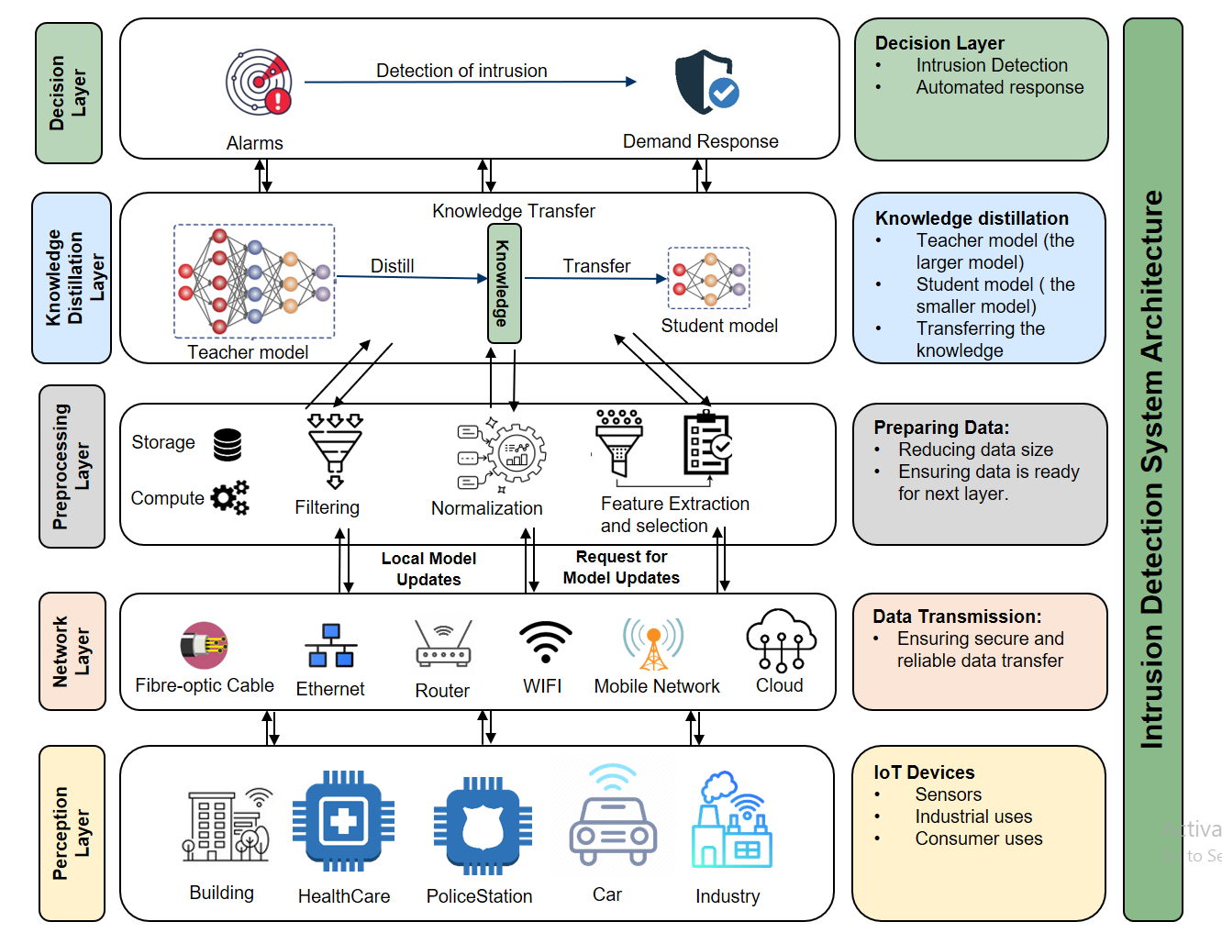
Architecture

Slide 51
Conclusion
  IoIDT is essential: A focused security approach is important for protecting IoT systems.
  Enhanced threat detection: IoIDT frameworks proactively address IoT-specific attacks.
  Efficiency through knowledge distillation: Lightweight models improve IoT security without heavy resource use.
  Detecting multiple types of attacks on different kind of IoTs
  Proposing a suitable architecture for IoIDT using knowledge distillation to overcome the discussed limitations.

Slide 52
References
Omer, Nadir, et al. "A novel optimized probabilistic neural network approach for intrusion detection and categorization." Alexandria Engineering Journal 72 (2023): 351-361.
Thakkar, Ankit, and Ritika Lohiya. "Fusion of statistical importance for feature selection in Deep Neural Network-based Intrusion Detection System." Information Fusion 90 (2023): 353-363.
Dina, Ayesha S., A. B. Siddique, and D. Manivannan. "A deep learning approach for intrusion detection in Internet of Things using focal loss function." Internet of Things 22 (2023): 100699.
Hajj, Suzan, et al. "Cross-layer federated learning for lightweight iot intrusion detection systems." Sensors 23.16 (2023): 7038.
Rajadurai, Hariharan, and Usha Devi Gandhi. "A stacked ensemble learning model for intrusion detection in wireless network." Neural computing and applications 34.18 (2022): 15387-15395.
Abdullayev, Javidan, et al. "Knowledge Distillation for Robotics Time Series Classification.“
Hinton, Geoffrey. "Distilling the Knowledge in a Neural Network." arXiv preprint arXiv:1503.02531 (2015).
Li, Ying, et al. "Deep knowledge distillation: A self-mutual learning framework for traffic prediction." Expert Systems with Applications 252 (2024): 124138.
Izadi, Mohammad, Mehran Safayani, and Abdolreza Mirzaei. "Knowledge Distillation on Spatial-Temporal Graph Convolutional Network for Traffic Prediction." arXiv preprint arXiv:2401.11798 (2024).

Slide 53
Thank you

