Slide 1
Data & Integrity Constraints

Slide 2

JOIN SESSION
Session code: JURBIQ
Join link:
http://localhost:5173/student/join/JURBIQ

Slide 3
Data Integrity
The term data integrity refers to the accuracy and consistency of data.
When manipulating databases, attention needs to be given to data integrity and how to maintain it. A good database will enforce data integrity whenever possible.
Sources of lack of integrity
  Human errors
  System errors

Slide 4
QUESTION 1
Analyze | Hard
Which statement correctly describes Data Integrity?
A. The term data integrity refers to the accuracy and consistency of data
B. Data Integrity depends on storage order
C. Data Integrity changes when examples are reordered
D. Data Integrity is defined by one sample value
Discuss, answer, then reveal feedback in the live session.

Slide 5
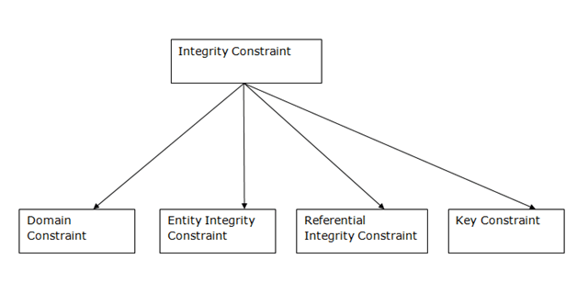
Integrity constraints
Integrity constraints are a set of rules used to maintain the quality of information.
Integrity constraints ensure that the data insertion, updating, and other processes have to be performed in such a way that data integrity is not affected.
Thus, integrity constraint is used to guard against accidental damage to the database.
Types

Slide 6
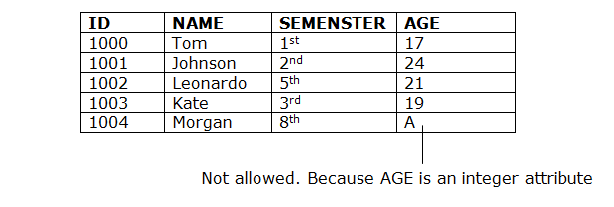
Domain constraints
Domain constraints can be defined as the definition of a valid set of values for an attribute.
The data type of domain includes string, character, integer, time, date, currency, etc.
The value of the attribute must be available in the corresponding domain.

Slide 7
QUESTION 2
Experienced | Hard
Which statement correctly describes Data Integrity?
A. A
B. B
C. C
D. D
Discuss, answer, then reveal feedback in the live session.

Slide 8
Key constraints
Keys are the attribute set that is used to identify an entity within its entity set uniquely.
Remember: An entity set can have multiple keys, but out of which one key will be the primary key.
  A primary key can contain a unique and non null value in the relational table.

Slide 9
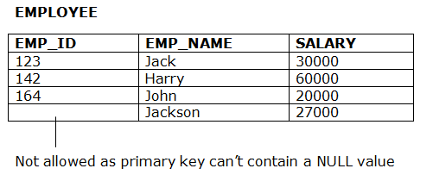
Entity integrity constraints
The entity integrity constraint states that primary key value can't be null.
This is because the primary key value is used to identify individual rows in relation and if the primary key has a null value, then we can't identify those rows.
A table can contain a null value other than the primary key field.

Slide 10
QUESTION 3
Evaluate | Hard
Which statement correctly describes the concept of data integrity?
A. Domain constraints can be defined
B. Domain constraints depends on storage order
C. Domain constraints changes when examples are reordered
D. Domain constraints is defined by one sample value
Discuss, answer, then reveal feedback in the live session.

Slide 11
Referential Integrity Constraints
A referential integrity constraint is specified between two tables.
In the Referential integrity constraints, if a foreign key in Table 1 refers to the Primary Key of Table 2, then every value of the Foreign Key in Table 1 must be null or be available in Table 2.
So, referential integrity will prevent users from:
  Adding records to a child table if there is no associated record in the parent table.
  Changing values in a parent table that result in orphaned records in a child table.
  Deleting records from a parent table if there are matching related records.

Slide 12
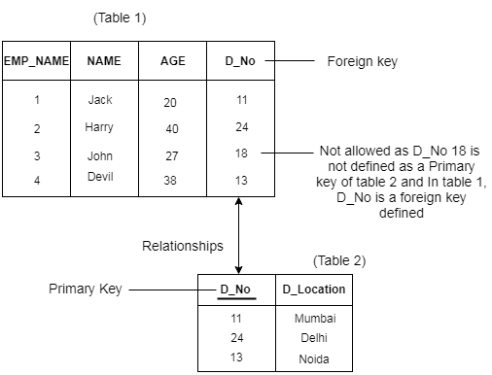
Dealing with referential integrity
4 cases
  On Delete Cascade: if parent record is deleted, then all the corresponding child record will be deleted automatically.
  On Delete Set Null: if parent record is deleted, then all the corresponding child record will be updated to null.
  On Update Cascade: if parent record is updated, then all the corresponding child record will be updated to the same value automatically.
  On Update Set Null: if parent record is updated, then all the corresponding child record will be updated to Null automatically.

Slide 13
QUESTION 4
Understand | Hard
In a few words or one short sentence, Explain why Entity integrity constraints matters in this lesson.
Write your short answer
Discuss, answer, then reveal feedback in the live session.

Slide 14
SQL Create
create table branch
(branch-name char(15),
branch-city char(30),
opening-date date not null,
assets integer,
primary key (branch-name),
foreign key (branch-city) references cities(city),
check (assets >= 0))

Slide 15
SQL Drop & Alter
To delete a table: Drop table
  NB: A referenced table can not be dropped
To modify a structure: alter table
  NB: Take care of referential integrity constraints

Slide 16
Anomalies
Data anomalies are cases of data not respecting integrity constraints
Data anomalies naturally occur and result in data that does not match the real world intended to be represented by the database
There are three types of Data Anomalies:
  Update Anomalies
  Insertion Anomalies
  Deletion Anomalies.

Slide 17
Update Anomalies
An update anomaly is a data inconsistency that results from data redundancy and/or a partial update.
Examples
  Updating an attribute to a value outside its domain
  Updating a FK to a value that does not exist in the referenced table
  Updating a PK referenced by other tables without updating the corresponding FK

Slide 18
Insertion Anomalies
An insertion anomaly is the anomaly resulting from an insertion.
Example
  Inability to add data due to the absence of referenced data.
  Inserting a FK in the referencing table that does not correspond to a PK in the referenced table

Slide 19
Delete Anomalies
A delete anomaly is the opposite of an insert anomaly.
Examples
  Inability to delete data from a table without having to delete the entire record.
  Inability to delete a PK referenced by some other tables

