Slide 1
MAC
Medium Access Control
Chapters 2, 3
Ethernet
&
other LAN

Slide 2
JOIN SESSION
Session code: ________
Join link:
________
QR code
placeholder

Slide 3
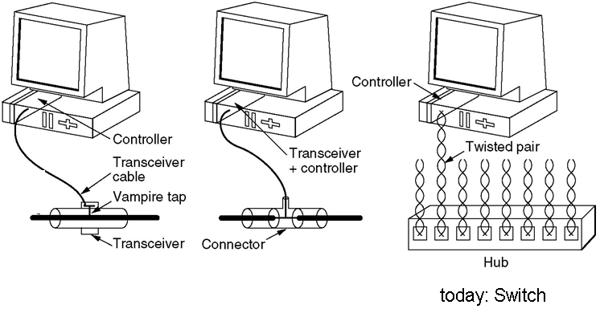
Classic Ethernet
Bus topology with repeaters. CSMA/CD
Star topology. Repeaters and hubs. Bridges and Switches.
10Base5, 10Base2 and 10BaseT

Slide 4
QUESTION 1
Apply | Hard
Which statement correctly describes MAC?
A. Medium Access Control
B. MAC depends on storage order
C. MAC changes when examples are reordered
D. MAC is defined by one sample value
Discuss, answer, then reveal feedback in the live session.

Slide 5
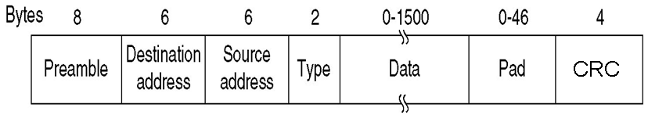
Ethernet Frame
MAC Address
48 bits (6 bytes) i.e. 10:13:31:1c:6b:0d
ff::ff:ff:ff:ff:ff reserved for broadcast
LSB of first byte = 1 => multicast address. i.e. 01:00:5e:00:00:fc
2nd LSB of first byte = 1 => address not globally unique
First 3 bytes identify a manufacturer. Manufacturer responsible to ensure global uniqueness of each card’s address.
Global uniqueness is a convenience, not a requirement. Uniqueness on the local LAN is only required.

Slide 6
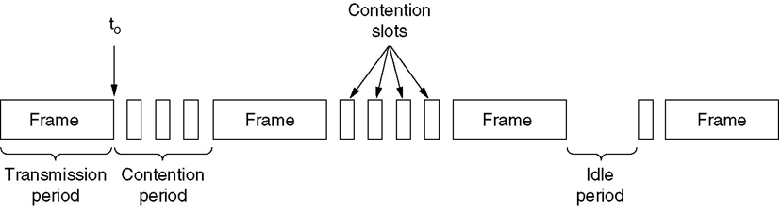
Collision Detection – CSMA/CD
Collision Detection means that a transmitting station can detect collision, stops transmitting immediately. CD is possible on wired media, not on wireless.
Conceptually, the slot-time T is the maximum RTT on the LAN, or twice the maximal delay between the farthest stations
Maximum “diameter” of LAN defined as 232 bits => RTT = 464 bits time
Each station involved in collision transmits “jam” of 48 bits. => Slot-time = 512 bits
If a station transmits successfully (no collision detected) within the slot time, it is sure to have acquired the channel so it continues the whole frame.
Minimum packet size must fill the slot time. That is 64 bytes minimum frame size. That’s headers + at least 46 bytes of payload. Padding used for smaller packets (i.e. TCP ACK has 40 bytes of TCP and IP headers, add 6 padding bytes).

Slide 7
The Binary-Exponential Backoff Algorithm
Listen before transmitting (“carrier detect”).
If line is busy, wait for sender to stop and then wait an additional 9.6μs (96 bits).
Begin transmitting while simultaneously monitoring for collisions (CD).
If collision occur, send the jam signal, and choose a backoff time, k slots of 51.2 μs . Select k randomly from {0, 1}, then from {0, 1, 2, 3} and so on. The interval doubles after each new failed attempt on the same packet until the 10th attempt. If someone else acquires the channel successfully during backoff, wait then restart from step 3.
If we reach16 transmission attempts, give up: drop the packet.

Slide 8
QUESTION 2
Analyze | Hard
Which statement correctly describes Classic Ethernet?
A. Bus topology with repeaters
B. Classic Ethernet depends on storage order
C. Classic Ethernet changes when examples are reordered
D. Classic Ethernet is defined by one sample value
Discuss, answer, then reveal feedback in the live session.

Slide 9
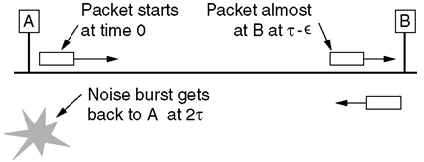
Slot Time and Minimum Frame Size
Hosts A and B separated by the max allowed distance (LAN diameter).This scenario shows
the need to define for a minimum packet length, enough to detect all collisions
The slot time T, defined as the maximum RTT
The LAN Diameter is the maximum distance between two hosts on the LAN
The IEEE 802.3 specification allows a diameter of 2500m, but with a max of 500m per segment, segments might be joined by repeaters.
Under these conditions, the delay budget was calculated by considering
  * signal delay in cables * delays in electronic devices (encoders, transceivers, repeaters, etc.).
The delay upper bound was calculated to be equivalent to 232 bits. (or 23.2 μs). Hence the upper-bound of RTT is 2 * 232 = 464 bits
In addition to the calculated RTT, the protocol specifies that when a collision is detected the host must send a “jam signal” of 48 bits. This extended RTT is called the Slot-time
T = 512 bits = 64 Bytes
If a host transmits successfully during the slot time (no collision detected), it is sure to have acquired the medium (everybody else will backoff) so it continues the whole packet.
Minimum packet size is 64 bytes. It must “fill” the RTT, to ensure that the transmitting host detects any possible collision. Ethernet header is 18 bytes, so we need at least 46 bytes of payload. Padding is used when the packet is too small.

Slide 10
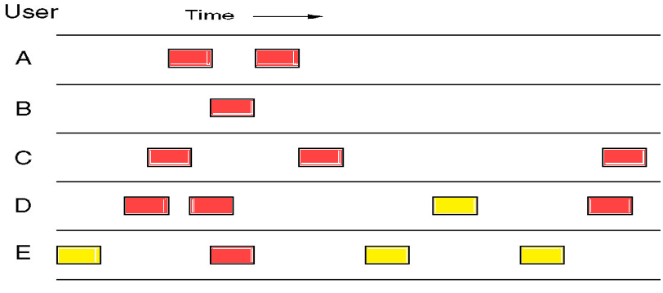
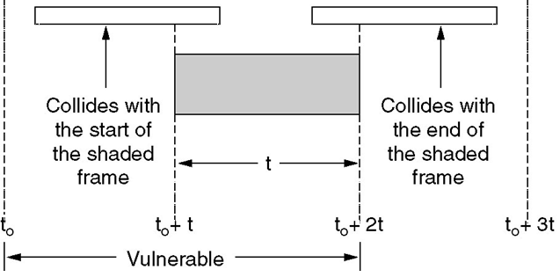
Performance analysis preliminary: ALOHA model
Host waits random time then transmits. No carrier sensing.
Vulnerability period is 2T

Slide 11
QUESTION 3
Evaluate | Hard
Which statement correctly describes Global uniqueness is a convenience, not a requirement?
A. Ethernet Frame MAC Address 48 bits (6 bytes) i
B. Global uniqueness is a convenience, not a requirement depends on storage order
C. Global uniqueness is a convenience, not a requirement changes when examples are reordered
D. Global uniqueness is a convenience, not a requirement is defined by one sample value
Discuss, answer, then reveal feedback in the live session.

Slide 12
performance analysis based on ALOHA model
Consider N hosts in contention, and each host has a probability s to transmit during a timeslot (or back-off with probability 1 – s).
For a given host, the probability of a successful transmission at a given slot is s(1–s)^{2(N–1)}
  the host transmits, probability = s
  all other N–1 hosts stay quite for 2 slot times, so that no collision occurs ( proba = (1-s)^{2(N-1)} ).
Accordingly, the successful transmit rate (probability of a successful transmission by any host) is
Ns (1 – s) ^{2(N – 1 )} = G (1 – G/N) ^{2(N – 1 )}
Where G = Ns is defined as the total “traffic” (total transmit attempts by all hosts). Under the assumption of large N and small s, the rate of successful transmissions → S = e^{– 2G}, with a maximum of (1 / 2e) at G = ½
Applying this result to approximate Ethernet’s contention period, under similar circumstances, avg. number of wasted slots per contention period is 2e – 1, or wasted time = (2e – 1)T.
Let P.T be the average the average time to transmit a successful packet. Then, the efficiency, defined as (useful time) / (total time) is P / (P + 2e – 1)
In other words, the throughput is P / (P + 2e – 1) times the bit-rate.
Examples. In 10Mbps Ethernet, T=51.2μs (512 bits, 64 bytes).
    P=2 (128 bytes) → eff. = 2/(2e+1) = 31%
    P=8 (512 bytes) → eff. = 8/(2e+7) = 64%.
    Max. packet size 1500 bytes → eff. = 80%.

Slide 13
Fast Ethernet (100Mbps) and Switched Ethernet
100BaseTX, works with Category 5 (or higher) UTP, (works also with coax but rarely used).
Network diameter reduced to 400m to keep the Minimum packet at 64 Bytes.
CAT5 imposes cable length < 100m. So with UTP the network diameter (max host-to-host distance) is 200m (hub and links to hosts).
To achieve longer distances, a Switch is used to “federate” the hubs. Switches separate the “collision domains”
For long (inter building) connections, we use Full Duplex 100BaseFX (fiber with limit 2km).
Full Duplex mode is collision-free, using switches only, and two twisted pairs (one in each direction). CAT5 and CAT6 cables have 4 twisted pairs.
  Today, in practice we use only Full Duplex, switched Ethernet, although some (useless) rules are inherited from classic Ethernet (i.e. slot time, min and max packet size, etc.)
  Still using mainly CAT5 UTP. Multimode fiber is used only in long distances because its high noise immunity, so it can achieve up to 2km distance (which is great for LAN…).
x

Slide 14
QUESTION 4
Understand | Hard
In a few words or one short sentence, Explain why Collision Detection – CSMA/CD matters in this lesson.
Write your short answer
Discuss, answer, then reveal feedback in the live session.

Slide 15
Gigabit Ethernet
GigE is especially important for “server clusters”, common in data centers and clouds.
1000BaseT works with Category 5 (or higher) UTP. Uses all four pairs. Each pair is 250Mbps bi-directional! Using the modern “echo cancellation” technique.
Versions that require CAT6 didn’t break through!
Purely Full Duplex, collision-free (switched). Still, inherits some obsolete rules from collision-enable Ethernet. i.e. 512-byte (4.096 μs) slot time and padding.
PAM5 encoding. 5 amplitudes (on each pair) yielding 5*5*5*5=625 codepoints. Only 256 codes used (8 bits/symbol, clocked at 125MHz), allowing 2X redundancy and FEC.
Variants: 1000BaseSX, 1000BaseLX, 1000BaseCX. See Ethernet versions summary slide
10GBase Ethernet: similar ideas, pushing the speed further
  10GBaseT, 10GBaseSR, 10GBaseLR, 10GBaseER, 10GBaseCX4
  Mostly uses “single mode” optical fibers.
40GBase...

Slide 16
Ethernet – versions, namings…
First number is the bit rate.
BASE means baseband. (BROAD existed but almost never used).
First letter is suffix concerns the medium:
  “T” twisted-pair cable (Cat5 or Cat6)
  “F” optical fiber
  “S” short-range optical (less than 100 m)
  “L” long-range optical (100 m to 10 km)
  “E” extended-range optical cable (10 km to 40 km)
  “K”: Backplane Ethernet (server farms)
  Other (C coax, STP or twinax. Z high wavelength optical etc.)
Then the following letter concerns coding scheme
  “X” 4B/5B (100Mbps case) or 8B/10B (GigE) (extended, unspecified, whatever!)
  “R” 64B/66B
Optionally used at the end: number of parallel lanes (default = 1)
Examples
10BaseT, 100BaseTX, 100BaseFX, 10GBaseER, 40GBaseSR4…

Slide 17
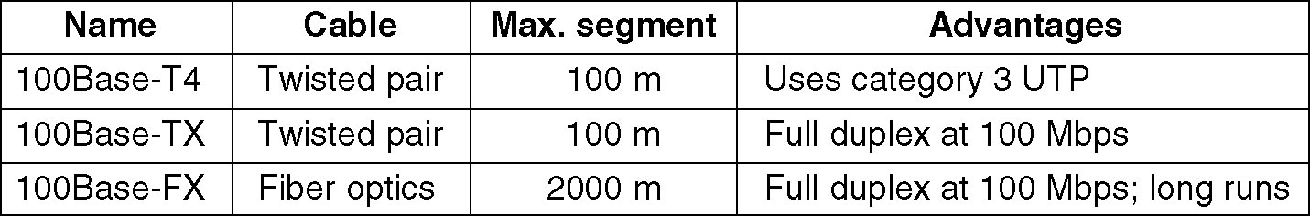
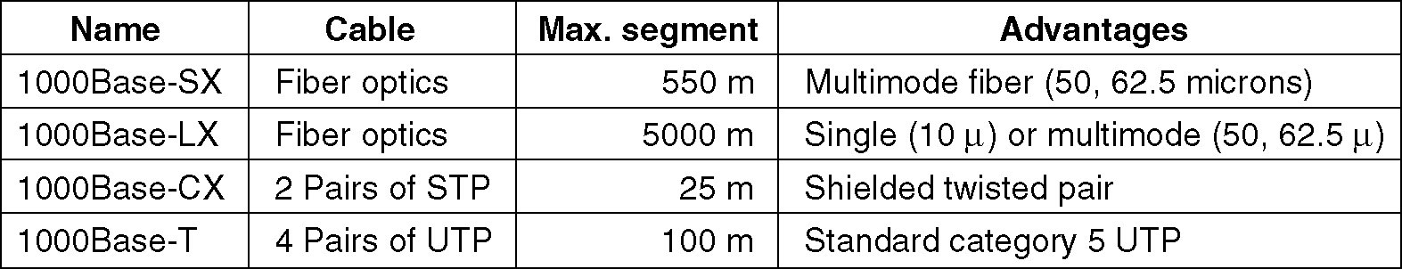
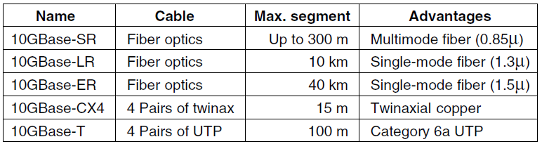
Fast Ethernet
Gigabit Ethernet
10Gigabit Ethernet

Slide 18
Encoding schemes in Ethernet
Encoding schemes are designed to avoid long periods of constant signal (long runs of 0 or of 1). This is necessary for “bit synchronization” as well as to maintain a zero DC component.
Classic Ethernet uses Manchester encoding. DataRate = ½ ClockRate.
1=transition in middle of clock cycle
0=no transition. Always transition at the end of each clock cycle.
100BaseT uses 4B/5B
    DataRate = 0.8 ClockRate.
GigE 64B/66B
    DataRate = 0.97 ClockRate.

Slide 19
Switches and Bridges
Switch is a “multiport bridge”. Similarly, Hub is a multiport repeater (layer 1).
Connects together different “collision domains” by doing “Store-And-Forward”. Hence it is technically a “layer-2” gateway (understands the frame).
Maintains a “forwarding table”: list of reachable MAC addresses per interface. The key idea of the Ethernet Learning Algorithm (how switches learn the topology and fill their forwarding table) is as follows. When a packet arrives to a switch:
  If Destination MAC not in forward table, apply “flooding”
  If source MAC not in forward table, add it to the list of the incoming interface.
Broadcasts are flooded. Multicast addresses can be listed on many interfaces.
Tree Topology is necessary to avoid forwarding loops. However, redundant links can be installed as backup (to use upon failure). The Spanning-Tree-Algorithm permits switches to negotiate which links to drop or use to establish a tree topology.
Thrill, SPB, SDN & OpenFlow… All these are ideas (mainly applied in data centers) to exploit the redundant links in order to achieve higher network throughput. In short,
  switches use a “routing update algorithm” ( ie. IS-IS) to have full routing tables, similarly to Internet routers, but using MAC addresses
  Broadcast packets and packets destined to unknown destinations are flooded on the spanning tree, which avoids infinite looping…

Slide 20
Spanning Tree Algorithm (sections 3.1, 3.1.1)
Redundant links are necessary to cope with link failures, but the existence of loops makes the broadcased packets (and packets destined to unknown destinations) loop forever. The Spanning tree algorithm allows the Switches to “elect” the links to use to form a spanning tree. The other links are considered “backup” (will be used if a link fails).
The algorithm is based on the “election” of a root node: the switch with the lowest ID. Then each switch activates the links that provide “shortest path” to the elected root.
Each switch broadcasts regular messages called bridge protocol data units (BPDU). Destination = multicast address 01:80:c2:00:00:00. (src = port MAC address) .The BPDU contains:
  ID of the node “thought to be” the root (lowest switch ID received in any BPDU)
  Path cost (number of hops to that (thought of) root switch
Each switch processes the received information to update its data:
  . Root switch (lower switch-ID received?) . Shortest path to root (does this BPDU advertise a shorter route to the root?)
  . Tie-breaking rule 1: In case of equal paths: elect the neighbour with lower ID
  . Tie-breaking rule 2: In case of multiple links to neighbour: elect the link with lower port number
Example.
S₁ lowest ID => elected root is S₁
S₂ and S₄ activate their links to S₁ (shortest route to elected root)
S₅ has two equal paths to S₁, it chooses the route via S₂ (TB rule 1, lower neighbour ID)
S₃ has shortest route to S₁ via S₂
S₆ has two equal paths to S₁, it elects the route via S₃ (TB rule 1)
Spanning Tree

Slide 21
VLAN
Technology to split a single physical LAN into separate logical LANs. Goals:
  Separate/secure different departments, giving each its own LAN
  Do this separation independently of the wiring. Cables plug in any switch/port. Network admin configures the VLANs administratively (coloring).
Each VLAN is a different subnet; traffic between VLANs goes through router. However, a l”ayer3 Switch” is switch that does this routing internally (examining the IP packet).
In addition to security, VLAN improves performance by splitting broadcast domains. broadcasts (ie. ARP) are limited to the VLAN (subnet), not the whole LAN.
802.1Q adds a VLAN TAG field to identify the VLAN to which the frame belongs. Each tag is like a color. Switch ports connected to end hosts are configured with one color. Traffic between switches might carry many colors as necessary.

Slide 22
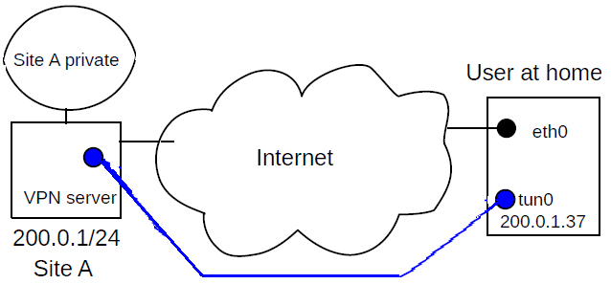
Other LAN technologies
VPN. Virtual NIC (blue) assigned a (private) IP belonging to site A’s subnet . Packet is encapsulated inside another packet (aka tunneling) which is sent via internet to VPN server, which forwards the internal packet to destination in site A.
Corporate VPNs similar, we might have an office LAN instead of a single user at home.
Encryption of the encapsulated packets permits the “privacy” and authenticity on the private net.
When you use the VPN to connect to a website, your (original) packets are sent toward an Internet router on private site A. The internet router “NAT”s your (original) packets and forwards them to the website. For any firewall between you and the VPN server, the destination website is invisible.
Carrier Ethernet. Leased point-to-point line that carries Ethernet frames, over any carrier technology. (see also DSL).
Token Ring & Token Bus. A “token” (special packet) is passed in circular way to the hosts to gibe them turn to transmit. Good for optical fiber nets.
Token Ring good for optical nets, ie FDDI

Slide 23
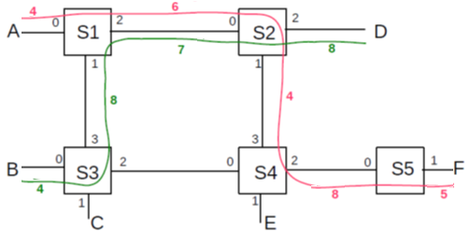
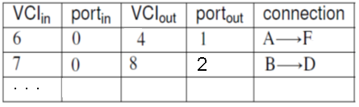
Virtual Circuit Networks, including ATM
VC table at switch S₂
VC (Path) established before communication takes place between endpoints. All packet for a VC follow the same path => arrive in order, unlike datagram forwarding (ie Internet).
VC is not physical circuit switching it’s packet switching but circuits are virtual.
Example technologies: ATM, Frame Relay, X.25.
Permits QOS guarantees, switches can reserve capacity when connection negotiated
Faster switching, based on VC numbers, and routing table not consulted for each packet
Small Headers allow efficient support of small packets (ie ATM cells are 48B), good for voice.
Permits per-connection billing
Must hold State information, which is bad for scalability and growth (compared to datagrams)
Router crash ➔ connections lost, rerouting not easy. Endpoints must reestablish new connection

Slide 24
Recommended Reading
Textbook
2.1 2.1.1 2.1.2 2.1.5 2.1.6 2.1.11 2.1.11.1
2.1.11.12 2.2 2.3 2.4 2.4.1
3.1 3.1.1 3.2 (not 3.2.1)
5.1 5.3 5.4 5.5 (not 5.5.1)

