Slide 1
TCP
Chapter 12
Transport

Slide 2
JOIN SESSION
Session code: ________
Join link:
________
QR code
placeholder

Slide 3
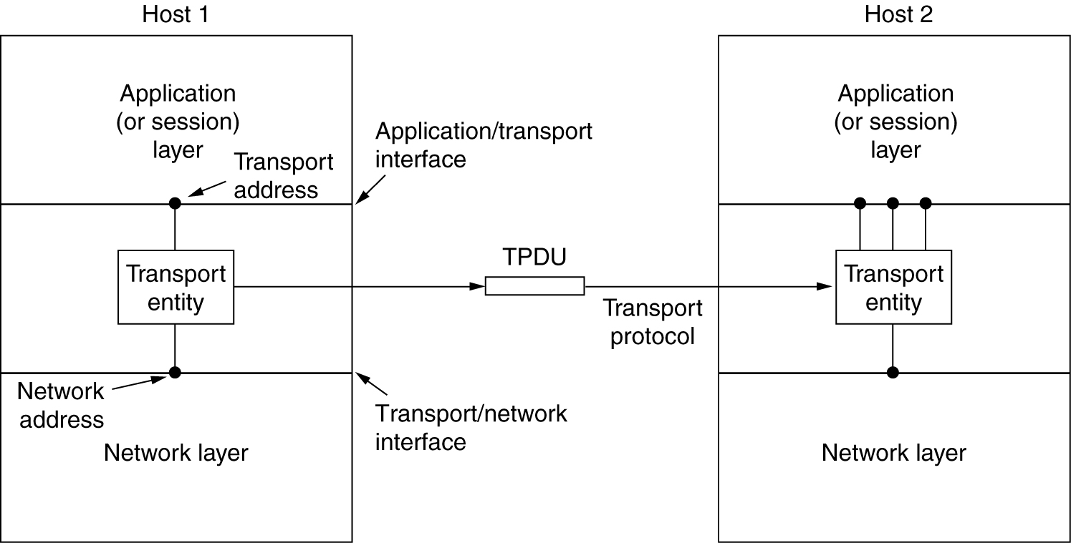
Transport: the first end-to-end layer

Slide 4
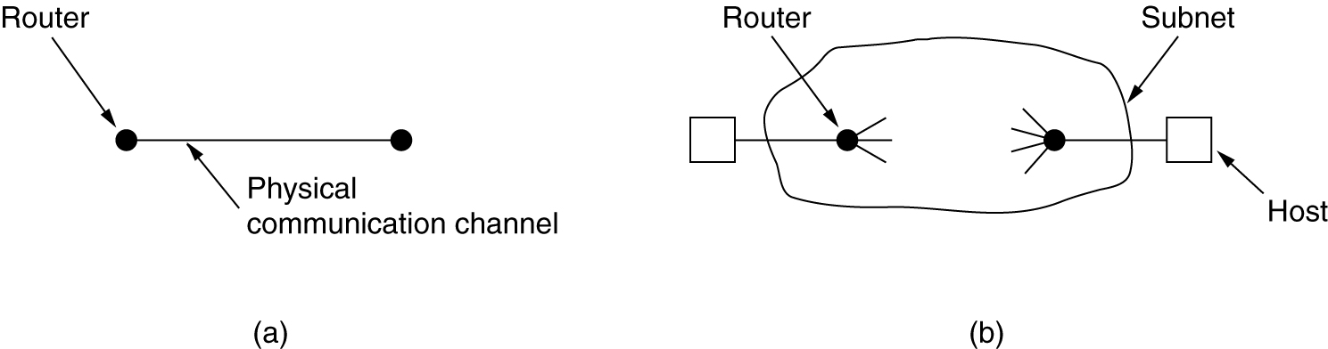
Transport Protocol
(a) Environment of the data link layer.
(b) Environment of the transport layer.
Some similarity, but much different environments!

Slide 5
QUESTION 1
Apply | Hard
Which statement correctly describes the concept of a relation schema?
A. (a) Environment of the data link layer
B. Transport Protocol depends on storage order
C. Transport Protocol changes when examples are reordered
D. Transport Protocol is defined by one sample value
Discuss, answer, then reveal feedback in the live session.

Slide 6
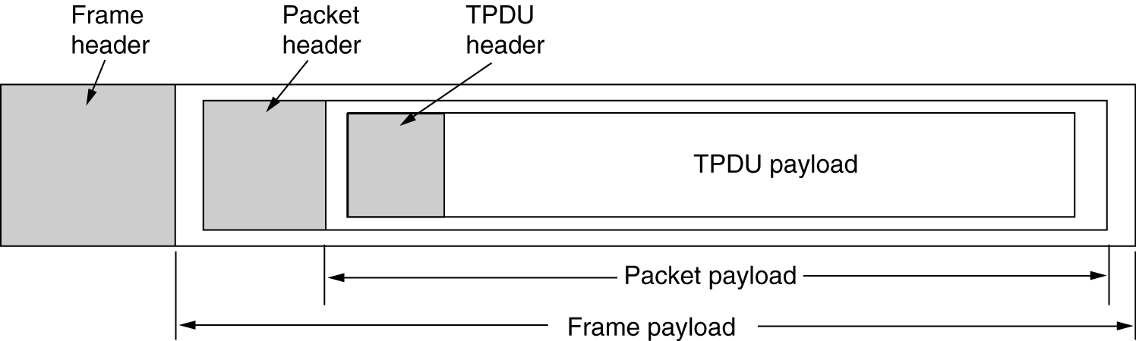
TPDU: The Segment
The nesting of segments, packets, and frames.

Slide 7
The Transport Layer
Services provided to upper layers (applications)
  Interface between software apps and the network infrastructure
  Addressing applications and services
  API for application programmers (i.e. Sockets API)
  Simplifying network complexity
Error Control
Flow control
Connection management
Congestion Avoidance (& Bandwidth management)
TCP and UDP

Slide 8
QUESTION 2
Analyze | Hard
What is the main purpose of the lecture content as a student?
A. To memorize facts and concepts taught by lecturer or professor
B. To understand topics thoroughly and retain information better
C. To apply knowledge to real-life situations
D. To gain practical skills for future careers
Discuss, answer, then reveal feedback in the live session.

Slide 9
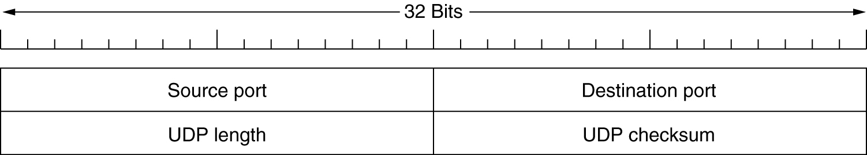
UDP – the datagram-oriented transport service

Slide 10
Some assigned ports
Port
Protocol
Use
21
FTP
File transfer
23
Telnet
Remote login
25
SMTP
E-mail
69
TFTP
Trivial File Transfer Protocol
79
Finger
Lookup info about a user
80
HTTP
World Wide Web
110
POP-3
Remote e-mail access
119
NNTP
USENET news

Slide 11
QUESTION 3
Evaluate | Hard
Which statement correctly describes The Transport Layer?
A. Better understand concepts
B. Increase understanding and retention
C. Examine different perspectives
D. Gain practical skills
Discuss, answer, then reveal feedback in the live session.

Slide 12
TCP: The connected, reliable Transport Control Protocol

Slide 13
TCP Connection management
Connection establishment
3-way handshake
Connection Release
Each direction is released separately

Slide 14
QUESTION 4
Understand | Hard
In a few words or one short sentence, Explain why TCP Connection management matters in this lesson.
Write your short answer
Discuss, answer, then reveal feedback in the live session.

Slide 15
TCP State diagram

Slide 16
The old duplicate problem and ISN
TIME_WAIT = 2*MSL = 60s to avoid creating the same connection before old duplicates are surely gone.
ISN generated from a real-time 4μs clock. The new connection will have ISN > seq of the old connection, unless its rate exceeds 250KB/s. In this case TIME_WAIT must be used.
Some randomness is added to ISN to avoid spoofing attacks.
ISN(t) = Clock(t) + hash(ip1, port1, ip2, port2, some_fixed_number)
ISN(t) is not the same for all calling sockets. But still, for a given ( ip2, port2), it increases each 4μs.

Slide 17
Other topics
Path MTU Discovery and MSS option (set in SYN packets)
TCP WindowScale option to increase multiplicatively the scale of window updates (to accommodate large buffers and high BW*RTT situations)
Nagle’s algorithm accommodates character apps such as telnet. Sender is encouraged to wait and accumulate more data in order to minimize the number of sent packets.
Silly window syndrome. The solution is that receiver should avoid making small window updates after window has reached zero. Rather wait until receiver app has read at least the size of a packet.
TCP Timeout and Retransmission. Estimate RTT and its deviation using smoothed average
KeepAlive
TCP Timers
Congestion Control

Slide 18
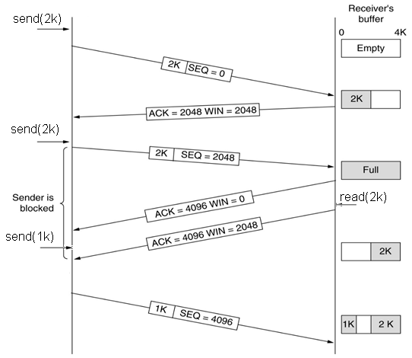
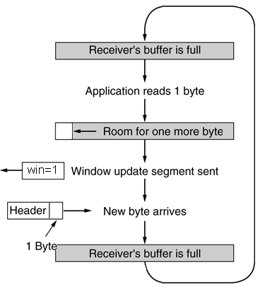
TCP Window management
silly window syndrome
The silly window syndrome occurs when a receiving application reads data in small units (1 – 10 bytes)
Nagel solution: when win=0, don’t send updates until enough data has been read by app (~ a packet size)
Similar problem when app sends small units of data (i.e. interactive apps, rsh)
Clark solution: buffering, wait and accumulate until either Ack comes back, or app sends enough data.

Slide 19
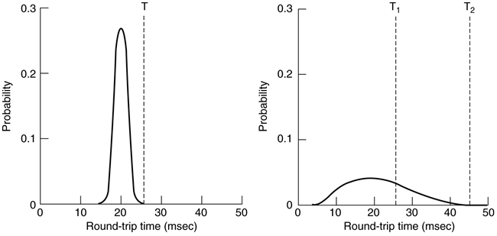
TCP Timeout and Retransmission
TCP Timeout is based on estimation of average and deviation of RTT, using the exponential moving average forecasting approach.
RTO (Retransmission TimeOut) timer used for ARQ. Based on estimation of the average and absolute deviation of RTT.. After each sample R of the round-trip time, it changes its estimation according to the EWMA (Exponential Weighted Moving Average) formula:
SRTT = α . SRTT + (1 – α) . R (average Smoothed RTT estimation)
RTTVAR = β . RTTVAR + (1 – β) * | SRTT – R | (mean absolute deviation estimation)
RTO = SRTT + 4.RTTVAR
Typically α = 7/8 β = 3/4
Acks for retransmitted segments are not taken into account in this estimation
RTO is doubled for retransmitted segments (Karn’s algorithm). This doubled value is set as SRTT for further estimations.

Slide 20
TCP Timers
RTO (Retransmission TimeOut)
Persistence Timer is used to avoid deadlock when a window update segment is lost and the sender thinks the receiver’s window is still at zero. A sender with a zero-window will send a “window probe” when this timer expires.
Keepalive Timer used to signal a connection that has been idle for long time.
TIMEWAIT Timer used to wait when connection is closed, before any other connection can be opened between the same two sockets. Value is 2*MSL.

Slide 21
Congestion Control
Implementation techniques are used to regulate the sending rate over the network and to avoid congestion.
How is congestion detected by the transport layer?
  Explicit: Notification from the network layer (i.e. Choke packets). Routers explicitly signal sources to lower their transmission rates
  Implicit: The transport layer senses the round-trip times and packet losses and concludes about an existing congestion.
How is the rate of transmission adjusted?
  Precise: i.e. when the network layer signal notifies the desired rate
  AIMD (Additive Increase Multiplicative Decrease) law. This law is used by default in TCP
IP header has flags ECN for ECN: Explicit Congestion Notification
TCP treats ECN and Ack-Timeout in the same way, as indication of congestion on the path

Slide 22
TCP Congestion Control
Objective: avoid congestion by adjusting the sender rate to what the network path can afford.
The path’s capacity is the capacity of the bottleneck link.
  We wish to use all the available capacity (determined by the bottleneck link)
  But we don’t want to exceed it because the queue will build (at the router of the bottleneck link) therefore packets will b dropped.
Given an anticipation window size winsize and a RTT, the used bandwidth is wsize/RTT, (assuming the sender continuously has data to transmit, such as in file download).
The path’s capacity is not known to TCP. How to guess the optimal wsize (hence optimal sending rate)?
  TCP maintains a congestion window cwnd. winsize = min(cwnd, advertisedWindow)
  Each timeout is indication of packet drop due to congestion (not always true). => TCP reduces cwnd.
  Each successful packet (Ack received) is indication of no congestion => TCP tries to increase cwnd.
Approach of TCP Reno:
Start cwnd = a reasonably small initial guess (i.e. cwnd = 1 or 2)
slowly increase cwnd if no losses occur. Assumption: maximum possible throughput is not reached yet
rapidly decrease cwnd when loss occurs. Assumption: packet was dropped due to congestion.
AIMD. Additive Increase, Multiplicative Decrease
Additive increase: After each successful packet (Ack received), cwnd += 1;
Multiplicative Decrease: After each loss (timeout, no Ack) or ECN, cwnd /=2.

Slide 23
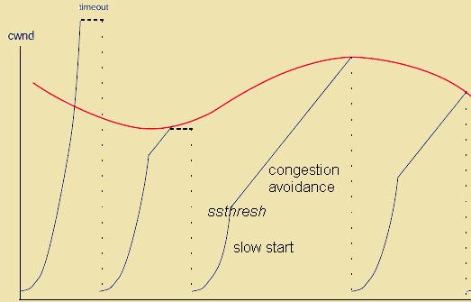
Slow Start
We start with a small initial guess cwnd =1 or 2.
cwnd++ after each Ack received. This is multiplicative, not slow! Because cwnd doubles after each windowful (~after each RTT).
Eventually the bottleneck queue gets full, and drops a packet. Let us suppose this is after N RTTs, so cwnd=2^{N}. Then during the previous RTT, cwnd=2^{N-1} worked successfully, so we go back to that previous value by setting cwnd = cwnd/2
A really slower method is called congestion avoidance mode: we increase cwnd by 1 for each successful windowful. This is equivalent to a per-Ack increase of:
cwnd = cwnd + 1/cwnd after each successful Ack
Threshold-Slow-Start method
combines the two methods:
Slow start (multiplicative) until a “slow-start threshold” ssthresh is reached, then switch to congestion avoidance mode.
ssthresh = cwnd/2 when a timeout occurs.

Slide 24
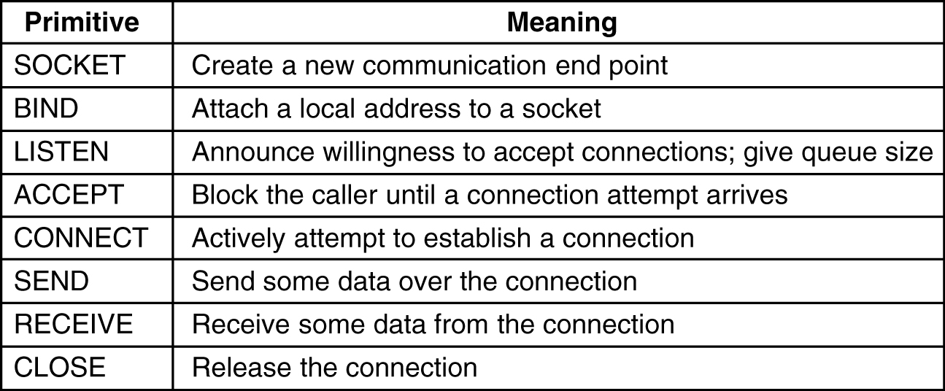
The Sockets API
The Berkeley Unix Sockets library also available in all OS’es… In Windows the name is “WinSock”. It is the most widely used API for network programming.

Slide 26
Reading list
Dordal’s book
17.1 17.2 17.3 17.4 17.7 17.7.1
18.1 18.2 18.3.1 18.5.1 18.6 18.7 18.9 18.10 18.11 18.12 18.13 18.14
19?... todo

