Slide 1
Introduction to SQL

Slide 2
JOIN SESSION
Session code: ________
Join link:
________
QR code
placeholder

Slide 3
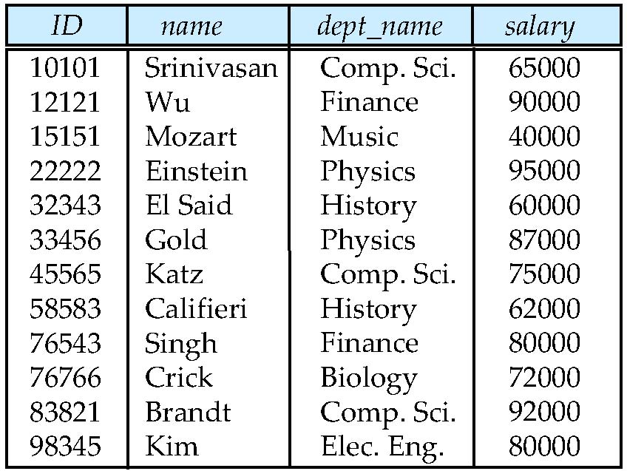
The Relational Model
Data is stored in tables we call relations
attributes
(or columns)
tuples
(or rows)

Slide 4
QUESTION 1
Apply | Hard
Which statement correctly describes the concept of a relation schema?
A. attributes (or columns) tuples (or rows) Data is stored in tables we call relations
B. The Relational Model depends on storage order
C. The Relational Model changes when examples are reordered
D. The Relational Model is defined by one sample value
Discuss, answer, then reveal feedback in the live session.

Slide 5
Attribute Types
The set of allowed values for each attribute is called the domain of the attribute
Attribute values are (normally) required to be atomic; that is, indivisible
The special value null is a member of every domain
The null value causes complications in the definition of many operations

Slide 6
Relation Schema and Instance
A₁, A₂, …, A_{n} are attributes
R = (A₁, A₂, …, A_{n} ) is a relation schema
Example:
instructor = (ID, name, dept_name, salary)
Formally, given sets D₁, D₂, …. D_{n} a relation r is a subset of
D₁ x D₂ x … x D_{n}
Thus, a relation is a set of n-tuples (a₁, a₂, …, a_{n}) where each a_{i} ∈ D_{i}
The current values (relation instance) of a relation are specified by a table
An element t of r is a tuple, represented by a row in a table

Slide 7
QUESTION 2
Apply | Hard
Which statement correctly describes Attribute Types?
A. Attribute Types depends on storage order
B. Attribute Types changes when examples are reordered
C. Attribute Types is defined by one sample value
D. attributes (or columns) tuples (or rows) Data is stored in tables we call relations
Discuss, answer, then reveal feedback in the live session.

Slide 8
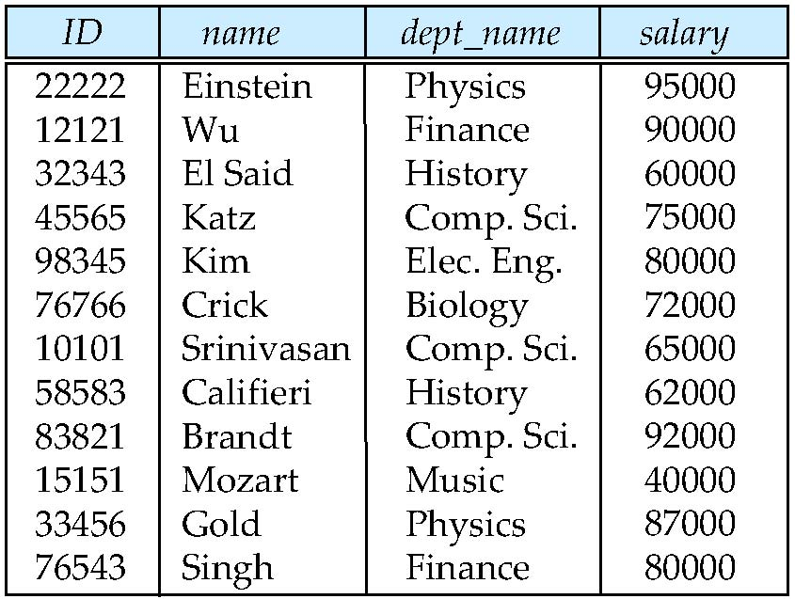
Relations are Unordered
Order of tuples is irrelevant (tuples may be stored in an arbitrary order)
Example: instructor relation with unordered tuples

Slide 9
Database
A database consists of multiple relations
Information about an enterprise is broken up into parts
instructor
student
advisor
Bad design:
univ (instructor -ID, name, dept_name, salary, student_Id, ..)
results in
  repetition of information (e.g., two students have the same instructor)
  the need for null values (e.g., represent an student with no advisor)
Normalization theory deals with how to design “good” relational schemas

Slide 10
QUESTION 3
Analyze | Hard
Which statement correctly describes Relation Schema and Instance?
A. A1, A2,
B. Formally, given sets D1, D2,
C. A1, A2, …, An are attributes R = (A1, A2, …, An ) is a
D. Relation Schema and Instance depends on storage order
Discuss, answer, then reveal feedback in the live session.

Slide 11
Keys
Let K ⊆ R
K is a superkey of R if values for K are sufficient to identify a unique tuple of each possible relation r(R)
  Example: {ID} and {ID,name} are both superkeys of instructor.
Superkey K is a candidate key if K is minimal
Example: {ID} is a candidate key for Instructor
One of the candidate keys is selected to be the primary key.
  which one?
Foreign key constraint: Value in one relation must appear in another
  Referencing relation
  Referenced relation

Slide 12
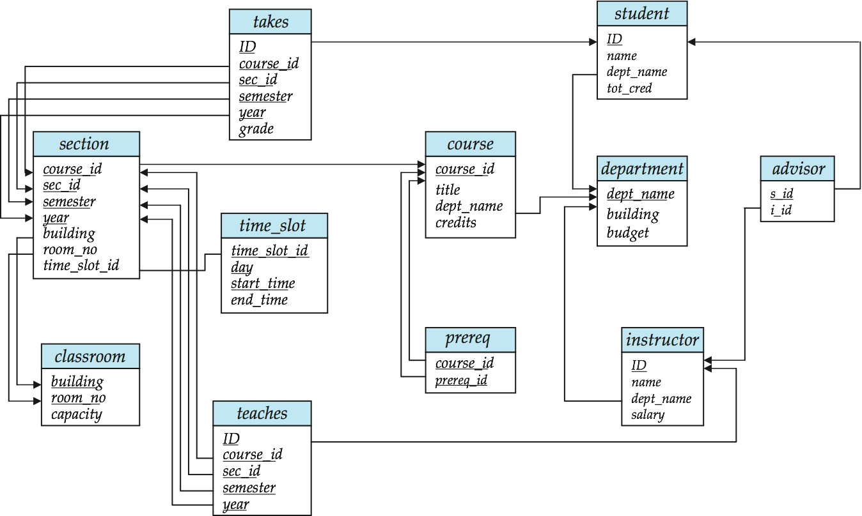
Schema Diagram for University Database

Slide 13
SQL
Structured Query Language
To manage relational databases
  DDL: define, modify and drop tables and indexes in the catalog
  DML: define, modify, delete and query data in tables
History
  IBM Sequel language developed as part of System R project at the IBM San Jose Research Laboratory
  Renamed Structured Query Language (SQL)
  ANSI and ISO standard SQL

Slide 14
QUESTION 4
Understand | Hard
In a few words or one short sentence, Explain why Database matters in this lesson.
Write your short answer
Discuss, answer, then reveal feedback in the live session.

Slide 15
SQL as a language
SQL is not procedural
  A procedural language is one where we designate HOW to do the task
  Usually it works through procedures and functions
  Example: Java, C….
SQL is declarative
  We only specify what we want regardless of how
  Query optimizer cares about the how
SQL is interactive
  SQL statements can be submitted using a command line processor, or a query tool and the results are immediate
SQL can be embedded inside programs

Slide 16
Domain Types in SQL
char(n). Fixed length character string, with user-specified length n.
  Char(10) “Database” == “Database “
varchar(n). Variable length character strings, with user-specified maximum length n.
  Varchar(10) “Database” == “Database“
int. Integer (a finite subset of the integers that is machine-dependent, 4 bytes).
  25, -38, between -2^31 and 2^31-1
smallint. Small integer (a machine-dependent subset of the integer domain type, 2 bytes).
  between -2^15 and 2^15-1
Some systems have bigint between -2^63 and 2^63-1 (4 bytes) and tinyint between 0 and 255 (1 byte)
numeric(p,d). Fixed point number, with user-specified precision of p digits, with n digits to the right of decimal point. Ex: 25.3
real, double precision. Floating point and double-precision floating point numbers, with machine-dependent precision.
float(n). Floating point number, with user-specified precision of at least n digits.

Slide 17
Basic Query Structure
A typical SQL query has the form:
select A₁, A₂, ..., A_{n}
from r₁, r₂, ..., r_{m}
where P
  A_{i} represents an attribute
  R_{i} represents a relation
  P is a predicate.
The result of an SQL query is a relation.
Notes:
2

Slide 18
The select Clause
The select clause list the attributes desired in the result of a query
  corresponds to the projection operation of the relational algebra
Example: find the names of all instructors:
select name
from instructor
NOTE: SQL names are case insensitive (i.e., you may use upper- or lower-case letters.)
  E.g. Name ≡ NAME ≡ name
  Some people use upper case wherever we use bold font.
Notes:
3

Slide 19
The select Clause (Cont.)
SQL allows duplicates in relations as well as in query results.
To force the elimination of duplicates, insert the keyword distinct after select.
Find the names of all departments with instructor, and remove duplicates
select distinct dept_name
from instructor
The keyword all specifies that duplicates not be removed.
select all dept_name
from instructor
Notes:
4

Slide 20
The select Clause (Cont.)
An asterisk in the select clause denotes “all attributes”
select *
from instructor
The select clause can contain arithmetic expressions involving the operation, +, –, ∗, and /, and operating on constants or attributes of tuples.
The query:
select ID, name, salary/12
from instructor
would return a relation that is the same as the instructor relation, except that the value of the attribute salary is divided by 12.
Notes:
5

Slide 21
The where Clause
The where clause specifies conditions that the result must satisfy
  Corresponds to the selection predicate of the relational algebra.
To find all instructors in Comp. Sci. dept with salary > 80000 select name
from instructor
where dept_name = ‘Comp. Sci.' and salary > 80000
Comparison results can be combined using the logical connectives and, or, and not.
Comparisons can be applied to results of arithmetic expressions.
Notes:
6

Slide 22
The from Clause
The from clause lists the relations involved in the query
  Corresponds to the Cartesian product operation of the relational algebra.
Find the Cartesian product instructor X teaches
select ∗
from instructor, teaches
  generates every possible instructor – teaches pair, with all attributes from both relations
Cartesian product not very useful directly, but useful combined with where-clause condition (selection operation in relational algebra)
Notes:
8

Slide 23
String Operations
SQL includes a string-matching operator for comparisons on character strings. The operator “like” uses patterns that are described using two special characters:
  percent (%). The % character matches any substring.
  underscore (_). The _ character matches any character.
Find the names of all instructors whose name includes the substring “dar”.
select name
from instructor
where name like '%dar%'
Match the string “100 %”
like ‘100 \%' escape '\'
SQL supports a variety of string operations such as
  concatenation (using “||”)
  converting from upper to lower case (and vice versa)
  finding string length, extracting substrings, etc.

Slide 24
Ordering the Display of Tuples
List in alphabetic order the names of all instructors
select distinct name
from instructor
order by name
We may specify desc for descending order or asc for ascending order, for each attribute; ascending order is the default.
  Example: order by name desc
Can sort on multiple attributes
  Example: order by dept_name, name

Slide 25
Where Clause Predicates
SQL includes a between comparison operator
Example: Find the names of all instructors with salary between $90,000 and $100,000 (that is, ≥ $90,000 and ≤ $100,000)
  select name
  from instructor
  where salary between 90000 and 100000
Tuple comparison
  select name, course_id
  from instructor, teaches
  where (instructor.ID, dept_name) = (teaches.ID, ’Biology’);
Notes:
7

Slide 26
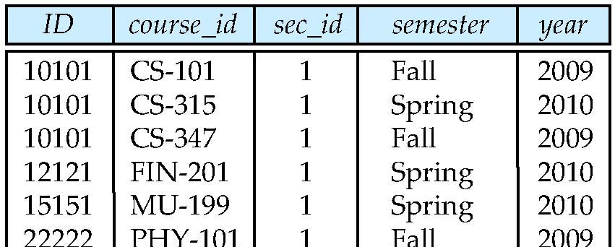
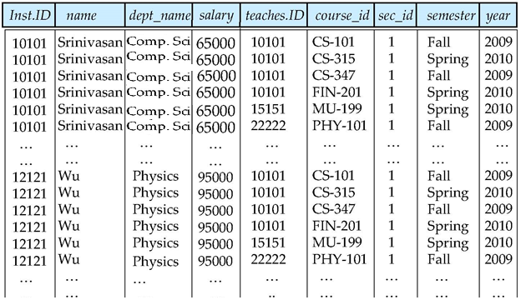
Cartesian Product
instructor
teaches

Slide 27
Joins
For all instructors who have taught some course, find their names and the course ID of the courses they taught.
select name, course_id
from instructor, teaches
where instructor.ID = teaches.ID
Find the course ID, semester, year and title of each course offered by the Comp. Sci. department
select section.course_id, semester, year, title
from section, course
where section.course_id = course.course_id and
dept_name = ‘Comp. Sci.'

Slide 28
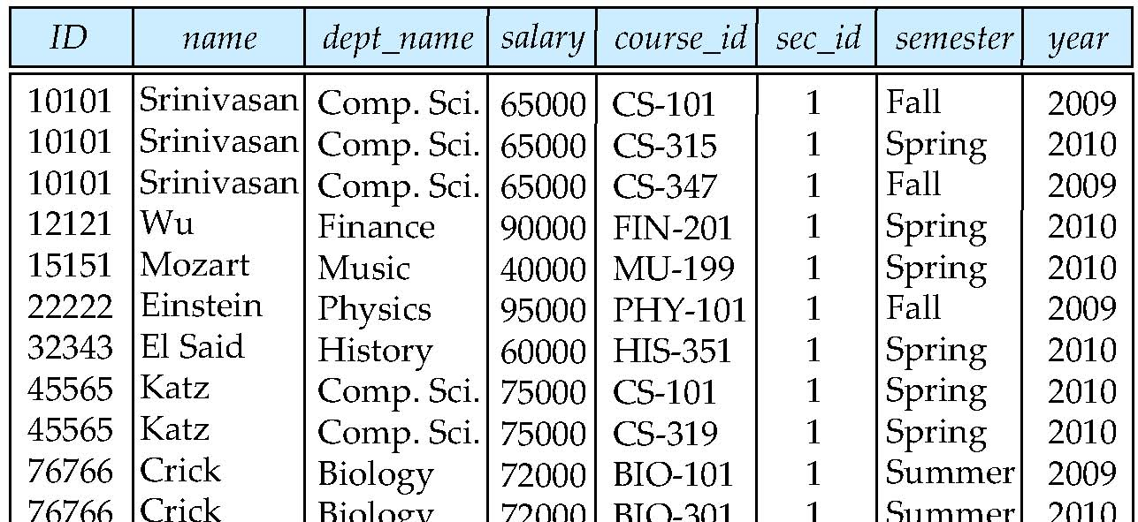
Natural Join
Natural join matches tuples with the same values for all common attributes, and retains only one copy of each common column
select *
from instructor natural join teaches;

Slide 29
Natural Join (Cont.)
Danger in natural join: beware of unrelated attributes with same name which get equated incorrectly
List the names of instructors along with the the titles of courses that they teach
Incorrect version (equates course.dept_name with instructor.dept_name)
  select name, title
  from instructor natural join teaches natural join course;
Correct version
  select name, title
  from instructor natural join teaches, course
  where teaches.course_id= course.course_id;
Another correct version
  select name, title
  from (instructor natural join teaches) join course using(course_id);

Slide 30
The Rename Operation
The SQL allows renaming relations and attributes using the as clause:
old-name as new-name
E.g.
  select ID, name, salary/12 as monthly_salary
  from instructor
Find the names of all instructors who have a higher salary than
some instructor in ‘Comp. Sci’.
  select distinct T. name
  from instructor as T, instructor as S
  where T.salary > S.salary and S.dept_name = ‘Comp. Sci.’
Keyword as is optional and may be omitted
instructor as T ≡ instructor T
Notes:
9

Slide 31
Set Operations
Find courses that ran in Fall 2009 or in Spring 2010
(select course_id from section where sem = ‘Fall’ and year = 2009)
union
(select course_id from section where sem = ‘Spring’ and year = 2010)
Find courses that ran in Fall 2009 and in Spring 2010
(select course_id from section where sem = ‘Fall’ and year = 2009)
intersect
(select course_id from section where sem = ‘Spring’ and year = 2010)
Find courses that ran in Fall 2009 but not in Spring 2010
(select course_id from section where sem = ‘Fall’ and year = 2009)
except
(select course_id from section where sem = ‘Spring’ and year = 2010)

Slide 32
Set Operations
Set operations union, intersect, and except
  Each of the above operations automatically eliminates duplicates
To retain all duplicates use the corresponding multiset versions union all, intersect all and except all.
Suppose a tuple occurs m times in r and n times in s, then, it occurs:
  m + n times in r union all s
  min(m,n) times in r intersect all s
  max(0, m – n) times in r except all s

Slide 33
Null Values
It is possible for tuples to have a null value, denoted by null, for some of their attributes
null signifies an unknown value or that a value does not exist.
The result of any arithmetic expression involving null is null
  Example: 5 + null returns null
The predicate is null can be used to check for null values.
  Example: Find all instructors whose salary is null.
select name
from instructor
where salary is null

Slide 34
Null Values and Three Valued Logic
Any comparison with null returns unknown
  Example: 5 < null or null <> null or null = null
Three-valued logic using the truth value unknown:
  OR: (unknown or true) = true,
  (unknown or false) = unknown
  (unknown or unknown) = unknown
  AND: (true and unknown) = unknown,
  (false and unknown) = false,
  (unknown and unknown) = unknown
  NOT: (not unknown) = unknown
  “P is unknown” evaluates to true if predicate P evaluates to unknown
Result of where clause predicate is treated as false if it evaluates to unknown

Slide 35
Nested Subqueries
SQL provides a mechanism for the nesting of subqueries.
A subquery is a select-from-where expression that is nested within another query.
A common use of subqueries is to perform tests for set membership, set comparisons, and set cardinality.

Slide 36
Example Query
Find courses offered in Fall 2009 and in Spring 2010
select distinct course_id
from section
where semester = ’Fall’ and year= 2009 and
course_id in (select course_id
from section
where semester = ’Spring’ and year= 2010);
Find courses offered in Fall 2009 but not in Spring 2010
select distinct course_id
from section
where semester = ’Fall’ and year= 2009 and
course_id not in (select course_id
from section
where semester = ’Spring’ and year= 2010);

Slide 37
Example Query
Find the total number of (distinct) studentswho have taken course sections taught by the instructor with ID 10101
select count (distinct ID)
from takes
where (course_id, sec_id, semester, year) in
(select course_id, sec_id, semester, year
from teaches
where teaches.ID= 10101);
Note: Above query can be written in a much simpler manner. The
formulation above is simply to illustrate SQL features.

Slide 38
Aggregate Functions
These functions operate on the multiset of values of a column of a relation, and return a value
avg: average value
min: minimum value
max: maximum value
sum: sum of values
count: number of values

Slide 39
Aggregate Functions (Cont.)
Find the average salary of instructors in the Computer Science department
  select avg (salary)
  from instructor
  where dept_name= ’Comp. Sci.’;
Find the total number of instructors who teach a course in the Spring 2010 semester
  select count (distinct ID)
  from teaches
  where semester = ’Spring’ and year = 2010
Find the number of tuples in the course relation
  select count (*)
  from course;

Slide 40
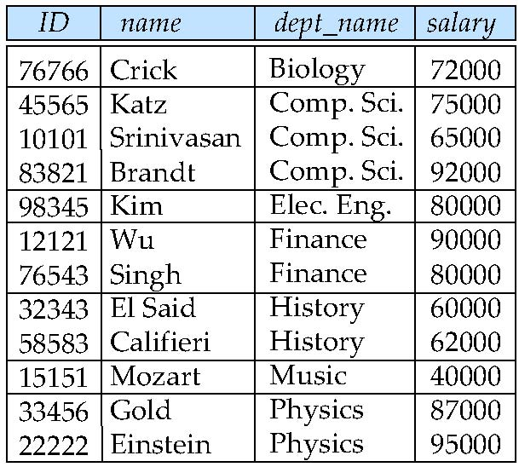
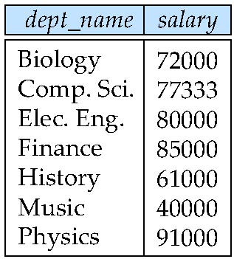
Aggregate Functions – Group By
Find the average salary of instructors in each department
  select dept_name, avg (salary)
  from instructor
  group by dept_name;
avg_salary

Slide 41
Aggregation (Cont.)
Attributes in select clause outside of aggregate functions must appear in group by list
  /* erroneous query */
  select dept_name, ID, avg (salary)
  from instructor
  group by dept_name;

Slide 42
Aggregate Functions – Having Clause
Find the names and average salaries of all departments whose average salary is greater than 42000
select dept_name, avg (salary)
from instructor
group by dept_name
having avg (salary) > 42000;
Note: predicates in the having clause are applied after the
formation of groups whereas predicates in the where
clause are applied before forming groups

Slide 43
Null Values and Aggregates
Total all salaries
select sum (salary )
from instructor
  Above statement ignores null amounts
  Result is null if there is no non-null amount
All aggregate operations except count(*) ignore tuples with null values on the aggregated attributes
What if collection has only null values?
  count returns 0
  all other aggregates return null

Slide 44
Set Comparison
Find names of instructors with salary greater than that of some (at least one) instructor in the Biology department.
select distinct T.name
from instructor as T, instructor as S
where T.salary > S.salary and S.dept name = ’Biology’;
Same query using > some clause
select name
from instructor
where salary > some (select salary
from instructor
where dept name = ’Biology’);

Slide 45
Modification of the Database – Deletion
Delete all instructors
delete from instructor
Delete all instructors from the Finance department
delete from instructor
where dept_name= ’Finance’;
Delete all tuples in the instructor relation for those instructors associated with a department located in the Watson building.
delete from instructor
where dept name in (select dept name
from department
where building = ’Watson’);

Slide 46
Example Query
Delete all instructors whose salary is less than the average salary of instructors
delete from instructor
where salary< (select avg (salary) from instructor);
  Problem: as we delete tuples from deposit, the average salary changes
  Solution used in SQL:
  1. First, compute avg salary and find all tuples to delete
  2. Next, delete all tuples found above (without recomputing avg or
  retesting the tuples)

Slide 47
Modification of the Database – Insertion
Add a new tuple to course
insert into course
values (’CS-437’, ’Database Systems’, ’Comp. Sci.’, 4);
or equivalently
insert into course (course_id, title, dept_name, credits)
values (’CS-437’, ’Database Systems’, ’Comp. Sci.’, 4);
Add a new tuple to student with tot_creds set to null
insert into student
values (’3003’, ’Green’, ’Finance’, null);

Slide 48
Modification of the Database – Insertion
Add all instructors to the student relation with tot_creds set to 0
insert into student
select ID, name, dept_name, 0
from instructor
The select from where statement is evaluated fully before any of its results are inserted into the relation (otherwise queries like
insert into table1 select * from table1
would cause problems)

Slide 49
Modification of the Database – Updates
Increase salaries of instructors whose salary is over $100,000 by 3%, and all others receive a 5% raise
  Write two update statements:
  update instructor
  set salary = salary * 1.03
  where salary > 100000;
  update instructor
  set salary = salary * 1.05
  where salary <= 100000;
  The order is important
  Can be done better using the case statement (next slide)

