Slide 1
Threads
LAB 3

Slide 2
Thread Concepts
A program may consist of many tasks that can run concurrently.
A thread is the flow of execution, from beginning to end of a task. A thread provides the mechanism for running a task.
A thread is an entity that executes by relying on the code and resources, holding by the associated process.
Several threads could be associated with a single process. Those threads share the code and resources of the process.
Multithreading allows an application to have multiple threads of execution running concurrently.

Slide 3
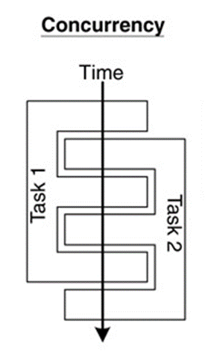
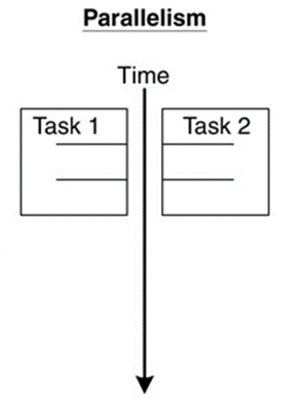
Concurrency and Parallelism
Concurrent multithreading systems give the appearance of several tasks executing at once, but these tasks are actually split up into chunks that share the processor with chunks from other tasks.
In parallel systems, two tasks are actually performed simultaneously. Parallelism requires a multi-core CPU system.

Slide 4
Thread States
A thread can be in one of five states: New, Ready, Running, Blocked, or Finished.

Slide 5
Daemon Versus Non-Daemon Threads
There are two types of threads in Java:
■ Daemon threads
■ Non-daemon (user) threads
Daemon threads are low priority threads which always run in background.
User threads are high priority threads which always run in foreground.
A non-daemon thread continues to live even when the parent thread dies.
JVM will force daemon thread to terminate if all user threads have finished their execution.
Every Java application has at least one non-daemon thread, which is the main thread.
Examples of daemon threads in Java include garbage collection (gc) and finalizer. These threads work silently in the background, performing tasks that support the main execution without interfering with the user’s operations.
A daemon thread can be set via the setDaemon(boolean on) method.

Slide 6

Creating Threads
Java implements thread functionality by using the following classes/interfaces:
■ The interface Runnable
■ The class Thread
■ The class ThreadGroup
To create threads in your Java program, you need to implement the Runnable interface in your
Java class. As a part of the interface implementation, you provide the implementation of the run method. In the run method, you program the desired functionality for your thread:
class Task1Thread implements Runnable {
public void run()
{ ... }
}
After creating this thread class, you need to create its instance of the Thread class and pass an object of the preceding class as a parameter to the Thread class constructor.
Thread t = new Thread(new Task1Thread());

Slide 7
Alternatively, you can create a thread by subclassing the Thread class:
class WorkerThread extends Thread {
public void run() {
...
}
}
In this case, you are overriding the run method to implement your own desired functionality. Once your thread class is created, some other thread will need to instantiate it and invoke its start method.
Thread t = new WorkerThread();
t.start();
When you start the thread, this does not mean it gets the CPU immediately. Rather, it is put in the Ready to Run queue where eventually it will receive a CPU time slice for execution.

Slide 8
Synchronization
Background
Concurrent access to shared data may result in data inconsistency.
Maintaining data consistency requires mechanisms for orderly execution of cooperating processes (or threads).
When do we need synchronization?
When two or more processes (or threads) work on the same data simultaneously.
  Example:
  Two threads are trying to update the same shared variable simultaneously:
    The result is unpredictable.
    The result depends on which of the two threads was the last one to change the value.
    The competition of the threads for the variable is called race condition.

Slide 9
Synchronization of Java Threads
In many cases concurrently running threads share data and must consider the state and activities of other threads.
If two threads can both execute a method that modifies the state of an object then the method should be declared to be synchronized, those allowing only one thread to execute the method at a time.
If a class has at least one synchronized method, each instance of it has a monitor. A monitor is an object that can block threads and notify them when the method is available.
Example:
public synchronized void updateRecord() {
//**** critical code goes here …
}
Only one thread may be inside the body of this function.
A second call will be blocked until the first call returns or wait() is called inside the synchronized method.
To program the synchronization behavior we use the Object class’ methods wait(), notify() and notifyAll().
InterruptedException is thrown when a thread is waiting, sleeping, or otherwise paused for a long time and another thread interrupts it using the interrupt method in class Thread.

