Slide 1


Cleanup: Mobile App Connecting Providers with Customers of Cleaning Services
Supervised by: Dr. Ahmad Kobiessi
Committee: Dr. Hadi Noureddine
1

Slide 2
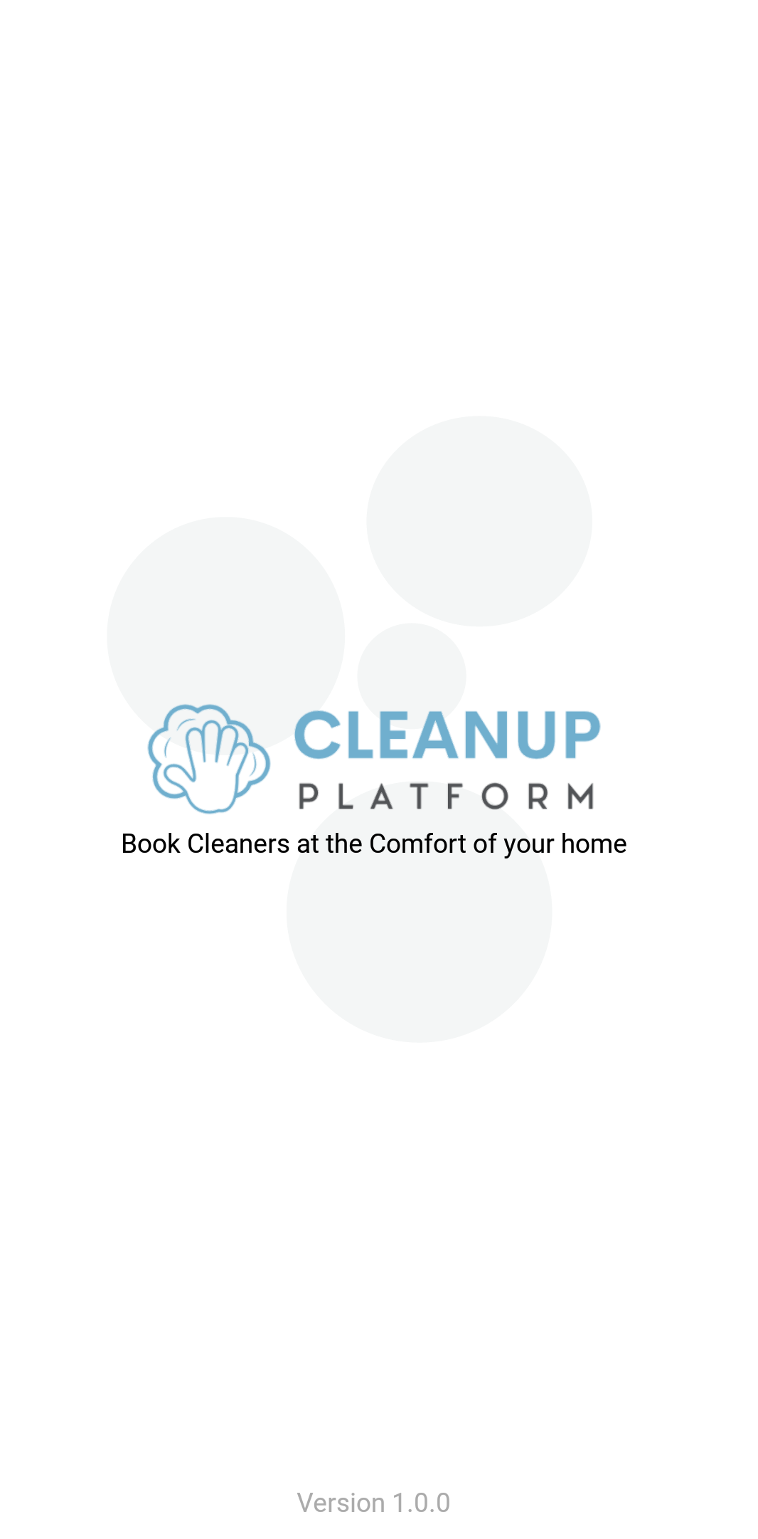
Introduction
2

Slide 3
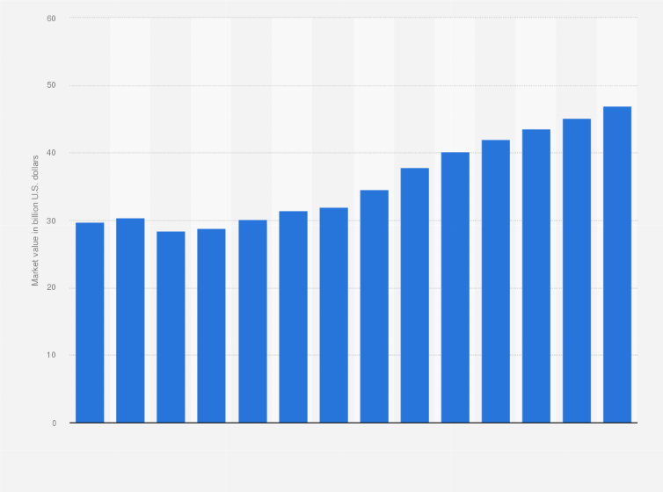
Background
The cleaning industry is to reach market value $46.9 billion by 2026 .
2020
2023
2026
2029
Market Value In Billion $S
3
Notes:
Reference:Read more at: https://thrivemyway.com/cleaning-industry-statistics/

Slide 4

Motivation
We believe everyone deserves a clean and organized space, effortlessly. Cleanup is here to revolutionize the cleaning service industry and make it easier than ever to find reliable and eco-friendly professional cleaners
Cleanup is a mobile Android platform designed to connect individuals with professional cleaners.
4

Slide 5



Posed Problem
Non-Professional Cleaners
Lack of eco-friendly awarness
Absence of Payment Transparency
5

Slide 6



Similar Systems
Handy
Tidy
TaskRabbit
Good UI
Security Measurement
Responsive
Provide several home services
Good UI
Accessible content
Usability
Provide several home services
Quality content structure
Easy and effective navigation
Usability
6

Slide 7






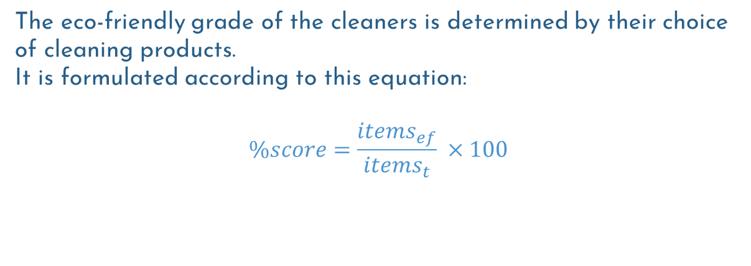
Special Feature: Eco-Friendly Rating
The eco-friendly grade of the cleaners is determined by their choice of cleaning products.
It is formulated according to this equation:
$$\%score=\frac{items_{ef}}{items_{t}} ×100$$
A: (100%) B: (90-99%) C: (80-89%) D: (70-79%) E: (60-69%) F: (0-59%).
7

Slide 8
System Design
8

Slide 9
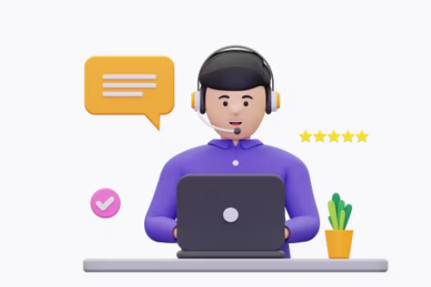
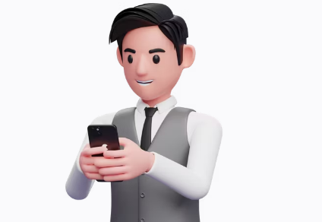

Users Types
Admin
Application Management
Customers
Service Seeker
Cleaners
companies/individuals
Service Providers
9

Slide 10




Implementation Tools
FIGMA
XAMPP
NOTEPAD++
ANDROID
STUDIO
MYSQL
For database management
PHP
Server-Side
JAVA Software development
XML
UI design
UI/UX Design
10

Slide 11
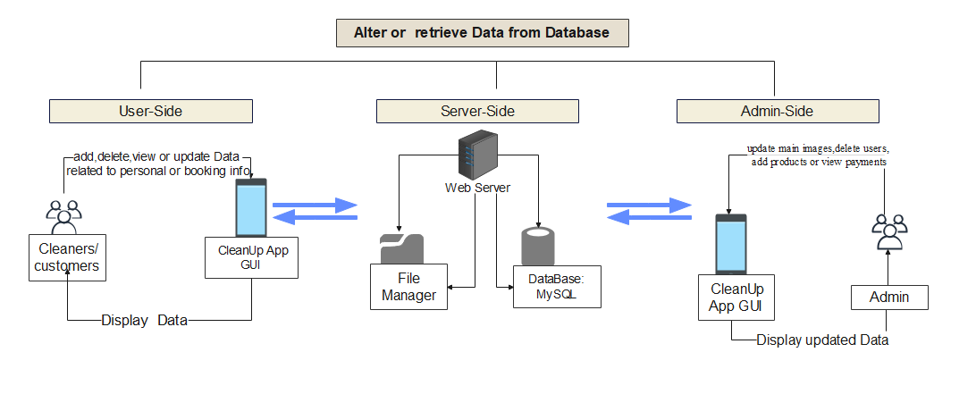
System Architecture
11

Slide 12
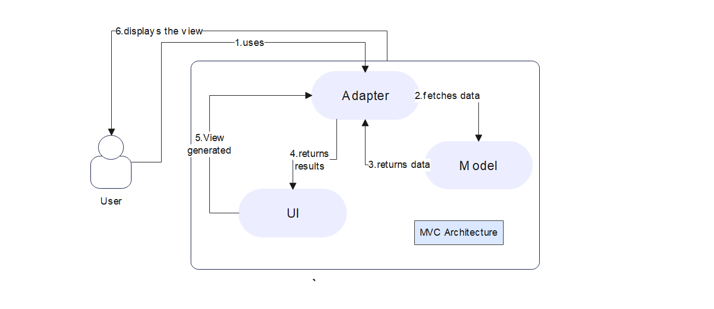
MVC Architecture
12

Slide 13
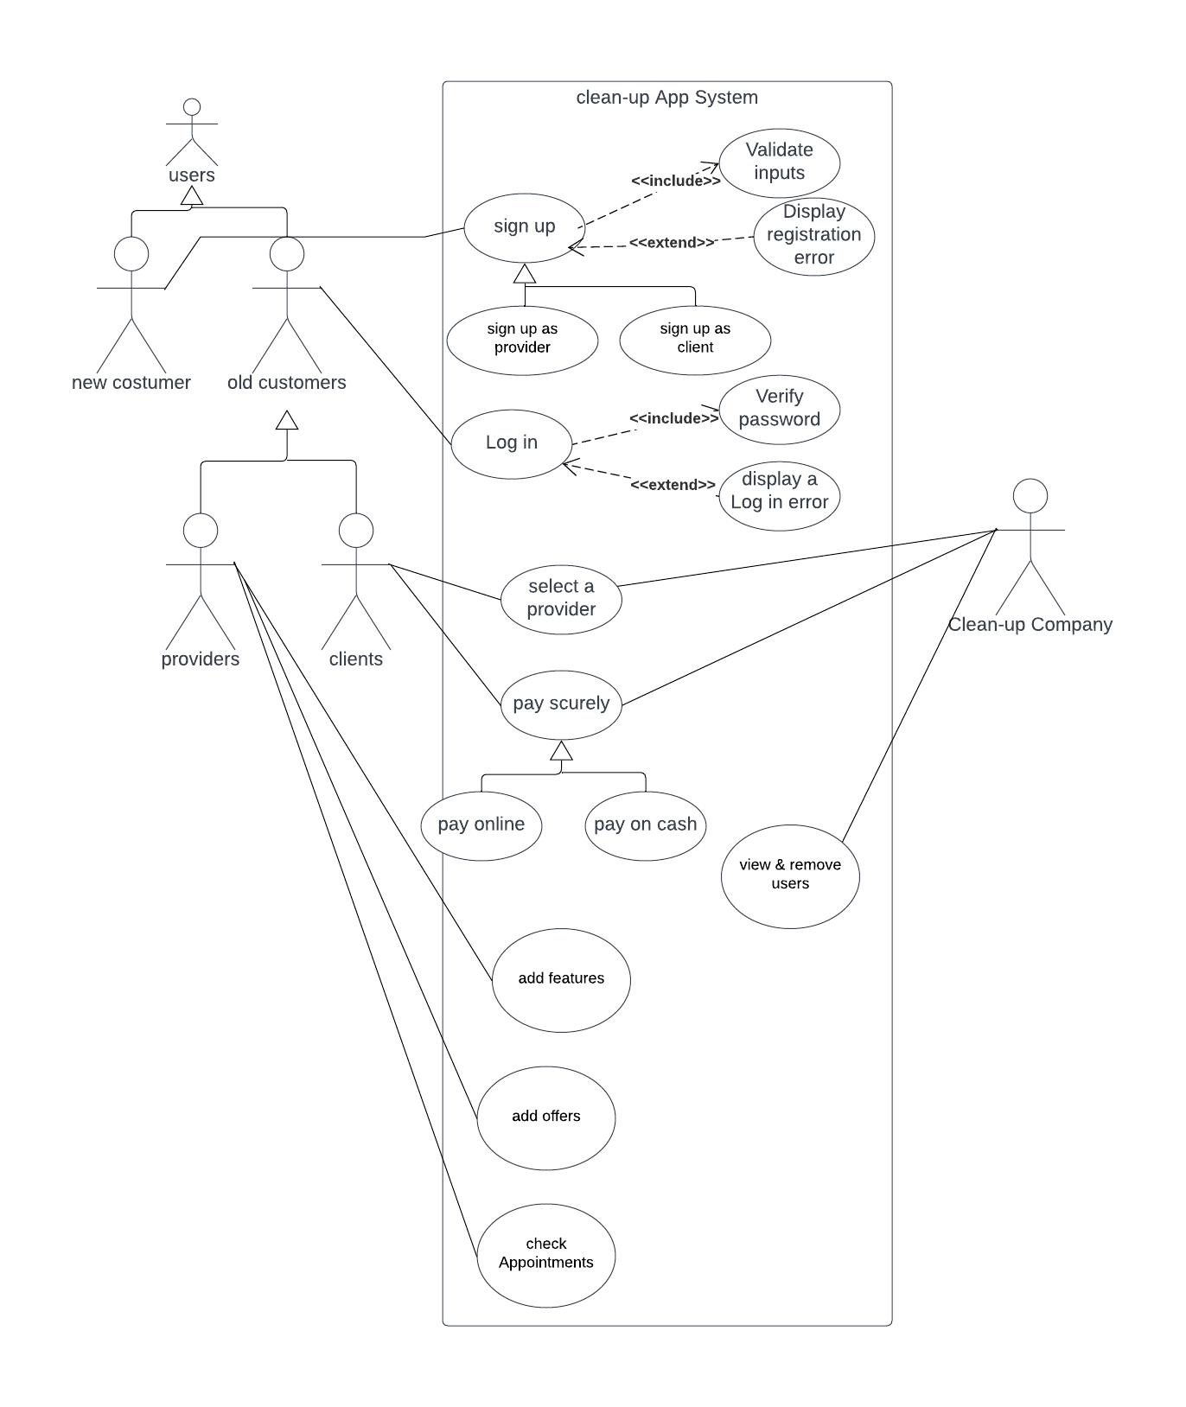







Login Use Case
13

Slide 14
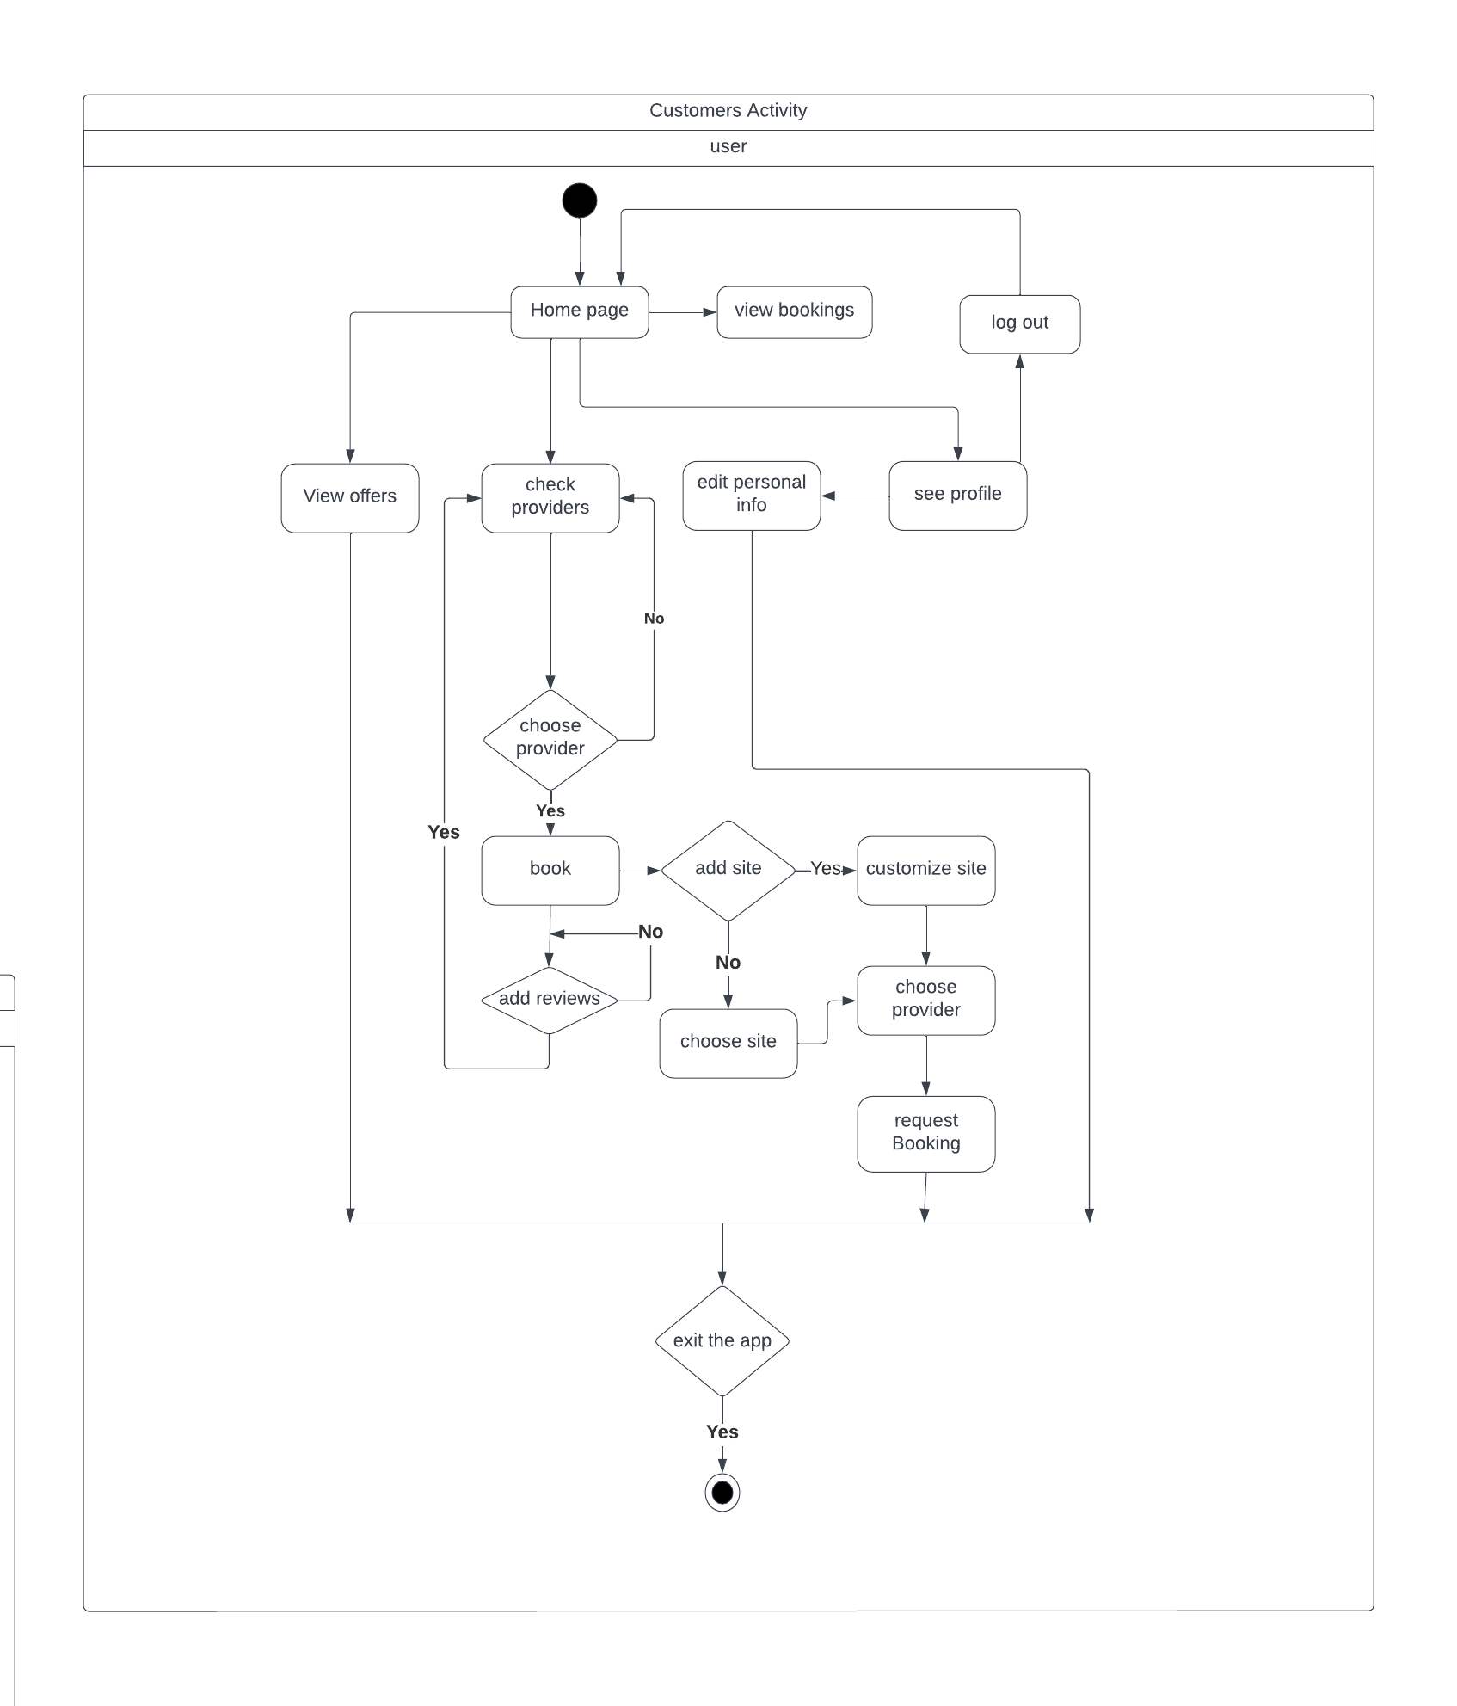
Customer Activity Diagram
14

Slide 15
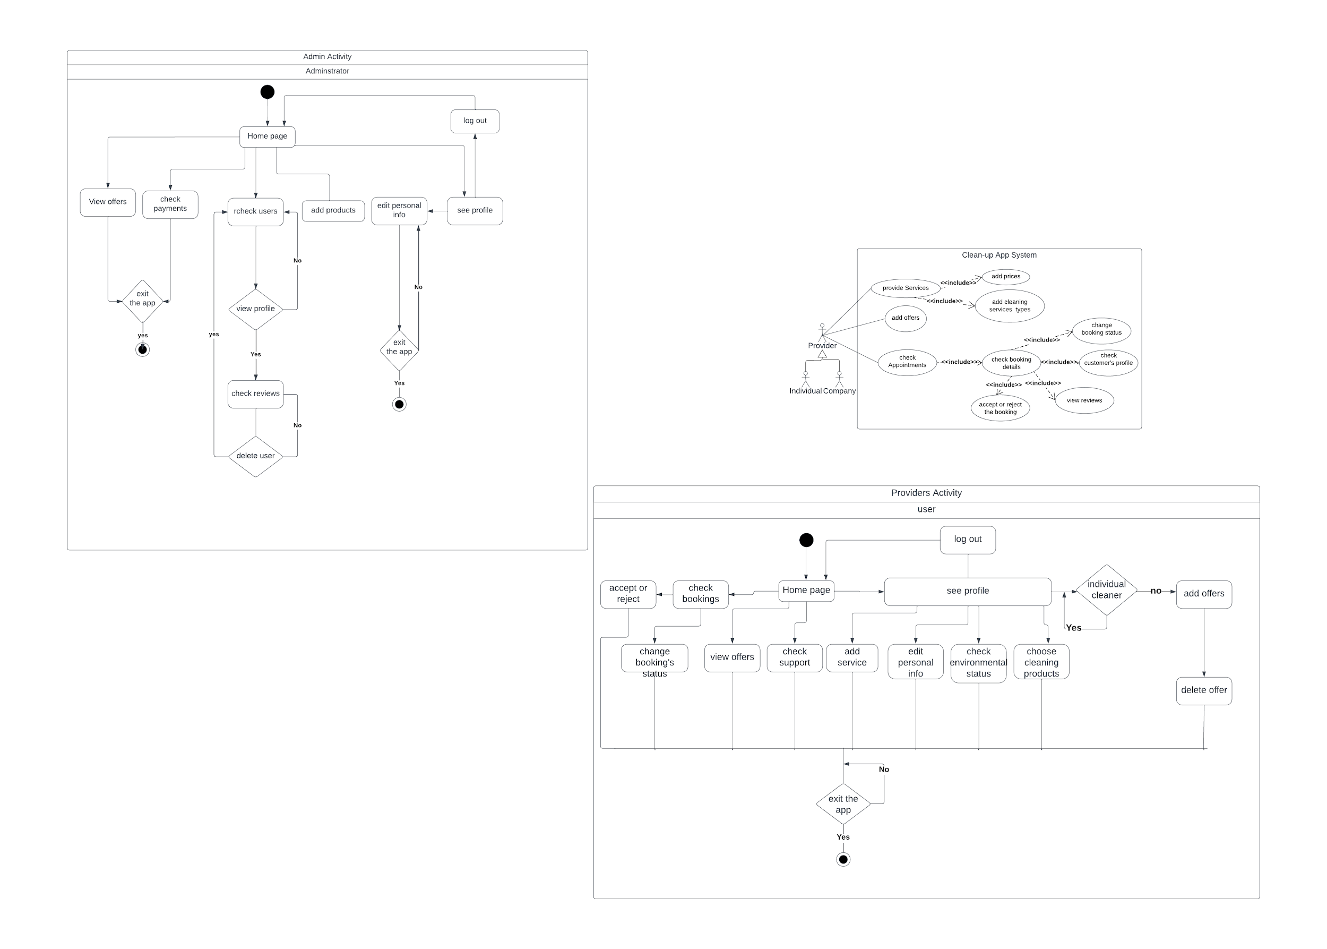
Providers Activity Diagram
15

Slide 16
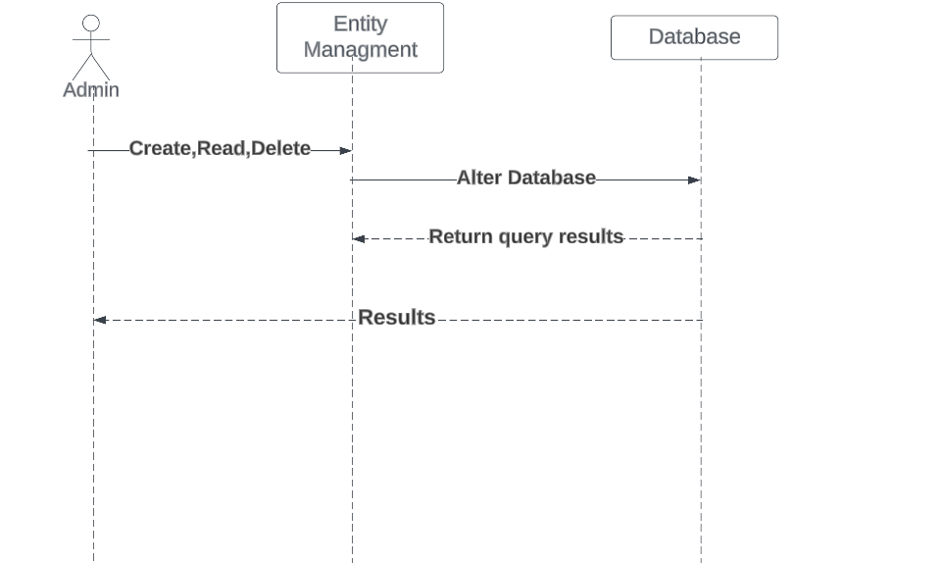
Admin Sequence Diagram
16

Slide 17
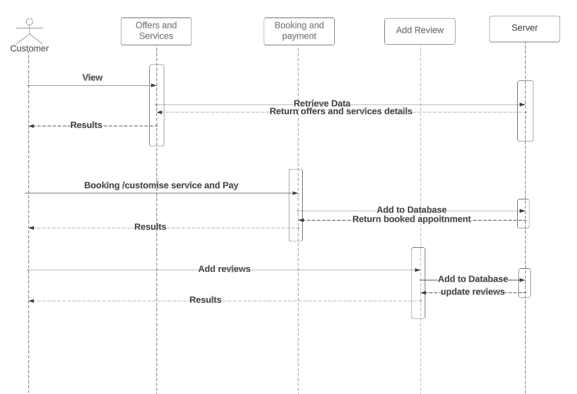
Customer Sequence Diagram
17

Slide 18
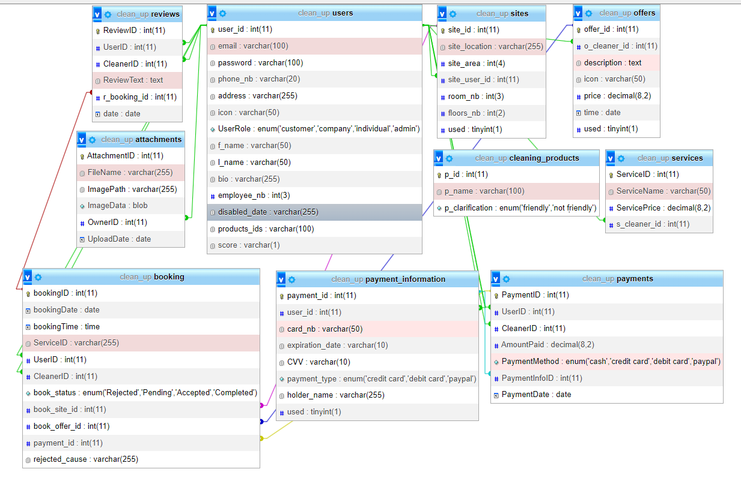
ER-Diagram
18

Slide 19




Future Work
01
03
Eco-friendly
Products Shop
Job
Opportunities
With Cleaning Companies
02
04
Customer-Provider Chat
Real Time
Tracking
19

Slide 20
Demo &Questions Time
Thank You
Ayah Mhanna 72030050@students.liu.edu.lb
Batoul Slaiman72030543@students.liu.edu.lb
20

