Slide 1
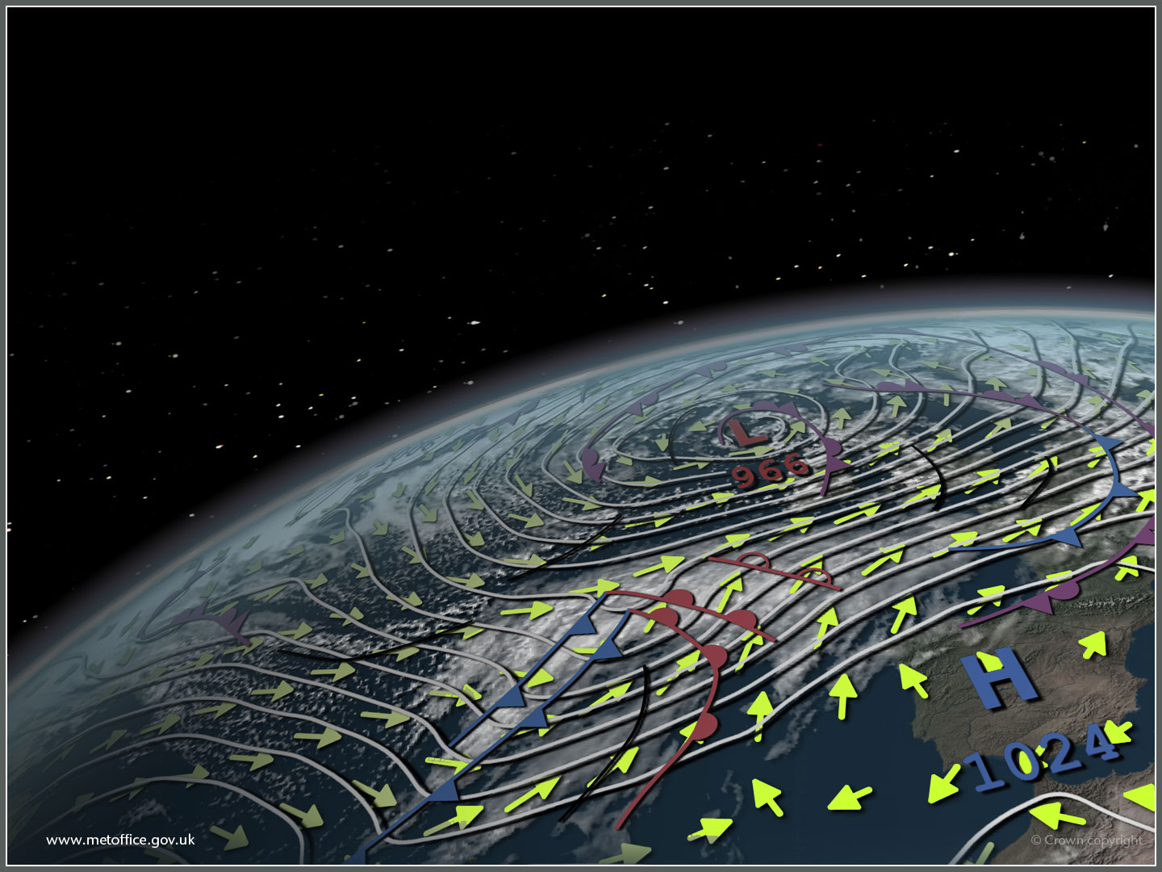
The use of satellite data in the Met Office for NWP and other forecasting applications
Crispian Batstone
12 Nov 2015

Slide 2
Acknowledgements & Partners
Met office
Isabella Ascione, Nigel Atkinson, Bill Bell, Thomas Blackmore, Anna Booton, Fabien Carminati, Mike Cooke, John Eyre, Emma Fiedler, Mary Forsythe, Pete Francis, Graeme Kelly, James Hocking, Simon Keogh, Katie Lean, Stuart Newman, Roger Saunders, Andy Smith, Ruth Taylor
Partners
Europe: ESA, EUMETSAT members, ECMWF, UK Space, Universities
USA: NASA, NOAA
Asia: BoM, CMA, JAXA, JMA, KMA
Unified Model development: KMA, CAWCR, BoM, NIWA

Slide 3
Outline
Operational NWP models
Satellite observations assimilated
Experiments with AMSR-2
Plans for Himawari-8
Other activities (FY-2 / FY-3 / Meteor-M N2)
Future challenges

Slide 4
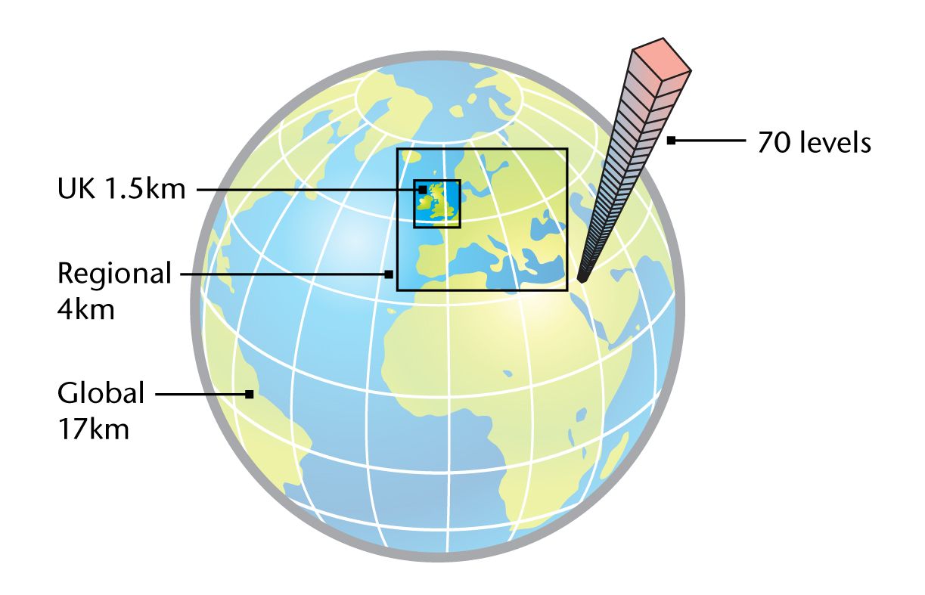
2015 NWP Models Seamless Suite
UKV and MOGREPS-UK
1.5km 70L (40km model top)
36hr forecast
8 times per day
12-member Ensemble - 2.2km 4x/day 36h
Euro4
4km 70L (40km model top)
66hr forecast twice/day
144hr forecast twice/day
Global and MOGREPS-G
17km 70L (80km model top)
66hr forecast twice/day
144hr forecast twice/day
12-member Ensemble - 33km 4x/day 7d
24-member Ensemble - 60km 2x/day 15d
Seasonal: GloSea5
60km 85L (80km model top)
¼ degree Ocean
14-member Ensemble
7month forecast once/week

Slide 5
Satellite data used in NWP (1)
Observation type | Satellites | NWP models *
AMSU/MHS radiances | 4 NOAA + 2 Metop | G, R
HIRS clear radiances | 2 Metop | G, R
IASI and AIRS clear+cloudy radiances | Metop + Aqua | G, R
ATMS & CrIS radiances | Suomi NPP | G
SSMIS radiances | F16 used before failure, preparing F17/18 | G, R
Geo imager clear IR radiances | MSG, MFG, GOES, MTSAT2 | G, R, UK
GPS RO bending angles | 5 COSMIC, Metop/GRAS, GRACE-A, TerraSAR-X, CNOFS | G, R
GPS ZTDs | ~350 European stations | G, R, UK
* G = Global, R = Regional = Europe, UK = UK area

Slide 6
Satellite data used in NWP (2)
Observation type | Satellites | NWP models *
AMVs - Geo | 5 geo satellites | G, R, UK
AMVs – MODIS and AVHRR | Aqua, Terra, NOAA, Metop | G, R
Scatterometers: sea-surface winds | Metop/ASCAT | G, R, UK
MW imager sea-surface winds | Windsat/Coriolis | G
SEVIRI cloud height/amount | MSG | R, UK
SSTs: AVHRR, AMSR-E… | NOAA, Metop, Aqua | G, R, UK
Soil moisture: ASCAT | Metop | G, R, UK
Sea ice: SSM/I, SSMIS | DMSP | G, R
Snow cover | various | G, R
* G = Global, R = Regional = Europe, UK = UK area

Slide 7
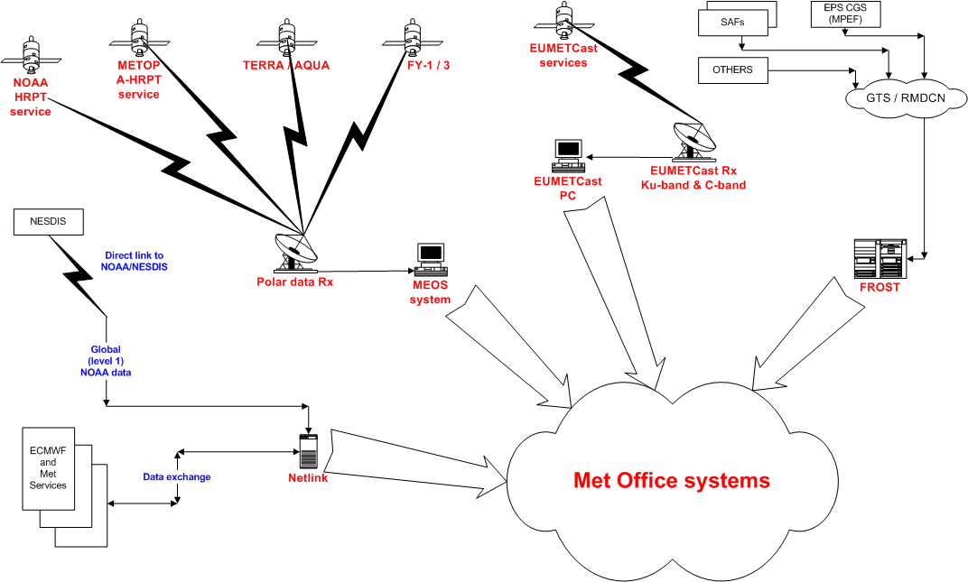
How we get the data
Washington
EUMETCast
RMDCN
Local reception
Global Networks
Global US data

Slide 8
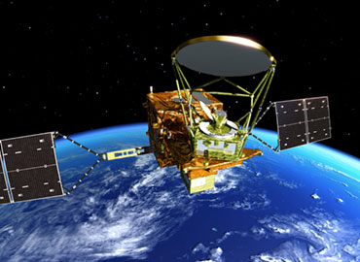
AMSR-2 in DA for Global Model
Assimilation of radiances for atmospheric global model
VISION:
“To utilize a constellation of AM and PM orbit microwave imagers in our satellite DA system”
GOALS:
To utilize AMSR-2 as the primary PM orbit imager
To utilize SSMIS as the primary AM orbit imager

Slide 9
AMSR-2 in DA for Global Model
May 2012: Launch of GCOM-W1 satellite
May 2013: L1B Test Data Available
Feb 2014: Trial service available on EUMETCast
Mar 2014: Met Office begins receipt and storage of data
May 2014: Data storage and retrieval fully operational
Jun 2015: Global NWP assimilation trials of AMSR-2 data
Nov 2015: Expected pre-operations parallel suite 37 start date
Feb 2016: Expected “go live” of AMSR-2 in NWP operations

Slide 10
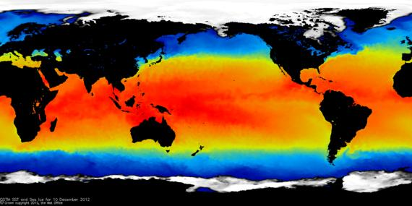
AMSR-2 in OSTIA
Operational Sea Surface Temperature and Sea Ice Analysis
Daily analysis, 1/20º grid resolution
Globally complete, gridded
Validates well compared to other analyses using independent near-surface Argo observations

Slide 11
AMSR-2 in OSTIA
Data types currently assimilated in OSTIA:
NOAA-18 & 19 & MetOp-A AVHRR
SEVIRI
GOES
In situ (ships, drifters, moored buoys)
Trial JAXA AMSR2 L2P v2.1:
For a test month of March 2015, a control run and a run assimilating AMSR2 SST observations was conducted.

Slide 12
AMSR-2 in OSTIA: Results
Biases and RMS errors in the high latitudes are large.
Likely related to microwave insensitivity at low SSTs for certain channels.
Comparison run using AMSR2 SST observations produced by RSS (Remote Sensing Systems)
RSS and JAXA AMSR2 biases compared to OSTIA are quite similar. Both have large RMS errors in the high latitudes, but RSS is smaller.
Ideally use JAXA AMSR2: RSS do not provide an operational service
AMSR-2 SST trial in Forecast Ocean Assimilation Model (FOAM)

Slide 13

Himawari 8 plans
11 channels @ 2km, every 30 minutes via EUMETCast (MSG SEVIRI-like)
October 2015: switch operational imagery from MTSAT2 (single channel / Volcanic Ash), new imagery (e.g. dust RGB)
Working on cloud mask + products
CSRs / AMVs soon in global model
High resolution locally processed CSRs / AMVs in SingV model
Enhanced VA products
AOD JAXA product

Slide 14
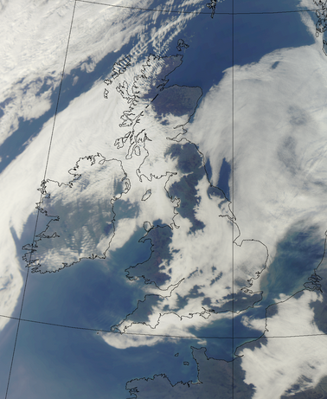
Other activities
FY-2 imagery
FY-3 direct broadcast imagery
Meteor-M N2 MTVZA-GY

Slide 15
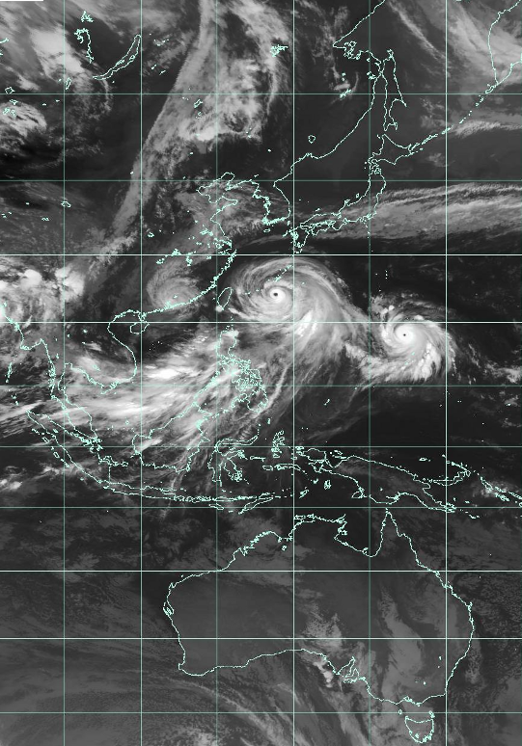
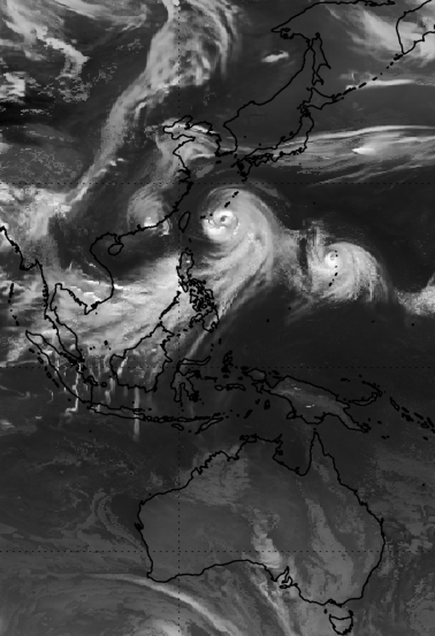
Simulated satellite imagery
9 July 2015 12:00 UTC
MTSAT2
Simulated

Slide 16
Future challenges
GEO
GOES-R + GLM
MTG FCI, LI, IRS
LEO
Sentinel 3
EPS-SG
JPSS 1
GPM GMI
ADM-Aeolus

Slide 17

Thank you for listening!

