Slide 1
Stock Price Prediction
DSCI-6002-01
Intro to Data science Mid Project
Team 11

Slide 2
Our Team
Team -11
Akhil Pingali
Ayyappa Tata
Meghana Bodduluri

Slide 3
Business Question
How can I know whether I have to buy, sell or hold the stock using present day technologies?
How can I know the stock which will give me profit if I invest on it?

Slide 4
Objective
To predict stock market moving which helps in making informed decision to prevent any financial crisis or make a business move.

Slide 5
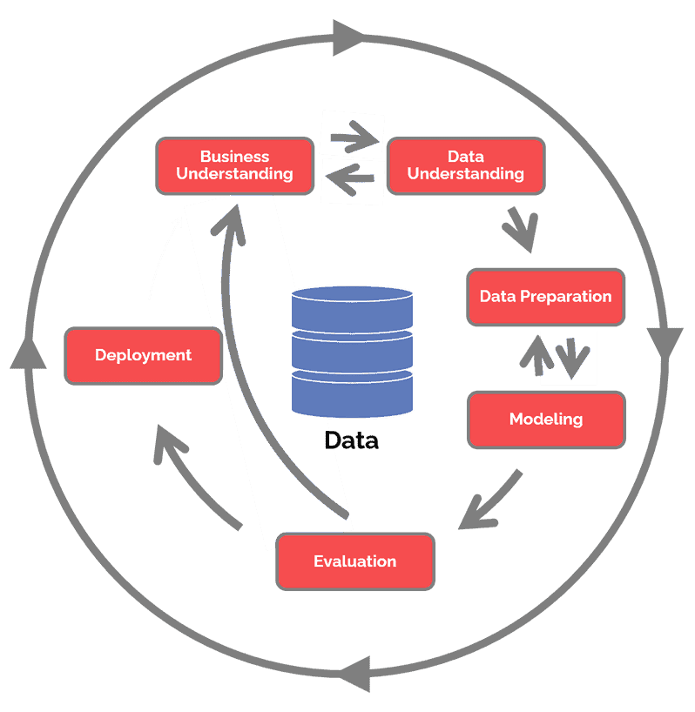
Methodology - Crisp DM

Slide 6
Business Understanding
Problem:Predicting stock market movements is challenging and uncertain.
Significance: Accurate predictions can help client make informed decisions.

Slide 7


Data Understanding
Data Sources: Historical Market DataMention whether the data is sourced from financial markets, news sources, social-media, Weather Data etc.
Data Type: Consists of Numeric Data which is generated based on certain time limit.

Slide 8

Data Preparation
May Include conversion of Data types and filling the Not available values using measures of central tendency.

Slide 9


Modeling
We aim to design or use a Machine Learning Model which works on numeric data well and the loss function will be minimal since the problem comes under time series analysis and the depends on the Data set.

Slide 10
Evaluation
The methodologies which can be used are R2 score, Accuracy, Root Mean Square, F1-precision and recall etc…

Slide 11


Deployment

Slide 12

Links
Can access resources

Slide 13
Thank You

