Slide 1


Internal Logic Analyzer Final presentation-part A
By: Moran Katz and Zvika Pery
Mentor: Moshe Porian
Dual-semester project
Spring 2012

Slide 2
Agenda
Overview
Goals
Requirements
Architecture
Data transfer
Internal Logic Analyzer Core
Registers
Write controller
Read controller
RAM
In out coordinator
Simulations
Problems & solutions
Part B work plan
Schedule

Slide 3
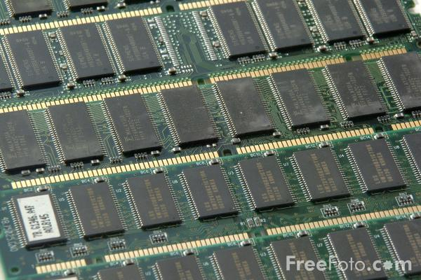
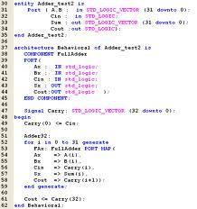
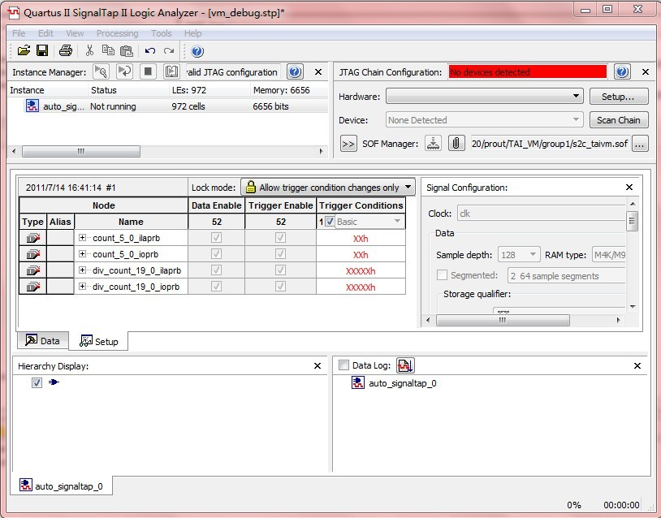
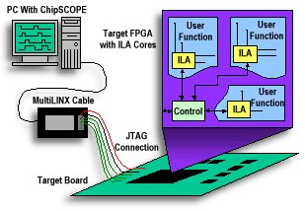
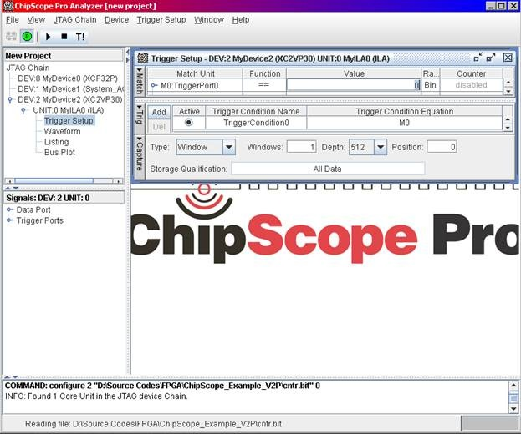
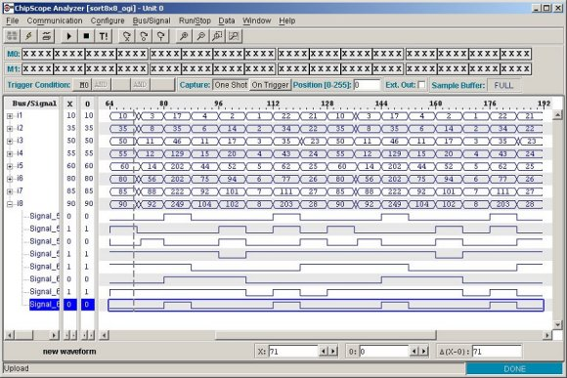
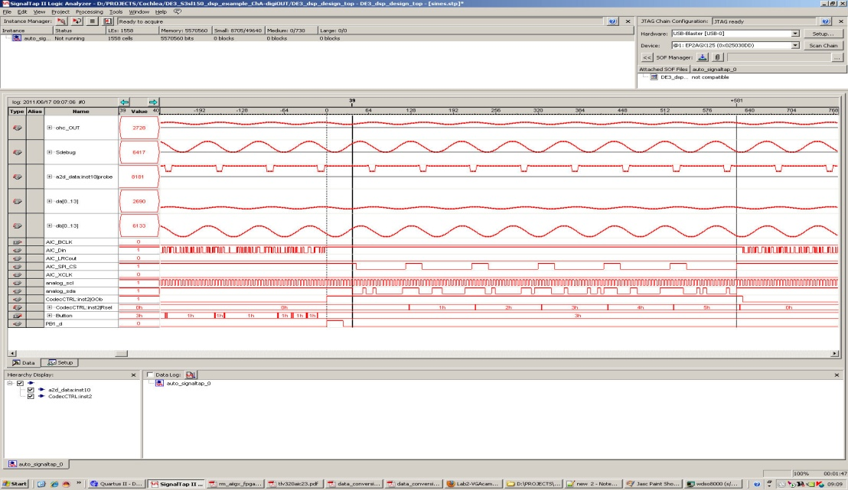
Project Overview
Logic Analyzer- Debugging tool for FPGA
Contains software & hardware
Common Logic Analyzer tools today:
Hardware: Change FPGA code
Memories to store data
Logic to change configuration
Software: Include GUI
Choose trigger, data location, signals name, record results
Altera- Signal Tap
Xilinx- Chip Scope
Notes:
1.יצרניות ה- FPGA-ים מספקות כלי למטרת DEBUG במעבדה, הקרוי Logic Analyzer, המאפשר הקלטה של מידע פנימי ב- FPGA והצגתו למשתמש. הכלי בנוי מחבילת חומרה, וחבילת תוכנה.(תמונה)
2. החלק החומרתי נכנס לקוד של ה- FPGA וכולל זיכרונות לאחסון המידע המוקלט, לוגיקה לשינוי קונפיגורציה (לדוגמא: סוג ה- Trigger, לדוגמא: פעיל בשינוי מ- '0' ל- '1'), לוגיקה לזיהוי נעילה של ה- Trigger הרצוי ולוגיקה לשליחת המידע המוקלט לתוכנה.
3. החלק התוכנתי כולל GUI, המאפשר לבחור את סוג ה- Trigger להקלטה, מיקום ה- Trigger ביחס למידע המוקלט, הצגה נוחה של שמות הסיגנלים המוקלטים והצגה של תוצאות ההקלטה, המגיעות מהחומרה, למשתמש.
4. הכלי של יצרנית ה- FPGA-ים, ALTERA, נקרא SignalTap. הכלי של יצרנית ה- FPGA-ים, XILINX, נקרא ChipScope.

Slide 4
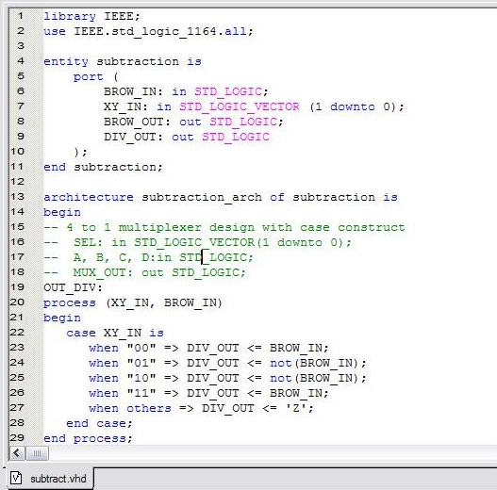

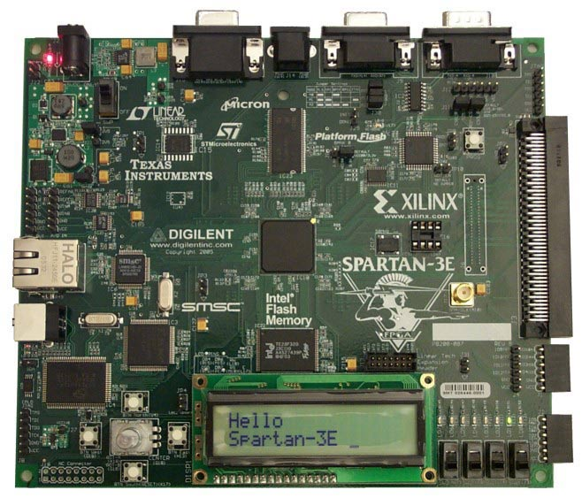
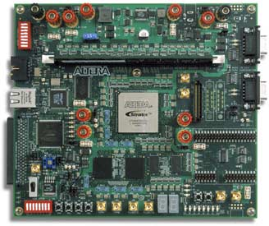
Project goals
Design an internal logic analyzer to the FPGA which will be an independent part
Hardware:
(1) VHDL
(2) Record the chosen signals
(3) Send it back to the user
Software:
(1) GUI- allow to present the recorded information
(2) Send request to change hardware according user’s choise
(3) Build a system to check our implementation
UART IN
RX PATH
Signal
Generator
WBS
XILINX- SPARTAN 3E
ALTERA- CYCLON II
WBM
GUI
Internal
Logic
Analyzer
Core
50 MHZ
100 MHZ
WhishBone
intercon
Clock &
Reset
WBS
Reset
Reset
WBS
UART OUT
TX PATH
WBM
WBM
WBM- Whishbone Master
WBS-Whishbone Slave
FPGA
Altera Cyclone II
Notes:
בניית Logic Analyzer פנימי ל- FPGA, בלתי תלוי ביצרן ה- FPGA. החלק החומרתי יכלול בניית מערכת ב- VHDL, המאפשרת הקלטה של הסיגנלים הרצויים ע"פ קונפיגורציה ושליחת המידע המוקלט חזרה למשתמש. החלק התוכנתי יכלול בניית GUI המאפשר שינוי קונפיגורציה והצגת המידע המוקלט למשתמש. בנוסף, תבנה מערכת תומכת המאפשרת בדיקה של המימוש במעבדה.

Slide 5
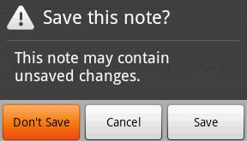

Requirements
Option to choose the parameters
Save the recorded information and present it using waveform
Internal communication is through Wishbone protocol
External communication is through UART protocol
Save and load settings
Duration of recording
position of trigger
Type of trigger, for example ‘rise’
Signals name, which signals to record
30%-70%
50%-50%
70%-30%
Notes:
כלי ה- Logic Analyzer יהיה בעל תכונות המאפשרות:
בחירת סוג ה- Trigger: שינוי מ- '0' ל- '1' (rise), fall, '0', '1'.
בחירת מיקום ה- Trigger ביחס למידע המוקלט (באמצע, בהתחלה, בסוף...).
קביעת כמות הסיגנלים להקלטה.
קביעת עומק ההקלטה (זמן ההקלטה).
שמירת וטעינת settings של פרויקט.
שינוי שמות הסיגנלים המוצגים.
שמירת המידע המוקלט לקובץ והצגתו באמצעות waveform בכלי סימולציה (ב- Modelsim).
שימוש ב- Resources (זכרונות ולוגיקה) בלתי תלויים בסוג ה- FPGA.
אופציונאלי: הגדרת Trigger-ים חכמים, כמו Trigger מקונן (sequence של תנאים), Trigger הכולל השוואות לוגיות (greater than, לדוגמא).
כל הבלוקים ב- FPGA יקושרו ביניהם באמצעות ממשק אחיד – Protocol Wishbone.
הממשק ביו החומרה ל- GUI ולתוכנה יהיה באמצעות פרוטוקול UART.
בניית מערכת תומכת, הכוללת חומרה ותוכנה, המאפשרת הזרקת חבילות מידע, המייצגות סצנות שונות של סיגנלים להקלטה ל- FPGA, קבלת מענה ממנו בנוגע למידע המוקלט והשוואה ביחס למצופה.
הרחבה לגבי פרוטוקולי התקשורת תינתן בהמשך המצגת.

Slide 6
Top Architecture
UART IN
RX PATH
Signal
Generator
WBS
WBM
GUI
Internal
Logic
Analyzer
Core
50 MHZ
100 MHZ
Clock &
Reset
WhishBone
intercon
WBS
Reset
Reset
WBS
UART OUT
TX PATH
WBM
WBM
WBM- Whishbone Master
WBS-Whishbone Slave
FPGA
Altera Cyclone II

Slide 7
Data Transfer
injecting signals behavior
Trigger- first signal
Recording time- 50%
Signal’s number-2
RX PATH
signal
UART IN
Signal
Generator
WBS
signal
signal
WBM
GUI
Internal
Logic
Analyzer
Core
50 MHZ
100 MHZ
Clock &
Reset
WhishBone
intercon
WBS
Reset
Reset
Recorded data
WBS
UART OUT
TX PATH
WBM
WBM
WBM- Whishbone Master
WBS-Whishbone Slave
FPGA
Altera Cyclone II
Notes:
קביעת קונפיגורציות: לדוגמא נבחר כטריגר סיגנל ראשון, עם עומק הקלטה של 50%

Slide 8
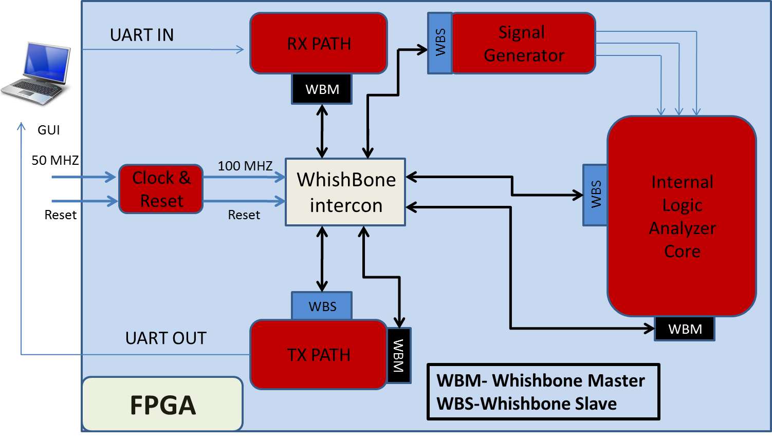
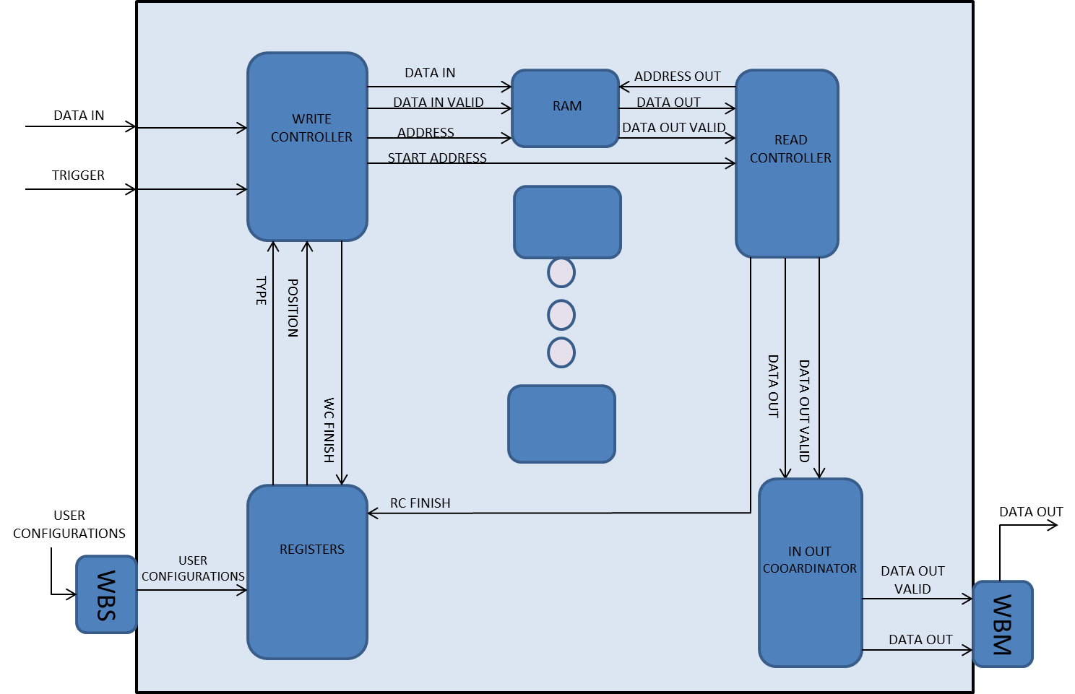
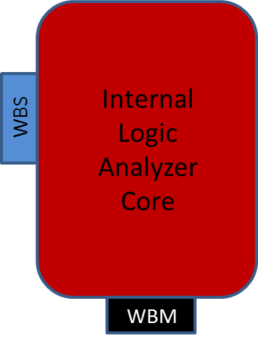
The Core
The core is build from 7 entities:
WBS
Registers
Write Controller
RAM
Read Controller
Data Coordinator
WBM
The core tasks:
Getting and saving user configurations
Getting new data each clock cycle and saving it
Getting new trigger signal each clock cycle and check for trigger rise according user configurations
Outputting relevant data back to user

Slide 9
The Core
Generic table
Description | Name | #
1
0 - Reset active Low, 1- Reset active High
reset_polarity_g
2
enable_polarity_g
0 - Enable active Low, 1- Enable active High
3
signal_ram_depth_g
depth of basic RAM
4
signal_ram_width_g
width of basic RAM
5
record_depth_g
number of bits that is recorded from each signal
6
data_width_g
defines the width of the data lines of the system
7
Add_width_g
width of address word in the RAM (Gets record_depth_g)
8
num_of_signals_g
number of signals that will be recorded simultaneously
9
power2_out_g
RAM output width is multiplied by this power factor
10
power_sign_g
'-1' => RAM output width > input width
'1' => RAM input width > output width
11
type_d_g
Type Depth. type is the WB client which the data is directed to
12
len_d_g
Length of the WB data (in words)

Slide 10

Registers
Saves the user configurations
Sends out the configurations to the WC
configuration
TYPE
POSITION

Slide 11
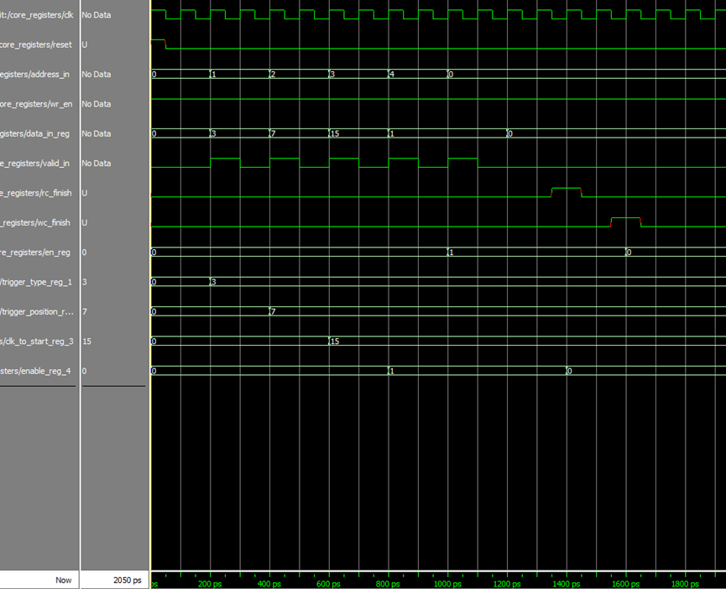
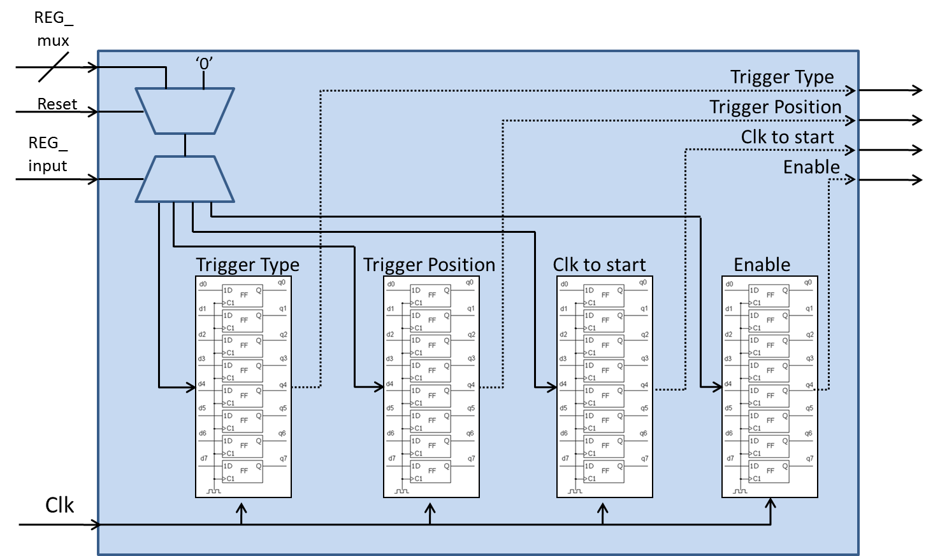
Registers
The inputs are Register’s address and data in
Valid signal rises and data in signal is being sampled to the relevant register according to the address
From now on, the data is available at the output
ADDRESS
DATA IN

Slide 12
Write Controller
Gets the data from the signal generator and saves it in the RAM
Gets the trigger signal and looks for trigger rise according configurations
DATA IN
DATA IN VALID
START ADDRESS
TRIGGER
ADDRESS
TYPE
POSITION

Slide 13
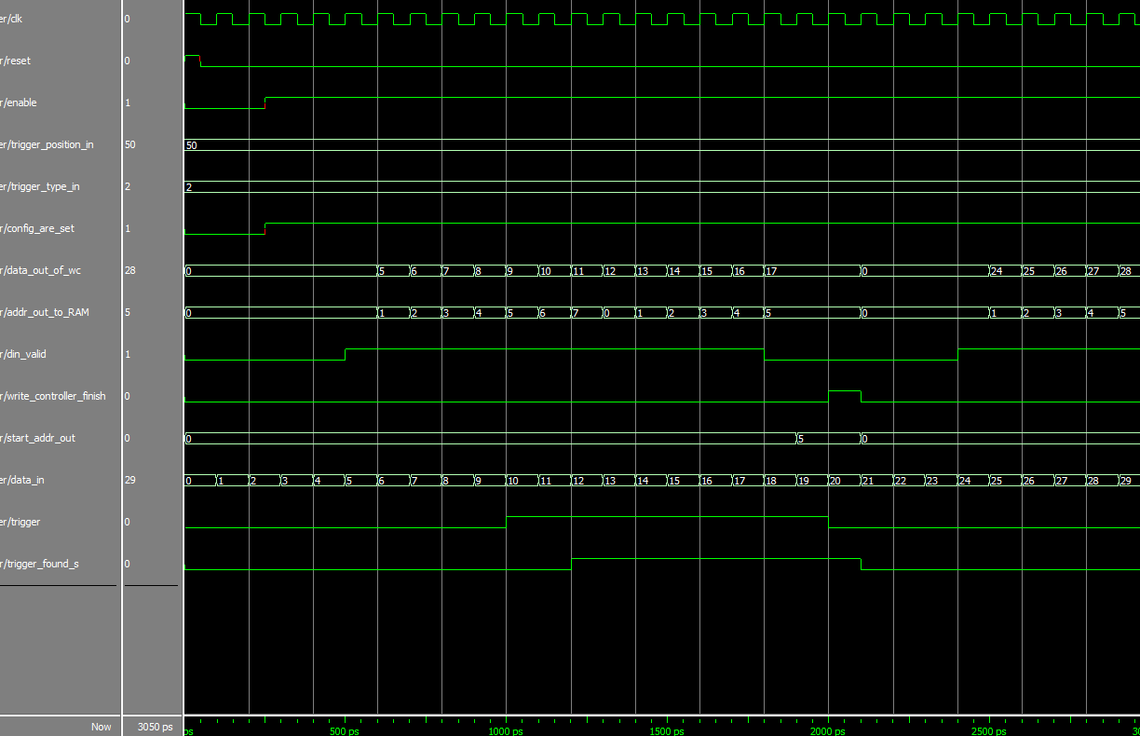
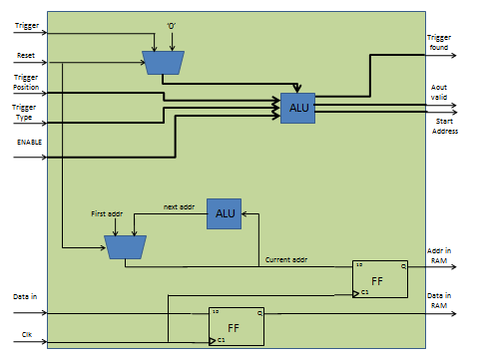
Write Controller
Trigger and data are entering each cycle
Data address and validity are being calculated and are being sent to the RAM
Trigger is compared to the configuration to identify trigger rise
If necessary start address is calculated according to the position and is being sent out
TRIGGER
?
POSITION
TYPE
START ADDRESS
AOUT VALID
ADDRESS
DATA IN

Slide 14
Read Controller
Gets the start address from the WC
Extracting the relevant data from the RAM
Sends the data out to the in_out_coordinator
DATA OUT
ADDRESS
DATA VALID
START ADDRESS

Slide 15
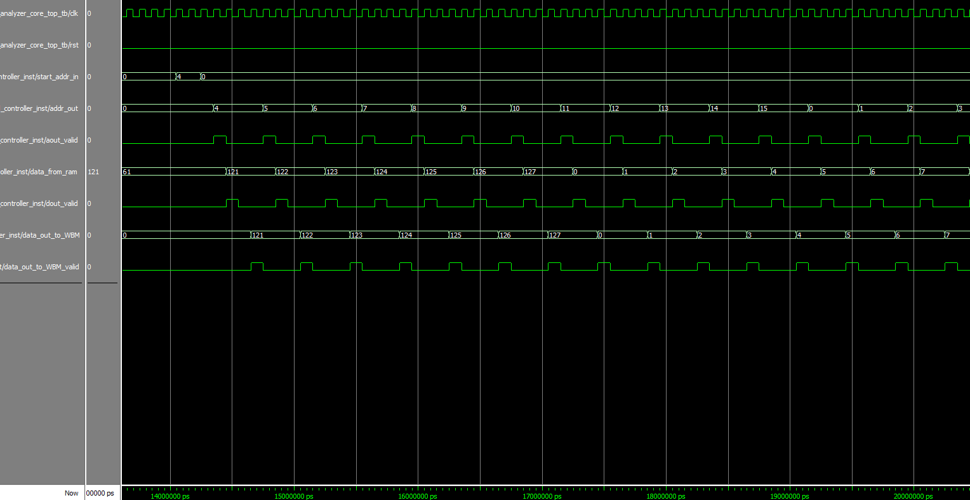
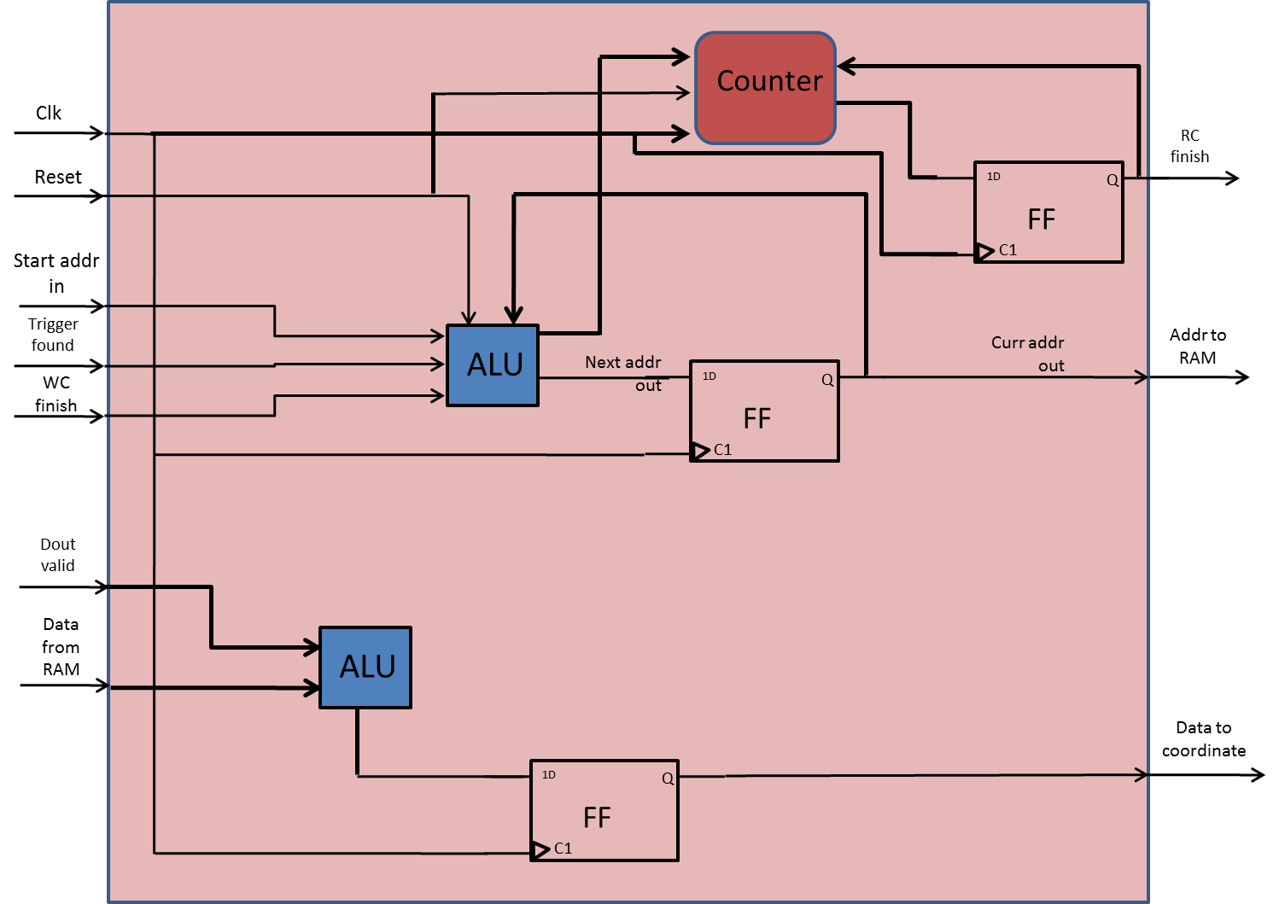
Read Controller
Start address is received
The next address is calculated and sent to the RAM
Data and validity is received from RAM
Output data is being sent to the coordinator
START ADDRESS
ADDRESS TO RAM
DATA VALID
DATA FROM RAM
DATA TO COORDINATOR

Slide 16
In Out Coordinator
Gets data and valid in from Read Controller
Sends out the data and valid out to WBM
DATA VALID
DATA
DATA OUT VALID
DATA OUT

Slide 17
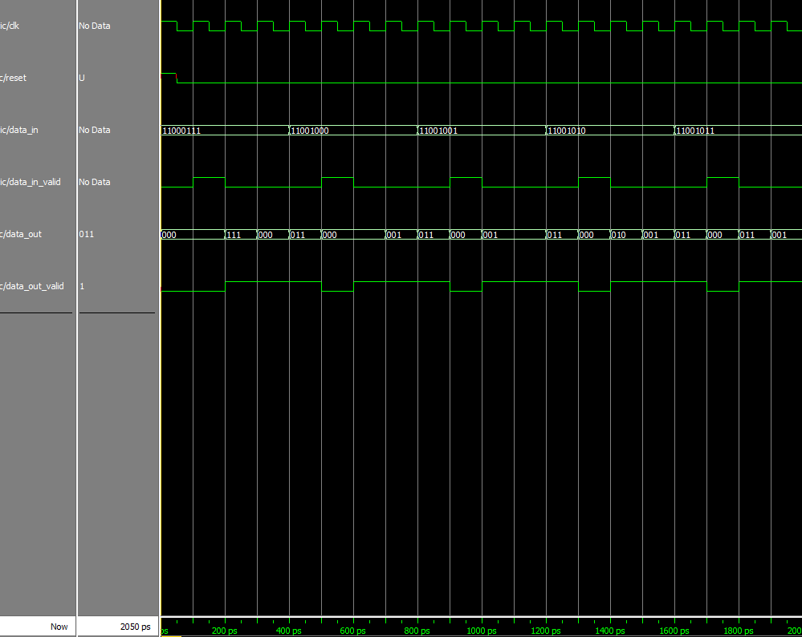
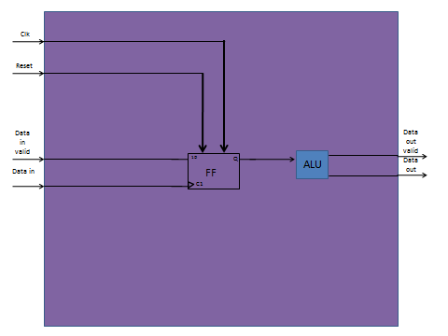
In Out Coordinator
Data in is being sampled when valid is high
Data out is being sent out according to width_out_generic
DATA IN VALID
DATA OUT VALID
DATA IN
DATA OUT

Slide 18
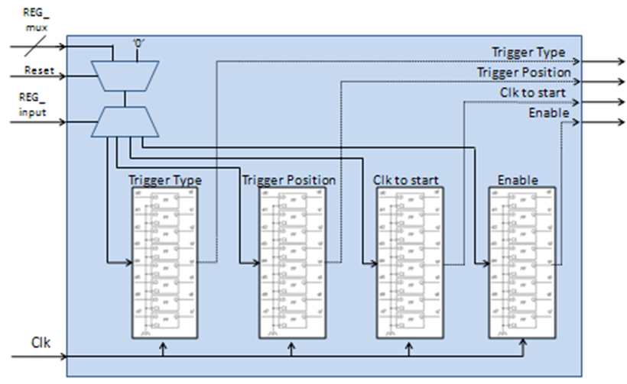
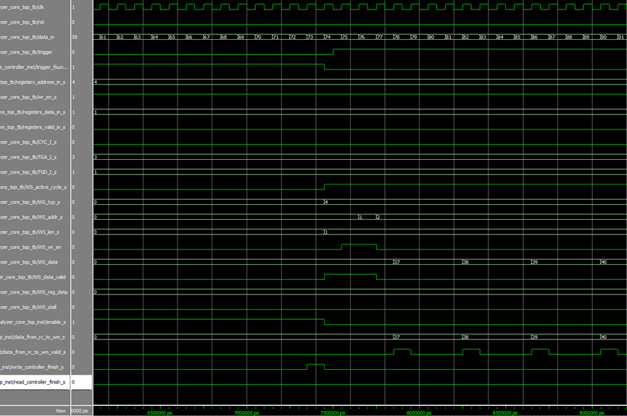
Simulations
At first we made a manual simulation to each entity to check the functionality
Afterwards, we built a core test bunch in order to check the entire core
Internal
Logic
Analyzer
Core
WBS
WBM

Slide 19
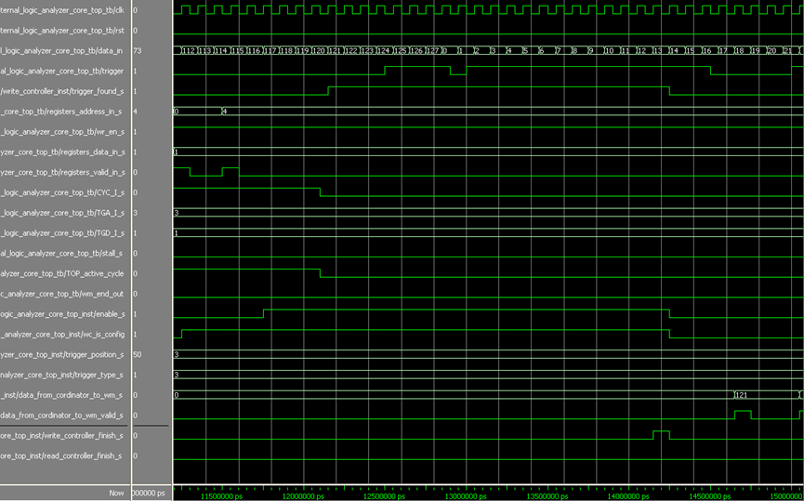
Simulations
Each diagram was checked and confirmed for the correct result and if necessary, code changes was made and the simulation was made again.
Check for | Simulation number | Check for | Simulation number
Configurations timing | 10. | Configurations, Trigger recognition | 1.
Enable polarity | 11. | Recording depth, Configurations | 2.
Reset polarity | 12. | Number of signals, Trigger position | 3.
Signal RAM width | 13. | Configurations, Reset | 4.
Input data = WB bus | 14. | Reset | 5.
Input data < WB bus | 15. | Configurations | 6.
Input data > WB bus, Reset, Configuration | 16. | Configurations | 7.
Input data >> WB bus, Reset, Configuration | 17. | Configurations, Second trigger rise | 8.
 |  | Configurations timing | 9.
?

Slide 20
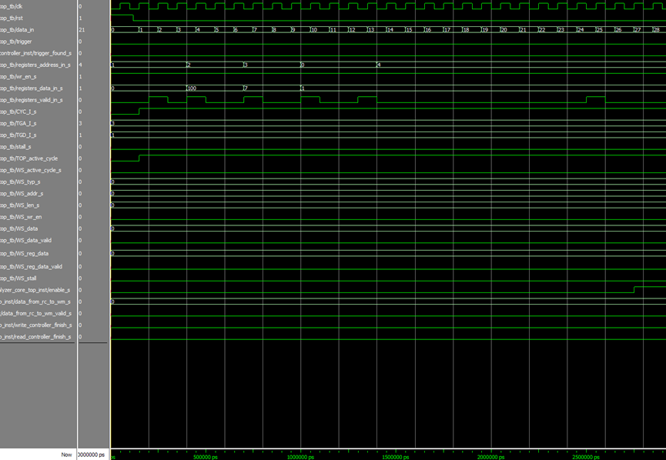
Simulations
Data is insert to the registers, in order to configure the user trigger position and type
Enable signal is written to the register to enable the system
value | Name | #
1 | reset_polarity_g | 1
1 | enable_polarity_g | 2
3 | signal_ram_depth_g | 3
8 | signal_ram_width_g | 4
3 | record_depth_g | 5
8 | data_width_g | 6
8 | Add_width_g | 7
5 | num_of_signals_g | 8
0 | power2_out_g | 9
1 | power_sign_g | 10
6 | Type_d_g | 11
1 | Len_d_g | 12
Number of signals is 5, meaning our input data is between 0-32 in decimal (2^5), at first the trigger position is 100 and all the data is recorded before the trigger, and second time the position is 0 and all the data is recorded after the trigger.
For example: (test number 3)

Slide 21
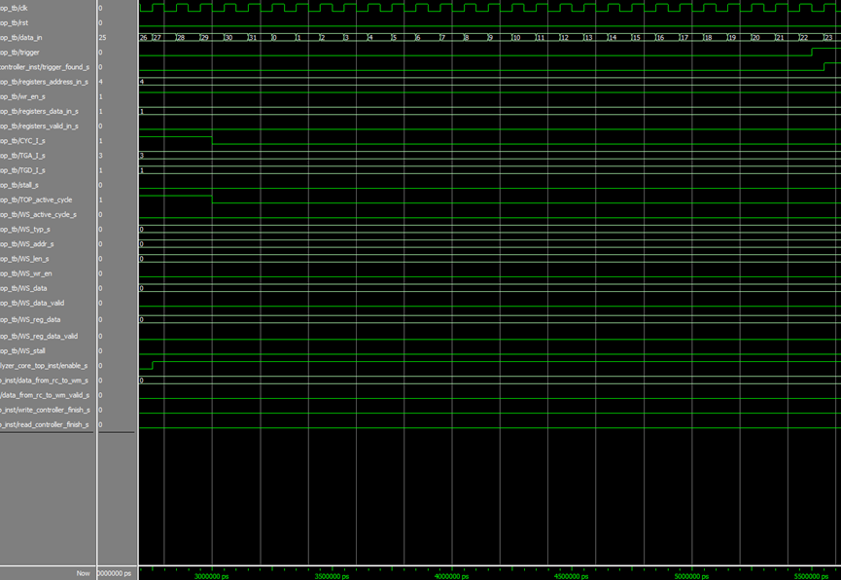
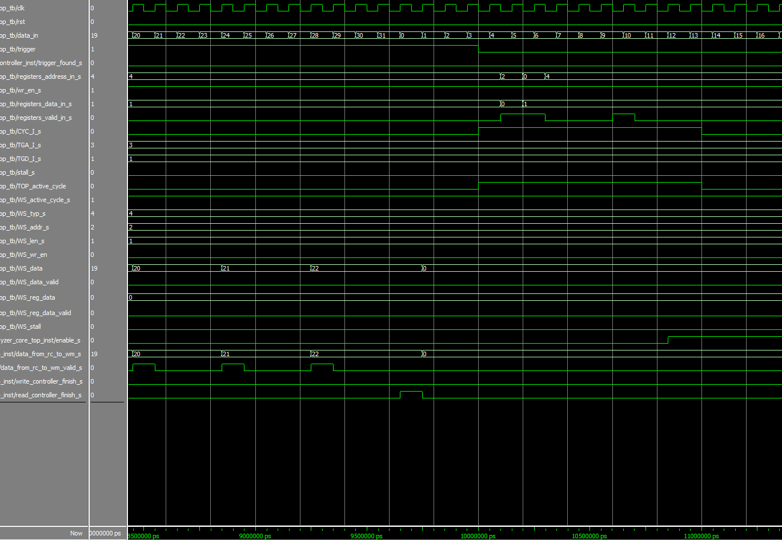
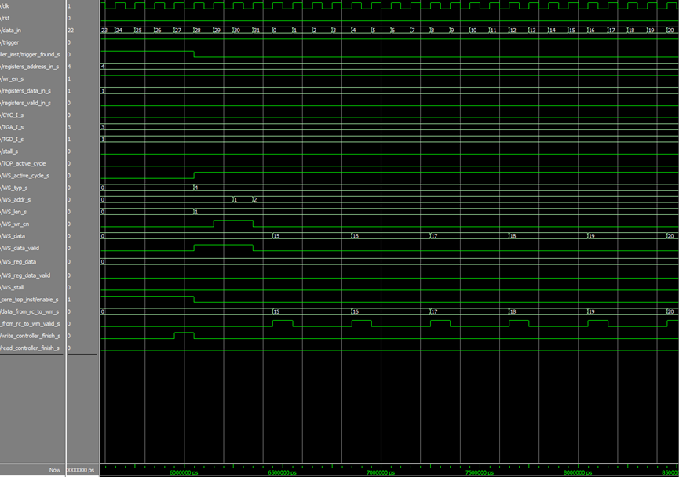
Simulations
After that all the relevant data has being sent out, read controller finish working
We can now configure a new and different simulation
Data is being save in the RAM until trigger rise
Since position is 100, we do not save data after trigger rise
Write controller is finish
Read controller starting to send the relevant data out

Slide 22
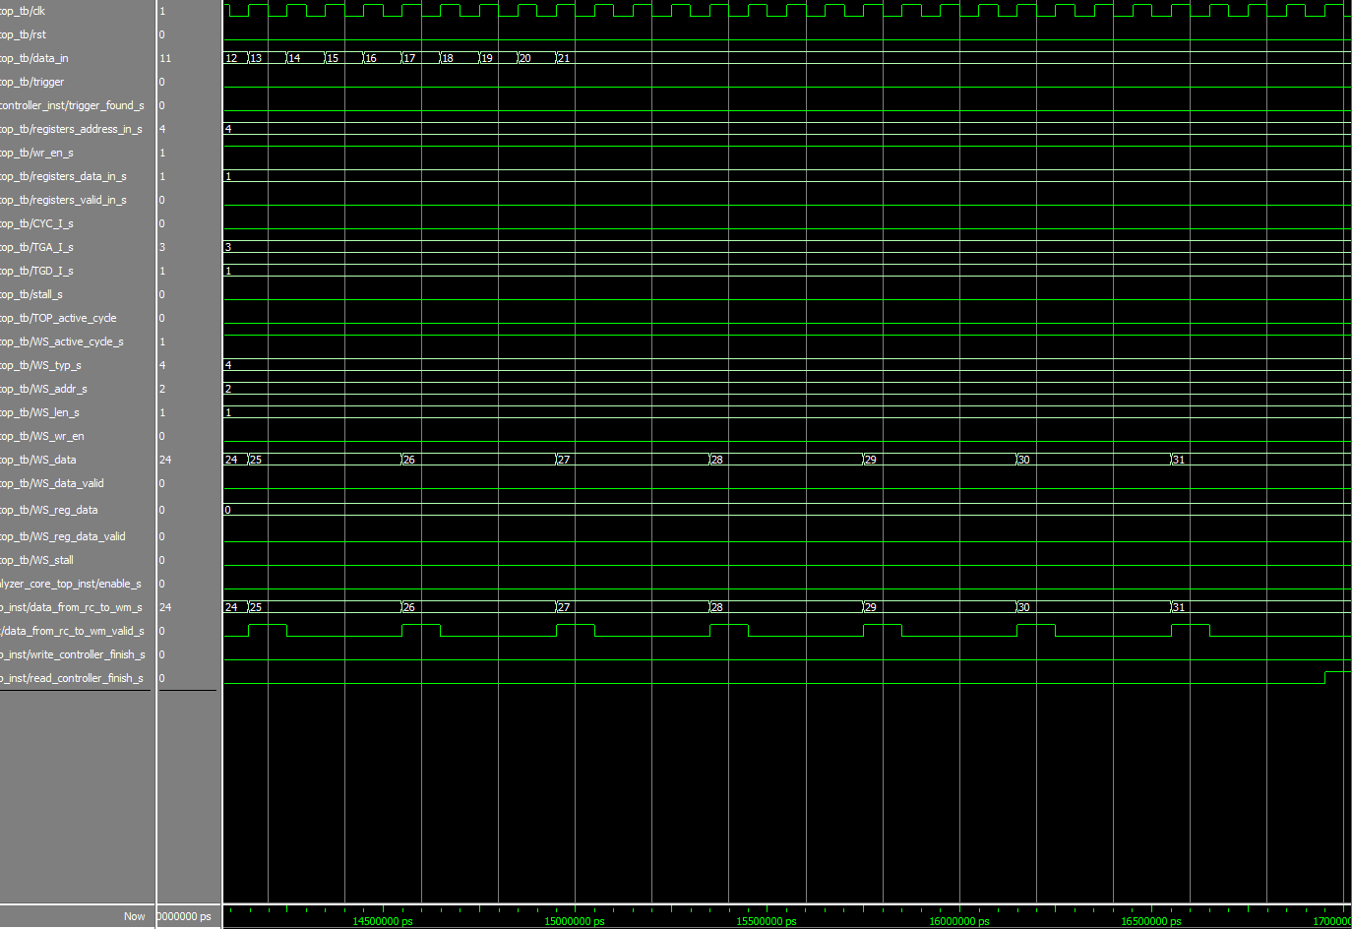
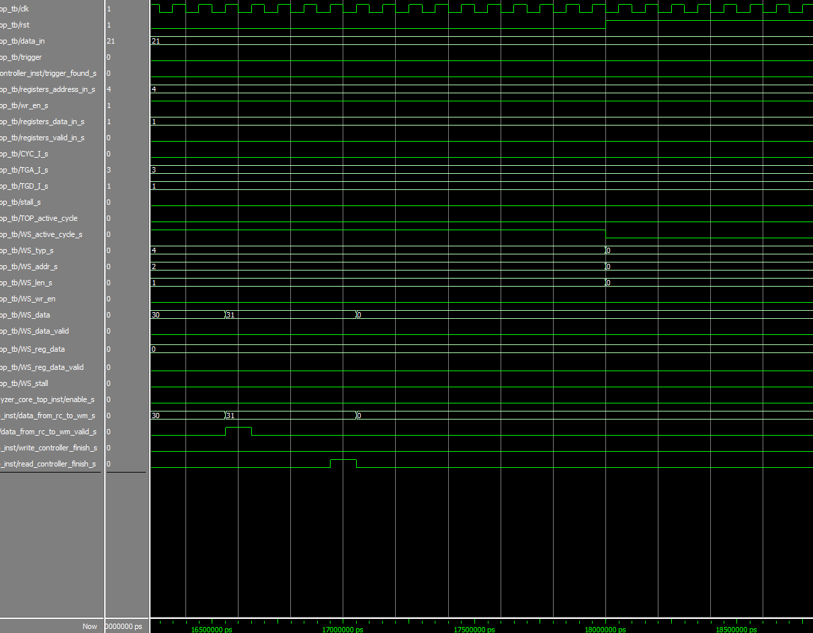
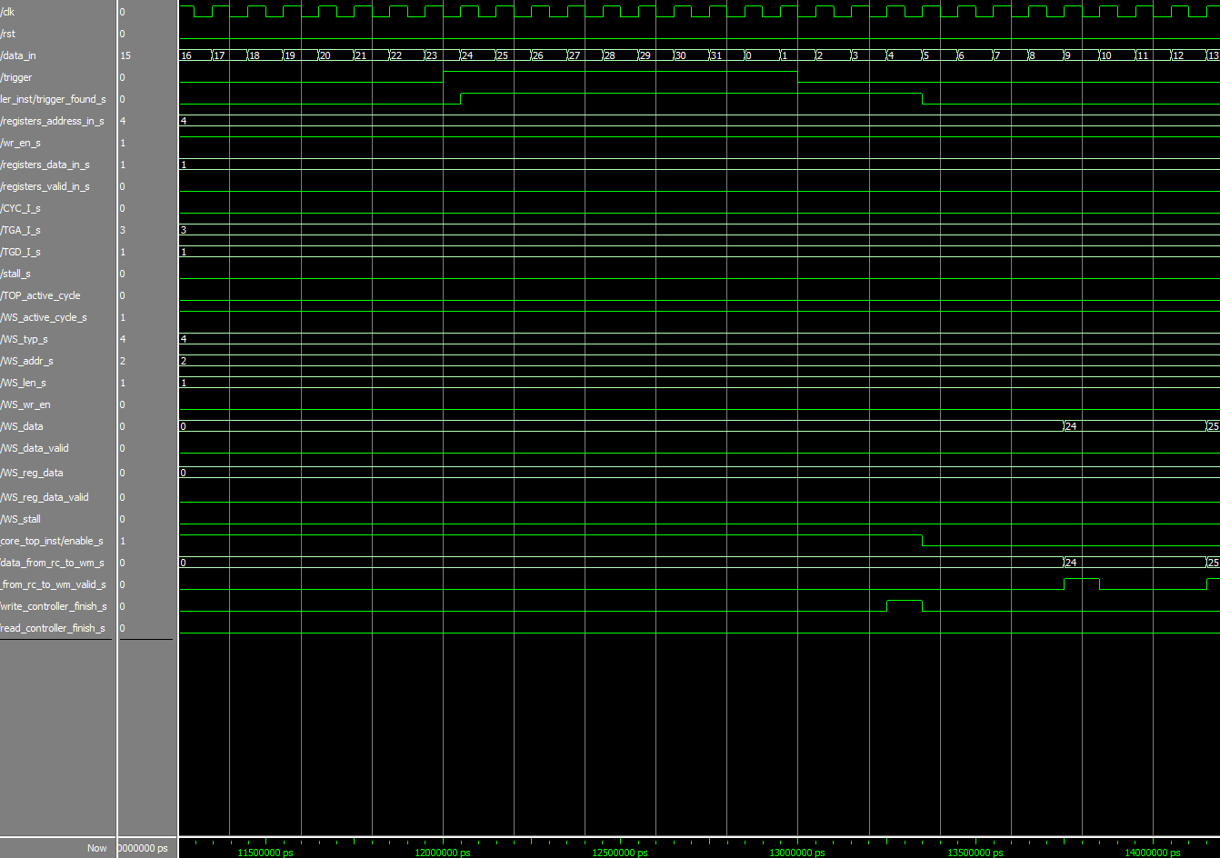
Simulations
Read controller is extractiong all the 8 samples, starting from 24 (trigger rise)
When finish, read controller finish signal is rise, and the system is ready for another configuration
Since position is 0, all the data is recorded after trigger rise
After WC finish saving all the data, the RC is starting to extract the data and send it out

Slide 23
Problems & Solutions
Solution | Problem
Adding entity that “break” the data into few clock cycles (data coordinator) | Coordinate between number of recorded signals to output width (WB bus width)
Inserting wc_finish signal to the registers entity and resetting the relevant register after first trigger rise | Trigger was rise twice in the same configuration
We set each register size to 7 bit and we assume that the WB bus width is larger then that. According to that we read only the 7 LSB of the data into the registers | Coordinate between incoming data width (from WBS) to the registers
Coordinate addresses of incoming data and data sent to RAM | Coordinate between input - saved data and address. (couple of clock cycles delay between them)
Will be solved in 2nd part | System can now work in clock frequency of ~50 MHZ (100 MHZ demanded)

Slide 24
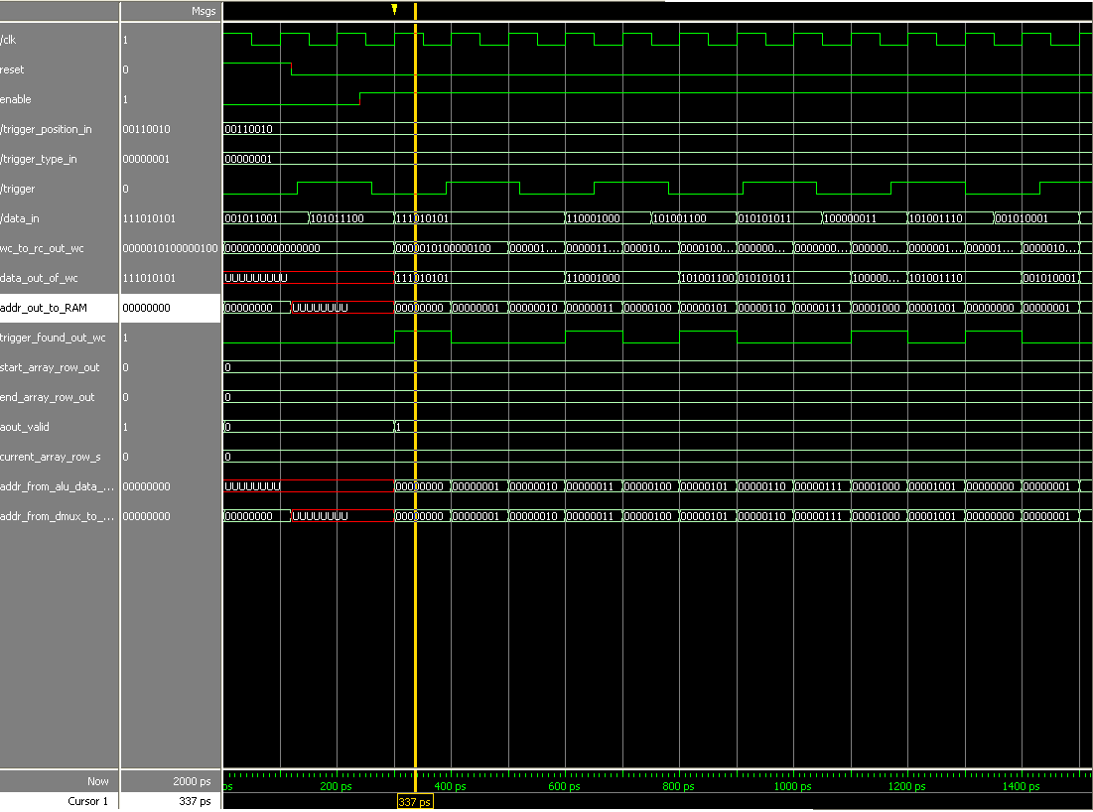
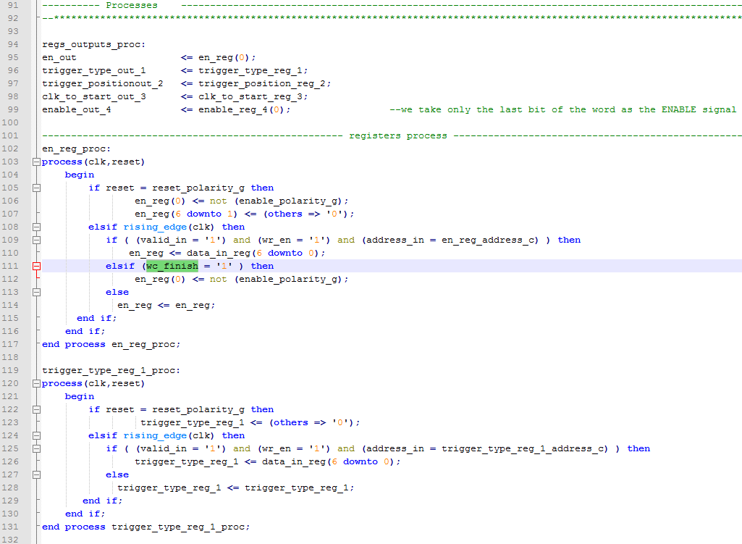
Problems & Solutions
First example: (problem that occurred in the middle presentation)
After first trigger rise, the system identify another trigger rise although the data was still recorded
Problem- there was no dependency between two trigger rises
Our solution- adding wc_finish signal to the registers and resetting the enable register

Slide 25
Problems & Solutions
Input width is num_of_signals_g, output width is data_width_g
Problem- the two widths don’t match
Our solution- adding an entity who coordinate between them
Second example: output width (bus) did not match the input width
DATA OUT
DATA OUT VALID
IN OUT COOARDINATOR
DATA OUT VALID
DATA OUT

Slide 26
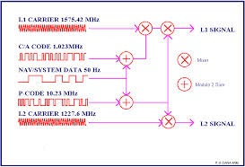

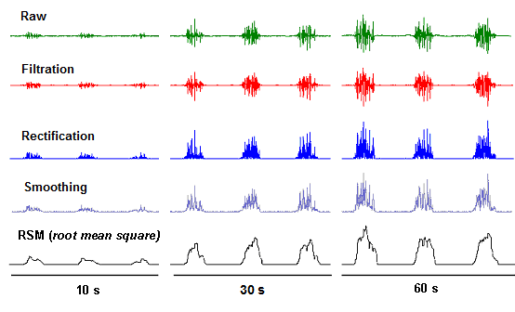
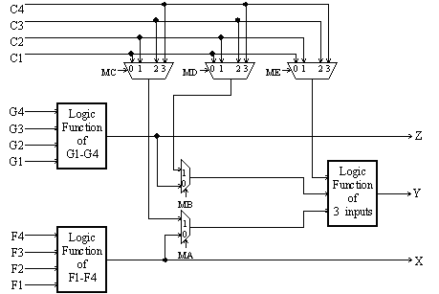
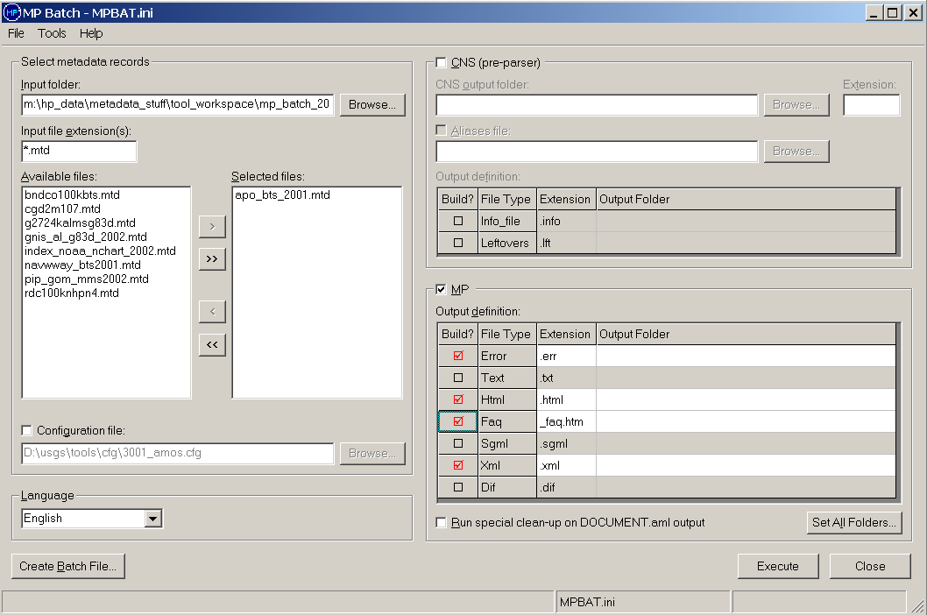
Part B- work plan
Creating Signal Generator
Integration with external blocks (rx/tx path, WB intercon and others)
Simulations to the whole system
Synthesis
Building and connecting the GUI
Connecting to FPGA in the lab

Slide 27
Schedule
Tasks | Date | #
Part A final presentation | 6.10.13 | 1
Submitting project documentation | 13.10.13 | 2
Finishing signal generator | 15.10.13 | 3
Integrating system blocks | 5.11.13 | 4
Top simulations | 12.11.13 | 5
synthesis | 17.11.13 | 6
Simple matlab GUI implementation | 21.11.13 | 7
Hardware burning to FPGA | 28.11.13 | 8
Part B final presentation | 6.12.13 | 9
0.5
חן

