Slide 1
Supply Chain Attacks: What are my options?

Slide 2

>>> import getpass; getpass.getuser()
Security Analyst
Defending all the things
Canberra
Exploring

Slide 3
What are supply chain attacks?
Leveraging your relationships with providers
Hardware level
Software level
Known to supplier
Unknown to supplier

Slide 4

Webmin backdoor
Webmin dev build servers hacked
Vulnerability added to code, hidden from git diffs using timestamp modification
Hacked server decommissioned, but backdoored code copied to new server
0-day released about 2 weeks ago, security update released

Slide 5

Malicious event-stream update
Many NPM (node.js) modules depend on event-stream, directly or indirectly
The person who made this package didn’t want to maintain it anymore
Someone made a Github issue asking to take over the package
That person added a dependency on flatmap-stream, which steals Bitcoin

Slide 6
Fortigate SSL VPN - CVE-2018-13382

Slide 7

ASUS Live Update Utility
Signed update
Targets just over 600 MAC addresses
ASUS potentially hacked
Kaspersky states that it was related to the BARIUM APT

Slide 8
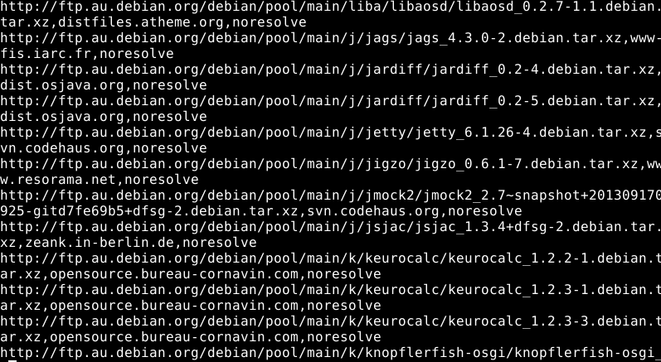
How can I do supply chain attacks?
Scope issues in pentest
Hacking suppliers
MITM
Contributing to open source projects
Domaining

Slide 9
How can I stop supply chain attacks?
You won’t be able to completely eliminate the threat
Trust Less
Trust Well

Slide 10



Trust Less
Self-hosting
Open-source
Self-compiling
Dealing with updates

Slide 11
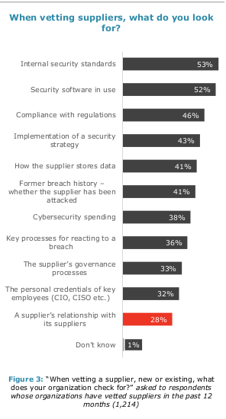
Trust Well
Have a process for evaluating your suppliers
Insist on good update mechanisms
Sign updates
Store the key safely
Limit updater functionality if possible

Slide 12
Contact
Matrix (Riot): @batterystaples:matrix.org
Email: riley@mailo.com
Twitter: @batterystaples
Slack: @batterystaples
LinkedIn: Riley Baird

