Slide 1
Resources and guidelines for scientific computing on MARCC
Battle Lab “Chalk Talk”
January 6, 2020
Notes:
H2Bt: presentation may seem a little bit all over the place because I’m hoping to foster some discussion about using MARCC in the lab;
Purpose here today- we've had some issues with MARCC in the past with memory, job management, etc. Want to try and centralize resources for us to do better as a group, a team, help foster an atmosphere of sharing tricks and the like. I want to introduce these resources to encourage everyone to upload their knowledge, and share some items that have come up frequently in our slack channel in discussion. I'm guessing for the senior trainees in the group this will be review, so I'd like to just ask that you feel free to jump in and make a contribution or correct me. Part of my motivation for taking this on is that I wanted to learn and felt like I had room to grow, so what I share isn't necessarily always grounded in an experiential education.
I don’t have all the answers, and so would love for those with more experience to chip in as needed. Want to start by sharing some of the resources me and some other lab members have been assembling, and then discuss some MARCC basics to help us better understand some of the errors and things we face.
As time permits, we may also have a discussion on organizing projects and recommendations for this, but I am not certain we will be able to have that discussion today.

Slide 2

Type of Core | Number
Regular compute cores | ~17500
Large memory cores | ~3700
GPU cores | ~50
TOTAL | 23,280
Notes:
Begin with overview of MARCC. This information came from the MARCC website, which as boring as it is to read is worth going through and informative for figuring things out
Maybe do in terms of nodes?

Slide 3


2 PB
“High-performance scratch” system mounted on
~/work and ~/scratch
“Users should conduct all intensive compute work using the Lustre file system”
14 PB
Standard filesystem that hosts the rest of ~/, including ~/work-zfs
“The ZFS file system should be used mainly to store large amounts of data, executables, and compiling code”
Notes:
Storage: 2 main sources
As on the slides

Slide 4
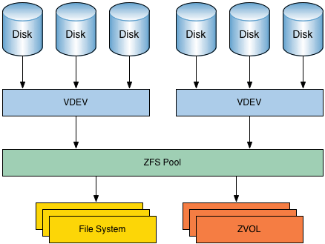
ZFS file system
“Z-file-system”
Pooled storage
Copy-on-write
Snapshots
Data integrity verification and repair
https://itsfoss.com/what-is-zfs/
Notes:
ZFS: "Z - file system"-vBasically, an advanced file system with…
Pooled storage: combines a files system with volume manager, such that the file system spans across various drives into a pool (show visual). So if you add another drive, you can increase your storage
ZFS system takes care of partitioning, formating, etc, so we can navigate easily
Copy-on-write: when you overwrite a file, it actually puts it in a new location, and then has systems meta-data point to the new one once the copying is complete. That way, files aren't lost in the even of a shutdown, etc.
Also means snapshots:
Snapshots to track changes (snapshot contains the original, live filesystem contains the new)
Importantly, doesn't track removals/additions of files, but changes to them

Slide 5
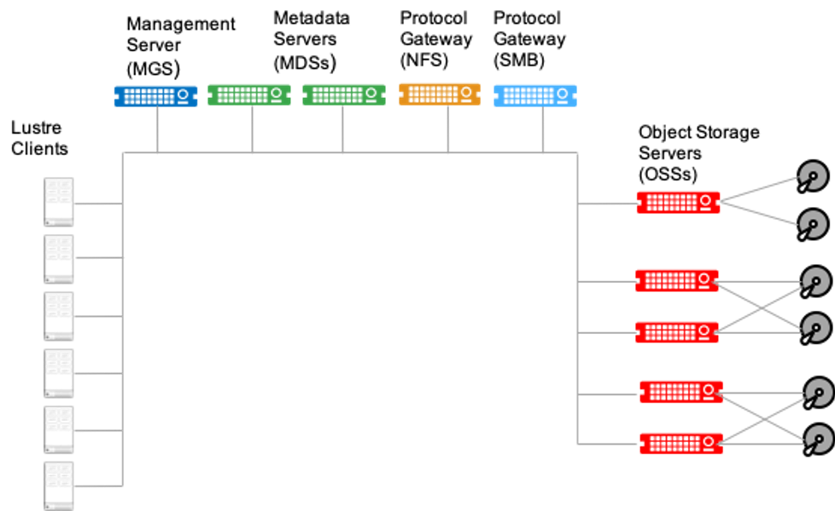
Lustre file system
Linux + Cluster = Lustre
“Parallel distributed file system”
Chunks data into blocks across servers to allow reads and writes in parallel (as opposed to a single storage controller that can be a bottleneck)
“Lustre is not well suited for AI/ML I/O intensive workloads”
https://www.weka.io/learn/lustre-file-system-explained/
Notes:
Quick visual on this:
OSS- these are I/O servers, which manage the data on Object storage targets (OSTs)
The meta data server (MDS) manages and access the metadata for files
In a query: request gets sent to the meta data server, which access the meta data target. The client then gets access to the location of the data, which accesses the OSS and the OST
MGS supports multiple file systems running
WHY not good for …?
Great for large file I/O performance, but managing the meta-data became the bottleneck
When doing an operation, it creates an “inode” object to manage the file, regardless of if that file we are accessing is large or small
Since some of these kinds of applications produce many small files very quickly, so fills ups with inodes even though the files themselves are very small (so could be full when only using 30% oifdisk space)
Generally- lustre great for large file access, ML requires small file access with low latency

Slide 6
Optimizing storage and I/O on MARCC
For a full rundown: https://www.marcc.jhu.edu/bluecrab-storage-guidelines/
Generally:
Determine I/O profile (how often, how many processors, file size, what filesystem)
Optimize I/O
Large reads? STAY on on ZFS, optimized for long-term storage
Large writes? Try migrating to Lustre, reduce # of file writes, and frequency
Notes:
We have had some i/o issues on MARCC, especially battle-bigmem.
MARCC has some guidleins on what helps- may have to do with where we are performing our operations
Sporadic i/o issues (on lusters and elsewhere)
Get a sense for your i/o profile
Focus on the work-zfs stuff:
Not great for …
Large data reads: keep on ZFS
Writing many files- don’t' do it, sore in memory if possible
Not good for large writes- try migrating to the lustre if you can.
Best practices for luster:
https://hpcf.umbc.edu/general-productivity/lustre-best-practices/
One tip worth noting: avoid using ls -l: has to query each file individually, can be costly (on luster)

Slide 7
General MARCC resources available
If you’ve ever wondered, “I’d like to do _____ better on MARCC…”, check out their tutorials (some listed here)
Issues installing R packages? https://www.marcc.jhu.edu/managing-r-packages-a-case-study/
Use a singularity?
Upload/download files directly to MARCC?
Using TensorFlow
Etc..
Notes:
Go through

Slide 8
Lab MARCC resources
Installing Snakemake
Image visualization via X11 Forwarding
Singularity to install PEER
Have something to contribute? Figure something out that might be helpful for other lab members?
Discussion: What questions do you have? What skills do you have you could share? (i.e. Snakemake, github)
Notes:
Some of these relevant to our lab, as well as others, we have put on what we are calling our lab wiki
Take them there
Ask the question, write them down.
Doesn’t need to be too nitty gritty, but something we do frequently, or would be useful for onboarding
Get volunteers to look into them, come up with brief things on them- get some names and commitment
Then proceed!
What kinds of things would be best for a tutorial or a seminar thing
One question- managing jobs on battle-bigmem, etc.

Slide 9
Using Battle-bigmem
48 CPUs: Intel(R) Xeon(R) Gold 6126 CPU @ 2.60GHz
1007GB of memory
Discussion: what are appropriate uses for bigmem? (what kinds/size of jobs, priority, etc)
Notes:
https://www.tecmint.com/commands-to-collect-system-and-hardware-information-in-linux/#:~:text=To%20know%20only%20system%20name,kernel%20name%20of%20your%20system.&text=To%20view%20your%20network%20hostname,with%20uname%20command%20as%20shown.&text=To%20get%20information%20about%20kernel,use%20'%2Dv'%20switch.
lscpu
Show in htop
DISCUSSIOMN

Slide 10
Running jobs simultaneously, in the background, or in ”parallel”
The option you choose will depend on your specific needs and situation!
With SLURM on MARCC: Quick and Dirty- split the job into parts and submit as many small jobs at once (order irrelevant)
Parallelize within your code (i.e. using python multiprocessing)
Put a job in the background using & or bg
`&` runs a job in the background in a subshell
logout terminates a shell and its subshells
Get job ID via htop or job -ls
Put a job in the background so it keeps running (nohup)
Allows the process to ignore “HUP” (hang-up) signal given when a terminal is closed and to continue running.
Notes:
I say “parallel” in quotes because its not truly parallel processing..
Demonstrate:
Job.py 1
Ctrl-z
Bg
Job.py 2 &
Job.py 3 &
Runs all in the background
Jobs
Can bring one forward:
Fg
Logout- jobs terminated
One simple fix- nohup:
Try again, log out, show jobs still running. Cool.

Slide 11
Running jobs simultaneously, in the background, or in ”parallel”
The option you choose will depend on your specific needs and situation!
Use the parallel program:
Part of Gnu, a MARCC module you can load:
A bit tricky to learn the syntax
Multiplexing (next slide)

Slide 12
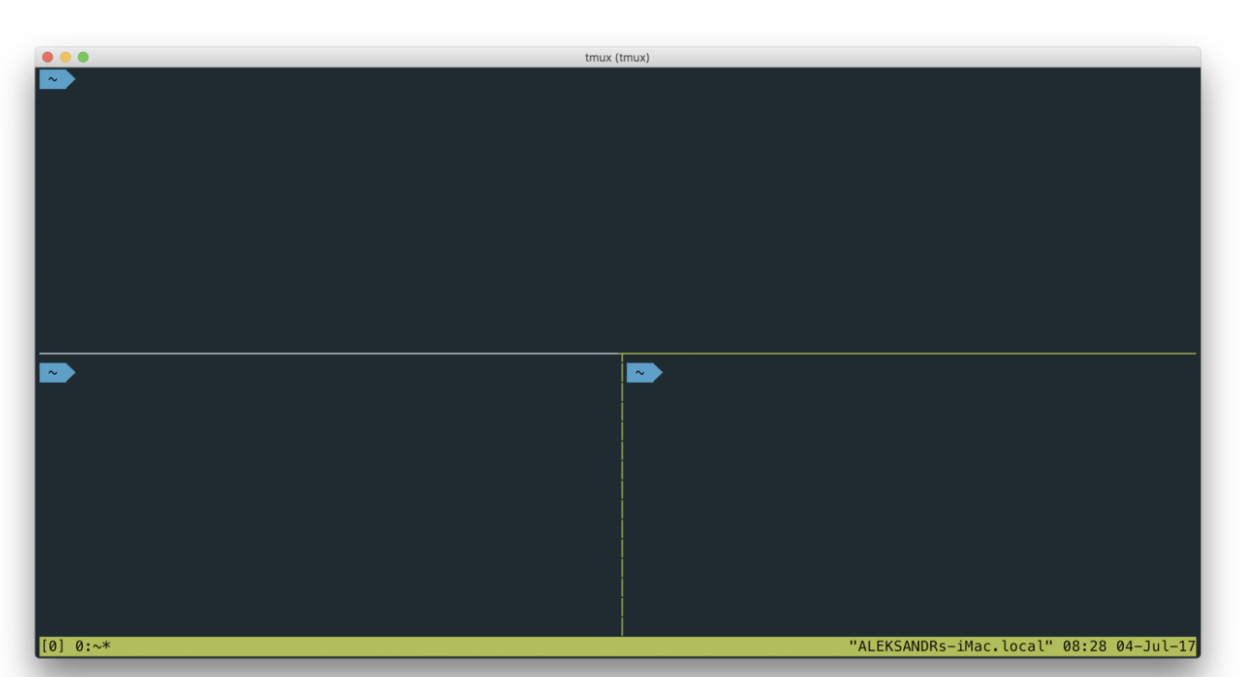
Terminal multiplexing
What it is: lets you run multiple terminal screens concurrently
2 popular utilities for this:
Screen:
Older, stable (?)
Tmux:
More visual/user friendly
Newer, under active development
Better screen layouts, customizeable
Quick tutorial using both:
https://medium.com/hackernoon/a-gentle-introduction-to-tmux-8d784c404340
Notes:
Example- have them running side by side
Or have them running the background
Quick tutorial with both:
Screen- start here, a bit easier
Run a job, job.py 1
Ctrl-a-d to detach
Screen –ls to see current ones
Screen –r number to jump back on
Log off and back on- stays running
View it on htop
Tmux
Ctrl-b to access commands:

Slide 13
Tracking jobs on battle-bigmem
View, sort, and kill jobs: htop
Search functionality
Many ways to kill a job
SIGTERM: “It is the normal way to politely ask a program to terminate… his signal can be blocked, handled, and ignored”
SIGKILL: “used to cause immediate program termination. It cannot be handled or ignored, and is therefore always fatal”
SIGQUIT: equivalent of CTRL-C; core dump when it terminates. “You can think of this as a program error condition “detected” by the user.”
SIGHUP: ”used to report that the user’s terminal is disconnected”
You can also view this in a more pipe-friendly manner using : ps aux
Notes:
First open htop- explain things realy quick there
Submit the loop job, and then see it in htop (search python)
Can use c to get children
Killl it
Explain why
Can set the niceness- basically the priority of a job
Walk through-
"VIRT stands for the virtual size of a process, which is the sum of memory it is actually using, memory it has mapped into itself (for instance the video card’s RAM for the X server), files on disk that have been mapped into it (most notably shared libraries), and memory shared with other processes. VIRT represents how much memory the program is able to access at the present moment."
Virtual memory being used: a task thinks it’s the only task taking place- so virtual memory accounts for all it has access to. For instance, if you memory map a file, you're not actually accessing it but it is accounted for in the virtual memory
It includes all code, data and shared libraries plus pages that have been swapped out and pages that have been mapped but not used."
Most of the time, not a useful numbewer
RES: resident size- what's currently in the physical memory; may be shared with other processes
Use this to track your jobs
Filter vs search- pretty simila, filter matches the name (?)

Slide 14
Managing jobs
How can you control the resources used by a job on battle-bigmem?
Program arguments:
(i.e. plink –pfile vars –o test –extract lista.txt –memory 1024)
Daeomontools softlimit
What happens if a job is running longer than expected? Or you need to terminate it for some reason?
Terminate in htop
Use “kill”:
kill PID
pkill –U username@jhu.edu
Surya’s ninjakiller
Notes:
pkill -U bstrobe1@jhu.edu
(suggestion from BEN)
Kill pid
Suggestions from Ben and prasanthi
Go to the page with ninjakiller on the wiki, explain how to use it
Demonstrate it real quick.
Questions?

Slide 15

Organizing projects
Notes:
Introduction-
Older paper, but still valuable
Author makes the point that while many of us get good training in algorithms, we don’t get as much with day-to-day organizational challenges that we face lookingat files and dealing with them, etc.
Provides some useful observations and principles I want to just review in brief- I recommend this paper, its very short, pretty quick read
In sharing these guidelines with you I admit I am a perfect hypocritek but I find that some of these are helpful in helping me make incremental steps towards better organizing my work.

Slide 16
Organizing projects
Overarching Principles:
“﻿Someone unfamiliar with your project should be able to look at your computer files and understand in detail what you did and why.”
" ﻿Everything you do, you will probably have to do over again”
Notes:
Overarching principles:
Seems a bit ambitious, but the principles is there– most important someone is you, but could be one of us, collaporator, etc.
I’m sure we have all been there- if you document well and use good tools, it will make things easier

Slide 17
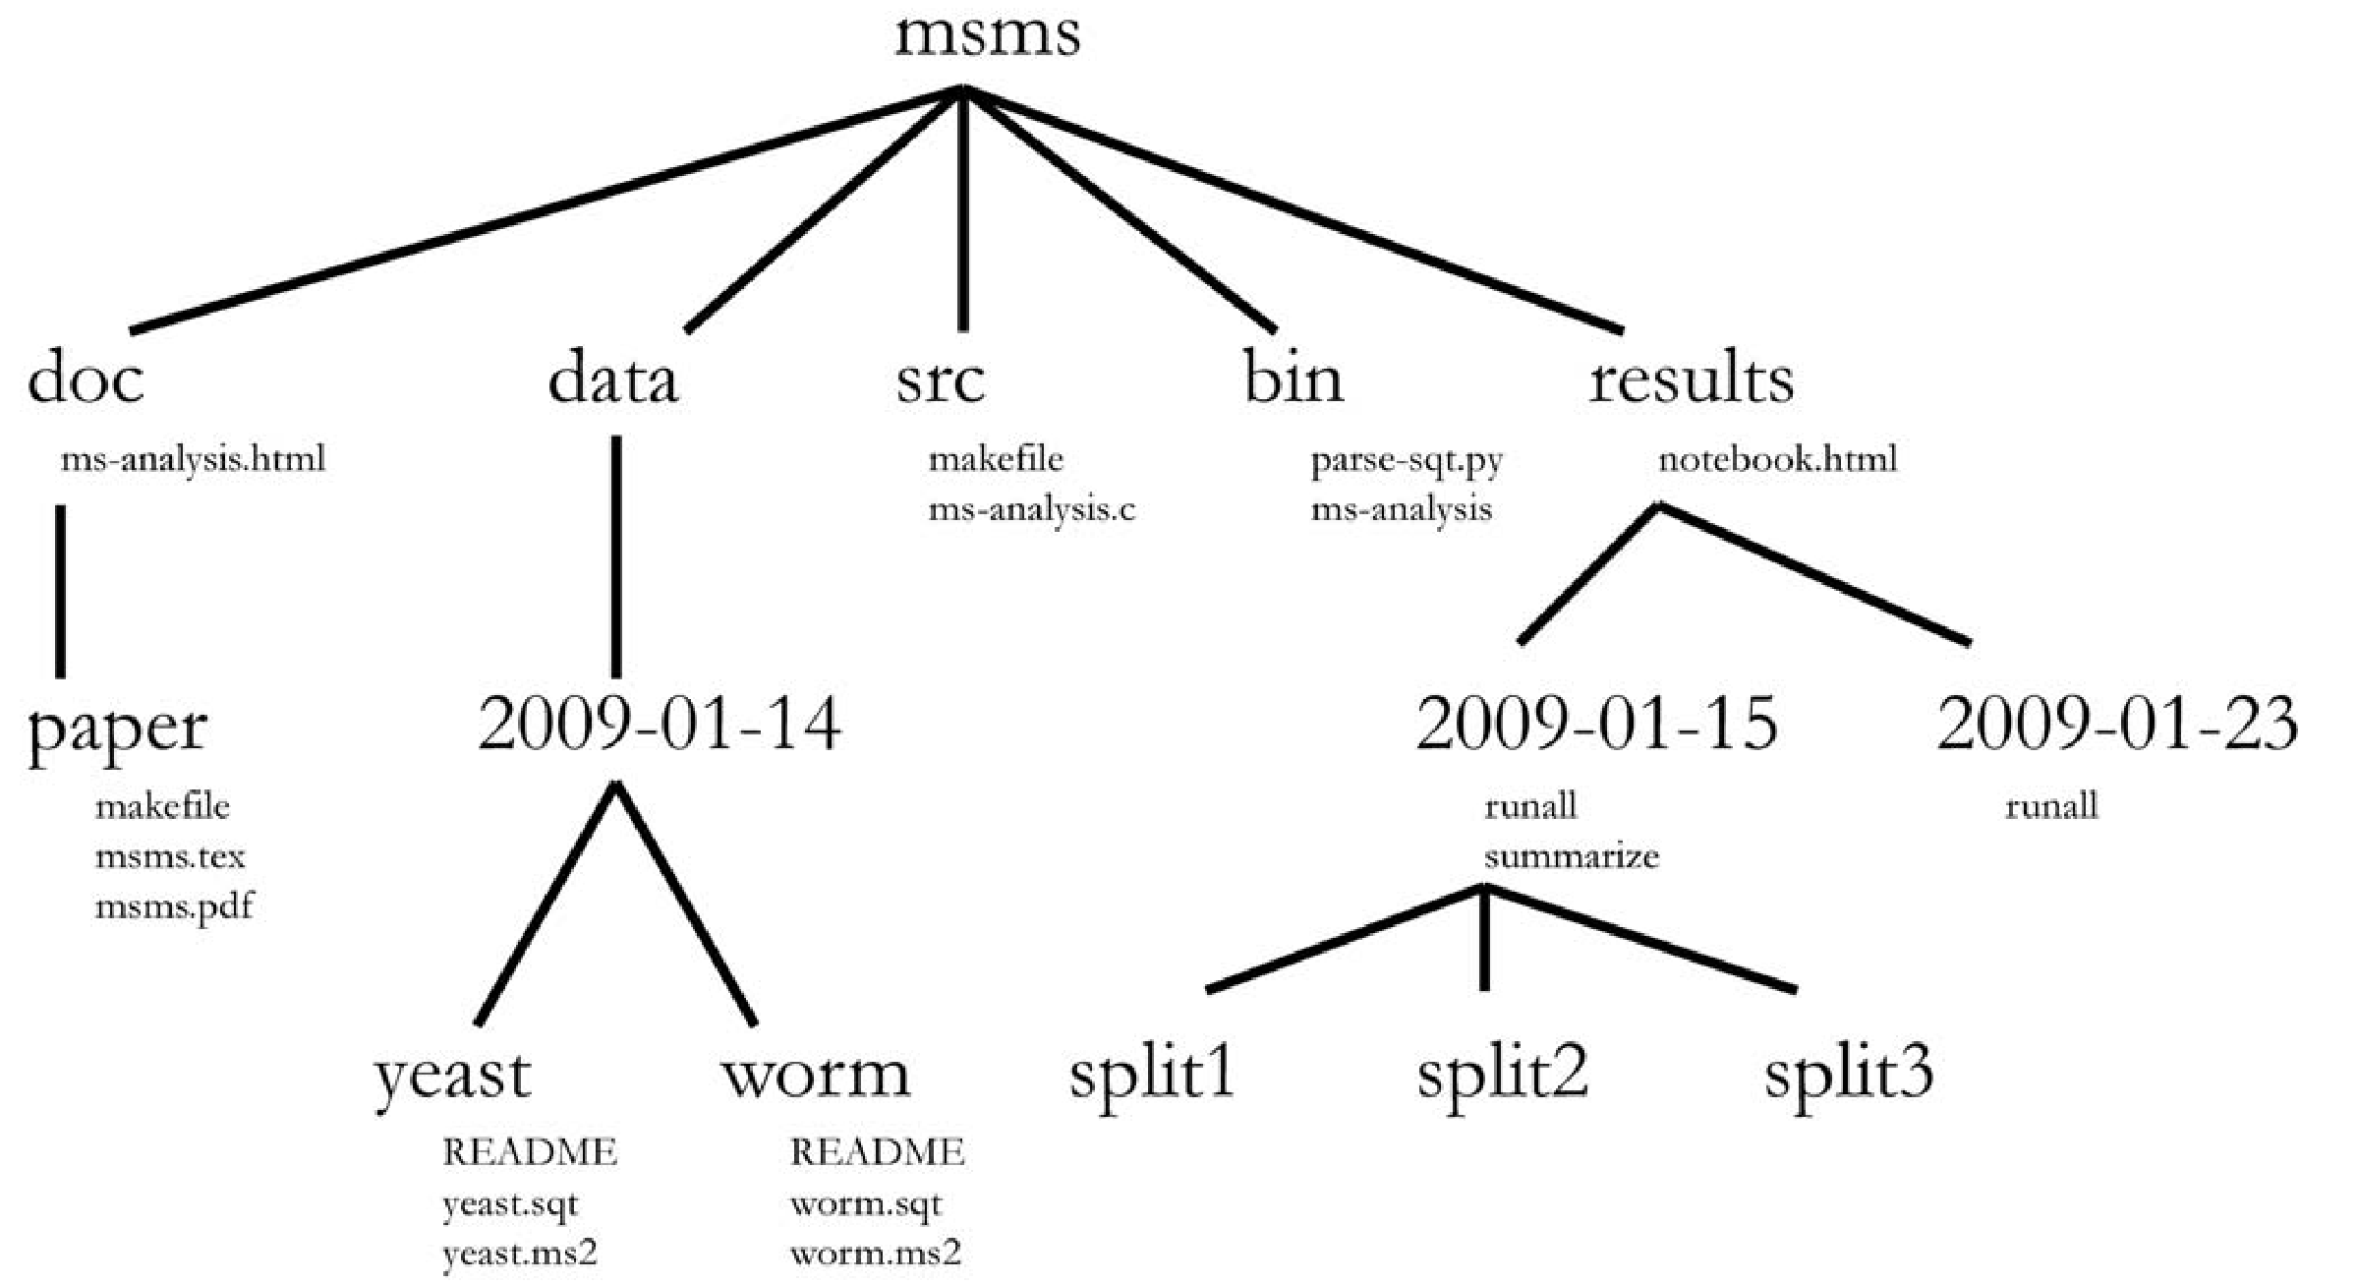
Directory organization
Notes:
Splits main into 5 consistent directories, followed by chronological organization below
Data: stores fixed data sets
Results: track the actual computational results
SRc: source code
Bin- the compiled binaries or scripts (may not be as relevant for us since most of us are running things in python or C but hey)
Doc: a subdirectory per analysis, also note this html file, which I will get to later

Slide 18
Directory organization
Notes:
Note: Author at this level argues for chronological organization as opposed to descriptive names. They can long and may not make sense late ron when you come back, but with dates you can show progress.
In fact, if you are really wanting to stick with dates, separating data from results may not make sense, but kind of combine the two into one “experiements” directory

Slide 19
Directory organization
LAB NOTEBOOK
Dated
Verbose and detailed (images, plots, etc.
Conclusions- if it failed, how you know
Ideas
Suggests to be kept online- so may not reside here but could coordinate with these dates
(i.e. Benchling notebook)
Notes:
The author strongly advocates for a lab notebook of some kind, here kept in results, which is chronologically organized so coordinates with these experiments
Likes it online because the PI can review with them for meetings, see status of work and previous, share with collaborators, lab memebers

Slide 20
Directory organization
Running experiments:
Include a readme with all commands or a driver script that runs everything start to finish
Notes:
Each experiment includes some kind of README or driver script that runs from start to finish
In building this script, you want to make sure that:

Slide 21
Directory organization
Record every command
Lots of comments!
Automate (i.e. don’t edit intermediate files)
Reference all directories/path names here (centralized → easier to manage)
Use relative pathnames for files within directory (reproducibility)
6) Abort if an error occurs (set –e)
7) Make the script restartable
Notes:
Each experiment includes some kind of README or driver script that runs from start to finish
In building this script, you want to make sure that:
Highlight number 6: Make it so you can match files with commands, rerun parts if needed and can see how far you got.
One idea for doing this is Snakemake, which allows you to build your pipeline in stages as a tree of dependencies, and then call which outputs you are interested in

Slide 22
Directory organization
Record every command
Lots of comments!
Automate (i.e. don’t edit intermediate files)
Reference all directories/path names here (centralized → easier to manage)
Use relative pathnames for files within directory (reproducibility)
6) Abort if an error occurs (set –e)
7) Make the script restartable
Notes:
Another idea:
Create a script to summarize all the results from runall- will display how far it got before failing, show what you can conclude, etc. (i.e. generate figures)

Slide 23
Directory organization
Specify when the script was downloaded, from where, by whom, etc.

Slide 24
Other tips
Use version control every day (github!)
Errors in your code are inevitable: act accordingly!
Write code to detect errors
Use well-documented libraries and standard formats (over ad hoc parsers)
Abort when errors occur- don’t’ skip over them
Check return codes >_<
Create output files with temporary names, rename when complete

Slide 25
Discussion
Which of these techniques/principles have you found effective?
How do you manage workflow/organization when you are in an exploratory stage?
Other comments/questions

