Slide 1
Reproducibility and packaging basics
Eric Kernfeld
Battle lab
Short talk 6/5/23

Slide 2


Scenarios
You develop code on your computer, which is nice.
You want to run it on someone else’s computer, which is evil.
Different OS, packages, R/python version, perhaps even compiler architecture (new Macs are ARM)
https://openclipart.org/detail/204064/happy-computer-laptop
https://openclipart.org/detail/204065/evil-computer-laptop

Slide 3


Scenarios
Reusable tools, e.g. CAFEH
Specific analyses, e.g. “the knockoffs preprint figure 2”

Slide 4
Desiderata
Precise control: I want to install exact versions of all deps
Flexible control: I want to permit a variety of deps for…
Extensions of this work
People running another OS
Encapsulation: Installing R version 3.6.3 on the knockoffs project shouldn’t over-write my installation of R 4.2.2 for a side project

Slide 5
Controlling packages
 |  | Language | Precise control | Flexible control | Encapsulation | Caveat
Install Python packages | Pip+pypi | Python | yes | yes | nope
 | Pip+github |  |  |  |  | Exact deets, e.g. commit hash, are not recorded for github installs.
 | R+github |  |  |  |  | Exact deets, e.g. commit hash, are not recorded for github installs.
Install R packages | R+CRAN | R | kinda | yes | nope | Old packages may disappear
 | R+MRAN | R | yes | yes | nope
 | R+BioC | R | yes | yes | nope
 | renv | R | no | NA | Packages but not R | Generally confusing

Slide 6
Encapsulation
 |  | Language | Precise control | Flexible control | Encapsulation | Caveat
Things that act like a separate computer | Docker and singularity | any | NA | NA | yes | Pain in the neck Can fail on Mac and Windows
 | AWS | any | NA | NA | yes | OS options can go away (e.g. ubuntu 18)
 | Colab | python or R | NA | NA | yes | Cannot activate virtual environments
 | Conda + mamba | Any | kinda | yes | yes | Some packages are pip-only, and are not found in conda list –explicit.
 | virtualenv | Python | NA | NA | yes

Slide 7
My scheme in R
Don’t:
Use whatever R version happens to be installed
Use whatever R packages happen to be installed
Do:
Run experiments on AWS or in Docker
Use the Posit/Rstudio instructions to install an explicitly named R version
Use explicit versions of MRAN (via the versions R package) or BioConductor
Alternatives:
Use renv with Rswitch (Mac only)
Use Conda

Slide 8
How to install R on ubuntu linux
Posit/Rstudio instructions
R_VERSION=4.1.2
curl -O https://cdn.rstudio.com/r/ubuntu-2004/pkgs/r-${R_VERSION}_1_amd64.deb
sudo gdebi r-${R_VERSION}_1_amd64.deb
sudo ln -s /opt/R/${R_VERSION}/bin/R /usr/local/bin/R
sudo ln -s /opt/R/${R_VERSION}/bin/Rscript /usr/local/bin/Rscript
R --version # 4.1.2 desired

Slide 9
How to install versioned R packages
# MRAN
dir.create(path = Sys.getenv("R_LIBS_USER"), showWarnings = FALSE, recursive = TRUE)
install.packages("versions", lib = Sys.getenv("R_LIBS_USER"))
library(versions)
versions::install.dates(
pkgs = c("tidyverse", "magrittr", "glasso", "ggplot2", "knockoff", "irlba", "data.table",
"tsne", "FNN", "poolr", "svglite", "GeneNet", "mclust"),
dates = "2021-11-05",
lib = Sys.getenv("R_LIBS_USER")
)
# BIOC
install.packages("BiocManager")
BiocManager::install("limma", version = "3.14")
# CRAN
install.packages("https://cran.r-project.org/src/contrib/Archive/BINCO/BINCO_0.1-1.tar.gz", from = "source", repo = NULL)

Slide 10
My scheme in Python
Don’t:
Use whatever Python version happens to be installed
Freely mix pip- and conda-installed packages
Do:
Make a project-specific conda environment
Build it from a hand-written dependencies.yml that is checked into git (example in 2 slides)
Print and version-control a list of exact environment specs using conda list and conda list --explicit
Minimize use of pip and separately document each use of pip
Alternatives:
AWS, Docker, Virtualenv for encapsulation
Pyenv for python versions
Pip or poetry for packages

Slide 11

Warnings about conda + pip
The advertised way to reproduce a conda environment is:
conda list --explicit > specs.txt
conda create -n my_same_environment –file specs.txt

Slide 12
Warnings about conda + pip
This does not work cross-platform.
This does not include pip-installed packages.
Surprisingly, conda list without --explicit does include pip-installed packages, though the output is not readable by conda create.
Note that conda create and conda env create are different. See next slide for an example of conda env create, which accepts a different type of input for use with flexible installations.

Slide 13
How to install Python and packages (one way)
[setup.sh]
mamba env create --name ggrn --file soft_deps.yaml
conda activate ggrn
conda list --explicit > exact_deps_no_pip.txt
conda list > exact_deps.txt
git add exact_deps.yaml
git commit -m “Update deps”
pip install cell-gears==0.0.3 --no-deps
pip install celloracle==0.12.0 --no-deps
pip install prescient==0.1.0 --no-deps
pip install geomloss==0.2.3 --no-deps
[soft_deps.yaml]
name: ggrn
channels:
- pytorch
- pyg
- conda-forge
- bioconda
- defaults
- lingfeiwang
dependencies:
- python=3.9
- python-duckdb
- pytorch-lightning
- scipy
- pytorch
- pyg
- torchvision
- torchaudio
- numpy[version='<=1.23']
- cython
- scikit-learn
- pyarrow

Slide 14
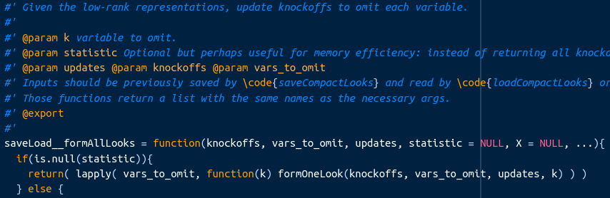
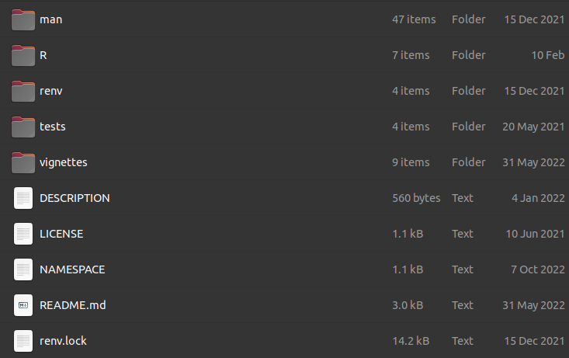
Make R packages
It’s easy. It’s clean. Do it early.
The book: https://r-pkgs.org/
devtools::create_package(“path/to/package”)
setwd(“path/to/package”)
devtools::document()
usethis::use_testthat(3)
devtools::test()
devtools::install()

Slide 15
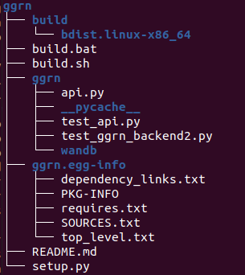
Make python packages
For a more complex and modern take, see packaging.python.org
For simplest possible, you write:
actual code
setup.py (the package metadata)
Pip does its thing:
cd .. # parent directory
pip install ggrn # consider -e for rapid development
You can then turn pip packages into conda packages
Conda-generated
from ggrn import api
Pip-generated

Slide 16
Contents of setup.py
from setuptools import setup
from setuptools import find_packages
with open('README.md', 'r', encoding='utf-8') as fh:
long_description = fh.read()
setup(
name='ggrn',
version='0.0.1',
description='Flexible gene regulatory network modeling',
long_description=long_description,
long_description_content_type='text/markdown',
author='Eric Kernfeld',
author_email='eric.kern13@gmail.com',
packages=find_packages(),
install_requires=[
'torch', 'pytorch-lightning','numpy','scikit-learn','pandas','anndata'
],
python_requires=">=3.7",
url='https://github.com/ekernf01/ggrn',
)

Slide 17

Diss track
reproducin' these slackers always loosen their tackin' of packages. they're boostin' their crap but their stack is still lackin' the versions. I'm obsessed. it's an immersion. I'm doin' conversion of hackers, I'm back, and I'm mad and I'm not takin' jack and I'm splittin' and driving a trip in a honda and spittin' at people who use pip with conda I'm flappin' my lip like a magical wand, get a grip they say maybe I'll calm down if I could just skip to retractin' your shit
Feedin' it to people who are gonna believe in it Needin' it and heedin' it without the key to repeatin' it

