Slide 1
CPE 301 Project Presentation
Desi Battle
Email: battled@unlv.Nevada.edu

Slide 2
AIM & ACCOMPLISHMENT
AIM:
The aim of this project was to introduce myself to creating internet of things designs.
ACCOMPLISHMENT
Measure temperature in a given room and send the measured value to a cloud server.

Slide 3
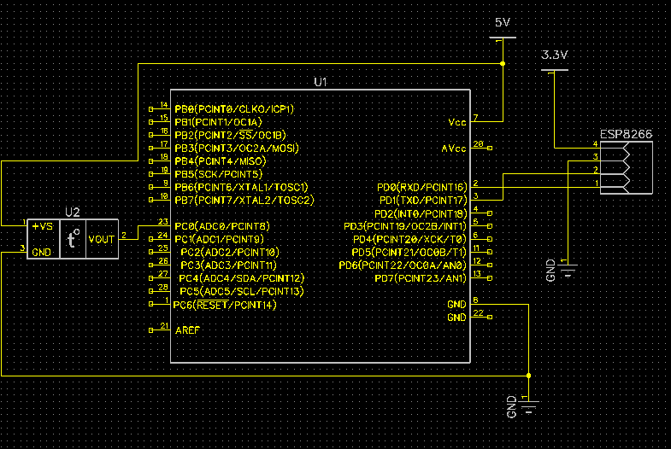
SCHEMATICS

Slide 4
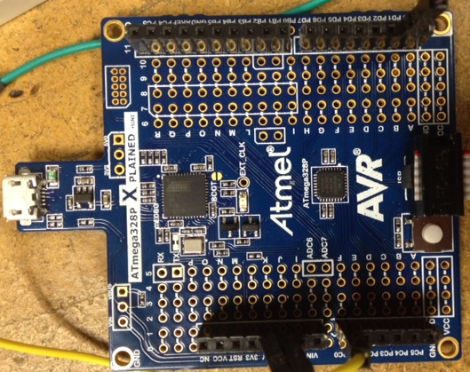
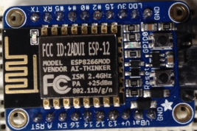
DESIGN STAGES
Components
AVR ATMEGA328p
DC Power Supply
LM34 Temperature sensor
ESP8266-12 WiFi Module
Interfaces
Atmega328p – ESP8266-12 VIA UART
IOT
Thingspeak account
Mobile Hotspot

Slide 5
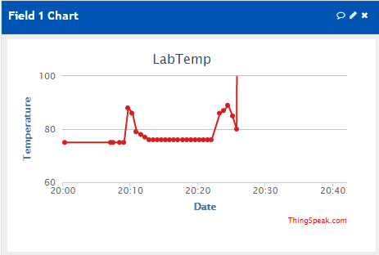
CODE DEVELOPMENT
Initialization
Flash 8266 with AT firmware
Connect WiFi module with hotspot via ESPlorer
Send initialization commands to prepare the sending of strings
Data Collection
LM34 sends data to Atmega328 through ADC0
IOT/Visualization-

Slide 6
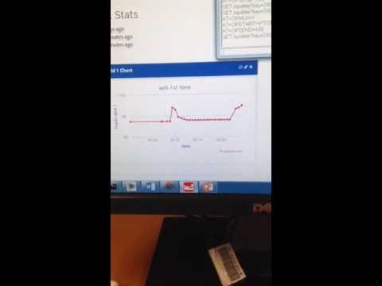
DEMO SNAPSHOT/VIDEO

