Slide 1
Traffic Sign Classifier
Vignesh Sivanandha Rao
Kishore Sherwin Rodriguez

Slide 2
Overview
Introduction
Background
Dataset Collection
Methods/Functions
Libraries Used
Visualization of Dataset
Normalization
Data Augmentation
Results
Summary

Slide 3
Introduction
Many modern vehicles include sensors for parking assistance, GPS and also to gather information about the external factors like, rain, snow, wind, adverse road conditions and suggest the drivers to drive with more caution.
Sign recognition is one of the major evolving technology in terms of vehicle safety.
Many modern vehicles have the facility of recognising some of the traffic signs by the road which can assist the drivers to improve road safety.

Slide 4
Background
Traffic Sign Recognition includes two major steps:
Detection: Determines the location of the traffic sign from an input image/frame.
Classification: Determines the class of sign that has been detected.
Traffic sign classifications are done by training a neural network model with a large amount of data.
Once the model is trained with multiple images, it would be able to classify the images and throw the accuracy of the training and validation.

Slide 5
Dataset Collection
Clicked traffic sign images on road side
Randomly downloaded images from google
Resize images to 200x200 pixels
Labelled images as per category for speed limit classification
Downloaded dataset for traffic signs

Slide 6
Methods/Functions
Regularization
Batch normalization
Data augmentation
Dropout
Optimization
Adam (Adaptive Moment Estimation)
SGD (Stochastic gradient descent)

Slide 7
Libraries Used
OpenCV - Data Augmentation
Tensorflow - Build layers
NumPy
Pickle - Pickled dataset (using matlab encoder)
Pandas - To read csv file containing the class IDs

Slide 8
Visualization of Dataset
Data Visualization is the key for creating and training any neural network model.
It provides an easy understanding of the data.
Matplotlib is a plotting library for the Python programming language and its numerical mathematics extension NumPy.
It provides an object-oriented API for embedding plots into applications using general-purpose GUI toolkits.
For simple plotting, the pyplot module provides a MATLAB-like interface, particularly when combined with IPython.

Slide 9
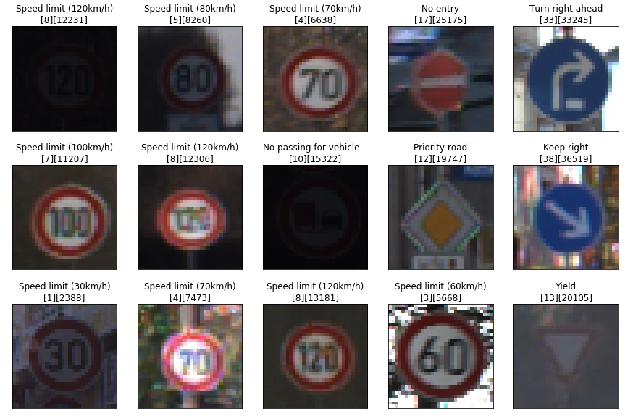

Slide 10
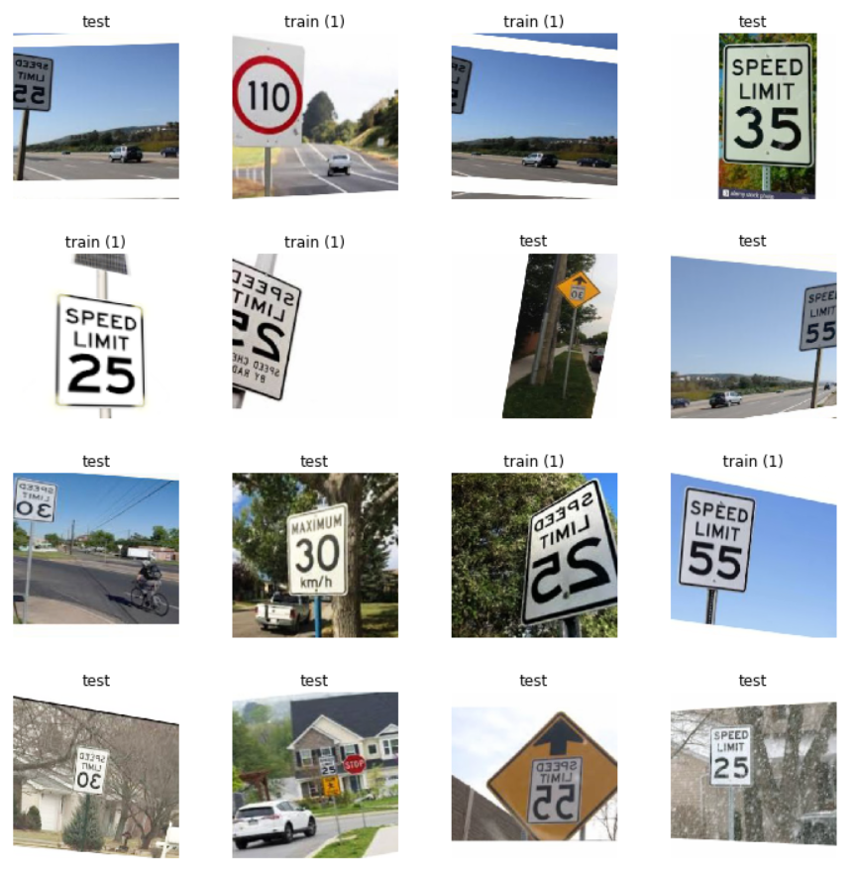

Slide 11
Normalization
It is the process of converting an unstructured data into a structured dataset.
This ensures that the images having a small dynamic range remains small and they're not normalized so that they become gray.
Therefore, every value has to be divided by the largest value possible by the image type, not the actual image itself. Then scaling this by 255 produces the normalized result.
normalized = (image.astype(np.float32) - 128) / 128

Slide 12
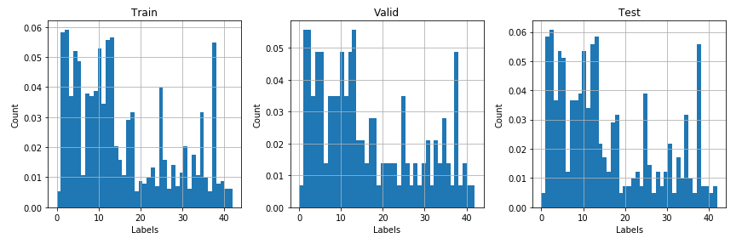
Label Distribution

Slide 13
Data Augmentation
Data augmentation adds value to base data by adding information derived from internal and external sources.
Data augmentation can be applied to any form of data, but may be especially useful where additional information can help provide more in-depth insight.
Data augmentation can help reduce the manual intervention required to developed meaningful information and insight of business data, as well as significantly enhance data quality.

Slide 14
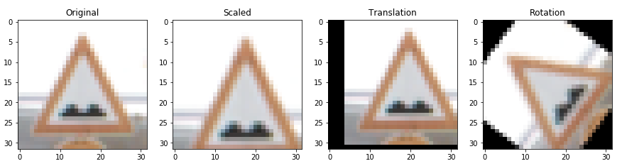
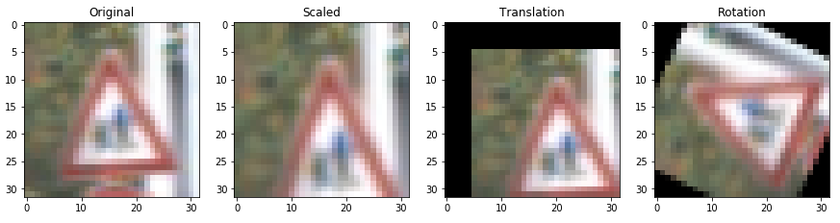

Slide 15
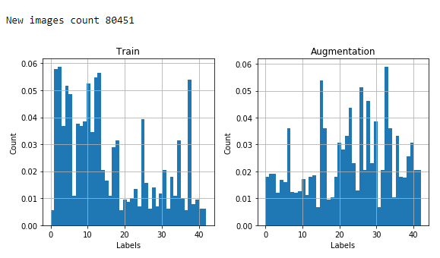
Label Distribution after Augmentation

Slide 16
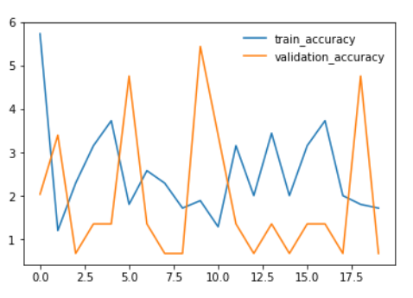
Initial Results
Learning rate: 5
Batch size: 128
Epoch: 20

Slide 17
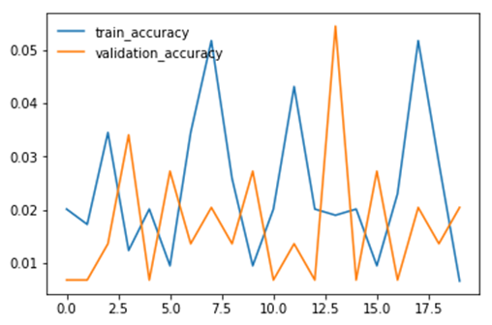
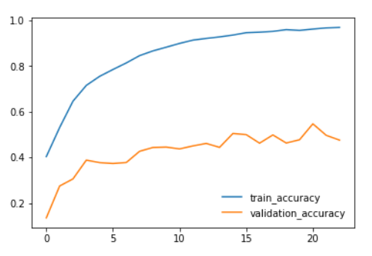
Better Results
Learning rate: 0.0005
Batch size: 128
Epoch: 20
Learning rate: 0.0025
Batch size: 128
Epoch: 23

Slide 18


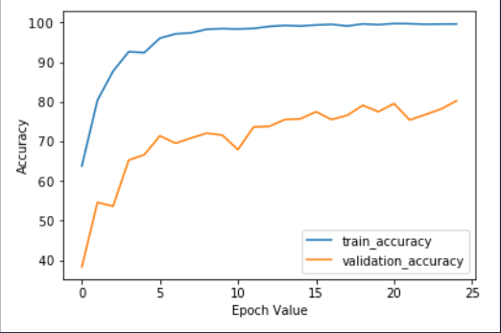
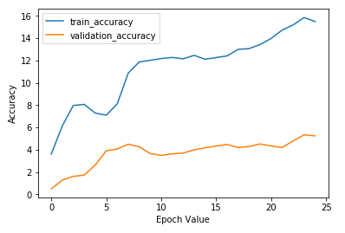
Adam vs Gradient Descent
Epoch: 25
Batch size: 128
Learning rate: 0.00070

Slide 19
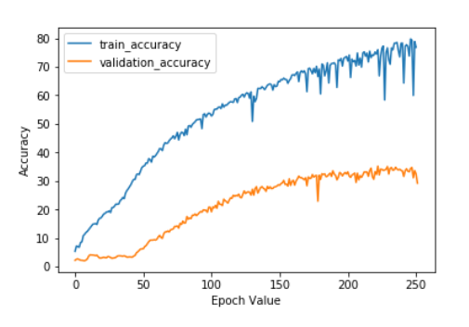
Gradient Descent Result
Epoch: 251
Batch size: 128
Learning rate: 0.00070

Slide 20



Results with Adam Optimizer
Dataset 1
Dataset 2
Dataset 3

Slide 21
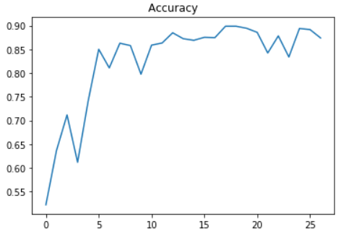
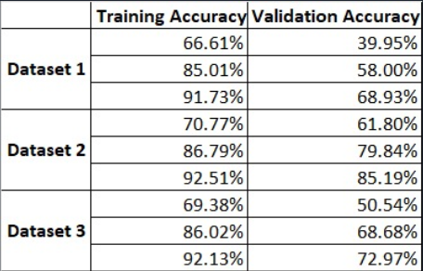
Summary

Slide 22
Future Work
Figure out the ways to achieve more accuracy on SGD using different parameters
Extend the classes for classification
Compare more optimizers to see which one works best at any given condition
Improve accuracy on prediction of new images

Slide 23
Conclusion
Gained knowledge on working of a deep neural network
Learnt how optimizers affect the accuracy of a model
Achieved a basic classification of SGD and Adam optimizer

Slide 24
Team Contribution
Vignesh
Worked on dataset collection
Pre-processed images to run in colabs
Worked on gathering pickled dataset
Worked on experimenting Adam and SGD optimizers
Worked on slides
Sherwin
Helped in dataset collection
Worked on fastai
Helped in experimenting Adam and SGD optimizers
Helped in getting experimental results
We both will work together in report creation

