Slide 1
EBC 5125 – Data Science Applications ASSIGNMENT-1
Group-4
Submitted to :
Prof. Arya Rahgozar

Slide 2
Dataset:
Downloaded books of seven authors from Gutenberg library.

Slide 3
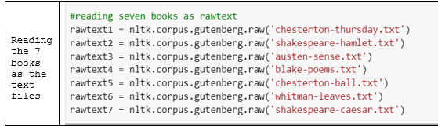
Data Preparation
Step-1 : We imported Gutenberg books using nltk library.
Step-2: Reading the 7 books as the text files

Slide 4
Steps…
Step-3 :
Taking all the author names into an array that we will use for the labelling afterwards.
Step-4:
To attain accuracy and proper results stop words or the filler words must be removed
So we cleaned up them using Nltk.stopwords(‘English’) .

Slide 5
Steps…
Step-5:
Tokenization of sentences to further clean up the sentences we have tokenized the sentences.
What is tokenization?
Tokenization is the process by which big quantity of text is divided into smaller parts called tokens.
. It becomes vital to understand the pattern in the text to achieve the above-stated purpose. These tokens are very useful for finding such patterns as well as is considered as a base step for stemming and lemmatization.

Slide 6
Steps…
Step-6:
Labelling the data with author names:
In order to model our data and find accuracies we need labelled data so when we give the sentence we get the author name .
Step-7:
Adding all the processed documents into single corpus.

Slide 7
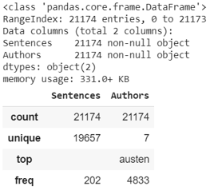
Data-pre processing
In data preprocessing we use pandas data frame its easy to process and transform data when it has some structure.

Slide 8
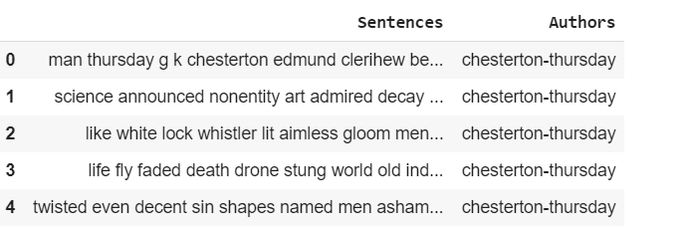
Sample data after labelling

Slide 9
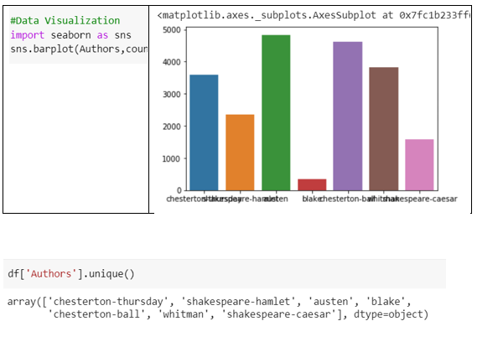
Data Visualization

Slide 10
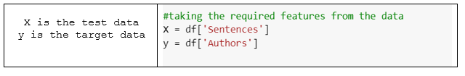
Future engineering step

Slide 11
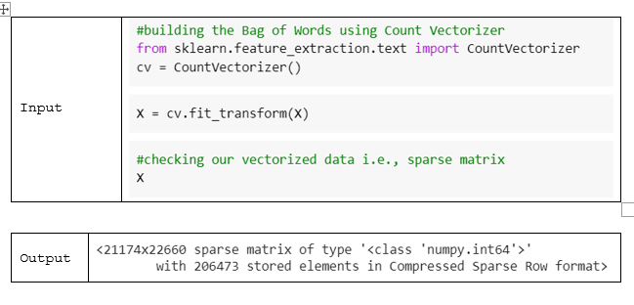
Transformation of the Data
Transformation of the data using Bag of Words (BOW):

Slide 12
Train and Test Split
Training
= 70% of data
Testing
Testing = 30% of data

Slide 13
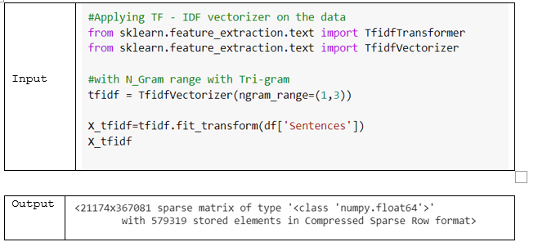
Transformation of the data using TF-IDF
Same division of 70 / 30 % of data into train and test split for modelling .

Slide 14
Classification of the data using the algorithms
1.Multinomial Naives Bayes Model
2.Decision Tree
3.Support Vector Machine
4. K Nearest Neighbors

Slide 15
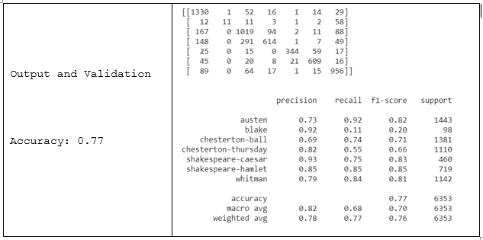
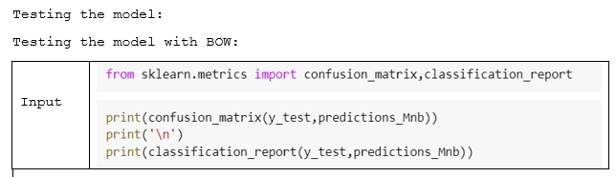
MultiNomial Naïve Bayes model

Slide 16
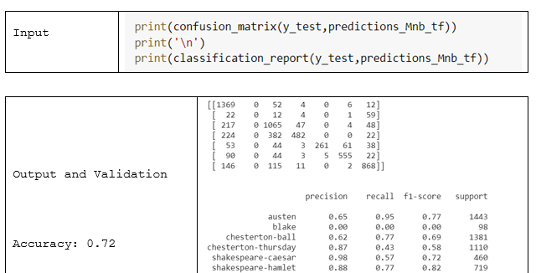

Slide 17
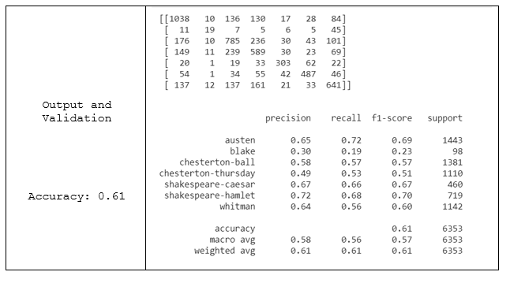
2. Decision Tree

Slide 18
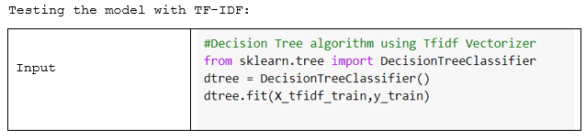
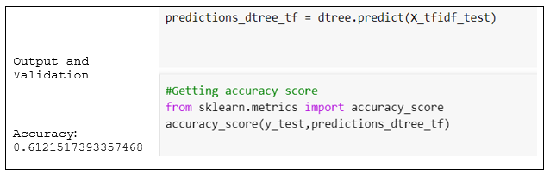

Slide 19
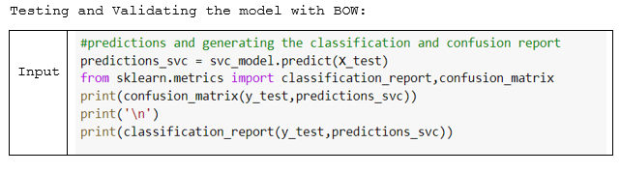
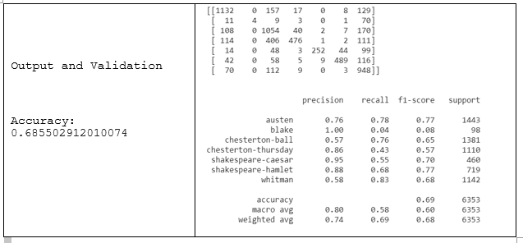
3. Support Vector Machine:

Slide 20
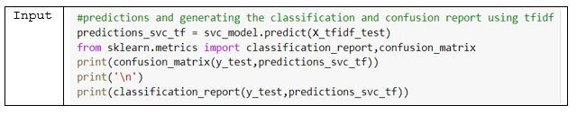
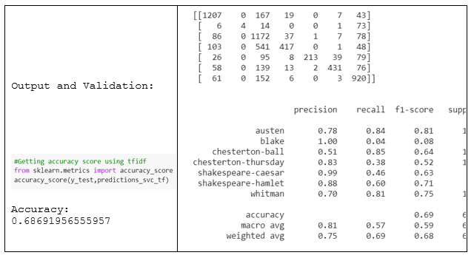
Testing the model with TF-IDF

Slide 21
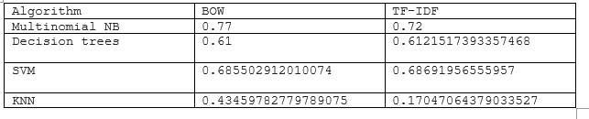
Results

Slide 22
THANK YOU

