Slide 1

Oil Production Forecasting
Submitted by Group-01
This project helps energy planners anticipate future oil production in the United States with reliable monthly and long-term forecasts. It supports better operational and strategic decisions by tracking changes in production patterns. A user-friendly UI makes the forecasts and insights easily accessible to stakeholders.

Slide 2

Business Understanding
Business Problem: Uncontrolled production changes can lead to price volatility, affecting economies worldwide. To stabilize oil prices and curb inflation, policymakers and oil producers need accurate monthly forecasts of U.S. oil production.
Success Criteria: The oil forecasting models were evaluated using RMSE, MAE, and MAPE to ensure high predictive accuracy. Model stability was validated through concept and data drift checks over time. Success was defined by low error rates, absence of significant drift, and full traceability through versioned logs in Weights & Biases.
Component | Detail of SIPOC criteria
Suppliers (S) | Data providers (EIA, OPEC, IMF, World Bank), Government agencies, Oil companies
Input (I) | Historical oil production data, Macroeconomic indicators (inflation, GDP, interest rates)
Process (P) | Data collection → EDA Preprocessing → Model training (short-term & long-term forecasting) → Evaluation → Deployment
Outputs (O) | Monthly oil production forecasts, Predictive insights on inflation impact
Customers (C) | Policymakers, Economists, Oil companies, Financial analysts, Governments

Slide 3

Data Understanding
The dataset used in this project was sourced from the U.S. Energy Information Administration (EIA), containing historical monthly crude oil production data for the United States.
Raw data scraped from the EIA is initially stored locally in CSV format. After preprocessing, the cleaned and transformed data is ingested into a SQLite database for structured storage and further processing.
The data spans multiple years and includes production volume (in thousand barrels) indexed by year and month.
Initial inspection revealed that the data was complete with no missing production values but required reshaping for time series analysis.
Key Observations from EDA:
A significant upward trend due to the shale boom post-2010
Seasonal patterns observed annually (e.g., summer dips, winter peaks)
Production dip during COVID-19 (2020), followed by recovery
Outliers during global shocks (e.g., geopolitical tensions, natural disasters)
Initial exploratory visualizations included decomposition plots (seasonal_decompose()), ACF/PACF plots, and moving average smoothing to understand trend-stationarity and lag correlations.
Challenges Identified:
Seasonality captured using lag and rolling statistics
External factor incorporation planned but yet to be fully integrated (e.g., inflation/elections data)

Slide 4

Data Preparation
Reshaping & Melting Transformed wide-format data into long-format time series with one row per month.
Datetime Construction Combined year and month into a unified datetime index (monthly frequency).
Data Cleaning Removed commas from values, converted to integers. No missing values were found in the dataset; any anomalies were handled during type conversion.
Filtering Retained data from January 2010 onward, focusing on the post–shale boom era for modern relevance.
Outlier Handling Used box plots and summary stats to identify anomalies. Retained values unless clearly erroneous, preserving real production shocks.
Train-Test Split
Short-Term: Fixed split at January 2024 to simulate near-future prediction.
Long-Term: Last 60 months held out for multi-year forecast validation.
Feature Engineering (ML Models) Created lag features (lag_1, lag_2, lag_3, lag_6, lag_12) and time variables (month, year) to model temporal dependencies.

Slide 5
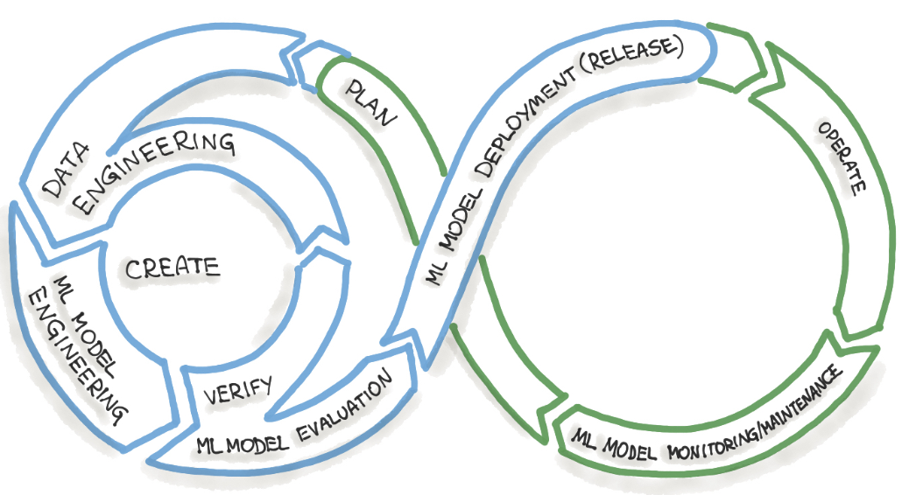
Pipeline Development
Forecasting Models
Short-Term Models: ETS, ARIMA + STL, SARIMA, Prophet, STL + LSTM
Long-Term Models: XGBoost, Hybrid STL + XGBoost, Prophet (log), STL + LSTM
Evaluated models using RMSE, MAE, and MAPE and ranked the models
Best models selected: ETS (short-term) and Hybrid STL + XGBoost (long-term).
Drift Detection
Monitored concept drift using rolling RMSE and MAPE.
Checked data drift using statistical tests on input features (KS test).
Model Tracking & Logging
Logged metrics, plots, and model artifacts to Weights & Biases for traceability.
Drift monitoring and version control integrated with W&B runs.
Forecast Delivery
Developed a Streamlit app to visualize forecasts and insights for business users.
Included interactive plots, confidence intervals, and performance summaries.
Project Repository
All code, notebooks, and artifacts are organized and saved in a GitHub repository.
Ensures version control, team collaboration, and reproducibility.

Slide 6
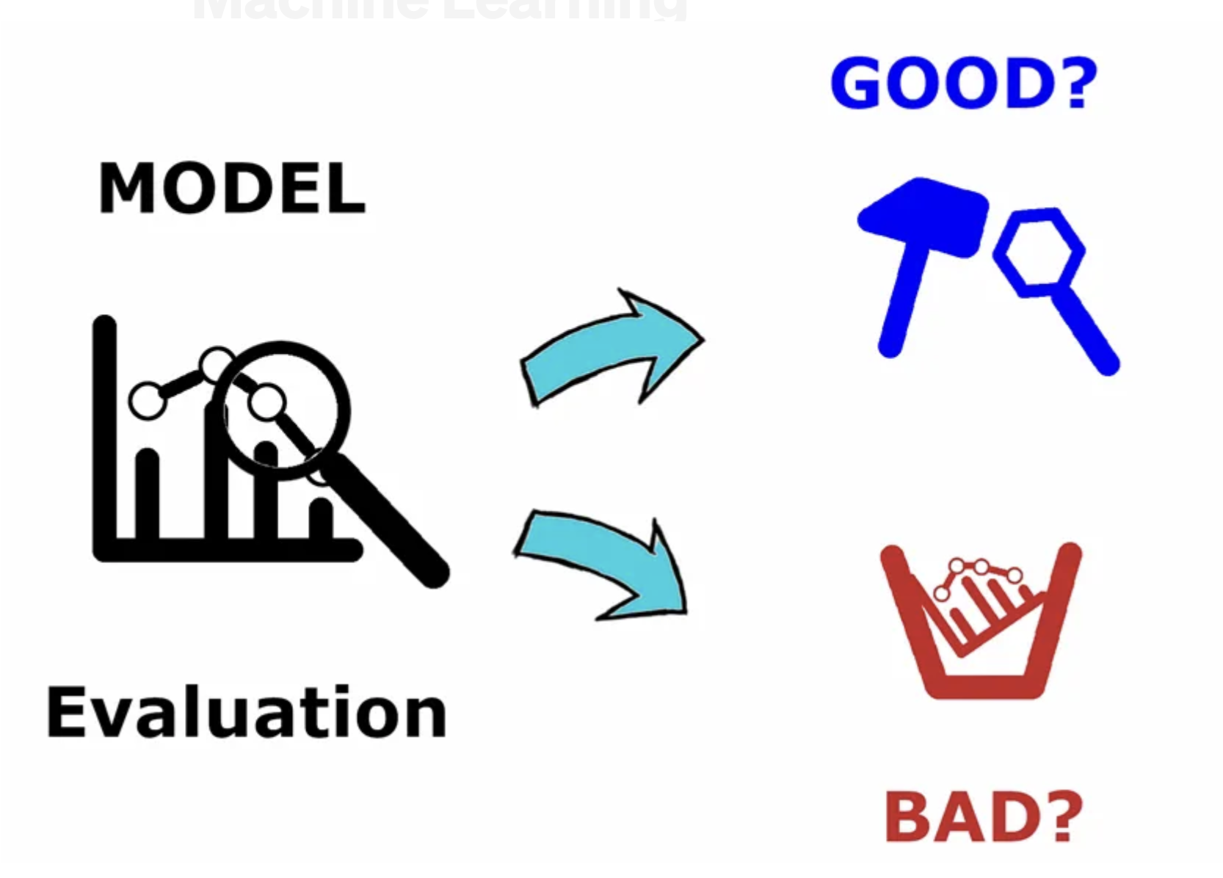
Modeling and Evaluation
Short-Term Forecasting
Exponential Smoothing (ETS): Provided strong baseline performance with minimal tuning and excellent fit for recent seasonality.
ARIMA + STL: Used STL decomposition to separate seasonality before fitting ARIMA to the residuals.
SARIMA: Applied to model both autoregressive and seasonal components simultaneously.
Prophet: Automatically captured trend and seasonal patterns with calendar-based flexibility.
STL + LSTM: Combined decomposition with deep learning to forecast residual patterns.
Long-Term Forecasting
XGBoost: Trained using engineered features like lags, month, and year to learn long-term production trends.
Hybrid STL + XGBoost: Modeled the residual component from STL decomposition using XGBoost for improved accuracy.
STL + LSTM: Applied deep learning to forecast long-term residuals after deseasonalization.
Prophet (log): Used log-transformed production values to stabilize variance over the long horizon.
Models were tested on a holdout period, with:
A fixed cutoff date (January 2024) for short-term forecasting.
The last 60 months used for long-term forecast evaluation
Each model was evaluated on forecast accuracy, and the best were selected based on a weighted scoring approach. The final choices—ETS for short-term(RMSE: 1.89%, MAPE: 1.43%) and Hybrid STL + XGBoost for long-term(RMSE: 5.14%, MAPE: 4.12%)—were selected for their accuracy, stability, and interpretability. The best-performing models were:

Slide 7
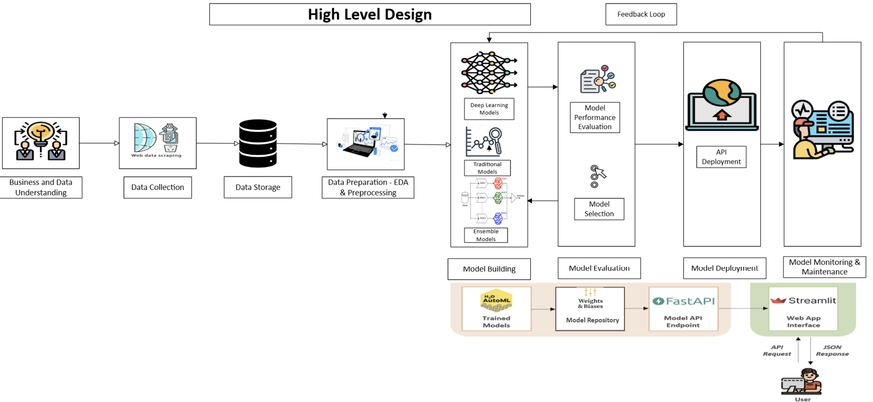
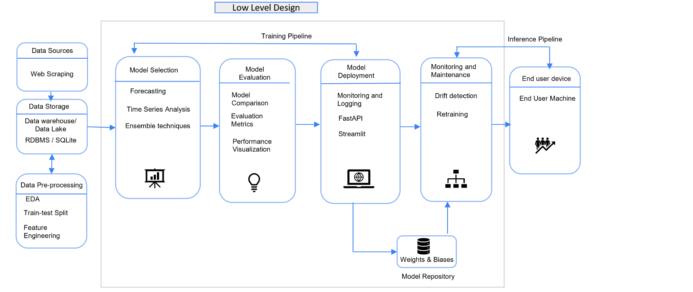
Architecture Diagram

Slide 8
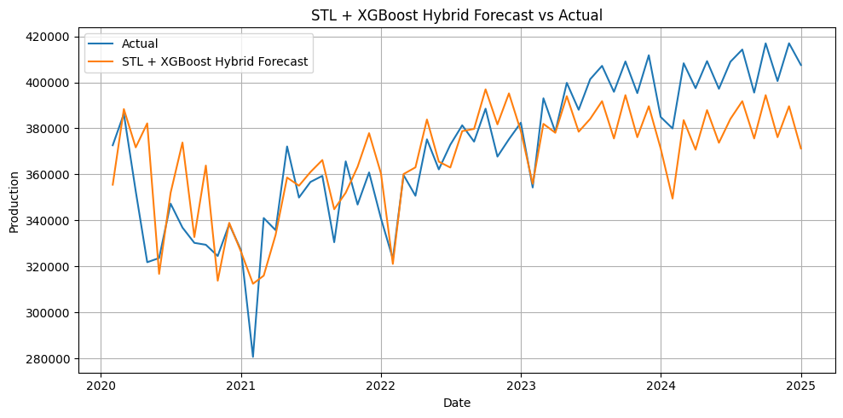
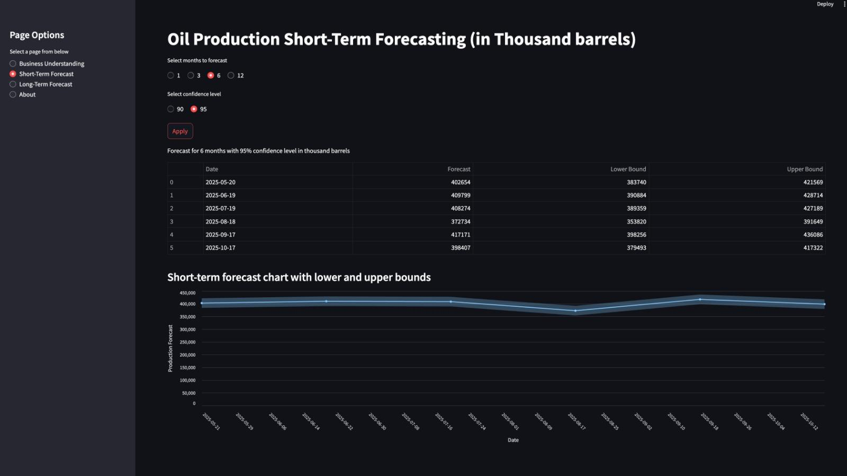
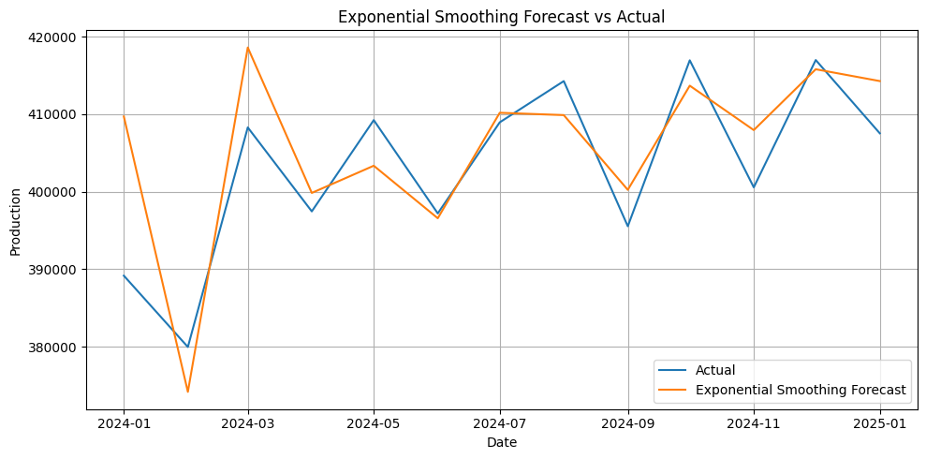
Model Deployment
Deployed using a user-friendly Streamlit app for interactive exploration of:
Forecast outputs
Performance metrics
Confidence intervals
Best models and outputs tracked via Weights & Biases, ensuring:
Full version control
Model reproducibility
Centralized experiment logging
System is designed for:
Easy retraining and updates
Scalability across future datasets
Seamless integration into operational workflows
Some screenshots of model forecasts and Streamlit app are shown on right.

Slide 9

Model Monitoring & Maintenance
Drift Detection
Rolling RMSE and MAPE tracked to monitor concept drift
KS tests used to detect data drift in input features over time
Drift metrics and plots logged to Weights & Biases for visibility
Performance Monitoring
Forecast accuracy evaluated using actuals vs predictions
Model Retraining and Readiness
Clean separation between training, evaluation, and deployment steps
We retrain the model whenever needed and latest retrained model is logged in Wandb
Version Control
All models, metrics, and artifacts tracked in wandb
Enables historical comparisons and rollback if needed
PESTEL Scenario Considerations for Forecasting
Factor | Relevance
Political | Government regulations on oil drilling, sanctions on oil exports/imports, political instability in key regions
Economic | Global oil price trends, inflation rates, exchange rate fluctuations, interest rate shocks
Social | Public sentiment on fossil fuel dependency, labor union strikes, demand variation due to consumption patterns
Technological | Advances in drilling/fracking, improved forecasting techniques (ML/DL), alternative energy development
Environmental | Natural disasters, climate change regulations, carbon tax policies impacting production cycles
Legal | Compliance requirements from bodies like EPA, litigation affecting exploration rights or transport laws

Slide 10

Conclusion and Learnings & Next Steps
Conclusion
A complete forecasting solution was built to predict U.S. oil production using a combination of time series, machine learning, and hybrid models.
The system achieved high accuracy across both short- and long-term forecasts, with integrated drift detection and model tracking.
Forecasts are deployed through a Streamlit app for easy access and interpretation by stakeholders.
Next Steps
Automate retraining pipeline as new monthly data becomes available
Integrate API access for seamless production use
Expand model to include external drivers (e.g., oil prices, rig counts)
Explore multi-region forecasting and demand-side modeling
Key Takeaways
Hybrid approaches (e.g., STL + XGBoost) effectively improve long-term forecast accuracy
Drift monitoring is essential for maintaining model reliability in production
Transparent tracking via W&B and interactive delivery through Streamlit ensure the solution is scalable, maintainable, and actionable
Stakeholder Feedback Alignment: Forecast outputs can be tailored based on stakeholder risk profiles
Stakeholders vary by risk appetite—risk-takers prefer upper-bound forecasts for opportunity, risk-averse prefer lower bounds for caution, and risk-neutral rely on central forecasts for balanced planning.

