Slide 1
DD
Power EnJoy
Design Document
Authors:
Andrea Battistello : 873795
William di Luigi : 864165
14/12/16

Slide 2
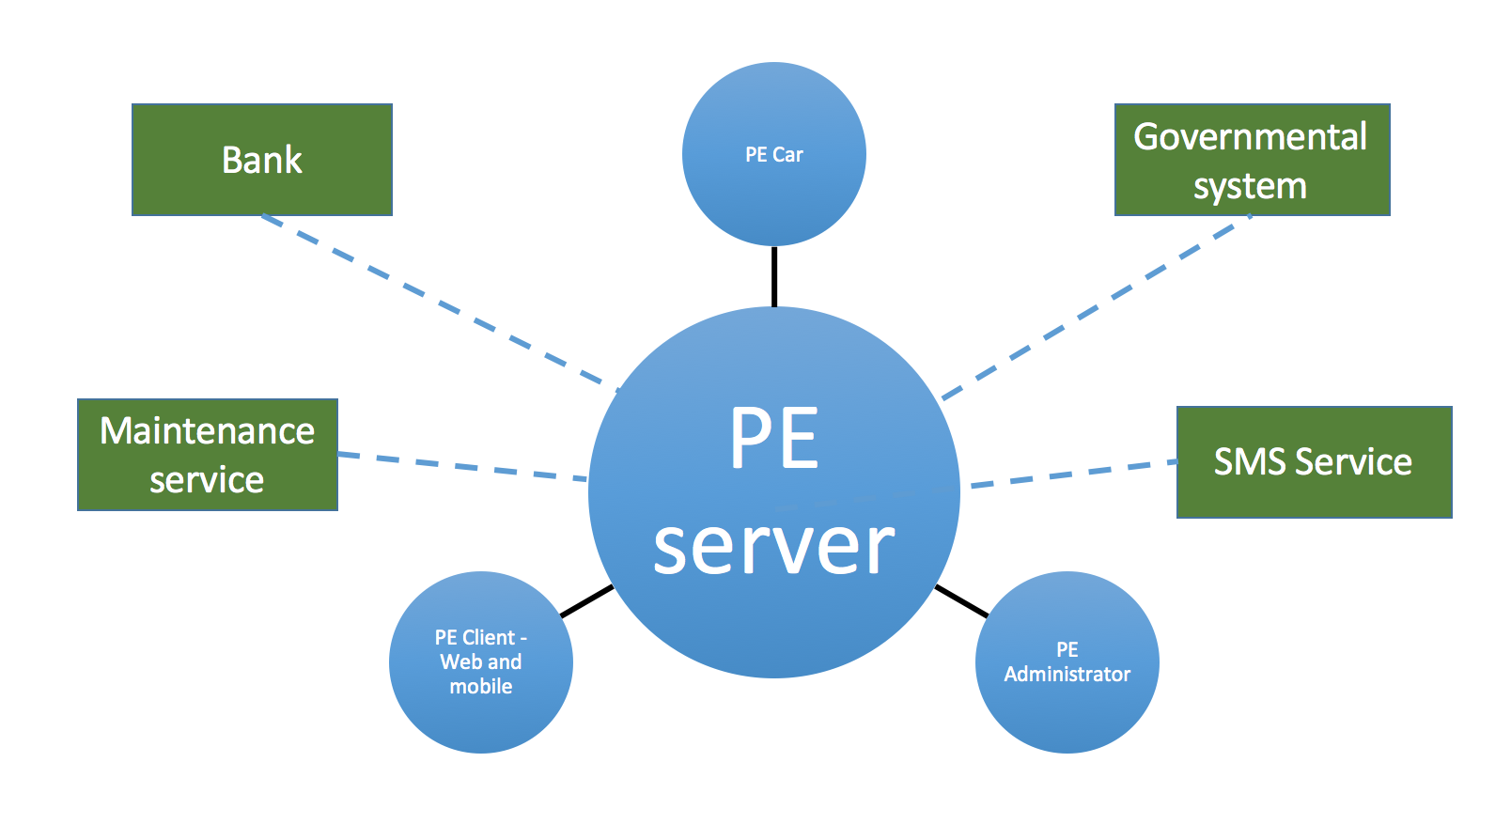
Overview

Slide 3
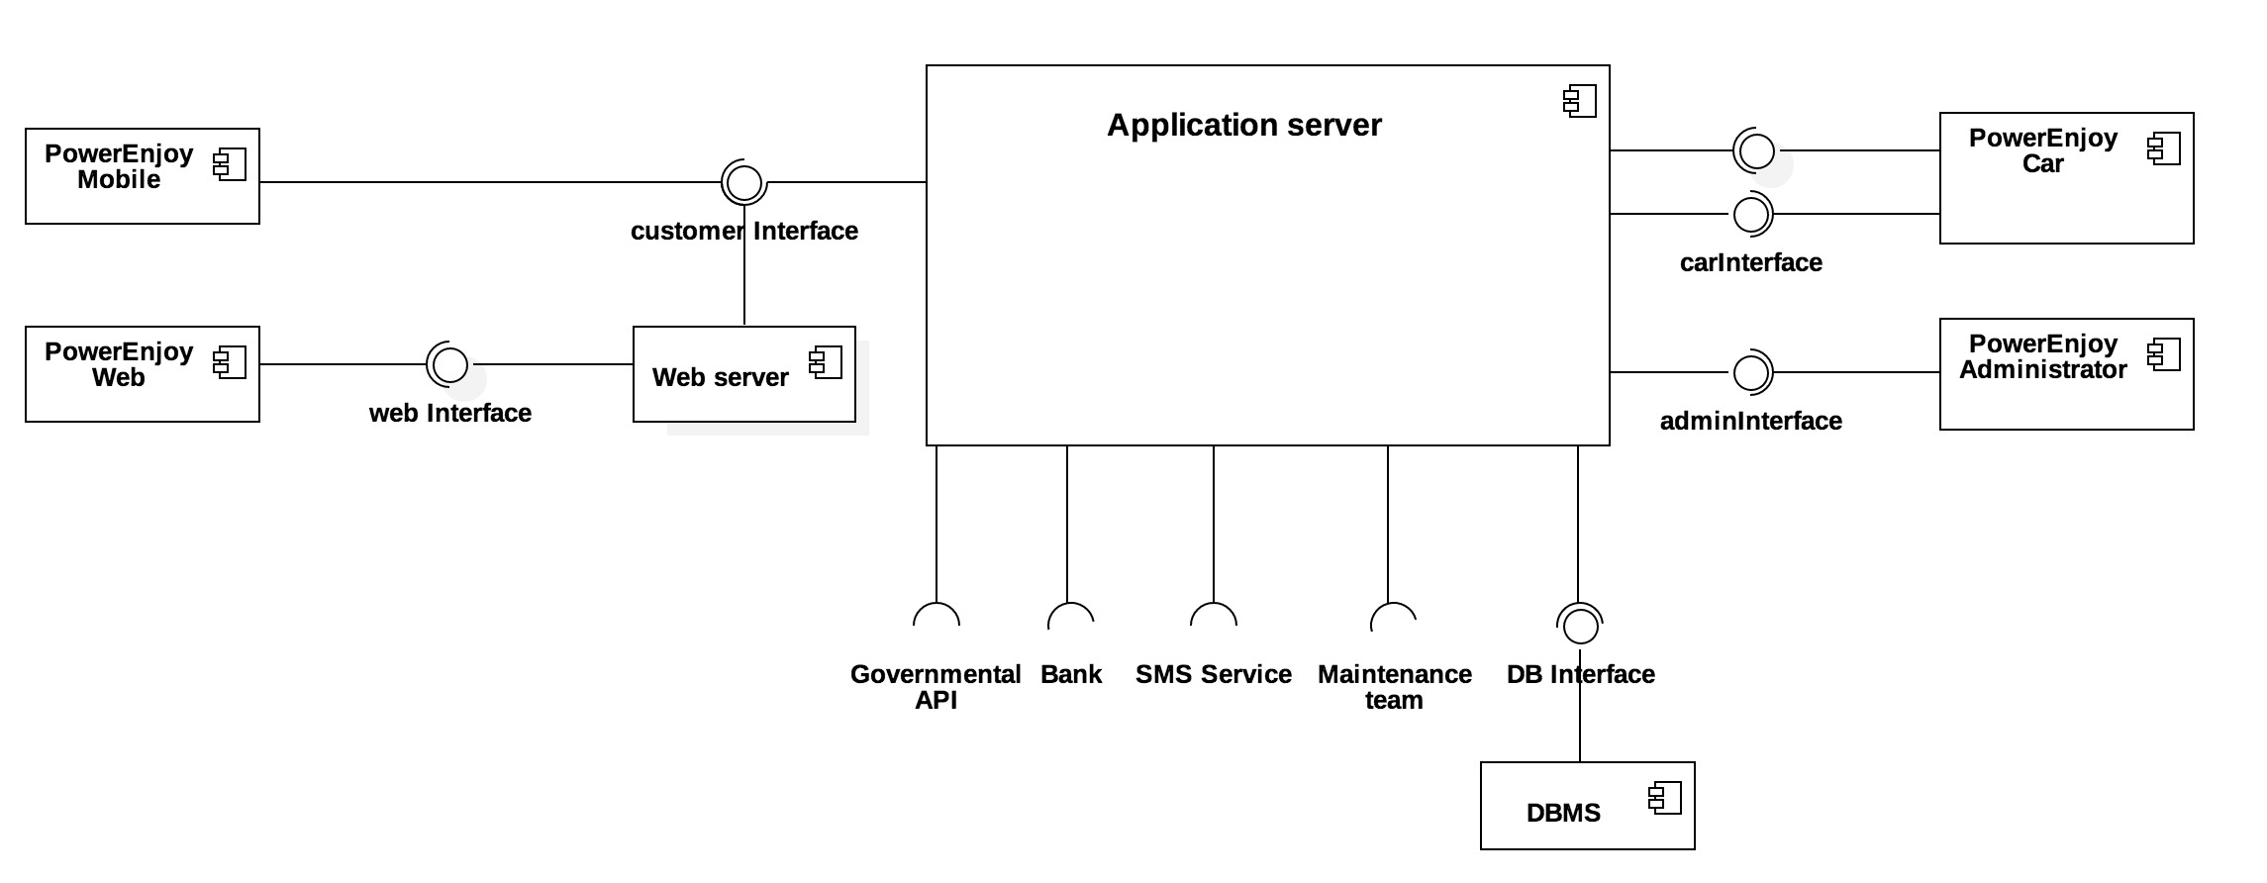
Component view

Slide 4
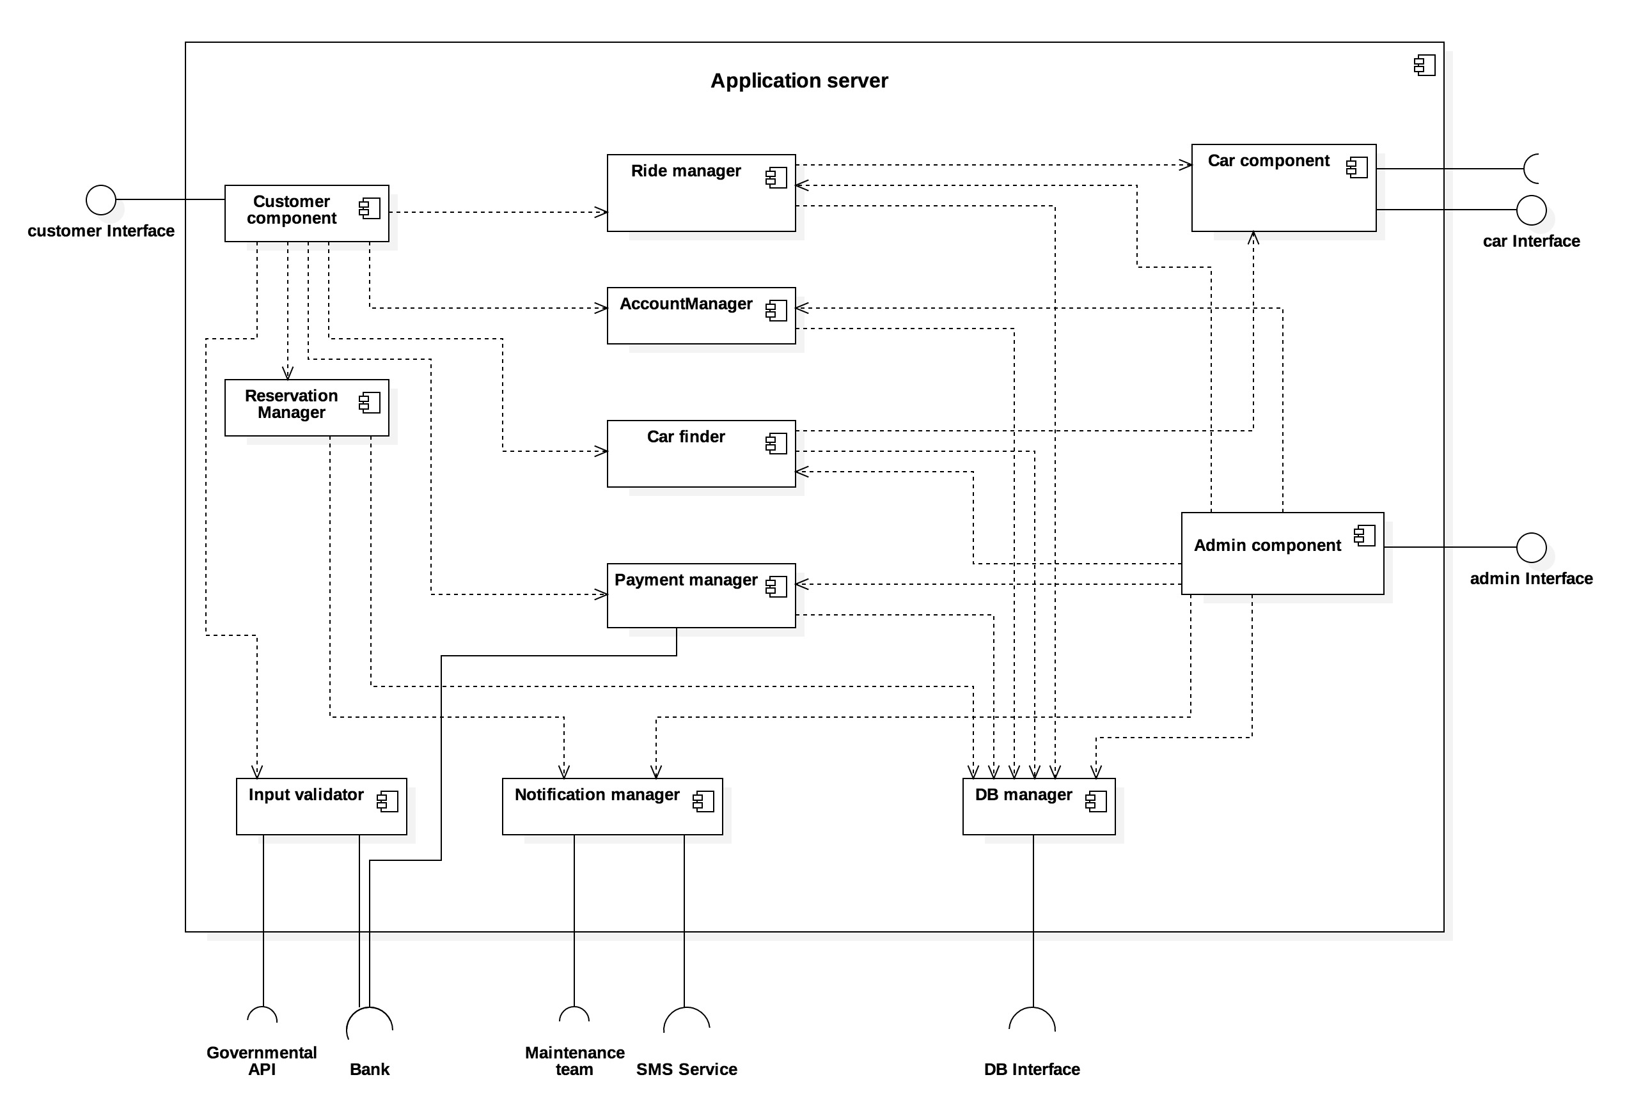
Application server

Slide 5
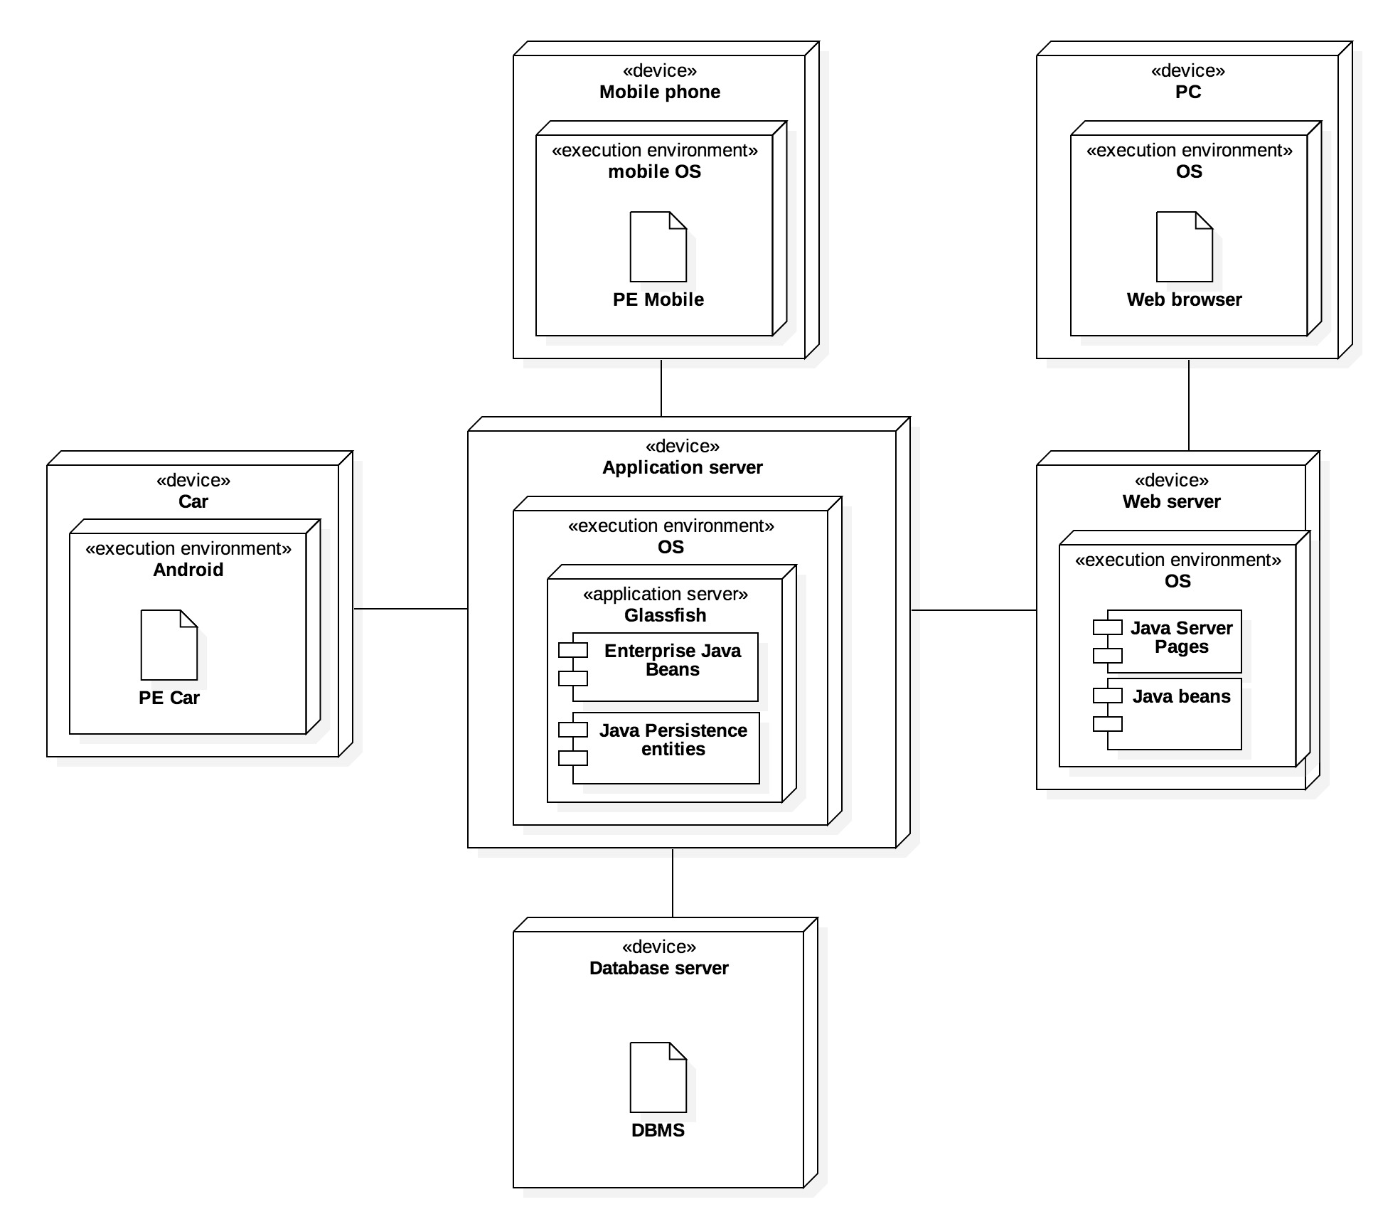
Deployment view

Slide 6
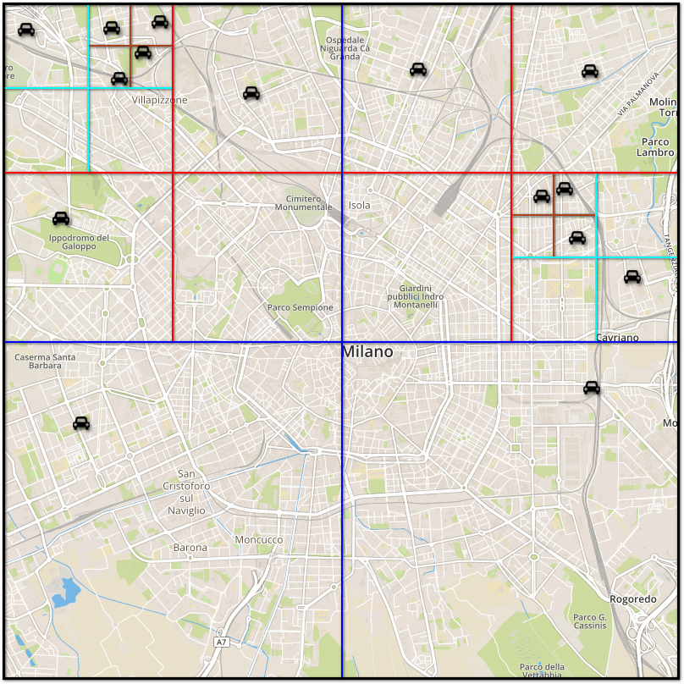
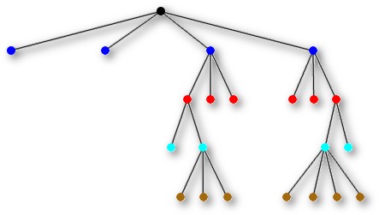
Quad trees

Slide 7
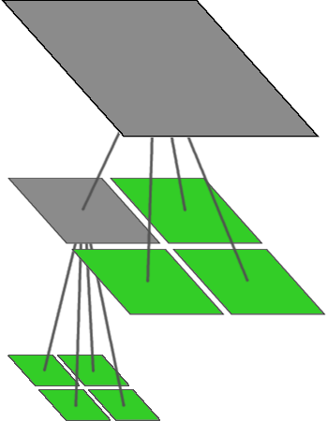
Insert
procedure QuadInsert(C, X) // Try to insert car C at node X in quadtree // By construction, each leaf will contain either // 1 or 0 cars if the subtree rooted at X has more than 1 car then determine in which child Y of node X the car C is in
// Y is either the top left, top right, bottom left, // or the bottom right “quadrant”
QuadInsert(C, Y)
else if the subtree rooted at X has exactly 1 car then // X is a leaf create four children for node X in the Quadtree
// X is not a leaf anymore move the car in X into the child in which it lies
let Y be child in which car C lies QuadInsert(C, Y) else // X is a leaf store car C in node X endif
end

Slide 8

List all cars in a given area – Step 1

Slide 9
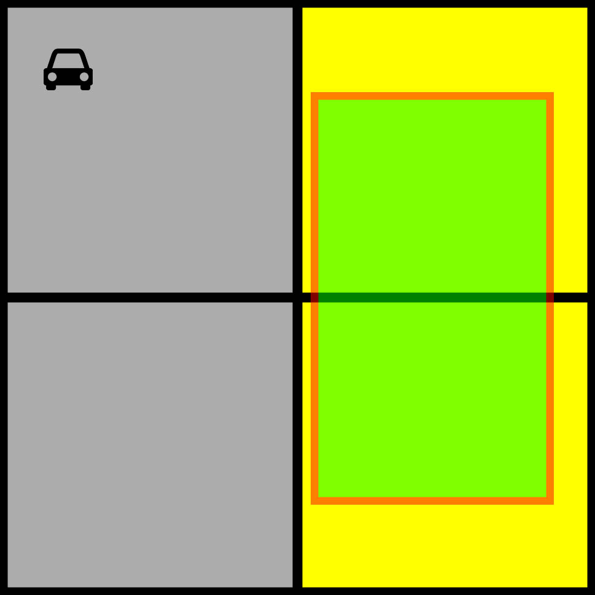
List all cars in a given area – Step 2

Slide 10
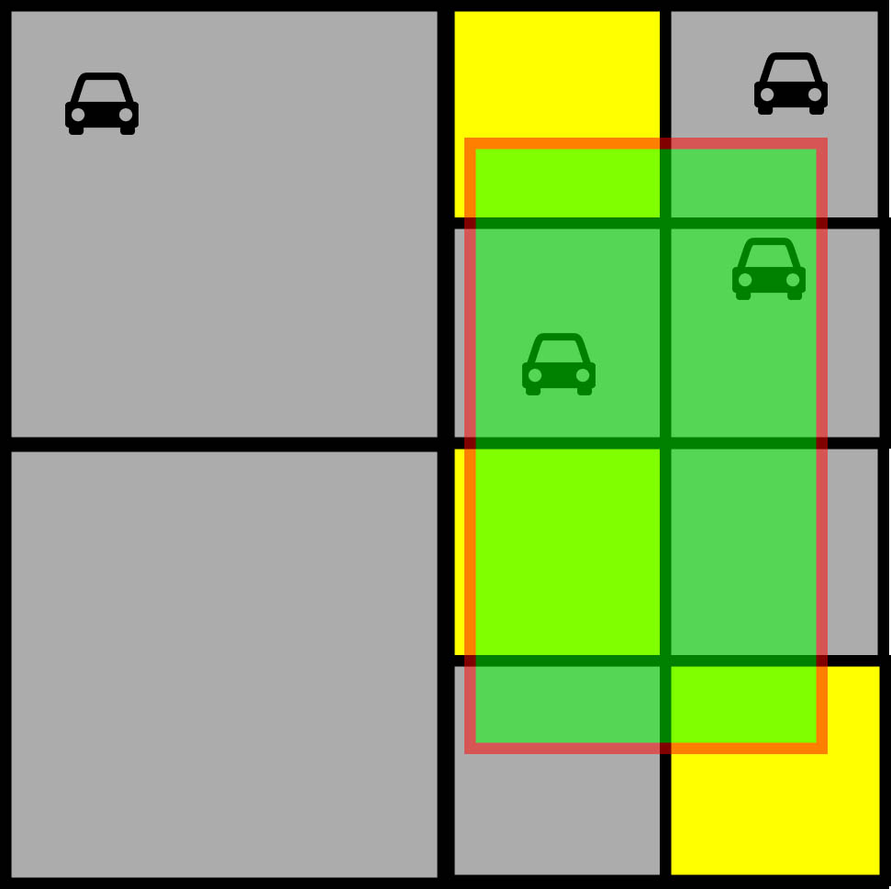
List all cars in a given area – Step 3

Slide 11
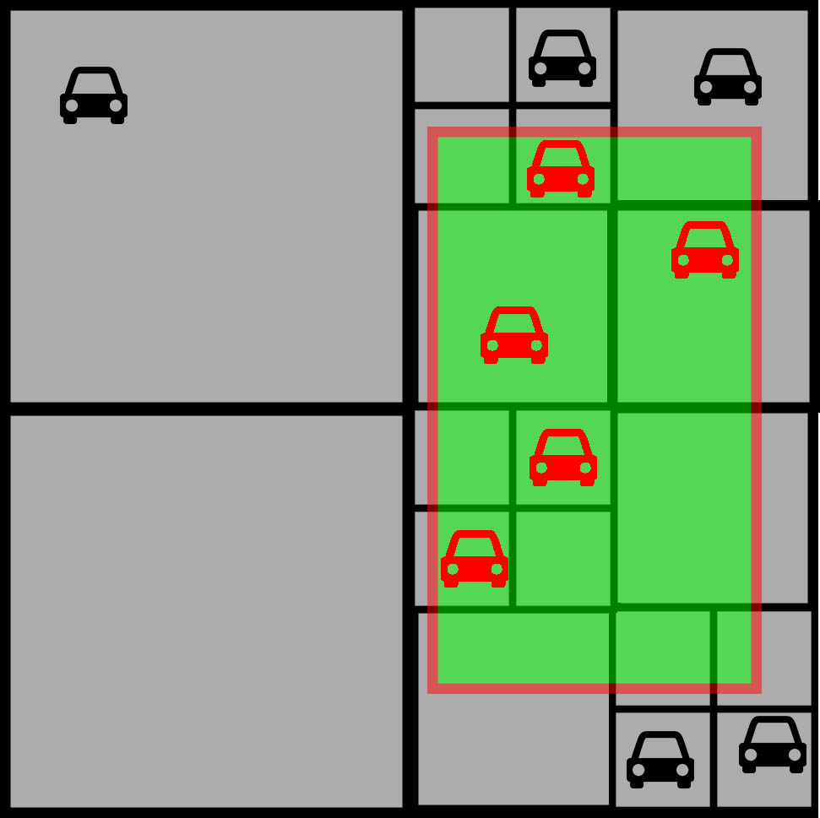
List all cars in a given area – Step 4

Slide 12
List all cars in a given area
procedure QuadList(S, X)
// S is the “query square”, that is: the interesting area // X is the root node, initially is set to root answer = [] // empty list
Y = S ⋂ area(X) // intersection between S and the area of X
if Y ≠ ∅ // non-empty intersection
if X is a leaf
answer += [all cars that are inside Y] // 0 or 1 car
else
answer += QuadList(S, top left of X) answer += QuadList(S, top right of X) answer += QuadList(S, bottom left of X) answer += QuadList(S, bottom right of X)
endif
endif
return answer

Slide 13

We’re done.
Any questions?

