Slide 1
RASD
Power EnJoy
Requirement Analysis and
Specification Document
Authors:
Andrea Battistello : 873795
William di Luigi : 864165
02/12/16

Slide 2
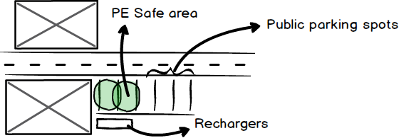
Safe areas

Slide 3
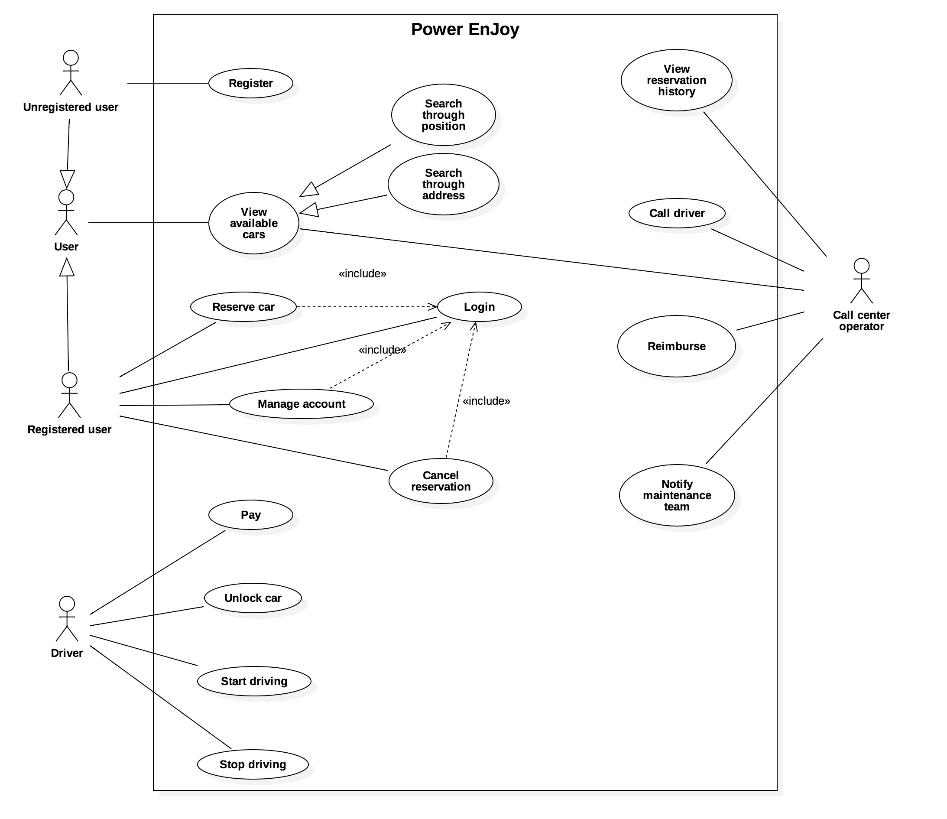
Use case diagram

Slide 4
Power EnJoy components
PE server
PE Car
PE Client - Web and mobile
PE Administrator
Bank
Governmental system
Maintenance service
SMS Service

Slide 5
Goals
[G1] Build an effective and reliable electric car sharing system.
[G1.1] Allow every user to view available cars near or in a given position.
[G1.2] Allow (activated) registered users to reserve available cars.
[G1.3] Allow users to drive their reserved car.
[G1.4] Allow users to cancel the reservation.
[G1.5] Allow users to access to PE and manage their account.
[G2] Encourage drivers to behave correctly and with respect to the law.
[G3] Offer an easy-to-use system for call center operators to monitor cars and give assistance to drivers.

Slide 6
G1.1 View available cars nearby or in a given position
PEM and PEW should be able to retrieve device position either with a GPS antenna or by using browser geolocalization after obtaining the user’s permission.
PE should be able to find the GPS coordinate given a specific address.
Every car must respond with their GPS coordinate when it is asked by PE.
The user should be able to specify the range of the area where to find available cars.
The user should be able to visualize the battery level of available cars.

Slide 7
G1.2 Reserve available cars
Each user should have only one active reservation at a time.
All reservations must be related to only one car and each car can be bound to at most one reservation at a time.
When the user reserves a car, it automatically becomes reserved and won’t be visible to other users until the reservation is cancelled or he/she stops driving.
Each reservation should expire after a fixed amount of time (e.g. 1 hour). If the user forgets to cancel the reservation within that deadline, user should incur in a penalty fee.
A car should be available only if it has at least 20% battery full.

Slide 8
G1.3 Drive the reserved car
Every car should be able to unlock every time they receive an unlock message by PE.
The user should be able to unlock the car either via SMS (e.g. with an ‘UNLOCK’ message) or PEM.
The car should lock the door after a fixed amount of time (e.g. 30 seconds) it have been unlocked. If the doors are still open after that time, the car will lock as soon as the doors closes.
The user should be able to stop the ride either via SMS (e.g. with a ‘STOP’ message) or PEM

Slide 9
G1.3 Drive the reserved car (2)
The user should be able to pay for all his rides monthly.
The car should be able to detect whether it is on a PE safe area or not.
The car should be able to detect the number of passengers it is carrying.
User should be aware of current charge when driving through a screen in the car.
PE should start charging the user either when the car engine ignites or when a fixed amount of time (e.g. 10 minutes) is passed from the first unlock made by the user.

Slide 10
G1.4 Cancel the reservation
User should be able to cancel a pending reservation only before he/she unlocks the car for the first time
User should be able to view his/her pending reservation.

Slide 11
G1.5 Allow users to access to PE and manage their account.
PE should verify all the data changed by the user
User should be able to:
Change password
Change/update driving license and ID card
Change phone number
View pending reservation (if any) and all past reservation
View the bills to pay and/or already paid
Change payment informations
Users should be able to register and create an account.
Users should be able to log in with a previously created account

Slide 12
G2 Encourage drivers to behave correctly and with respect to the law.
PE should be able to retrieve driver information for a specified car in a given time.
PE should be able to verify the correctness of the driving license and ID card of a driver (e.g. using a governmental system)
PE should apply some discounts on the ride in this situations:
The driver is carrying at least 2 passengers
The driver leaves the car with at least 50% of battery full.
The driver parks in a PE safe area and plugs the car in the power grid
PE should apply some penalty fees on the ride in this situations:
The driver parks the car far from the nearest PE safe area (e.g. the nearest PE safe area is at least 3 km far)
The driver leaves the car with less than 20% of battery full.
PE should periodically check the validity of the documents presented by each user and forbid user to reserve cars with out-of-date documents.

Slide 13
G3 Monitor cars and give assistance to drivers
Call center operators should be able to:
View the position of all the cars on road
Notify maintenance operators
Reimburse the driver
Call the driver
Notify police/ambulance of emergencies.
View the reservation history of each car.

Slide 14
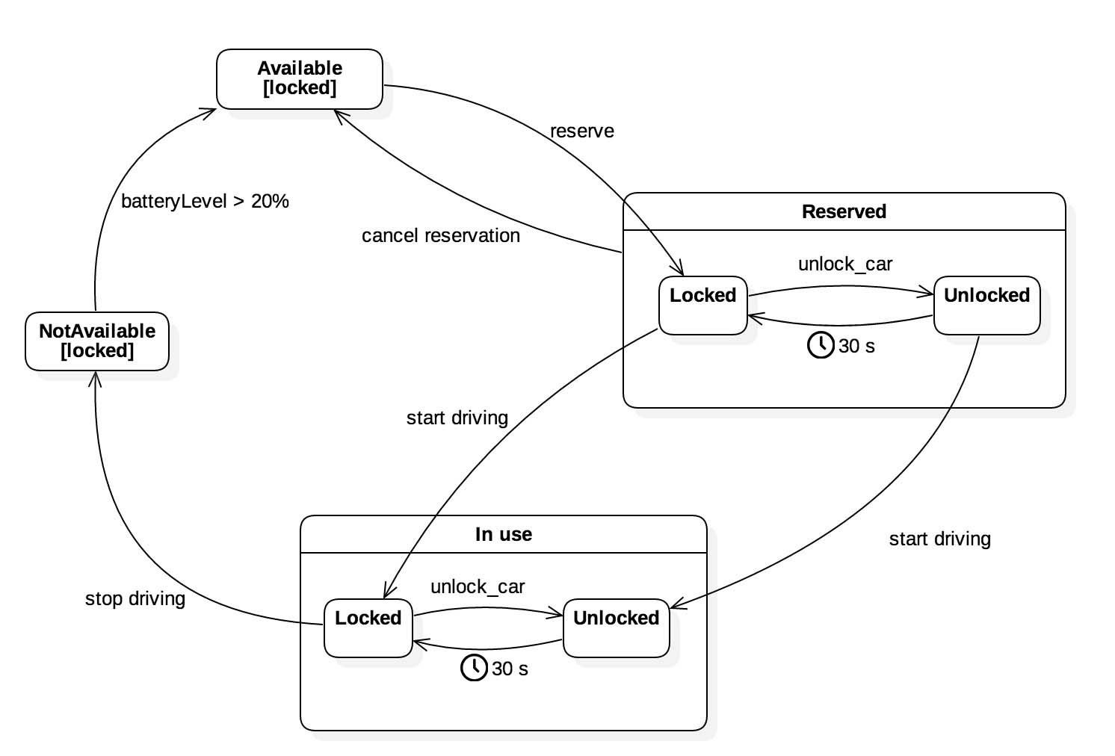
Car state

Slide 15
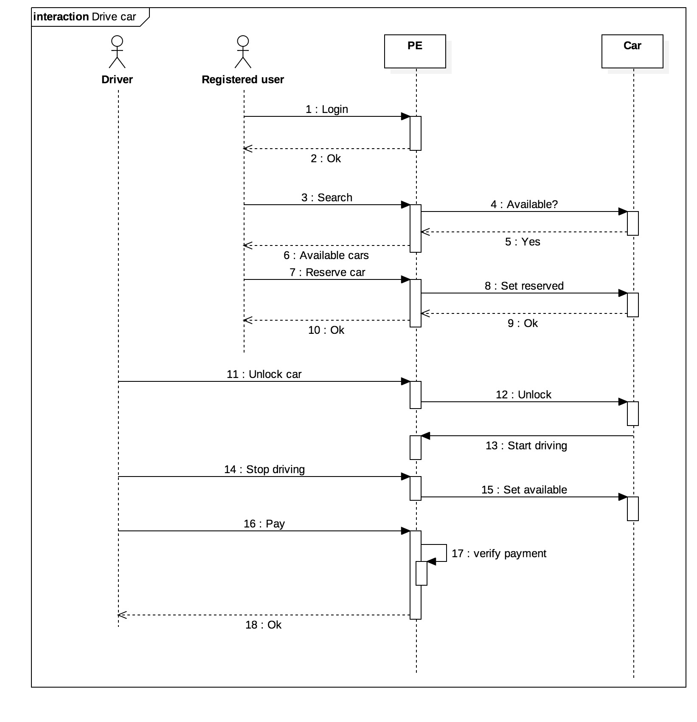
Reserve car sequence diagram

Slide 16
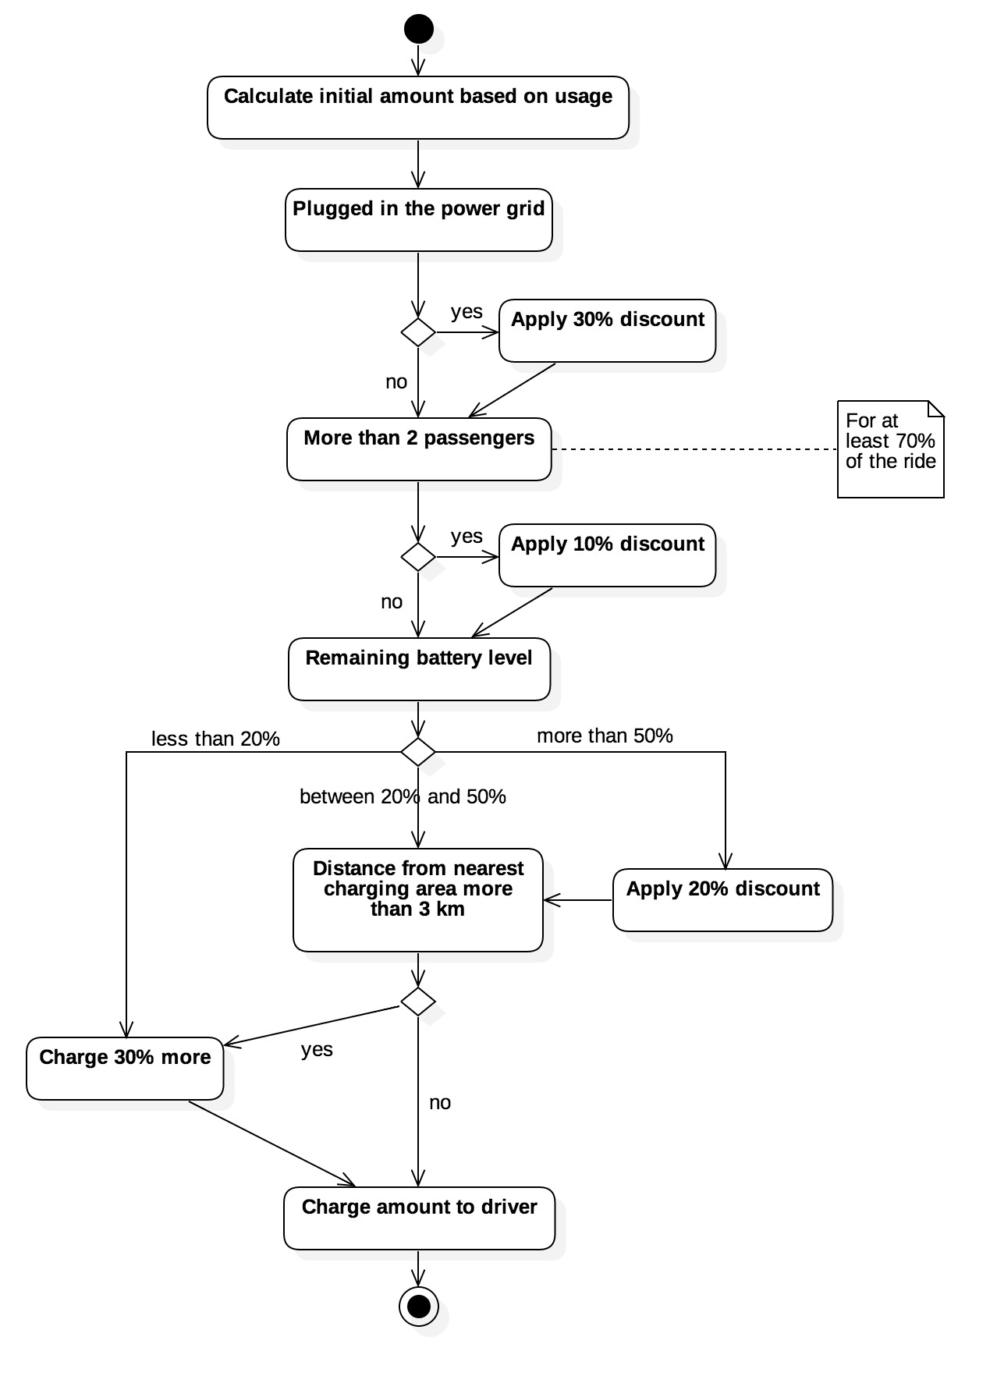
Calculate discounts

Slide 17
Calculate discounts (2)

Slide 18
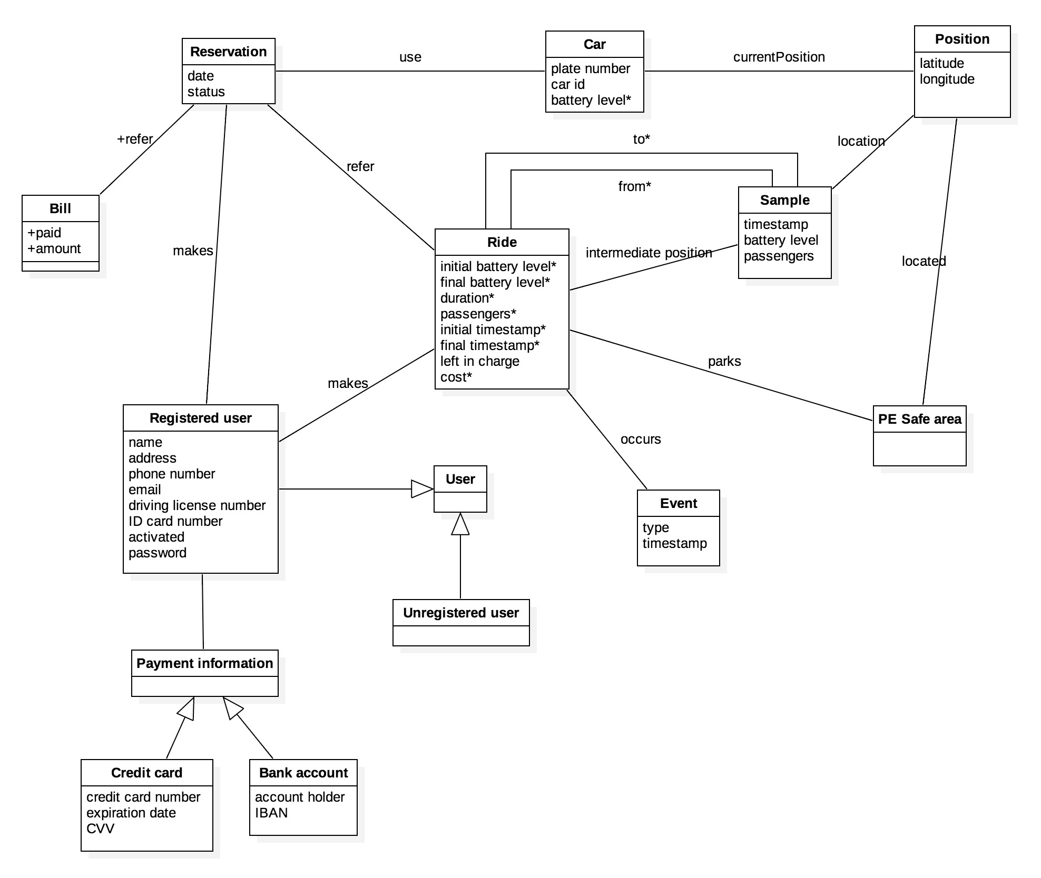
Class diagram

Slide 19

We’re done.
Any questions?

