Slide 1
SLINK
Andrea Battistello 873795
Fabio Chiusano 874294
Notes:
We are Fabio and Andrea. Our project is about SLINK, which is an efficient way to perform single linkage hierarchical clustering. Indeed, SLINK stands for ”single linkage”.

Slide 2
ROADMAP
Clustering
Single linkage naive method
Theoretical limits
Pointer representation
SLINK algorithm
Classifiability
Presentation of results
Benchmark and analysis of results
Notes:
We’ll give a brief overview of what clustering is. We’ll see a naive implementation of an algorithm that performs single linkage hierarchical clustering, what the theoretical limits of the problem are (in terms of time and space complexity) and how SLINK manages to achieve them. Finally we’ll see an analysis of the results obtained.

Slide 3
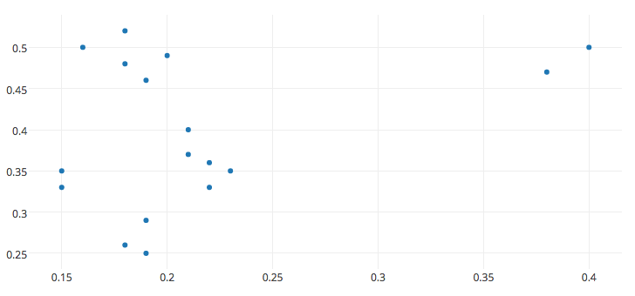
Clustering
Clustering is the process of grouping objects so that
similar objects are in the same cluster and dissimilar objects are in different clusters
Notes:
So, what is clustering? Clustering is the process of grouping similar objects together, as we can see in this image. We also want to make objects belonging to different clusters as dissimilar to each other as possible

Slide 4
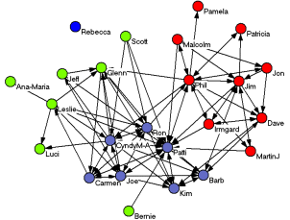
Clustering
Applications:
Business: marketing segmentation, product positioning
WWW: social network analysis
Computer science: image segmentation, recommender systems, evolutionary algorithms
Medicine: analysis of antimicrobial activity
Notes:
There are several applications of clustering. For example, we may want to find groups of similar customers in order to do targeted promotions. This is called marketing segmentation. We may want to find communities in networks of people that talk about the same topics. The neural networks in out brain is also prone to be clustered since there are groups of neurons that connect with each other but not with other groups, and this may help to understand better how our brains work.

Slide 5
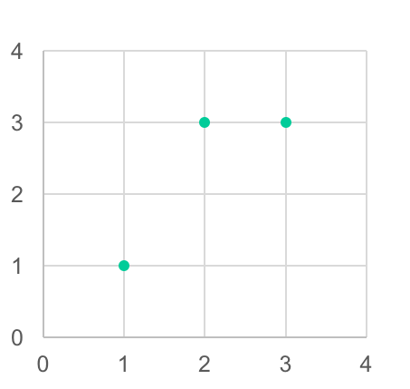
Clustering
What does ”similar objects” mean?
A definition of similarity is needed. We can define a distance/dissimilarity
function that accepts two objects and whose result is a measure of how the
two objects are different from each other.
Some examples of dissimilarity functions:
Euclidean distance
Manhattan distance
Custom dissimilarity functions built even upon non numerical objects
3
2.236
2.828
4
Notes:
We need to define what “similar objects” mean. We define a distance function, also called dissimilarity function, that accepts two objects and whose result is a measure of how the two objects are different from each other. For example, we can use the euclidean distance or the manhattan distance.

Slide 6
Clustering
How is the dissimilarity function used?
Connectivity models: hierarchical clustering where grouping is done according
to the dissimilarity between members of different groups. E.g. SLINK
Density models: a point is in a group if it is sorrounded by at least a certain number
of other points whose dissimilarity with that point is lower than a certain
amount. E.g. DBSCAN
Centroid models: each cluster is represented by a single point, which is its centroid.
E.g. k-means
Notes:
There are different types of clustering depending on how the distance function is used. In connectivity models, where similar objects are iteratively clustered together in order to achieve a hierarchy of clusters. SLINK belongs to this category. In density models, a cluster is an area which contains a high number of elements, so it’s an area with high density. An example is DBSCAN. In centroid models, clusters have a representative (indeed it’s also called representative based clustering), e.g. K-means. Talking about connectivity models...

Slide 7
Clustering
In connectivity models, how do we compare two clusters where at least one has more
than one point?
Single linkage: use the minimum dissimilarity between a point of the first cluster and a point of the second
cluster
Complete linkage: use the maximum dissimilarity between a point of the first cluster and a point of the second
cluster
Use the dissimilarity between the centroids of the two clusters
Average linkage: use the average dissimilarity between each possible pair of points belonging to different clusters
Notes:
... we need to define how to compare clusters, so, a distance between clusters. In single linkage, the distance between two clusters is the minimum distance of a pair of points in the clusters. In complete linkage, the maximum distance is used. Then, we can take the distance between the centroids of the two clusters or the average of all the possible distances between the elements. These two last approaches are more expensive than the first two. SLINK works with single linkage.

Slide 8
Clustering
Is it possible to say that a point belongs to a cluster with a certain probability?
Hard clustering: each point belong to a cluster or not. E.g. SLINK
Soft/fuzzy clustering: each point belong to each cluster with
a certain degree. E.g. Fuzzy C-means
Can a point belong to more than one cluster?
String partitioning clustering: each point belong to only one cluster. E.g. SLINK
Overlapping clustering: each point belong to a cluster or more. E.g. COGNAC
Notes:
There are other distinctions in clustering. In hard clustering, each point belongs to a single cluster or not. In soft clustering, each point belongs to each cluster with a certain probability. SLINK is hard clustering. Then, we can also have overlapping clusters where a point belongs to a cluster or more than one, but this is not the case of SLINK.

Slide 9
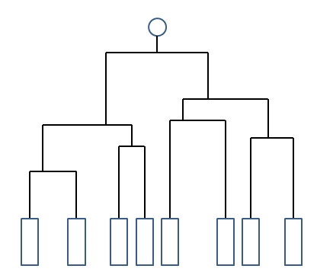
Clustering
So, what is SLINK?
SLINK is an intelligent and efficient implementation of hierachical clustering based on connectivity, where each point belongs to only one cluster and the single linkage criterion is used.It’s an online algorithm.
How are the results presented?
The results are often presented as a dendrogram.
Notes:
So, recap. What is SLINK? SLINK is an intelligent and efficient algorithm to perform hierarchical clustering, where each point belongs to only a single cluster and the single linkage criterion is used. It’s also an online algorithm. The results of hierarchical clustering are usually presented with a dendrogram. At the bottom we have all the points and above we have these merging points in which clusters are formed. The height of these merging points indicates the dissimilarity between the two merged clusters.

Slide 10
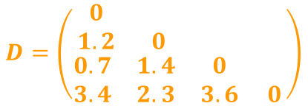
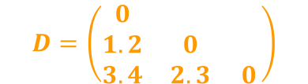

Single linkage naive method
1. Compute the dissimilarity matrix in O(n²) time and space.
2. Find the rows with the lowest dissimilarity value (there could be many rows with same minimum value)
3. Merge such rows in a cluster
4. Repeat until you are left with only one point (At most will take O(n) iterations)
Total complexity: O(n³) time and O(n²) space
e.g.
1 2 3 4
1&3 2 4
1&2&3 4
Join 1&3
Join 1&(2&3)
Notes:
Let’s see a naive algorithm to perform single linkage hierarchical clustering. At first, we compute the distance between each pair of objects and we put them in a matrix called distance matrix. Then we find the two most similar objects in the distance matrix, which are 1 and 3. We join 1 and 3 in a single cluster and we update the distance matrix. ... We keep doing this till we have only one cluster. The total time complexity is O(n^3) since we must find the minimum of a squared matrix n times. The space complexity is O(n^2) because we keep in memory the distance matrix. We tried to improve this naive algorithm as Andrea will show you now.

Slide 11
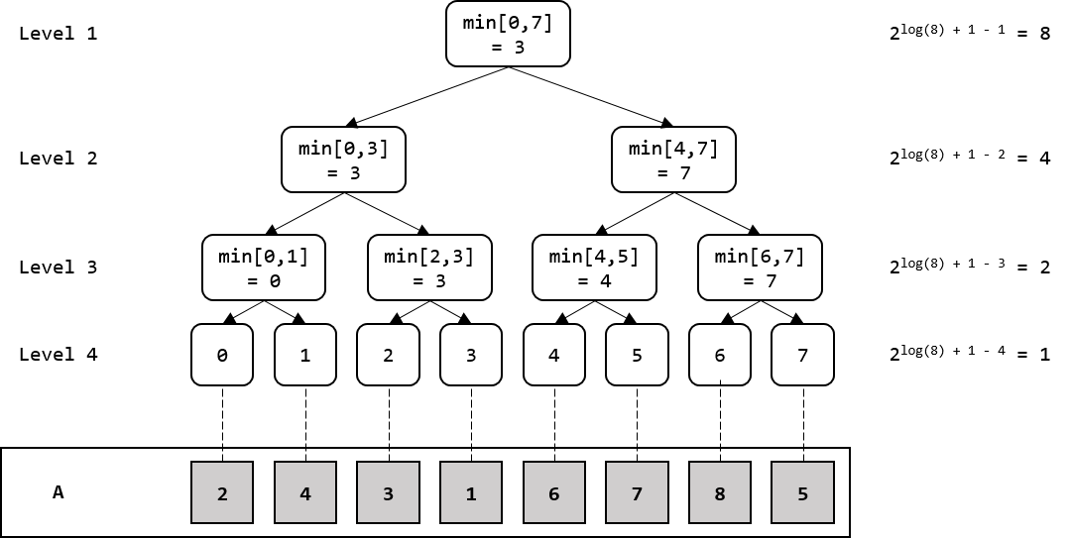
Optimizing naive method
Observation: we can avoid the visit to all O(n²) cells to find the minimum.
We can use a segment tree to find the minimum in O(1) and handle the O(n) updates in O(log n) time each.
Total complexity: O(n² log n) time and O(n²) space
Source: https://gsourcecode.wordpress.com/2014/03/12/introduction-to-segment-trees-range-minimum-query/

Slide 12
Theoretical limits
Space: a dendogram of N points can have up to N - 1 dinstict splitting levels, i.e. levels where some clusters merge, and so at least storage O(N) is required.
Time: a cluster method operating on the dissimilarity measure will have a time-dependence of at least O(N²) because each dissimilarity must be examined at least once.
O(N)
d(1,1) | d(1,2) | ... | d(1,N)
d(2,1) | ... | ... | ...
... | ... | ... | ...
d(N,1) | ... | ... | d(N,N)
O(N)
O(N)

Slide 13
Pointer representation
If the dissimilarity matrix is held in memory, O(N²) locations will be needed, whereas both the original data and the dendrogram only require O(N) locations. Thus, we want to avoid holding the matrix in memory if possible.
The SLINK algorithm avoids this problem by using the dissimilarity values just once: at stage n, a random access is needed only to values of the form d(i,n) for i < n, and no sorting or rearrangement are employed.
Therefore, the SLINK algorithm uses smaller data structures that take O(N) space, and this is done by defining an equivalent representation of a dendrogram on which the algorithm will work, that is called pointer representation.

Slide 14

Pointer representation
A dendrogram can be defined as the following function:
Where P is the set of points that we want to cluster, E(P) is the set of equivalence classes (clusters) that we have using a specific maximum dissimilarity value (the argument of the function).
E.g. c(h) = E(P) can be represented in the following way:
h=3
{a,b} is an equivalence class because their dissimilarity is less than h. Same for {c,d}, {g, h}.
E(P) = {{a,b},{c,d},{e},{f},{g,h}}
P = {a,b,c,d,e,f,g,h)
a
b
c
d
e
f
g
h

Slide 15
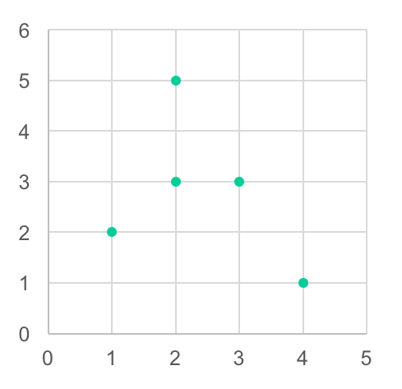
Pointer representation
A pointer representation is defined by two functions defined over the data, where each data point is given a number from 1 to N:
Where λ(i) is the lowest level at which i is no longer the last object of its cluster and π(i) is the last object in the cluster which it then joins.
5
λ(1) = 3, π(1) = 5
λ(2) = 1, π(2) = 3
λ(3) = 2, π(3) = 5
λ(4) = 4, π(4) = 5
λ(5) = +∞, π(5) = 5
3
2
4
1

Slide 16
Pointer representation
It is proven in the paper of Sibson (1972) that there is a 1-1 correspondence between dendrograms and pointer representations.
Thus, by working only on the pointer representation, it’s possible to convert it to a dendrogram. Indeed, SLINK works only on the pointer representation, by recursevely updating it.
SLINK starts considering only 1 point and building the pointer representation. Then, it considers also the next point and updates the pointer representation, and so on.
There are N points to be considered and each pointer representation update takes O(N) time, so the total running time will be O(N²). It’s proven that the final pointer representation obtained in this way is equivalent to the dendrogram built with the naive implementation of the algorithm.
Moreover, the memory is used only for the functions λ and π, which take O(N) storage, and for other auxiliary arrays that take again O(N) storage. Thus, the total space needed is O(N).

Slide 17
SLINK algorithm
Suppose that Π, Λ contains π_{n}, λ_{n} in their first n positions. Then for the new point n+1 we will rewrite Π and Λ in this way:
1. Set Π(n+1) to n+1, Λ(n+1) to ∞
2. Set M(i) to d(i, n+1) for i = 1 .. N
3. For i increasing from 1 to n
if Λ(i) ≥ M(i)
set M(Π(i)) to min{ M(Π(i)), Λ(i) }
set Λ(i) to M(i)
set Π(i) to n + 1
if Λ(i) < M(i)
set M(Π(i)) to min{ M(Π(i)), M(i) }
4. For i increasing from 1 to n
if Λ(i) ≥ Λ(Π(i))
set Π(i) to n + 1

Slide 18
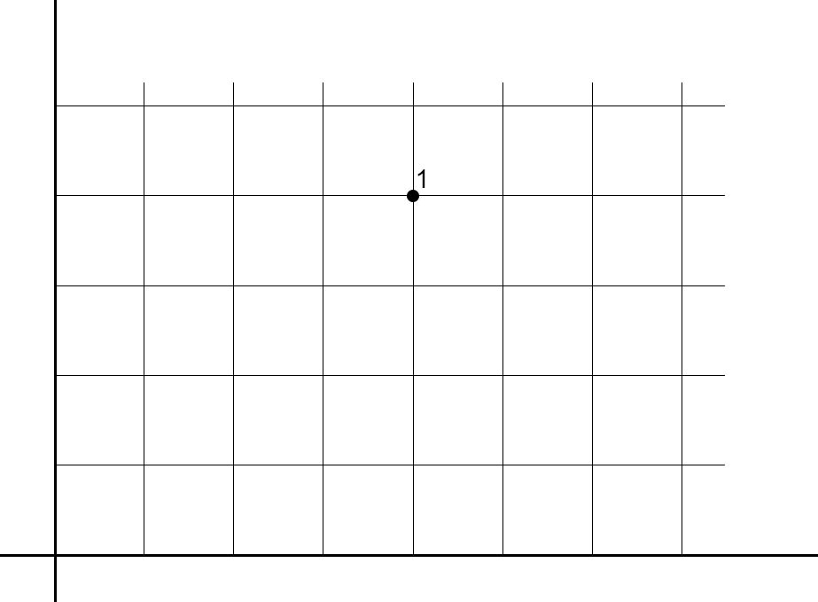
SLINK algorithm
n = 0
 | 1
λ | ∞
π | 1
M | –
Set:
λ₀(1) = ∞
π₀(1) = n+1 = 1

Slide 19
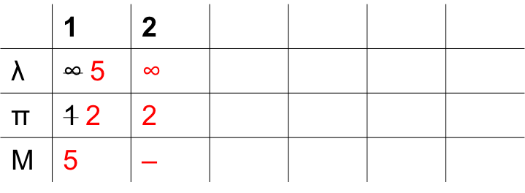
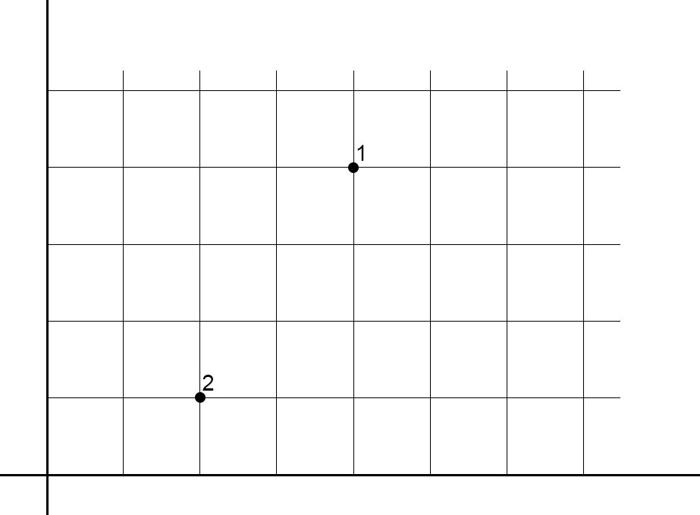
SLINK algorithm
n = 1
Set:
λ₁(2) = ∞
π₁(2) = n+1 = 2
Point 2 is closer than ∞, so
add it to its cluster.

Slide 20
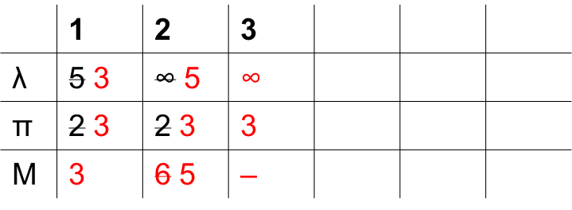
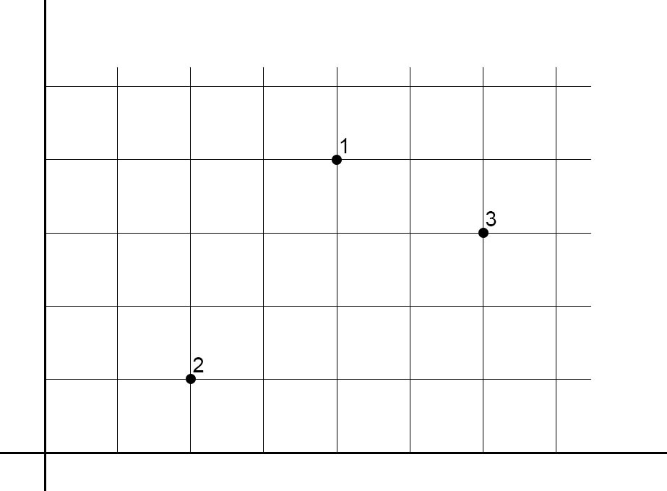
SLINK algorithm
n = 2
Set:
λ₂(3) = ∞
π₂(3) = n+1 = 3
(3) is closer than 5 for(1), so
update λ₂(1) = 3 and π₂(1) = 3.
Now (2) can reach point (3) through
(1), so the required distance is 5.
(3) is closer than ∞ for (2), so
set λ₂(2) = 5 and π₂(2) = 3

Slide 21
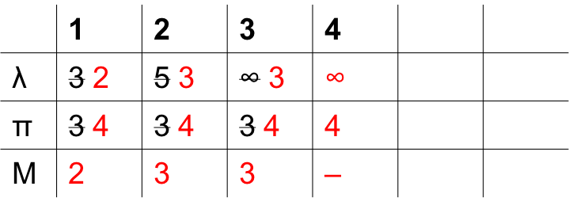
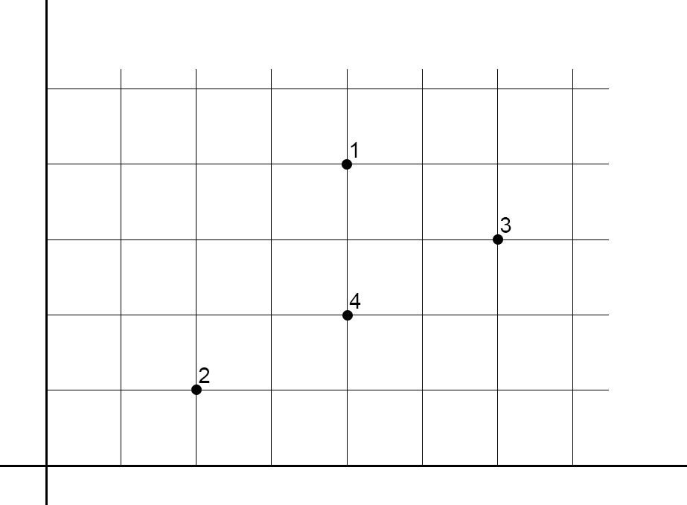
SLINK algorithm
n = 3
Set:
λ₃(4) = ∞
π₃(4) = n+1 = 4
(4) is closer than 3 for(1), so
set λ₃(1) = 2 and π₃(1) = 4.
(4) is closer than 5 for (2), so
set λ₃(2) = 3 and π₃(2) = 4
(4) is closer than ∞ for (3), so
set λ₃(3) = 3 and π₃(3) = 4

Slide 22
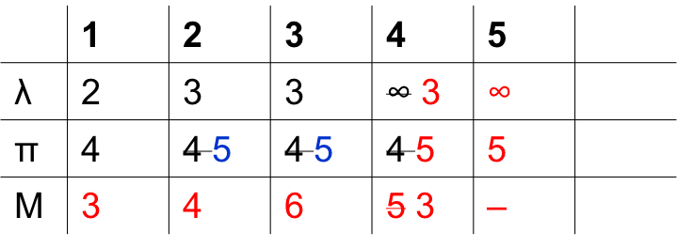
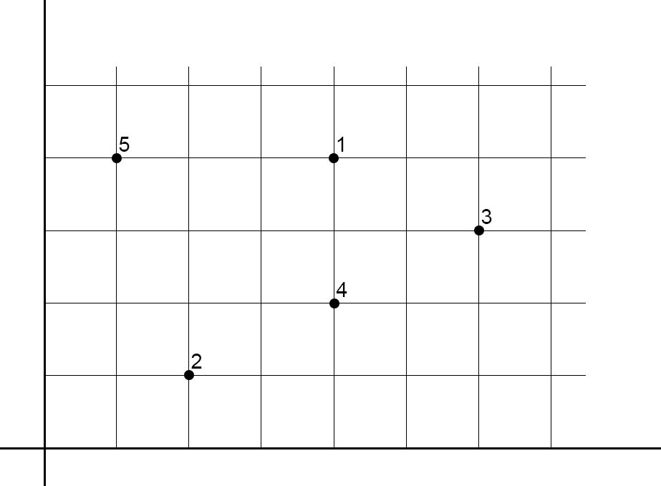
SLINK algorithm
n = 4
Set:
λ₄(5) = ∞
π₄(5) = n+1 = 5
(5) is not closer than 2 for (1), but
(4) can reach (5) in 3 instead of 5.
Update M(4) = 3
(5) is not closer than 3 for (2), and is
not an improvement for M(4).
(5) is at same distance for (3), so only
set π₄(3) = 5
(5) is closer than ∞ for (4), so
set λ₄(4) = 3 and π₄(4) = 5
Now the point (2) has λ₄(2) ≥ λ₄(π₄(2))
so we can merge the two clusters by
setting π₄(2) = 5. Same for point (3)

Slide 23

Classifiability
Jardine and Sibson (1971) suggest the use of this quantity as a measure of how amenable to single-link classification the data is.
Where:
The lower the Δ₁ the better.
Notes:
Just last two things before the analysis of the benchmark results. In the paper, Sibson suggests the use of this index as a measure of how much the data are amenable to single linkage clustering. Let’s have a quick look at it. At both the numerator and the denominator we have a sum over all possible pairs of distinct points. “d” is the distance between the two points and “d star” is the minimum distance at which the two points are in the same cluster, thanks to the chaining effect typical of single linkage. It corresponds to the lambda in the SLINK algorithm. We want these two distances to be as much similar as possible, which means that we have few chaining effect, so we want a low value for the index.

Slide 24
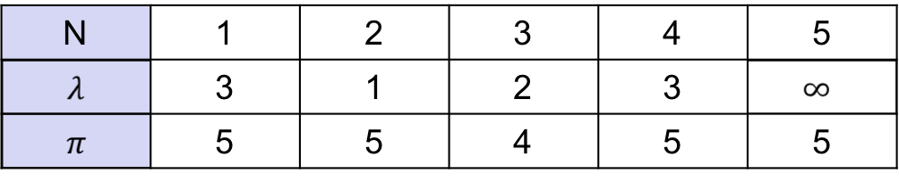
Presentation of results
The pointer representation of a dendogram is not particulary helpful from the user's point of view and it's desiderable to convert it into another representation called the packed representation for output, from which a tree-diagram can be easily drawn.
E.g.
We want to draw something like this:
1
3
4
2
5
Notes:
The other thing is that, from the pointer representation, it’s not easy to draw a nice dendrogram, that is a dendrograms where lines don’t cross each other. Sibson suggests to do something like this. We draw the last point, 5, at right and we draw a vertical line from it. Then we find the points that directly merge with 5, which are the points which have 5 as PIE. They are 1, 4 and 2, and we order them in decreasing LAMBDA. From each point, then, draw a vertical line long LAMBDA, and then an horizontal line. Then we should consider 1, 4 and 2 and see if there are points that merge with them and so on...

Slide 25
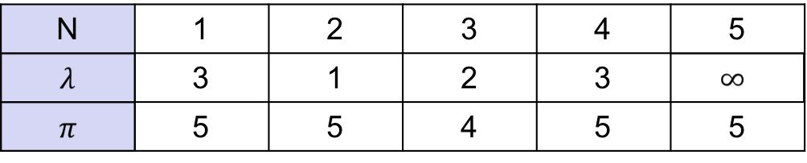
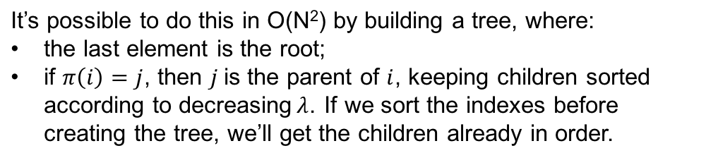
Presentation of results
5
1
4
2
depth first tree walk
3
1
3
4
2
5
Notes:
It’s not easy to do this from the pointer representation. We can easily do this by building a tree, which is our packed representation, using the pointer representation and the rules I said before. We can then perform a depth first tree walk in order to find the correct order of the points with which drawing the dendrogram.

Slide 26
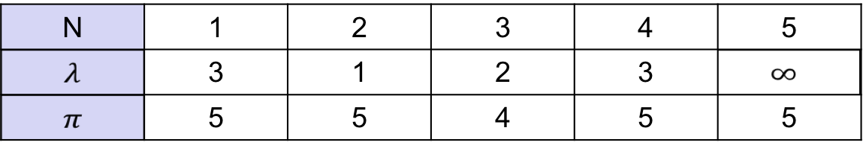
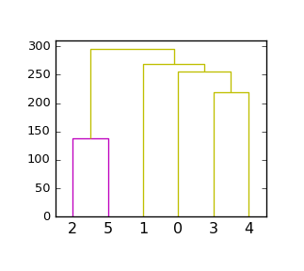
Presentation of results
Another way to build the dendogram is to create the linkage matrix and then pass it to plotting libraries that will carry the load of drawing a clear dendrogram. E.g. from scipy.cluster.hierarchy we can create a dendrogram using the dendrogram function together with the linkage matrix and then plot it with matplotlib.pyplot.
linkage matrix
plotter
Notes:
However, we used another representation that is called linkage matrix, which is the input that several plotting libraries want to draw dendrograms. It’s really fast to covert the pointer representation to the linkage matrix and it can easily be built in the naive algorithms. The reason why we chose to follow this way is that we would have spent too much time in trying to draw a dendrogram with similar beauty of the ones plotted by those libraries.

Slide 27
Benchmarks
We tested the three algorithms on datasets:
with total number of points between 50 and 3000
with point dimensions between 2 and 200
the results are...
Notes:
Let’s see now the results of the benchmarks! We tested the three algorithms on datasets with total number of points between 50 and 3000, with points with dimensions between 2 and 200.

Slide 28
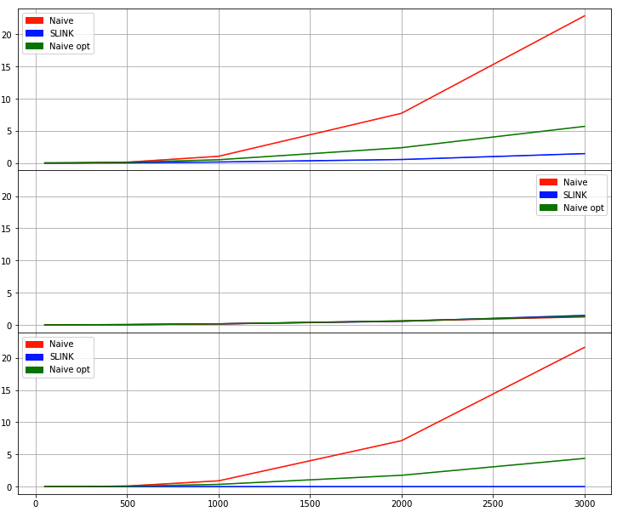
Benchmarks
time [s]
Total time
SLINK: time to build the pointer representation
Naive & Naive opt: time to build the dissimilarity matrix
SLINK: time to convert pointer representation to linkage matrix
Naive & Naive opt: time to create the linkage matrix iteratively from the dissimilarity matrix
# of points
Notes:
On the first graph are plotted the total running time of the algorithms. In red we have the naive algorithm, O(n^3). In green we have our optimized naive algorithm, O(n^2*log(n)). In blue SLINK, O(n^2). With 3000 points, SLINK takes 2 seconds, while the naive implementation takes more than 20 seconds. In the second graph we compare the time in which the naive algorithms build the distance matrix with the time in which SLINK builds the pointer representation. They both are O(n^2) in time, the difference is that what remains to do to SLINK is to just convert the pointer representation into the linkage matrix in order to do plots, so its job is almost finished. We can see this in the third graph, which shows the time that the naive algorithms take to work on the distance matrix, and the time that SLINK takes to convert the pointer representation into the linkage matrix.

Slide 29
Benchmarks
The naive algorithms spend the majority of the time working on the dissimilarity matrix rather than building it.
However, SLINK terminates its execution when the other algorithms are starting to work on the dissimilarity matrix!
# of points

Slide 30
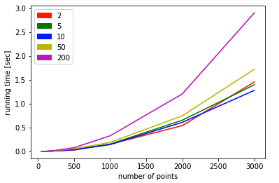
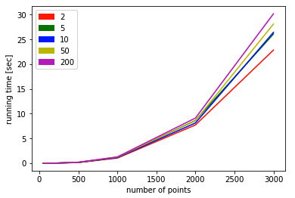
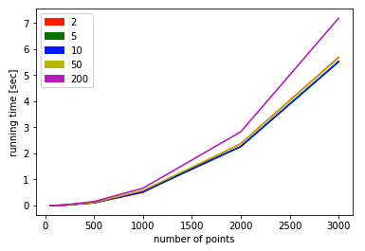
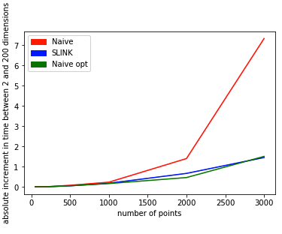
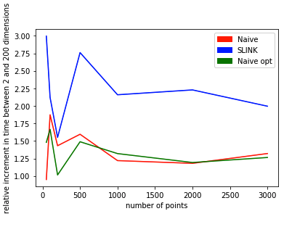
Benchmarks
Effect of data dimensionality over running time
SLINK
Naive
Naive optimized
Notes:
Now we see the effect of the dimensionality of data on the running time. The top three graphs show the running time of SLINK, naive and naive optimized, with datasets of different dimensions and different dimensionality. In particular, in red we have the time with two dimensions and in purple we have the time with 200 dimensions. Please note that the y-axis have different scales, so it’s easy to see the relative increment but hard to see the absolute increment. The bottom-left graph shows the absolute increment in time, while the bottom-right graph shows the relative increment. Each algorithm computes once the distance between each pair of distinct points. SLINK has the biggest relative increase of total running time simply because it’s the fastest wrt total time. Other variations may be dued to locality of data and instructions.

Slide 31
Benchmarks
Each algorithm computes once the distance between each pair of distinct points. SLINK has the biggest relative increase of total running time simply because it’s the fastest wrt total time. Other variations may be dued to locality of data and instructions.

Slide 32
Conclusions
The tests confirm the theoretical performance of the algorithm.
SLINK is a huge improvement over the naive implementation and allows single linkage clustering to work on bigger datasets than before.
Source code: https://github.com/battuzz/slink

