Slide 1

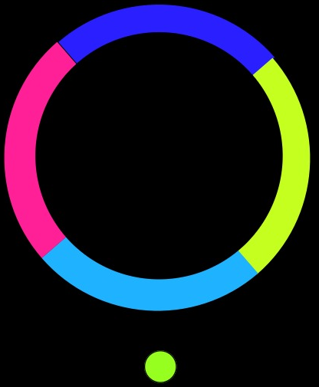
COLOR SWITCH GAME
CSE201-ADVANCED PROGRAMMING PROJECT
DONE BY
GUGULOTHU SAI CHANDAN 2019242 CSAM
RAHUL DAHIYA 2019318 CSD

Slide 2

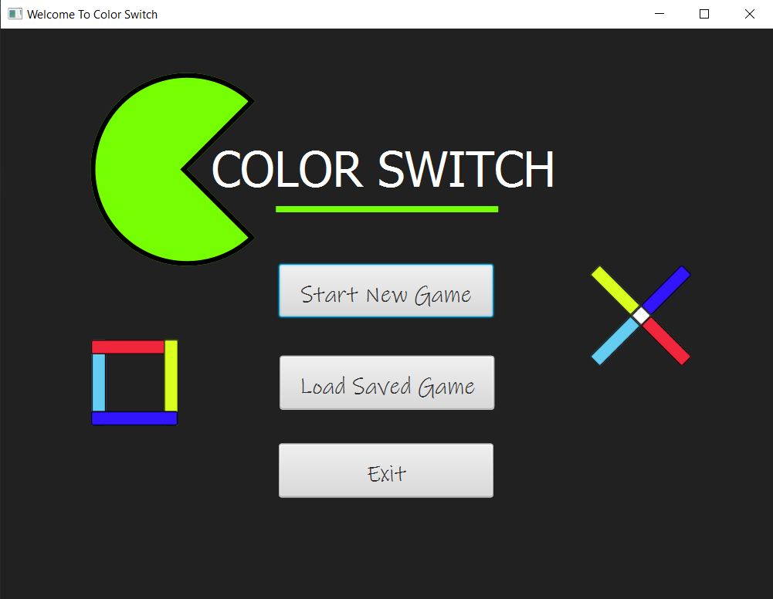
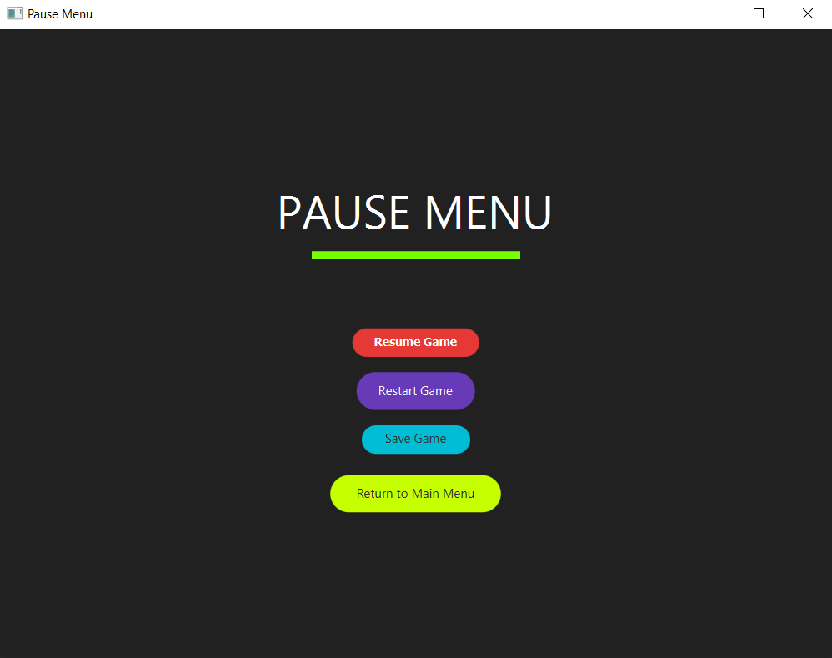
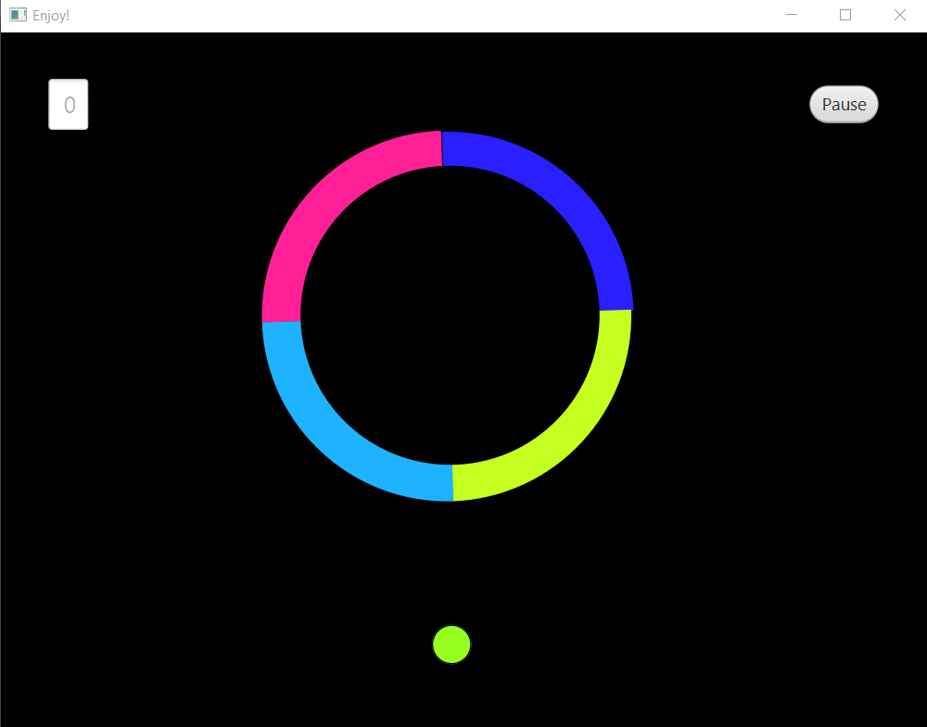
DESIGN AND IMPLEMENTATION
We have used the Scene Builder to design the graphical interface.
Different game screens are linked together using the controller classes and navigation is taking place by the FXML files.
In the Main Menu: The user gets the option to Start a New Game, Load saved games and to Exit the game.
When the user clicks on Start New Game, a new window opens and the game starts.
Then the user can move the ball by clicking the mouse button anywhere on the game screen.
Translate Transition is used to move the ball up and down whereas the Rotate transition is used to move the obstacles in circular motions.
During the game when we click the pause button it takes us to the pause menu where the user has the option to choose to Resume the Game, Restart the game and to Exit to the Main Menu.
Once the user clicks on the Exit game button on the Main Menu then a new window is opened.
The Design Patterns used in the Game are -
Singleton- We didn’t want more that one instance of database of entire game.
Facade - For Menu based implementation.
Flyweight - For storing the animations.

Slide 3
Individual Contributions
Rahul Dahiya
Use Case Diagram
GUI Part - Main Menu and Game layout.
Obstacles(circle and triangle).
Linking between different screens.
Animation of the obstacle movement.
Enabling and stopping animations.
Score box.
Presentation.
Added music part
Gugulothu Sai Chandan
1)UML diagram
2)GUI Part-Pause menu,exit of the game 3)Animation of the ball movement
4)Initializing classes and attributes
5)GUI(all the buttons and backgrounds)
6)Presentation
7)GUI Obstacles(square and plus)
8)Added music part

