Slide 1


BloodPool
Using communication and software for better healthcare

Slide 2
Why BloodPool?
State of Blood access in the country is poor
Shelf life of collected blood is only 30-45 days, which means excess of blood needs to be soon sent to all needy areas.
The system around Blood Banks is pretty faulty
WhatsApp, Facebook forwards requesting donation or donor card cover most of the process for Blood Requests in cases of emergency

Slide 3
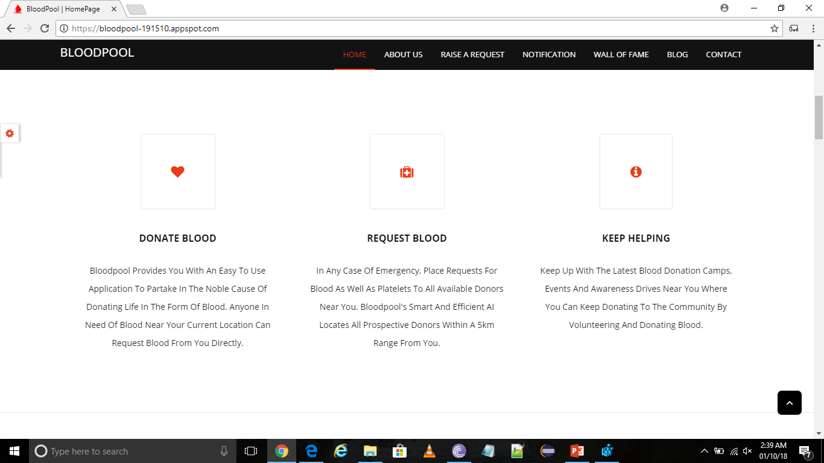
What does BloodPool offer?

Slide 4
Proposed Idea Sending Request
Our proposed solution presents a prototype that counters most problems. The website is available anywhere and the application can be installed on any compatible device (iOS or Android).
The user has the ability to publish a request for themselves or someone else, cater to someone’s active request or check for donation drives happening in the city.

Slide 5
Proposed Idea Receiving a Request
On the receiving end are either other willing donors or Blood Banks already registered with BloodPool that are in a radius of 5 kilometers from the requester and the user meets certain crieteria.
A user receives a notification and and email and can choose to donate and contact the patient directly
A blood bank or hospital has a raspberry pi device with an attached speaker which reads out loud the details. They get the choice to respond positively, negatively or respond later.

Slide 6
Selecting Suitable Donors
When the request is raised our algorithm checks for all registered users that fulfil these conditions: -
Is the user willing to donate blood?
Is the user aged above 18?
Is the user’s donation status good?
Is the user capable of donating to that patient?
Is the user located within 5 km of the patient’s hospital or not? (This radius is increased to 10km and so on if no user is found)
The selected users are then notified via an email and push notifications.

Slide 7
Working of the Raspberry Pi device at the Blood Banks
The devices are installed at different blood banks. After receiving a request, it then proceeds to voice loud and clear messages describing the patients’ details.
It can be used to revert back, and has 3 buttons with easy instructions of what they do.
1. will send an affirmative mail back to the requester.
2. will send a negative message to our server.
3. will indicate the device to sleep for half an hour and begin the talk back again after that.

Slide 8

The System Architecture

Slide 9


Thank You!
A presenation by
Kartik Madan and Joyendra Roy Biswas

