Slide 1

Ohio Election Estimator

Slide 2
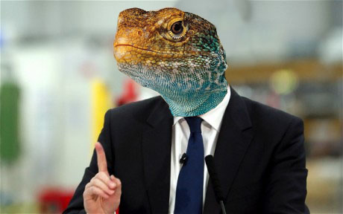
OUR CUSTOMERS
Are you…
A dishonest, cynical candidate for public office?
A lying, manipulating political operative?
A greedy, selfish plutocrat looking for someone to push your nefarious ends?

Slide 3

Our Product
Uses political beliefs to predict political success
Questions relate to bills run through Ohio House of Representatives
The more your answers agree with a districts representative, the more of the vote you’ll get from that district.

Slide 4
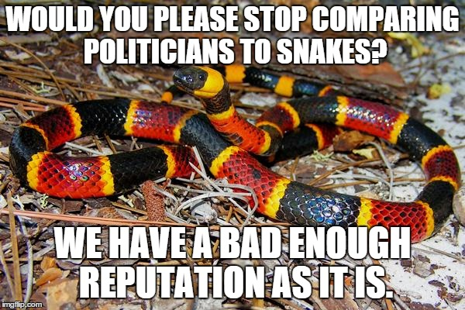
Making Decisions For You!
Can look at your choices and suggest ways to improve your vote total in a district!
Can recommend an easy path to victory without you having to lift a finger!

Slide 5

Publish Your Resume!
You can store your results along with your name so donors can look you up!
Compare your results to others who have taken our test!

Slide 6
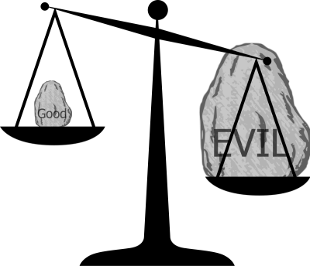
Compare Districts
In order to better control the unwashed masses, find correlations between the voting record of particular districts!

