Slide 1
Convolutional Neural Nets
HLML – 06/02/2019

Slide 2
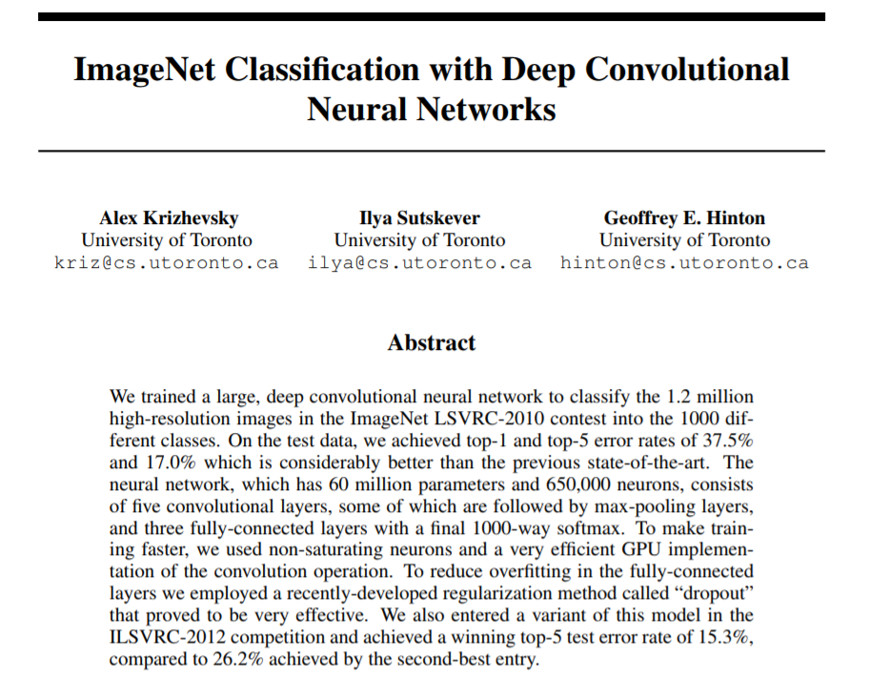
The paper that started it all

Slide 3
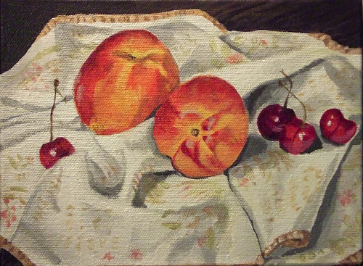
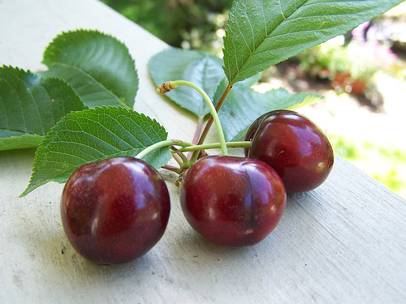
The Problem| ImageNet Large-Scale Visual Recognition Challenge
>1.2 million high-res images of different sizes to train with
1000 categories
Examples:
CHERRY
CHERRY

Slide 4
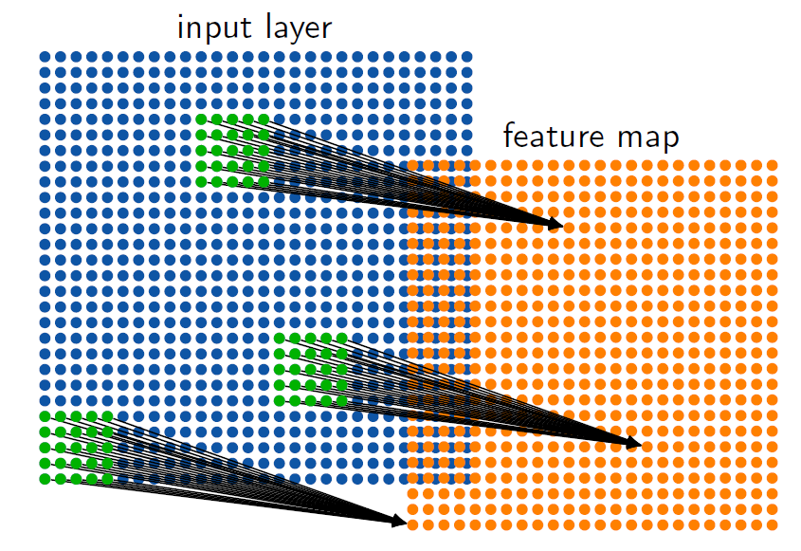
The Approach| Convolutional Neural Networks
We want a NN which can extract features from anywhere in an image

Slide 5
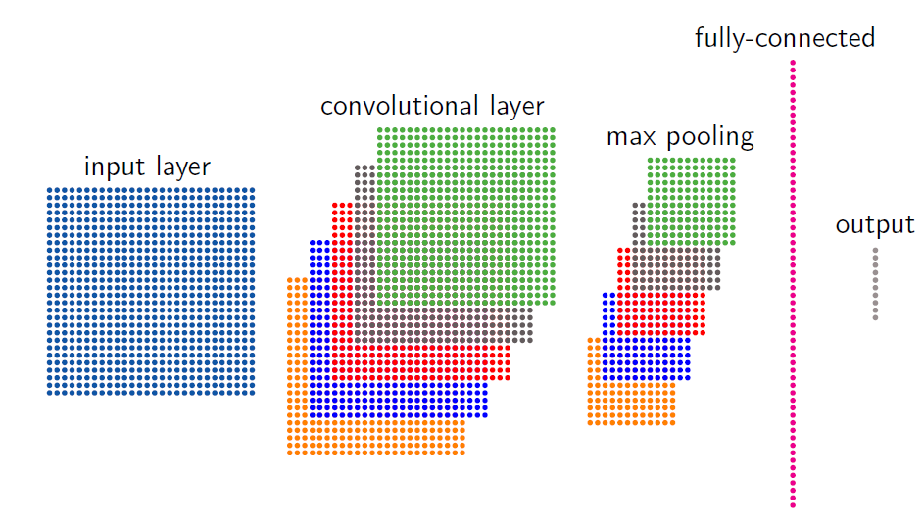
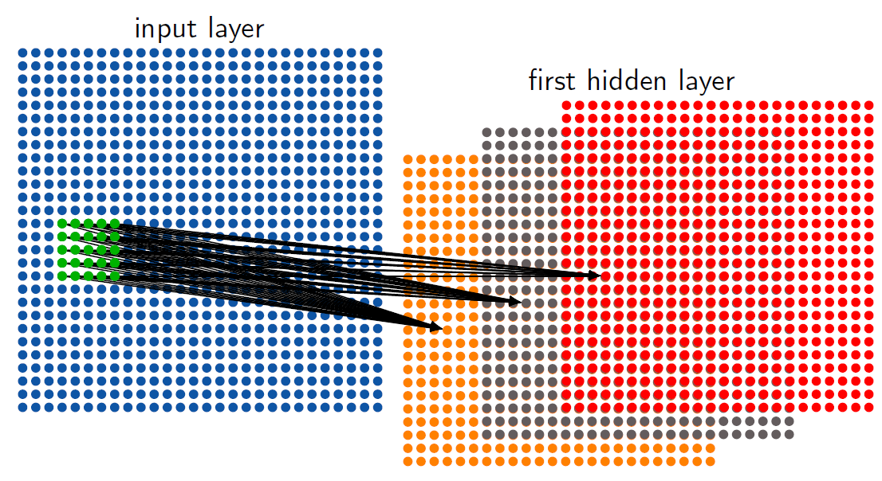
The Approach| Convolutional Neural Networks
Typical architecture of a CNN

Slide 6
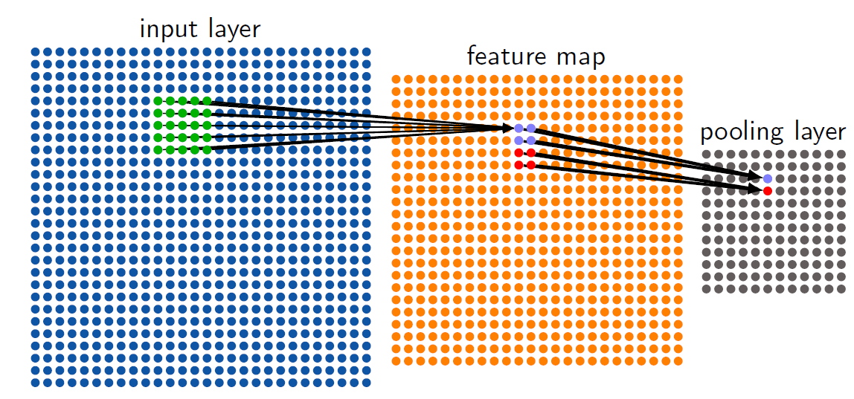
Architecture of a CNN
“Filters” or “kernels” refer to feature maps
There must be multiple filters in a given layer for an effective CNN
Max pooling is a quick-and-dirty dimensionality reduction technique

Slide 7
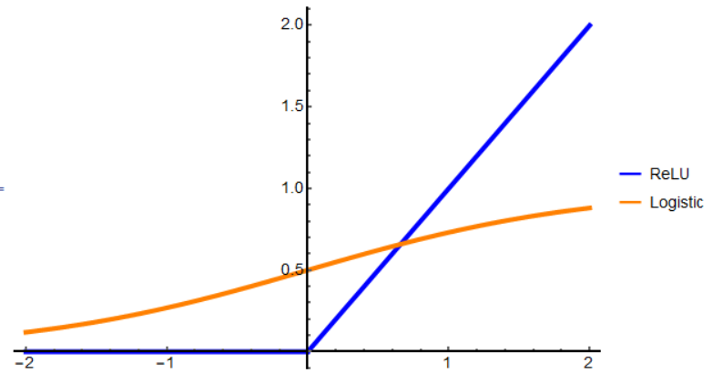

The Success of AlexNet
ReLU activation function necessary to train such a large network in reasonable time
$$ReLU\left(x\right)=max⁡(0,x)$$

Slide 8
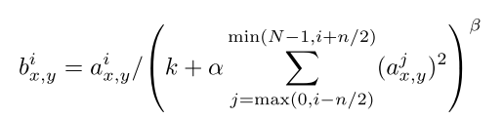
The Success of AlexNet
Local response normalization
Overlapping pooling
Using stride length less than window helps prevent overfitting

Slide 9
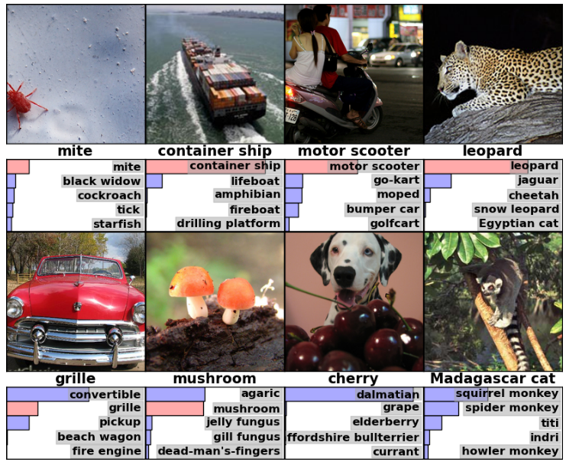
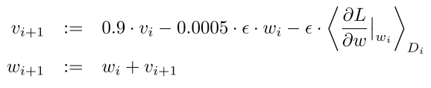
The Success of AlexNet
Data augmentation
Image translations and horizontal reflections
Adding colour noise
Dropout
Used 50% dropout
Weight decay

Slide 10
Sources
Krizhevsky, A., I. Sutskever, and G. Hinton. 2012. ImageNet Classification with Deep Convolutional Neural Networks. Proceeding NIPS’12 Proc. 25th Int. Conf. Neural Inf. Process. Syst. 1: 1097–1105.
DAT112 Lecture Slides – Erik Spence, SciNet HPC Consortium

