Slide 1



MIDTERM PROJECT
INTRODUCTION TO
RISK ANALYSIS
An Analysis of the Risks to be Encountered in the Transition from University Life to Business Life
AÇELYA SILA MUHÇİ
ADAL AYDINAY
BATUHAN OK
DAMLA TATLISU
HALİM ONAT KARAOSMANGİL

Slide 2

Content
01
02
03
Diving the Unknown
Risk Identification
Risk Impact-Probability Scale
04
05
06
Risk Matrix for
Risk Assessment
Risk Response Strategies
Realistic Actions for
Risk Response Planning

Slide 3

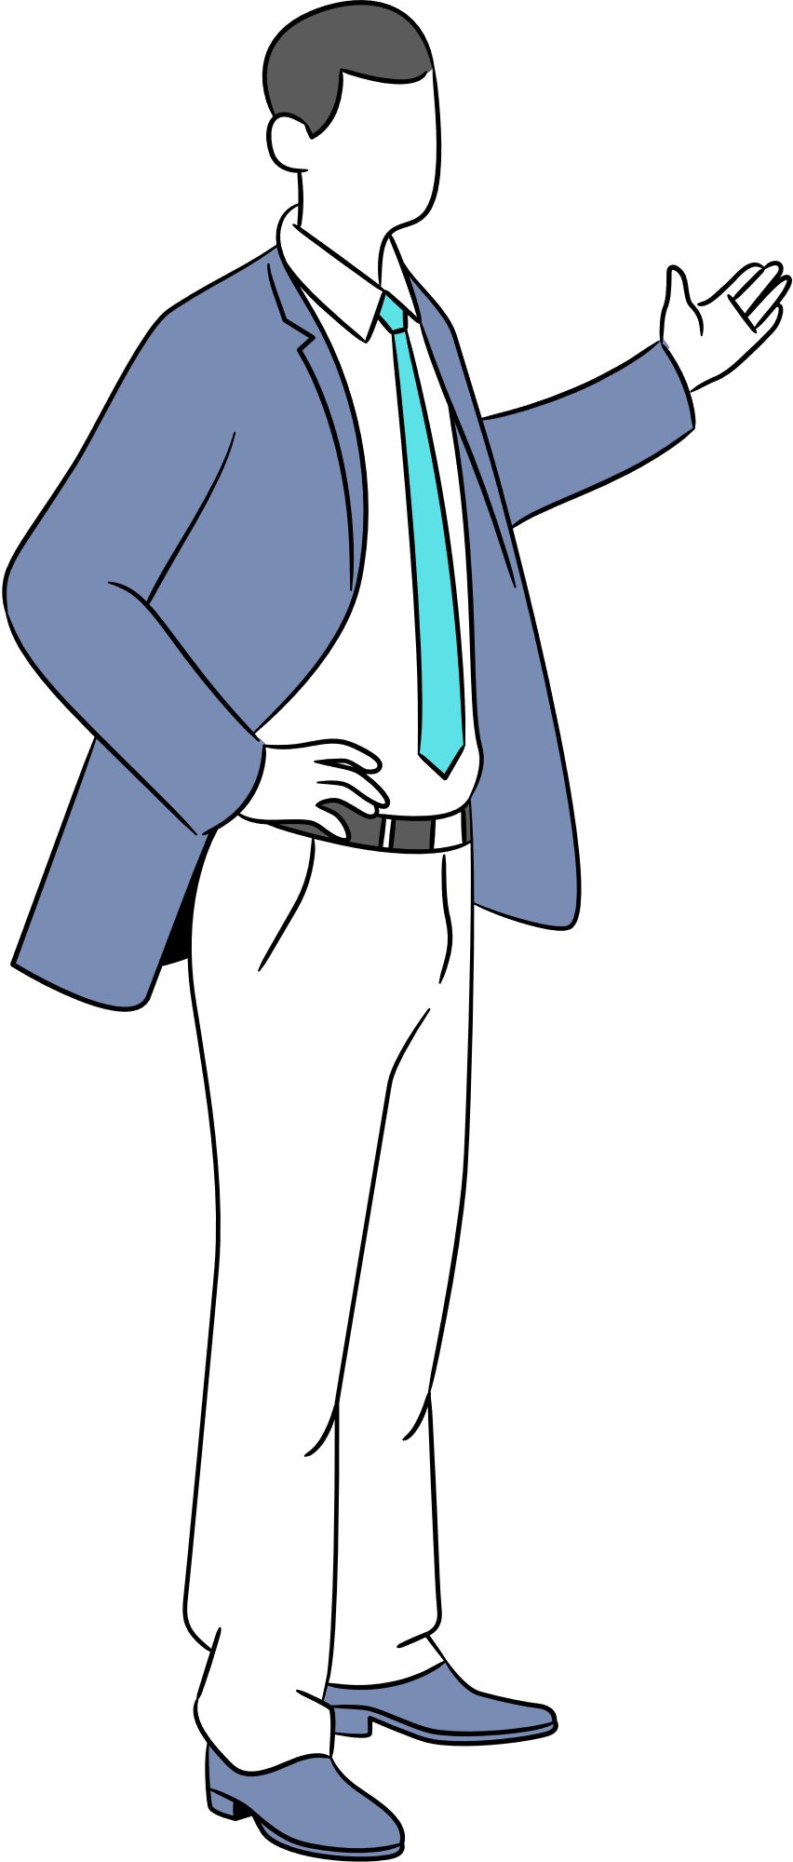



Diving the Unknown
This project delves into the potential risks faced by graduates venturing from the academic world into the professional landscape. We analyze the key risks associated with this transition, aiming to equip graduates with a deeper understanding of the journey ahead.

Slide 4


Risk Identification
1
Lack of Work Experience
University knowledge might not
directly translate to
real-world business skills.
Limited Networking
2
Few professional connections can cause
difficulty at finding jobs or career advancement.
3
Mismatched Expectations
University may not fully prepare you for the realities and demands of business life.
Work Life Balance
4
Difficulty establishing boundaries between work responsibilities and personal life.
5
Adaptation to Corporate Culture
Adapting to a new work environment with
different communication styles and expectations.

Slide 5

Global Recession and Crises
6
Economic downturns can impact job security
and career opportunities.
7
Diversity, Equity and Inclusion Challenges
Facing potential bias or
unequal treatment in the workplace.
Social Pressure
8
Feeling pressured to conform to
social environment norms or expectations.
9
Ethical Dilemma
Encountering situations that may require compromising
personal values in a professional setting.
Psychological Issues
10
Increased stress and anxiety due to new pressures
and workload. - imposter syndrome

Slide 6

RISK IMPACT(I) SCALE
RISK PROBABILITY(P) SCALE
5
Interruption of Activity
VERY HIGH
5
Almost Everyone Experience This
4
Long Term Difficulties
HIGH
Many Experience This
4
3
Short Term Difficulties
MEDIUM
Happens Quite Often
3
2
Small Scale Damage
LOW
Small Chance of Happening
2
1
VERY LOW
1
Has No Impact
Almost No Chance of Happening

Slide 7

RISK MATRIX
RISK SCORE = P X I
VERY HIGH (5) |  |  |  | LACK OF WORK EXPERIENCE | MISMATCHED EXPECTATIONS
HIGH (4) |  | WORK-LIFE BALANCE |  | SOCIAL PRESSURE | PSYCHOLOGICAL ISSUES
MEDIUM (3) |  |  | LIMITED NETWORKING |  | DIVERSITY, EQUITY, AND INCLUSION CHALLANGES
LOW (2) |  | ADAPTATION TO CORPORATE CULTURE | ETHICAL DILEMMAS
VERY LOW (1) |  |  |  |  | GLOBAL RECESSION AND CRISES
 | VERY LOW (1) | LOW (2) | MEDIUM (3) | HIGH (4) | VERY HIGH (5)
5
10
15
20
25
4
8
12
16
20
3
6
9
12
15
PROBABILITY
2
4
6
8
10
1
2
3
4
5
IMPACT

Slide 8


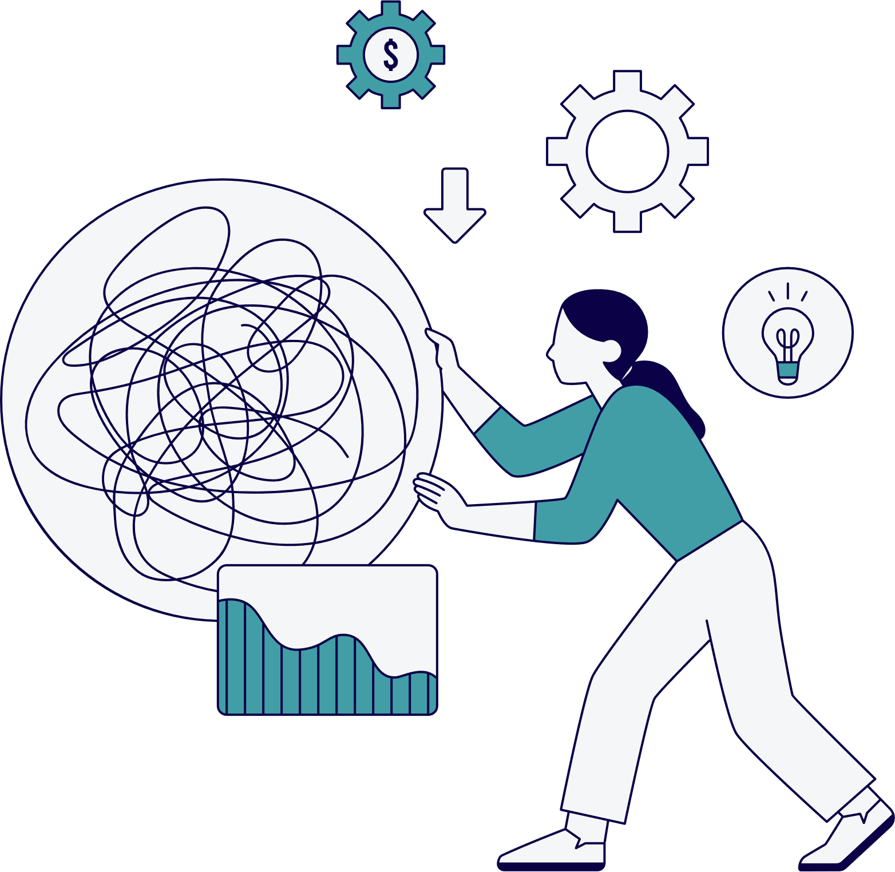
Risk Response Strategies
1
Lack of Work Experience ---- MITIGATE
2
Limited Networking ---- MITIGATE & TRANSFER
3
Work Life Balance ---- MITIGATE
4
Mismatched Expectations ---- MITIGATE &ACCEPT
5
Adaptation to Corporate Culture ---- MITIGATE & ACCEPT
6
Global Recession and Crises ---- ACCEPT
7
Diversity, Equity, and Inclusion Challenges ---- MITIGATE & TRANSFER
8
Social Pressure ---- MITIGATE
9
Ethical Dilemma ---- MITIGATE & ACCEPT
10
Psychological Issues ---- MITIGATE

Slide 9
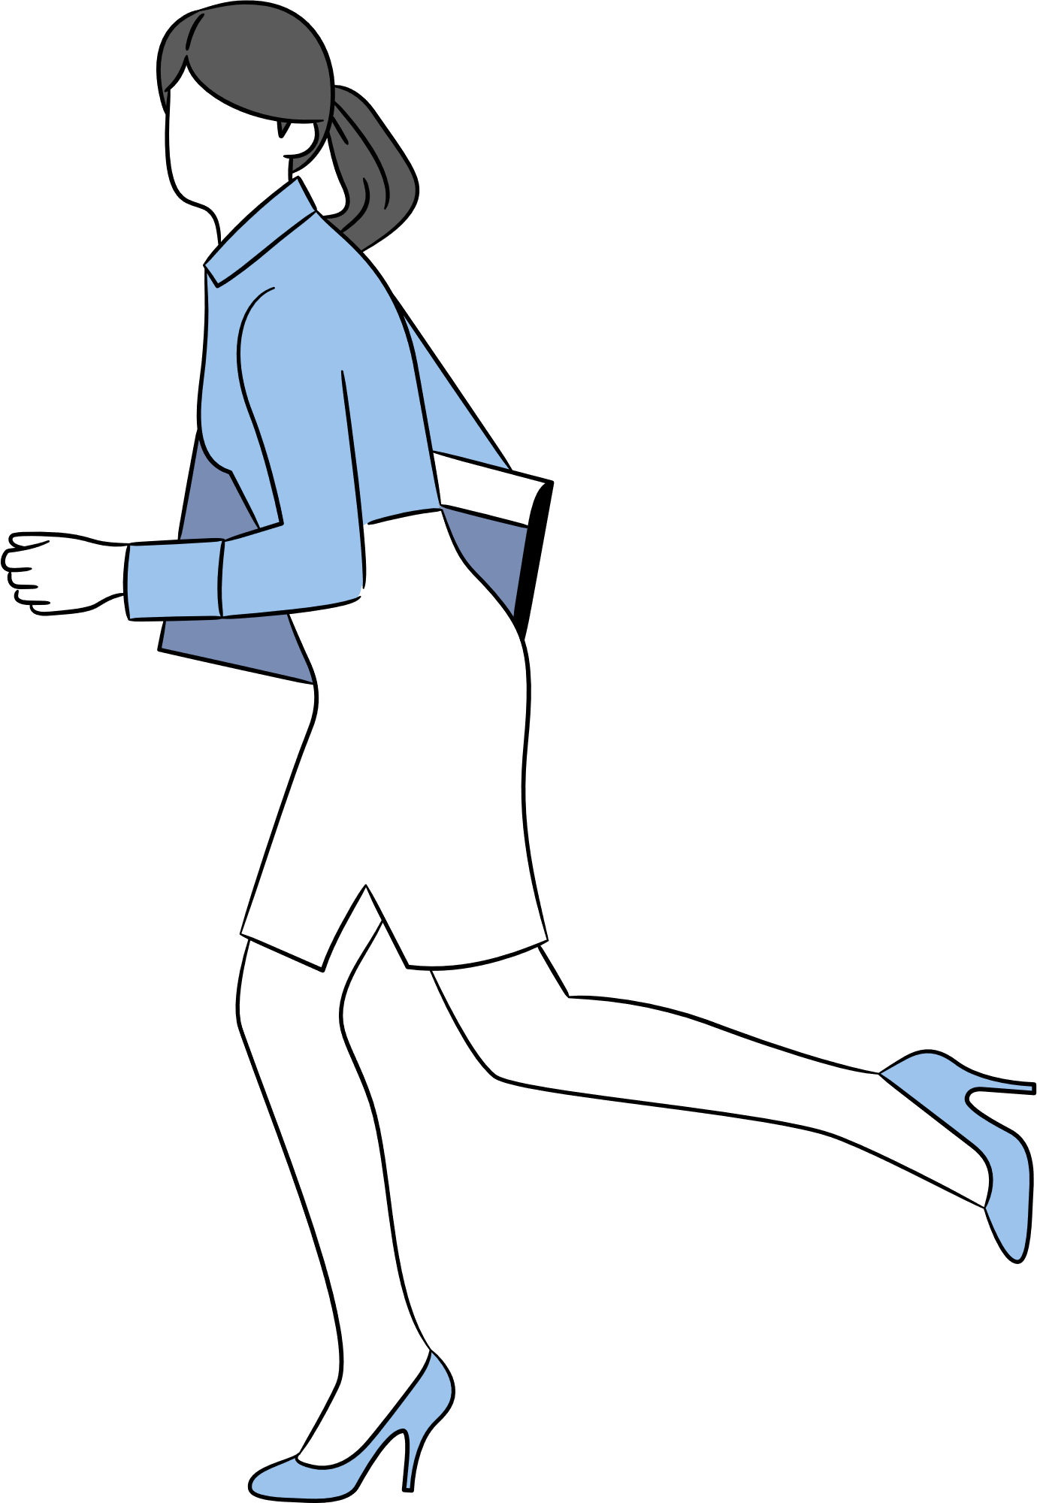


LACK OF WORK EXPERIENCE
ACTIONS TO TAKE
PROBABILITY: 5
Seek Internship Opportunities
Skills Development Courses
IMPACT: 4
Actively search for internships related to your field of study.
This provides hands-on experience and allows you to build relevant skills.
Enroll in online or in-person courses that focus on practical skills demanded in the workplace.
RISK SCORE
TECHNIQUE: Accepting
20
ACTIONS TO TAKE
RISK SCORE
TECHNIQUE: Mitigating
5
Stay Informed
Develop Transferable Skills
Regularly follow economic news and industry trends. This awareness can help you anticipate potential challenges and make informed career decisions.
Focus on developing skills that are valuable across different industries. Skills like communication, problem-solving, and adaptability are highly sought after and can help you navigate economic downturns.
GLOBAL RECESSION AND CRISES
PROBABILITY: 1
IMPACT: 5

Slide 10
THANK YOU
FOR LISTENING!
And never forget,
RISK IS ALWAYS BETTER THAN REGRET.

