Slide 1
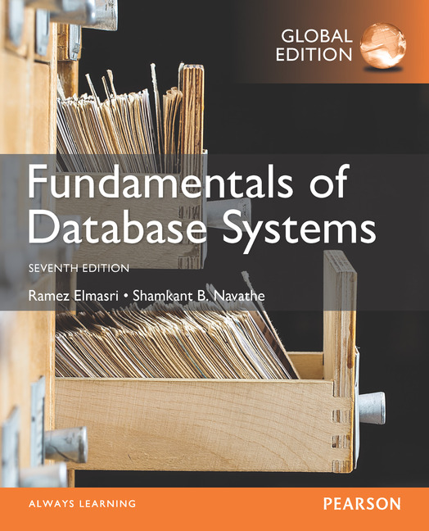
Notes:
<number>

Slide 2
CHAPTER 23
Distributed Database Concepts

Slide 3
Introduction
Distributed computing system
Consists of several processing sites or nodes interconnected by a computer network
Nodes cooperate in performing certain tasks
Partitions large task into smaller tasks for efficient solving
Big data technologies
Combine distributed and database technologies
Deal with mining vast amounts of data
Slide 23- <number>

Slide 4
23.1 Distributed Database Concepts
What constitutes a distributed database?
Connection of database nodes over computer network
Logical interrelation of the connected databases
Possible absence of homogeneity among connected nodes
Distributed database management system (DDBMS)
Software system that manages a distributed database
Slide 23- <number>

Slide 5
Distributed Database Concepts (cont’d.)
Local area network
Hubs or cables connect sites
Long-haul or wide area network
Telephone lines, cables, wireless, or satellite connections
Network topology defines communication path
Transparency
Hiding implementation details from the end user
Slide 23- <number>

Slide 6
Transparency
Types of transparency
Data organization transparency
Location transparency
Naming transparency
Replication transparency
Fragmentation transparency
Horizontal fragmentation
Vertical fragmentation
Design transparency
Execution transparency
Slide 23- <number>

Slide 7
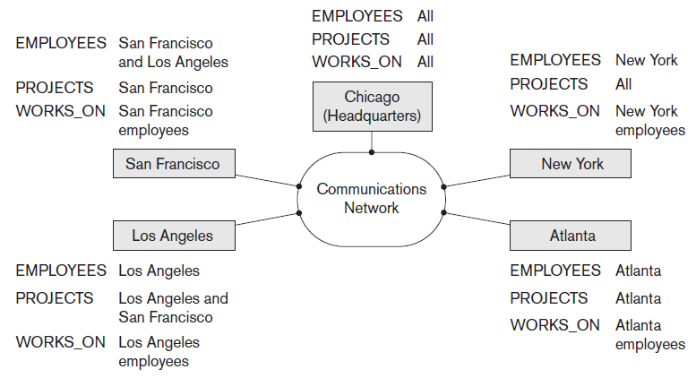
Distributed Databases
Figure 23.1 Data distribution and replication among distributed databases
Slide 23- <number>

Slide 8
Availability and Reliability
Availability
Probability that the system is continuously available during a time interval
Reliability
Probability that the system is running (not down) at a certain time point
Both directly related to faults, errors, and failures
Fault-tolerant approaches
Slide 23- <number>

Slide 9
Scalability and Partition Tolerance
Horizontal scalability
Expanding the number of nodes in a distributed system
Vertical scalability
Expanding capacity of the individual nodes
Partition tolerance
System should have the capacity to continue operating while the network is partitioned
Slide 23- <number>

Slide 10
Autonomy
Determines extent to which individual nodes can operate independently
Design autonomy
Independence of data model usage and transaction management techniques among nodes
Communication autonomy
Determines the extent to which each node can decide on sharing information with other nodes
Execution autonomy
Independence of users to act as they please
Slide 23- <number>

Slide 11
Advantages of Distributed Databases
Improved ease and flexibility of application development
Development at geographically dispersed sites
Increased availability
Isolate faults to their site of origin
Improved performance
Data localization
Easier expansion via scalability
Easier than in non-distributed systems
Slide 23- <number>

Slide 12
23.2 Data Fragmentation, Replication, and Allocation Techniques for Distributed Database Design
Fragments
Logical units of the database
Horizontal fragmentation (sharding)
Horizontal fragment or shard of a relation is a subset of the tuples in that relation
Can be specified by condition on one or more attributes or by some other method
Groups rows to create subsets of tuples
Each subset has a certain logical meaning
Slide 23- <number>

Slide 13
Data Fragmentation (cont’d.)
Vertical fragmentation
Divides a relation vertically by columns
Keeps only certain attributes of the relation
Complete horizontal fragmentation
Apply UNION operation to the fragments to reconstruct relation
Complete vertical fragmentation
Apply OUTER UNION or FULL OUTER JOIN operation to reconstruct relation
Slide 23- <number>

Slide 14
Data Fragmentation (cont’d.)
Mixed (hybrid) fragmentation
Combination of horizontal and vertical fragmentations
Fragmentation schema
Defines a set of fragments that includes all attributes and tuples in the database
Allocation schema
Describes the allocation of fragments to nodes of the DDBS
Slide 23- <number>

Slide 15
Data Replication and Allocation
Fully replicated distributed database
Replication of whole database at every site in distributed system
Improves availability remarkably
Update operations can be slow
Nonredundant allocation (no replication)
Each fragment is stored at exactly one site
Slide 23- <number>

Slide 16
Data Replication and Allocation (cont’d.)
Partial replication
Some fragments are replicated and others are not
Defined by replication schema
Data allocation (data distribution)
Each fragment assigned to a particular site in the distributed system
Choices depend on performance and availability goals of the system
Slide 23- <number>

Slide 17
Example of Fragmentation, Allocation, and Replication
Company with three computer sites
One for each department
Expect frequent access by employees working in the department and projects controlled by that department
See Figures 23.2 and 23.3 in the text for example fragmentation among the three sites
Slide 23- <number>

Slide 18
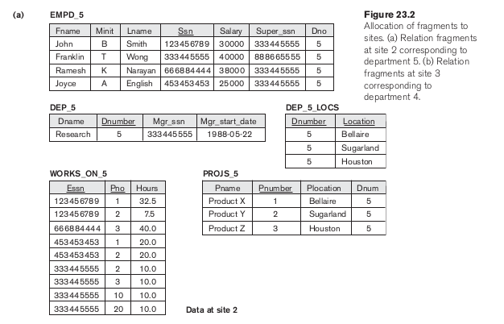

Slide 19
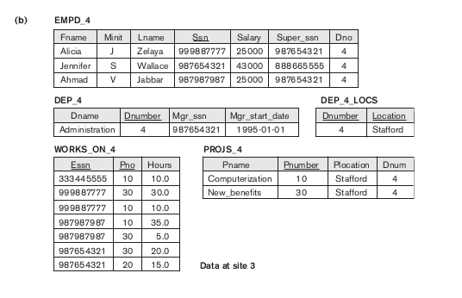

Slide 20
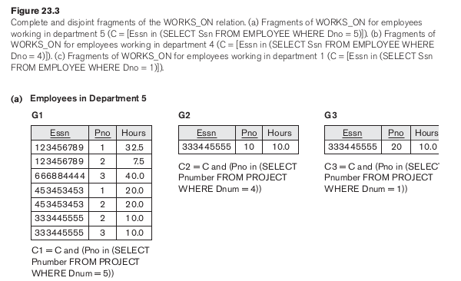

Slide 21
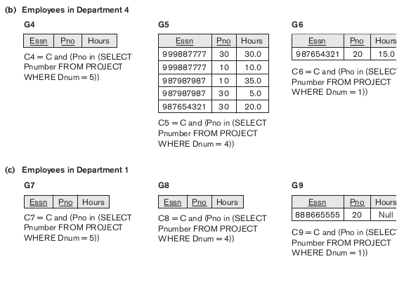

Slide 22
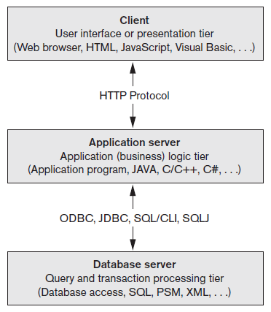
An Overview of Three-Tier Client/Server Architecture
Division of DBMS functionality among the three tiers can vary
Figure 23.10 The three-tier client/server architecture
Slide 23- <number>

