Slide 1
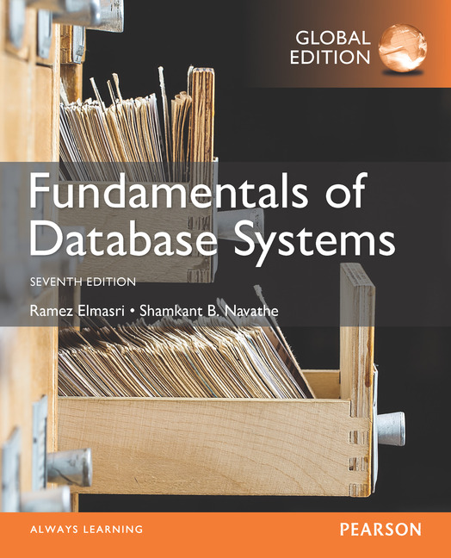
Notes:
<number>

Slide 2
CHAPTER 25
Big Data Technologies Based
on MapReduce and Hadoop

Slide 3
Introduction
Phenomenal growth in data generation
Social media
Sensors
Communications networks and satellite imagery
User-specific business data
“Big data” refers to massive amounts of data
Exceeds the typical reach of a DBMS
Big data analytics
Slide 25- 1

Slide 4
25.1 What is Big Data?
Big data ranges from terabytes (10¹² bytes) or petabytes (10¹⁵ bytes) to exobytes (10¹⁸ bytes)
Volume
Refers to size of data managed by the system
Velocity
Speed of data creation, ingestion, and processing
Variety
Refers to type of data source
Structured, unstructured
Slide 25- 1

Slide 5
What is Big Data? (cont’d.)
Veracity
Credibility of the source
Suitability of data for the target audience
Evaluated through quality testing or credibility analysis
Slide 25- 1

Slide 6
25.2 Introduction to MapReduce and Hadoop
Core components of Hadoop
MapReduce programming paradigm
Hadoop Distributed File System (HDFS)
Hadoop originated from quest for open source search engine
Developed by Cutting and Carafella in 2004
Cutting joined Yahoo in 2006
Yahoo spun off Hadoop-centered company in 2011
Tremendous growth
Slide 25- 1

Slide 7
Introduction to MapReduce and Hadoop (cont’d.)
MapReduce
Fault-tolerant implementation and runtime environment
Developed by Dean and Ghemawat at Google in 2004
Programming style: map and reduce tasks
Automatically parallelized and executed on large clusters of commodity hardware
Allows programmers to analyze very large datasets
Underlying data model assumed: key-value pair
Slide 25- 1

Slide 8
The MapReduce Programming Model
Map
Generic function that takes a key of type K1 and value of type V1
Returns a list of key-value pairs of type K2 and V2
Reduce
Generic function that takes a key of type K2 and a list of values V2 and returns pairs of type (K3, V3)
Outputs from the map function must match the input type of the reduce function
Slide 25- 1

Slide 9
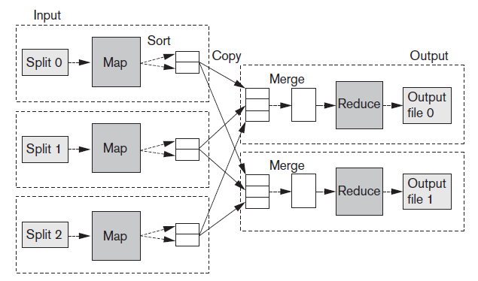
The MapReduce Programming Model (cont’d.)
Figure 25.1 Overview of MapReduce execution (Adapted from T. White, 2012)
Slide 25-1

Slide 10

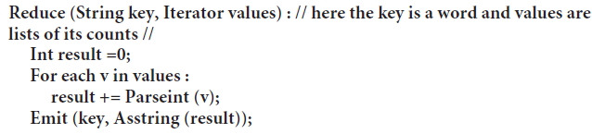
The MapReduce Programming Model (cont’d.)
MapReduce example
Make a list of frequencies of words in a document
Pseudocode
Slide 25- 1

Slide 11
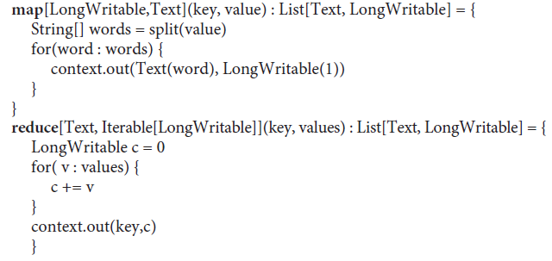
The MapReduce Programming Model (cont’d.)
MapReduce example (cont’d.)
Actual MapReduce code
Slide 25- 1

Slide 12
The MapReduce Programming Model (cont’d.)
Distributed grep
Looks for a given pattern in a file
Map function emits a line if it matches a supplied pattern
Reduce function is an identity function
Reverse Web-link graph
Outputs (target URL, source URL) pairs for each link to a target page found in a source page
Slide 25- 1

Slide 13
The MapReduce Programming Model (cont’d.)
Inverted index
Builds an inverted index based on all words present in a document repository
Map function parses each document
Emits a sequence of (word, document_id) pairs
Reduce function takes all pairs for a given word and sorts them by document_id
Job
Code for Map and Reduce phases, a set of artifacts, and properties
Slide 25- 1

Slide 14
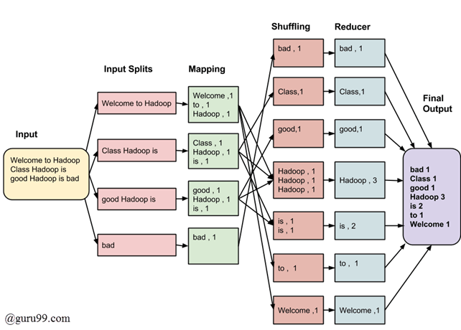

Slide 15
The MapReduce Programming Model (cont’d.)
Hadoop releases
1.x features
Continuation of the original code base
Additions include security, additional HDFS and MapReduce improvements
2.x features
YARN (Yet Another Resource Navigator)
A new MR runtime that runs on top of YARN
Improved HDFS that supports federation and increased availability
Slide 25- 1

Slide 16
25.3 Hadoop Distributed File System (HDFS)
HDFS
File system component of Hadoop
Designed to run on a cluster of commodity hardware
Patterned after UNIX file system
Provides high-throughput access to large datasets
Stores metadata on NameNode server
Stores application data on DataNode servers
File content replicated on multiple DataNodes
Slide 25- 1

Slide 17
Hadoop Distributed File System (cont’d.)
HDFS design assumptions and goals
Hardware failure is the norm
Batch processing
Large datasets
Simple coherency model
HDFS architecture
Master-slave
Decouples metadata from data operations
Replication provides reliability and high availability
Network traffic minimized
Slide 25- 1

Slide 18
Hadoop Distributed File System (cont’d.)
NameNode
Maintains image of the file system
i-nodes and corresponding block locations
Changes maintained in write-ahead commit log called Journal
Secondary NameNodes
Checkpointing role or backup role
DataNodes
Stores blocks in node’s native file system
Periodically reports state to the NameNode
Slide 25- 1

Slide 19
Hadoop Distributed File System (cont’d.)
File I/O operations
Single-writer, multiple-reader model
Files cannot be updated, only appended
Write pipeline set up to minimize network utilization
Block placement
Nodes of Hadoop cluster typically spread across many racks
Nodes on a rack share a switch
Slide 25- 1

Slide 20
Hadoop Distributed File System (cont’d.)
Replica management
NameNode tracks number of replicas and block location
Based on block reports
Replication priority queue contains blocks that need to be replicated
HDFS scalability
Yahoo cluster achieved 14 petabytes, 4000 nodes, 15k clients, and 600 million files
Slide 25- 1

Slide 21
The Hadoop Ecosystem
Related projects with additional functionality
Pig and hive
Provides higher-level interface for working with Hadoop framework
Oozie
Service for scheduling and running workflows of jobs
Sqoop
Library and runtime environment for efficiently moving data between relational databases and HDFS
Slide 25- 1

Slide 22
The Hadoop Ecosystem (cont’d.)
Related projects with additional functionality (cont’d.)
HBase
Column-oriented key-value store that uses HDFS
Slide 25- 1

Slide 23
25.4 MapReduce: Additional Details
MapReduce runtime environment
JobTracker
Master process
Responsible for managing the life cycle of Jobs and scheduling Tasks on the cluster
TaskTracker
Slave process
Runs on all Worker nodes of the cluster
Slide 25- 1

Slide 24
MapReduce: Additional Details (cont’d.)
Overall flow of a MapReduce job
Job submission
Job initialization
Task assignment
Task execution
Job completion
Slide 25- 1

Slide 25
MapReduce: Additional Details (cont’d.)
Fault tolerance in MapReduce
Task failure
Runtime exception
Java virtual machine crash
No timely updates from the task process
TaskTracker failure
Crash or disconnection from JobTracker
Failed Tasks are rescheduled
JobTracker failure
Not a recoverable failure in Hadoop v1
Slide 25- 25

Slide 26
MapReduce: Additional Details (cont’d.)
The shuffle procedure
Reducers get all the rows for a given key together
Map phase
Background thread partitions buffered rows based on the number of Reducers in the job and the Partitioner
Rows sorted on key values
Comparator or Combiner may be used
Copy phase
Reduce phase
Slide 25- 1

Slide 27
MapReduce: Additional Details (cont’d.)
Job scheduling
JobTracker schedules work on cluster nodes
Fair Scheduler
Provides fast response time to small jobs in a Hadoop shared cluster
Capacity Scheduler
Geared to meet needs of large enterprise customers
Slide 25- 1

Slide 28
MapReduce: Additional Details (cont’d.)
Strategies for equi-joins in MapReduce environment
Sort-merge join
Map-side hash join
Partition join
Bucket joins
N-way map-side joins
Simple N-way joins
Slide 25- 1

Slide 29
MapReduce: Additional Details (cont’d.)
Apache Pig
Bridges the gap between declarative-style interfaces such as SQL, and rigid style required by MapReduce
Designed to solve problems such as ad hoc analyses of Web logs and clickstreams
Accommodates user-defined functions
Slide 25- 1

Slide 30
MapReduce: Additional Details (cont’d.)
Apache Hive
Provides a higher-level interface to Hadoop using SQL-like queries
Supports processing of aggregate analytical queries typical of data warehouses
Developed at Facebook
Slide 25- 1

Slide 31
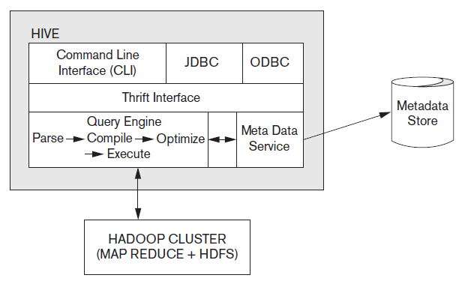
Hive System Architecture and Components
Figure 25.2 Hive system architecture and components
Slide 25-1

Slide 32
Advantages of the Hadoop/MapReduce Technology
Disk seek rate a limiting factor when dealing with very large data sets
Limited by disk mechanical structure
Transfer speed is an electronic feature and increasing steadily
MapReduce processes large datasets in parallel
MapReduce handles semistructured data and key-value datasets more easily
Linear scalability
Slide 25- 1

Slide 33
25.5 Hadoop v2 (Alias YARN)
Reasons for developing Hadoop v2
JobTracker became a bottleneck
Cluster utilization less than desirable
Different types of applications did not fit into the MR model
Difficult to keep up with new open source versions of Hadoop
Slide 25- 1

Slide 34
YARN Architecture
Separates cluster resource management from Jobs management
ResourceManager and NodeManager together form a platform for hosting any application on YARN
ApplicationMasters send ResourceRequests to the ResourceManager which then responds with cluster Container leases
NodeManager responsible for managing Containers on their nodes
Slide 25- 1

Slide 35
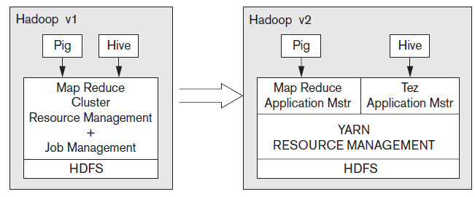
Hadoop Version Schematics
Figure 25.3 The Hadoop v1 vs. Hadoop v2 schematic
Slide 25-1

Slide 36
Other Frameworks on YARN
Apache Tez
Extensible framework being developed at Hortonworks for building high-performance applications in YARN
Apache Giraph
Open-source implementation of Google’s Pregel system, a large-scale graph processing system used to calculate Page-Rank
Hoya: HBase on YARN
More flexibility and improved cluster utilization
Slide 25- 1

Slide 37
25.6 General Discussion
Hadoop/MapReduce versus parallel RDBMS
2009: performance of two approaches measured
Parallel database took longer to tune compared to MR
Performance of parallel database 3-6 times faster than MR
MR improvements since 2009
Hadoop has upfront cost advantage
Open source platform
Slide 25- 1

Slide 38
General Discussion (cont’d.)
MR able to handle semistructured datasets
Support for unstructured data on the rise in RDBMSs
Higher level language support
SQL for RDBMSs
Hive has incorporated SQL features in HiveQL
Fault-tolerance: advantage of MR-based systems
Slide 25- 1

Slide 39
General Discussion (cont’d.)
Big data somewhat dependent on cloud technology
Cloud model offers flexibility
Scaling out and scaling up
Distributed software and interchangeable resources
Unpredictable computing needs not uncommon in big data projects
High availability and durability
Slide 25- 1

Slide 40
General Discussion (cont’d.)
Data locality issues
Network load a concern
Self-configurable, locality-based data and virtual machine management framework proposed
Enables access of data locally
Caching techniques also improve performance
Resource optimization
Challenge: optimize globally across all jobs in the cloud rather than per-job resource optimizations
Slide 25- 1

Slide 41
General Discussion (cont’d.)
YARN as a data service platform
Emerging trend: Hadoop as a data lake
Contains significant portion of enterprise data
Processing happens
Support for SQL in Hadoop is improving
Apache Storm
Distributed scalable streaming engine
Allows users to process real-time data feeds
Storm on YARN and SAS on YARN
Slide 25- 1

Slide 42
General Discussion (cont’d.)
Challenges faced by big data technologies
Heterogeneity of information
Privacy and confidentiality
Need for visualization and better human interfaces
Inconsistent and incomplete information
Slide 25- 1

Slide 43
General Discussion (cont’d.)
Building data solutions on Hadoop
May involve assembling ETL (extract, transform, load) processing, machine learning, graph processing, and/or report creation
Programming models and metadata not unified
Analytics application developers must try to integrate services into coherent solution
Cluster a vast resource of main memory and flash storage
In-memory data engines
Spark platform from Databricks
Slide 25- 1

Slide 44
25.7 Summary
Big data technologies at the center of data analytics and machine learning applications
MapReduce
Hadoop Distributed File System
Hadoop v2 or YARN
Generic data services platform
MapReduce/Hadoop versus parallel DBMSs
Slide 25- 1

