Slide 1
İSTINYE UNIVERSITY · BA DEGREE PROJECT II
The Impact of Machine Learning-Based Credit Scoring Models on the Accuracy of Loan Default Prediction in Banking
Batuhan Şen
200527078
Batuhan Şen · 200527078 · İstinye University
01
Notes:
Hello. My name is Batuhan Sen. This is my BA Degree Project at Istinye University. My topic is machine learning in banking: do ML models predict loan default better than the traditional method, and what is the cost of using them?

Slide 2
THE QUESTION
The problem & research question
When someone asks for a loan, the bank must predict one thing: will this customer repay?
TRADITIONAL
NEWER
Logistic Regression
Machine Learning
Simple, transparent, and easy to explain — the standard that regulators accept.
Often more accurate, but a “black box” — hard to explain why.
RESEARCH QUESTION
How much do ML models improve default prediction over logistic regression — and at what cost?
Batuhan Şen · 200527078 · İstinye University
02
Notes:
Every bank has the same problem: when someone asks for a loan, will they pay it back? For years banks used logistic regression - simple and easy to explain. Then machine learning arrived: often more accurate, but a black box. My question: how much better is ML really, and what do we lose to get it?

Slide 3
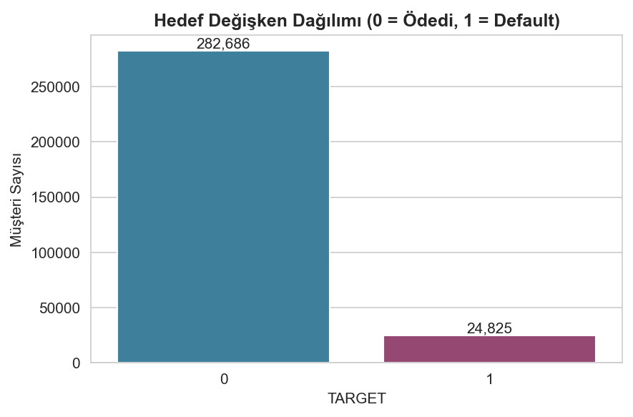
THE DATASET
Home Credit Default Risk
307,511
loan applications
122
variables per applicant
Real, public lending data from Kaggle — downloaded directly under the competition rules.
One key label per customer: default (1) vs repaid (0).
8.07%
defaulted → a strong class imbalance
Target distribution — repaid (0) vastly outnumbers default (1).
Batuhan Şen · 200527078 · İstinye University
03
Notes:
I used the Home Credit Default Risk dataset - real, public lending data from Kaggle. More than 300,000 applications, 122 variables, and one key label: did they default or not. Only about 8 percent defaulted. This imbalance shaped almost every decision.

Slide 4
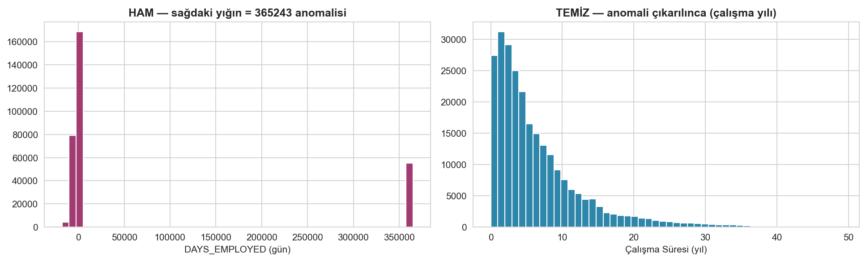
PREPARATION
Data preparation & cleaning
Removed 17 columns with over 60% missing values.
Fixed an error — “1000 years of employment” set to missing.
Median imputation and outlier capping (winsorization).
Built banking ratios; Boruta selection cut 146 → 23 variables.
Leakage-safe — every step learned from training data only.
The “365243-day” placeholder (left) removed → a realistic distribution (right).
Batuhan Şen · 200527078 · İstinye University
04
Notes:
Real data is never clean. I removed columns over 60 percent empty, fixed an error where some people had worked about 1000 years, imputed with the median, capped outliers, built banking ratios, and used Boruta to select 23 variables. Every step was learned only from training data.

Slide 5
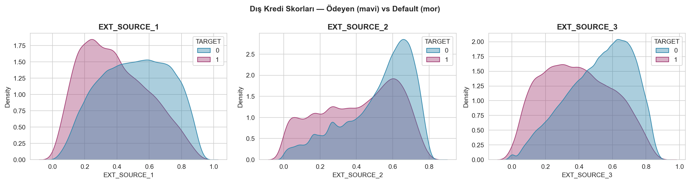
METHOD
Models & tools
BASELINE
ML
ML
ML
Logistic Regression
Random Forest
XGBoost
LightGBM
SMOTE for imbalance — applied inside training folds only.
5-fold cross-validation with hyperparameter tuning.
Main metric AUC-ROC ; tools: Python, scikit-learn, XGBoost, LightGBM, SHAP.
External credit scores separate payers (blue) from defaulters (purple).
Batuhan Şen · 200527078 · İstinye University
05
Notes:
I compared four models: logistic regression as baseline, against Random Forest, XGBoost and LightGBM. Imbalance handled with SMOTE inside training folds only. 5-fold cross-validation and tuning. Main metric AUC-ROC. All in Python.

Slide 6
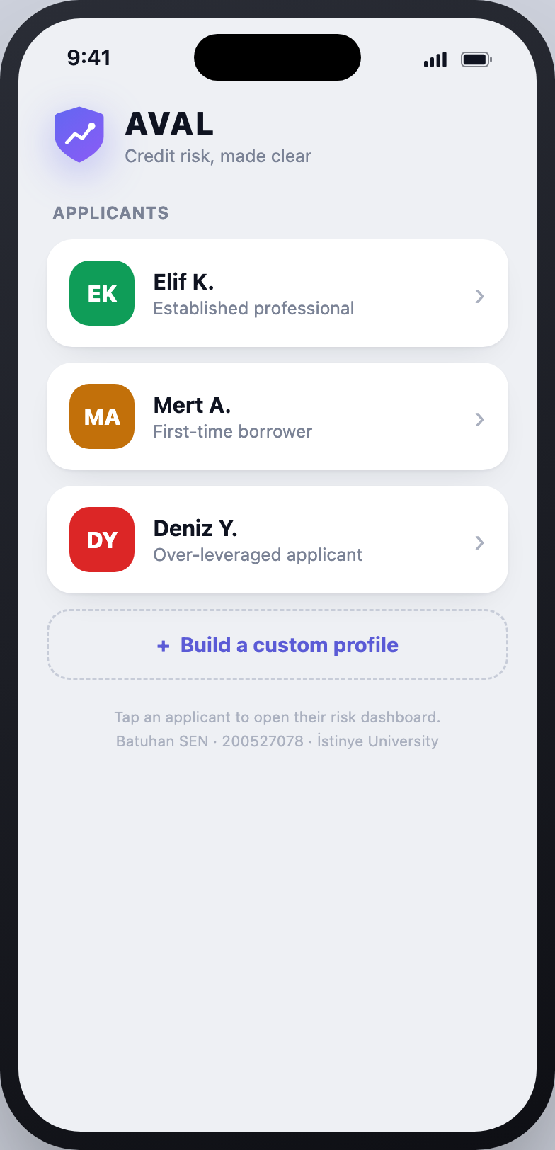
LIVE DEMO · AVAL · 1 OF 3
AVAL — the model as a working app
I built AVAL — “credit risk, made clear” — a small app that puts the trained model behind a real interface.
Three example applicants — strong, first-time, over-leveraged.
Tap one → their risk dashboard opens.
Or build a custom profile for what-if analysis.
Batuhan Şen · 200527078 · İstinye University
06
Notes:
I did not stop at charts. I built a small app called AVAL that runs my credit-risk model live. The home screen shows three example applicants - an established professional, a first-time borrower, and an over-leveraged applicant - plus a button to build a custom profile. Let me walk you through it.

Slide 7
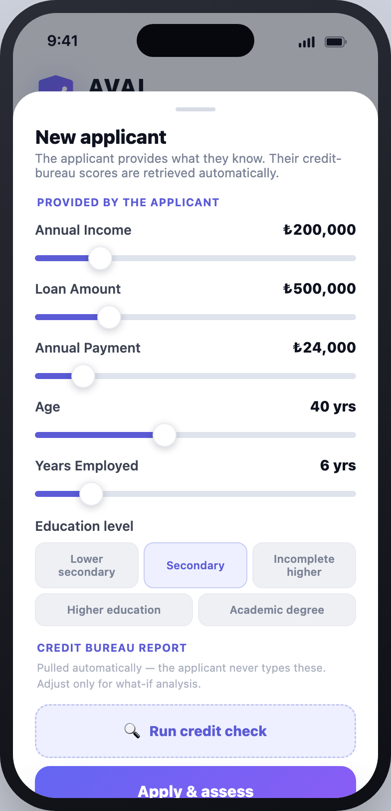
LIVE DEMO · AVAL · 2 OF 3
From application to assessment
The applicant enters only what they know — income, loan, payment, age, work, education.
Credit-bureau scores are pulled automatically — never typed.
One tap — Apply & assess — and the model scores instantly.
Powered by a simplified, interpretable version of the thesis model — nine key features.
Batuhan Şen · 200527078 · İstinye University
07
Notes:
This is how a new application works. The applicant enters only what they know: income, loan amount, payment, age, employment and education. The credit-bureau scores are pulled automatically - they never type those. Then one tap, apply and assess, and the model scores them instantly.

Slide 8
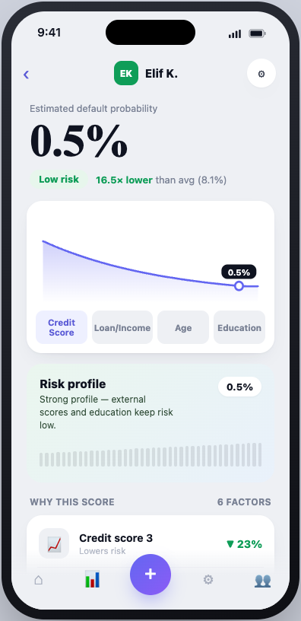
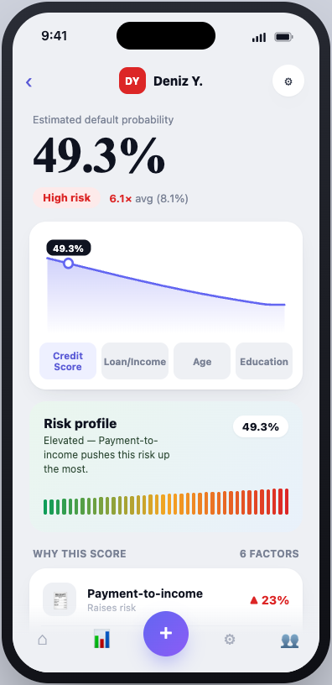
LIVE DEMO · AVAL · 3 OF 3
The decision — and the reasons
Instant default probability for every applicant.
“Why this score” lists the six factors behind it — the model’s SHAP reasons.
Elif K. → 0.5% low · Deniz Y. → 49.3% high.
Accurate and explainable — the goal of this thesis.
Elif K. · 0.5% low
Deniz Y. · 49.3% high
Batuhan Şen · 200527078 · İstinye University
08
Notes:
And here is the result. Elif, the strong profile, gets 0.5 percent - low risk. Deniz, the over-leveraged applicant, gets 49.3 percent - high risk. Below every score, the app explains the reasons - the same SHAP factors from my analysis. Accurate and explainable - the goal of this thesis. Let me show it for real now.

Slide 9
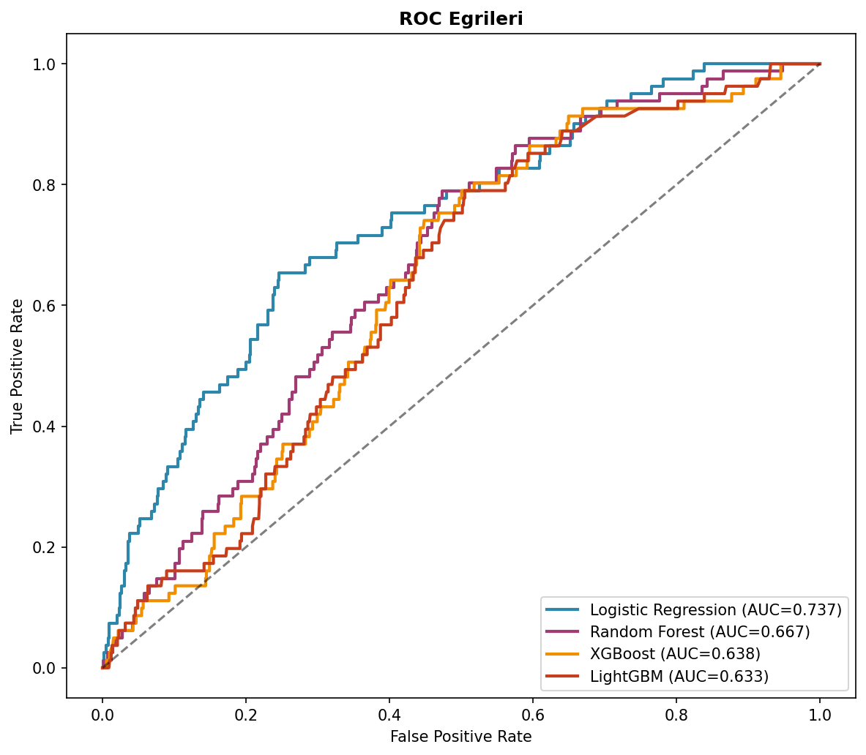
RESULTS · SMOTE PIPELINE
Model comparison
Logistic Regression
0.737
LightGBM
0.725
XGBoost
0.718
Random Forest
0.703
The surprise: under SMOTE, the simple model won.
Batuhan Şen · 200527078 · İstinye University
09
Notes:
Here are the results, and the first finding was a surprise. Under SMOTE the simple logistic regression got the highest AUC, about 0.74, with the ML models slightly behind. The literature usually says boosting wins, so I did not stop here.

Slide 10
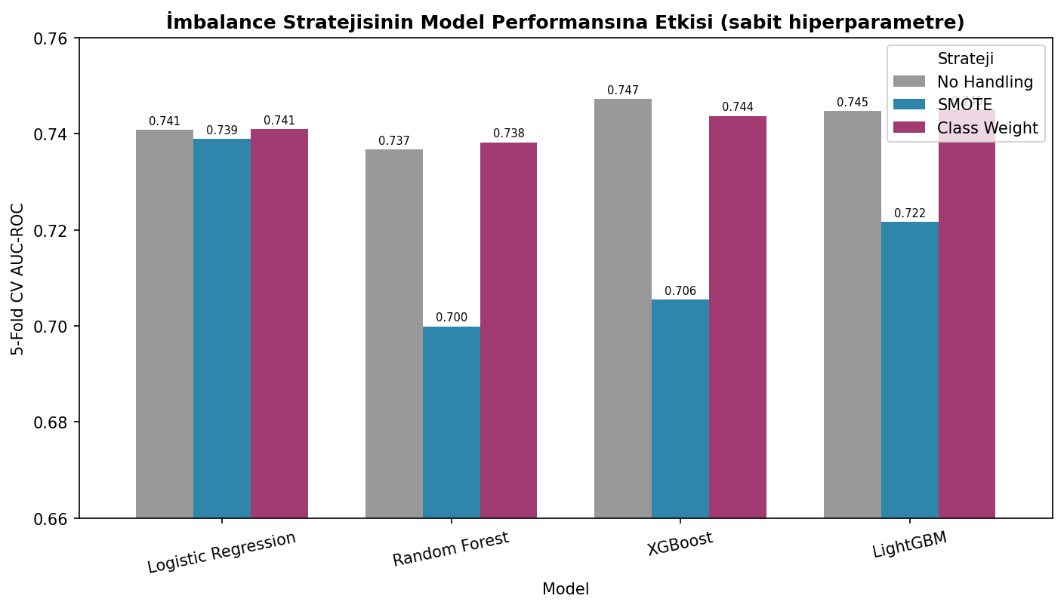
KEY FINDING
It depends on imbalance handling
I tested three strategies: none · SMOTE · class-weighting.
SMOTE damages the tree models — XGBoost drops 0.042.
With class-weighting the ranking flips: XGBoost 0.747 · LightGBM 0.745 · LogReg 0.741.
Boosting wins — but by only ~0.006 AUC . The handling method mattered more than the model.
Same models, three strategies — SMOTE (blue) sinks the tree models.
Batuhan Şen · 200527078 · İstinye University
10
Notes:
This is the most important slide. SMOTE actually damages the tree models. When I switched to class-weighting, the ranking flipped: XGBoost and LightGBM moved ahead, exactly as the literature predicts. But the advantage is tiny - about 0.006 AUC. The handling method mattered more than the model.

Slide 11
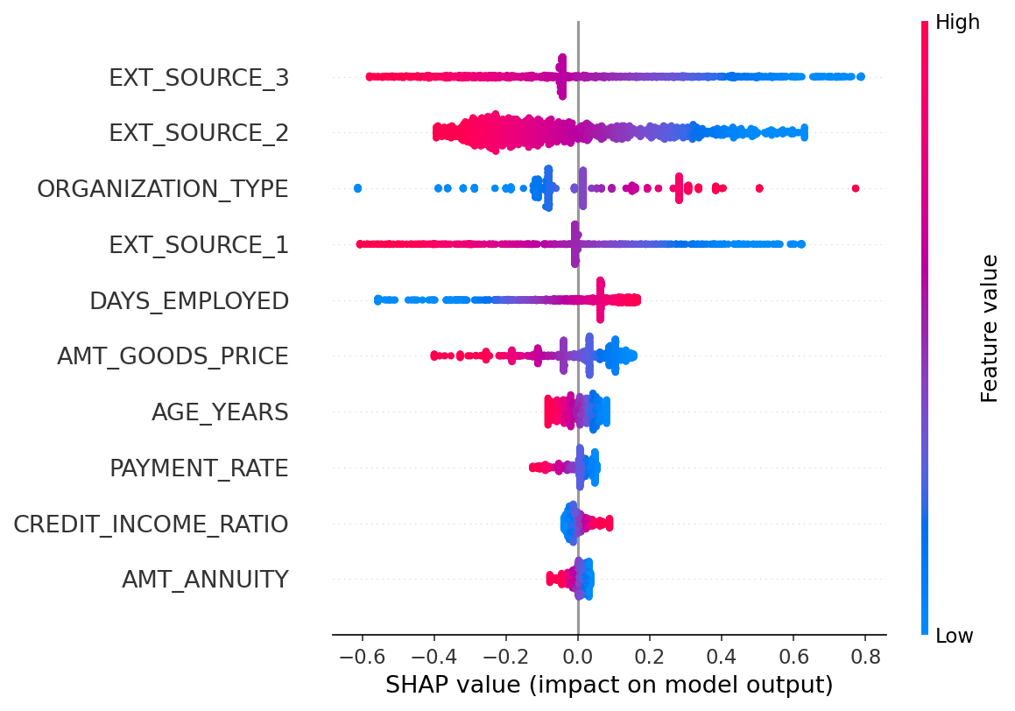
INTERPRETABILITY · SHAP
What drives the predictions
The three external credit scores dominate — like bureau scores in real banks.
My engineered banking ratios — payment rate, annuity/income — also rank high.
Weak on their own, but real signal inside the model — feature engineering paid off.
These same factors power the “Why this score” list in AVAL.
SHAP — each dot is one applicant; spread shows a feature’s pull on the prediction.
Batuhan Şen · 200527078 · İstinye University
11
Notes:
I opened the black box with SHAP. The external credit scores dominate predictions. The banking ratios I engineered myself, like payment rate, also ranked high - their simple correlation looked weak, but inside the model they carried real signal. Good feature engineering paid off. And these are exactly the factors you saw in AVAL, in the why-this-score list.

Slide 12
CONCLUSION
What the answer is
01
ML gives only a marginal gain over a well-built logistic regression.
02
Data prep, honest imbalance handling and feature engineering matter as much as the algorithm.
03
In regulated banking, an explainable model can be worth more than a tiny accuracy gain.
04
AVAL turns the result into practice — a working, explainable scoring app.
Batuhan Şen · 200527078 · İstinye University
12
Notes:
So, the answer: yes, ML can predict default a little better, but only with the right setup. The algorithm is not the most important thing - clean data, honest imbalance handling and feature engineering matter just as much. In regulated banking, an explainable model can be worth more than a tiny gain. That is why I built AVAL - to show the model working as a clear, explainable tool, not just a number in a table.

Slide 13
Thank you
I am happy to answer any questions.
Batuhan Şen
200527078
İstinye University
Batuhan Şen · 200527078 · İstinye University
13
Notes:
Thank you. I am happy to answer any questions.

