Slide 1
Deep Learning for Medical Researchers
Sam Green and
Prof. Çetin Kaya Koç

Slide 2
Seminar goals
Provide intuition regarding deep learning
How to identify problems which deep learning may solve
How to identify the type of data needed for deep learning
Provide technical understanding
Implement deep learning algorithms in Python
Analyze popular deep learning techniques

Slide 3
Terminology
Artificial Intelligence (MIT 6.825 Techniques in Artificial Intelligence)
Computational models of human behavior?
Computational models of human “thought” processes?
Computational systems that behave intelligently?
Computational systems that behave rationally.
Machine Learning (Princeton COS 511)
Machine learning studies computer algorithms for learning to do stuff.
Machine Intelligence
Search Google for this: “machine learning” and “artificial intelligence” are returned.

Slide 4
Terminology
Computational Statistics (Johns Hopkins 625.664)
A branch of mathematical sciences concerned with efficient methods for obtaining numerical solutions to statistically formulated problems.
Data Science (Berkeley Data Science)
Examines which questions need answering and where to find the related data. Data science requires business acumen and analytical skills as well as the ability to mine, clean, and present data.
Deep Learning (deeplearningbook.org)
Algorithms which learn from experience and understand the world in terms of a hierarchy of concepts, with each concept deﬁned through its relation to simpler concepts.

Slide 5
Neural networks
Foundation of popular AI techniques

Slide 6
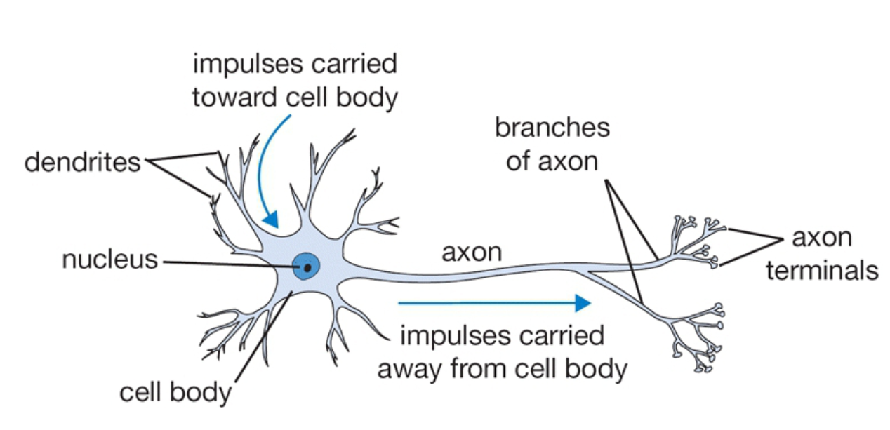
Deep learning uses neural networks
http://cs231n.github.io/neural-networks-1/

Slide 7
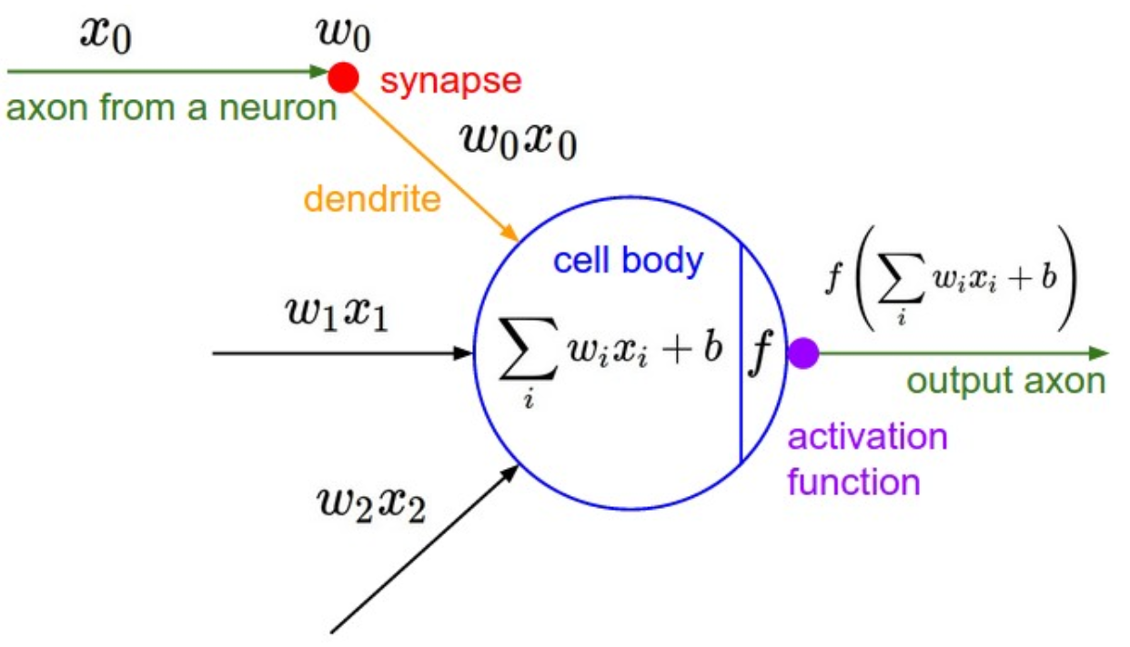
McCulloch-Pitts Neuron
http://cs231n.github.io/neural-networks-1/

Slide 8
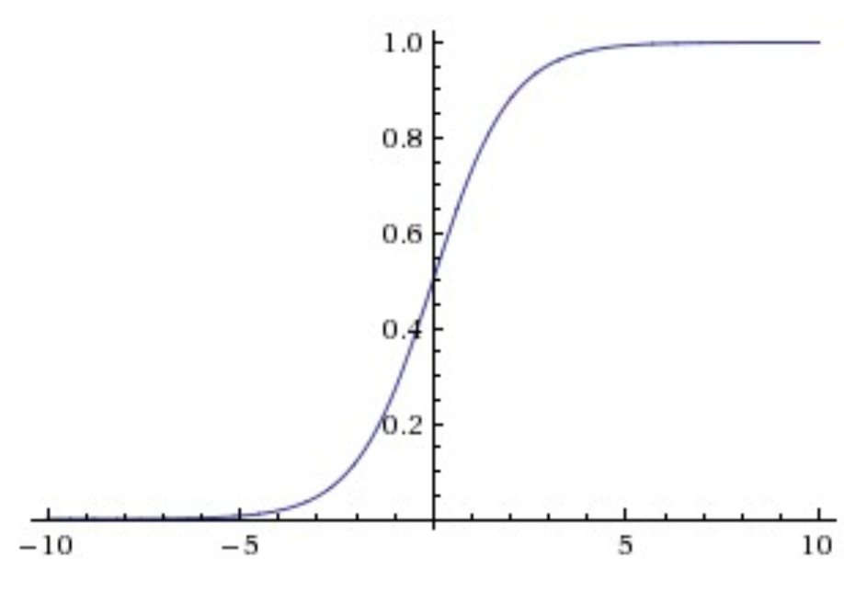
Activation function is nonlinear
http://cs231n.github.io/neural-networks-1/

Slide 9
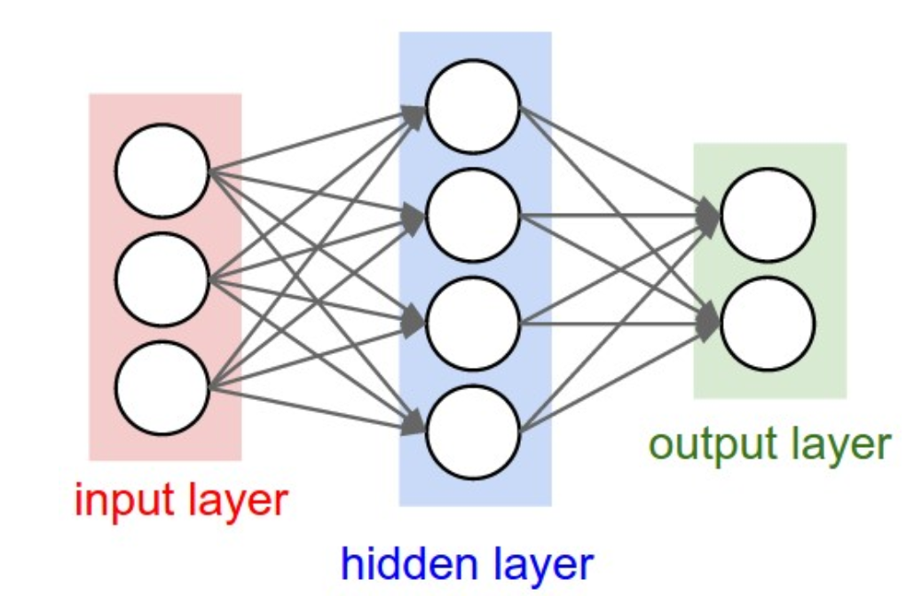
The “Perceptron” Each circle represents a neuron
http://cs231n.github.io/neural-networks-1/

Slide 10
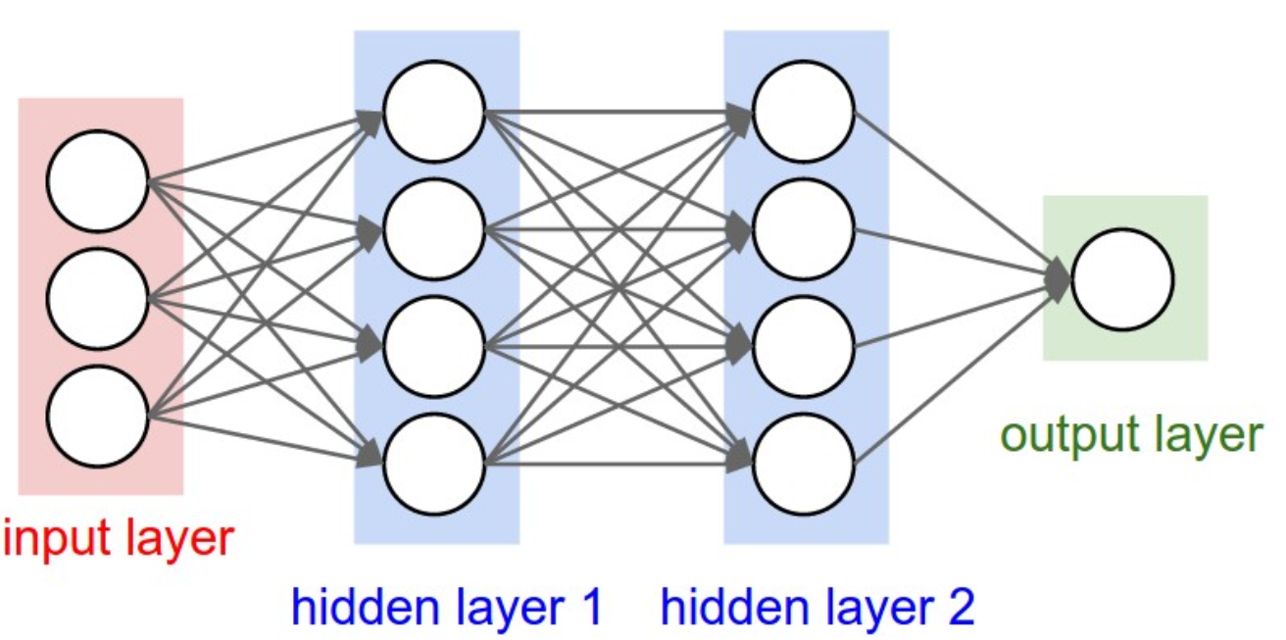
Multi-Layer Perceptron Technically a deep neural network (DNN)
http://cs231n.github.io/neural-networks-1/

Slide 11
Binary classification
True/false, positive/negative, disease/no disease

Slide 12
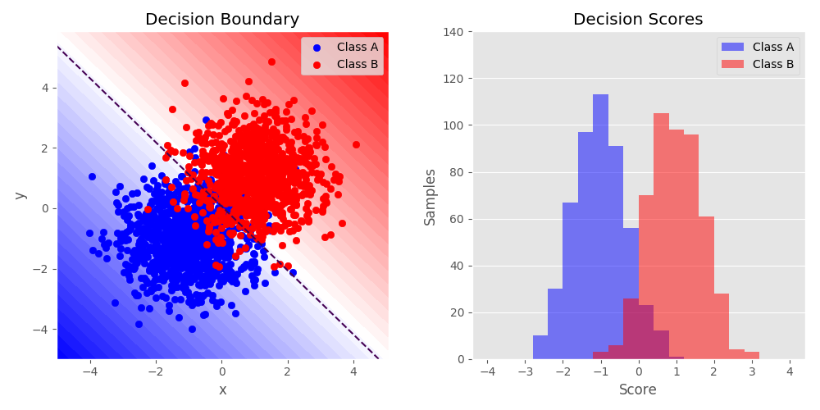
Binary Classification
http://scikit-hep.org

Slide 13
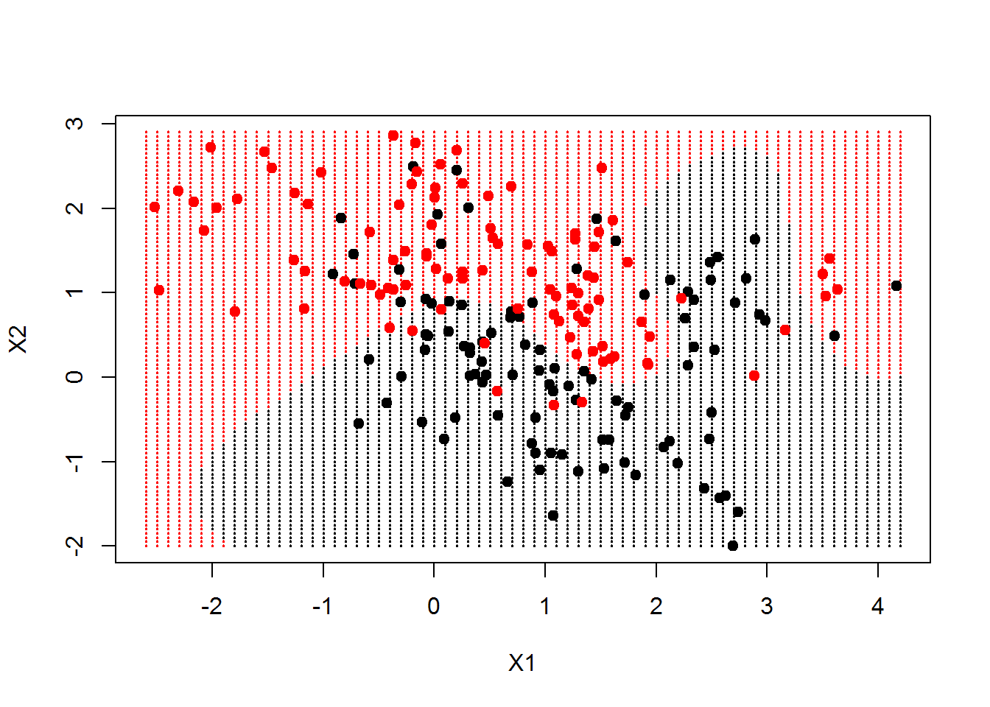
https://datascienceplus.com

Slide 14
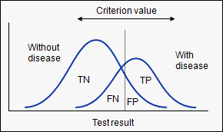
Sensitivity and specificity
Sensitivity: probability that a test result will be positive when the disease is present
Specificity: probability that a test result will be negative when the disease is not present
https://www.medcalc.org

Slide 15
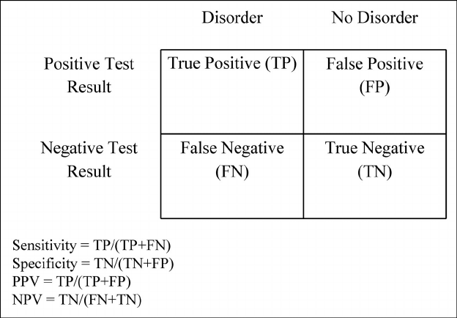
Sensitivity and specificity

Slide 16
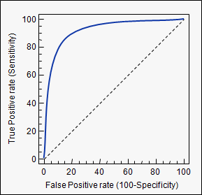
Area Under Curve (AUC)
https://www.medcalc.org/manual/roc-curves.php

Slide 17
Binary Classification Examples

Slide 18
A few recent medical applications
Skin cancer screening
Diabetic retinopathy
Fogel, Alexander L., and Joseph C. Kvedar. "Artificial intelligence powers digital medicine." npj Digital Medicine 1.1 (2018): 5

Slide 19
Skin cancer screening
The most common type of cancer
5.4 million new cases and 10,000 deaths in US each year
Training dataset had hundreds of thousands of images
DNN achieved AUC between .91 and .96
Fogel, Alexander L., and Joseph C. Kvedar. "Artificial intelligence powers digital medicine." npj Digital Medicine 1.1 (2018): 5

Slide 20
Diabetic retinopathy
Diabetes affects 29.1 million Americans
Another 86 million Americans have pre-diabetes
28.5% of U.S. diabetics have diabetic retinopathy (can lead to blindness)
Screening involves a dilated eye exam referral to an ophthalmologist
Fogel, Alexander L., and Joseph C. Kvedar. "Artificial intelligence powers digital medicine." npj Digital Medicine 1.1 (2018): 5

Slide 21
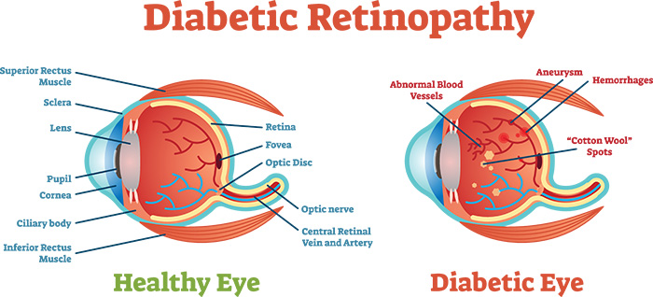
https://www.aoa.org

Slide 22
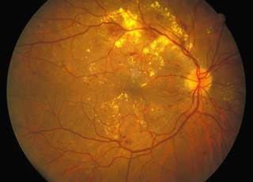
https://www.endocrinologyadvisor.com

Slide 23
Diabetic retinopathy
DNN trained 128,175 images previously evaluated by a panel of 54 board-certified U.S. ophthalmologists and senior ophthalmology residents
AUC of 0.97–0.99 for detecting referable diabetic retinopathy
Fogel, Alexander L., and Joseph C. Kvedar. "Artificial intelligence powers digital medicine." npj Digital Medicine 1.1 (2018): 5

Slide 24
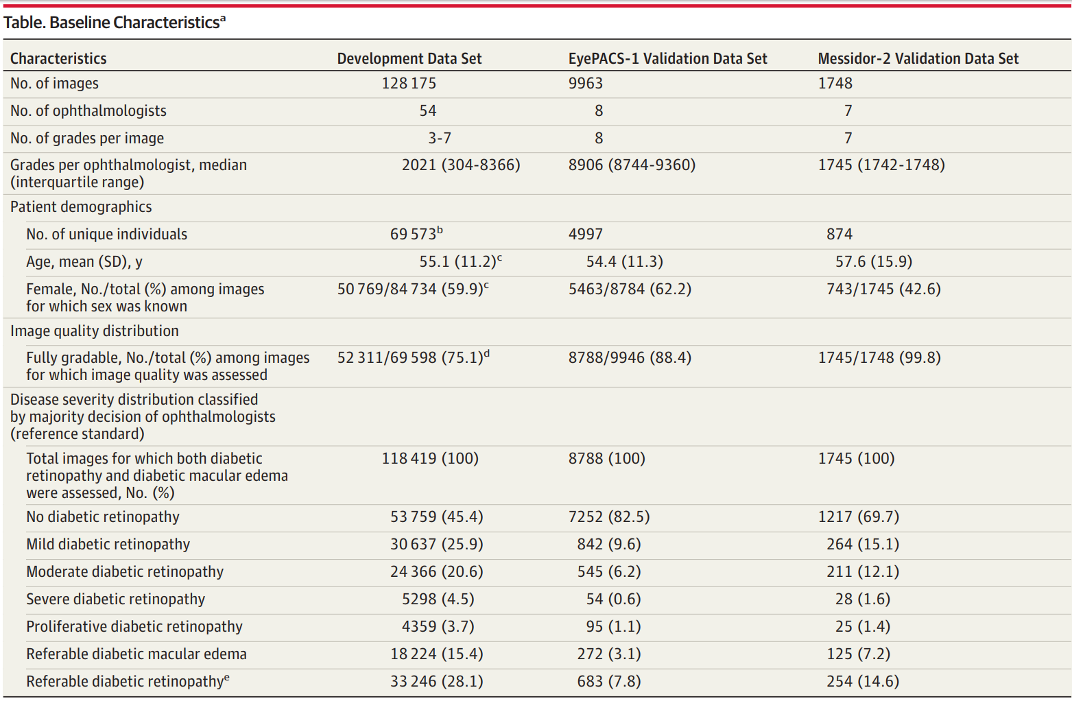

Slide 25
Deep Learning Tools

Slide 26
Introduction to Python and Google Colaboratory
https://colab.research.google.com/github/sg2/intro/blob/master/1%20-%20introduction/Python%20Introduction%201.ipynb

Slide 27
Tools for deep learning
Academic and industry has focused on Python language
Tensorflow is a Python deep learning framework from Google
Focused on performance in the beginning, now usability
PyTorch is a Python deep learning framework from Facebook
Focused on useability in the beginning, now performance

Slide 28
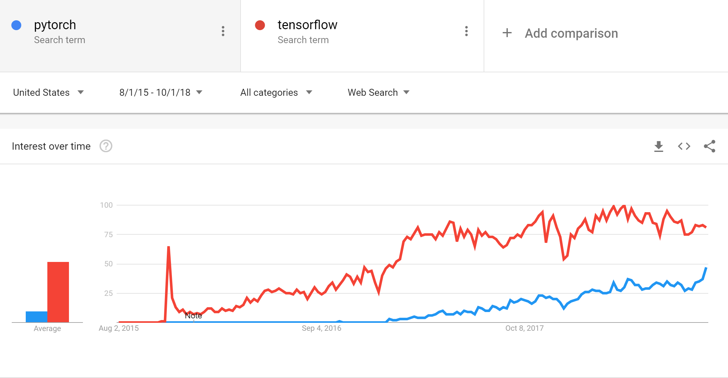

Slide 29
Training our first neural network
https://colab.research.google.com/github/sg2/intro/blob/master/1%20-%20introduction/PyTorch_CIFAR_10.ipynb

Slide 30
Conclusion

Slide 31
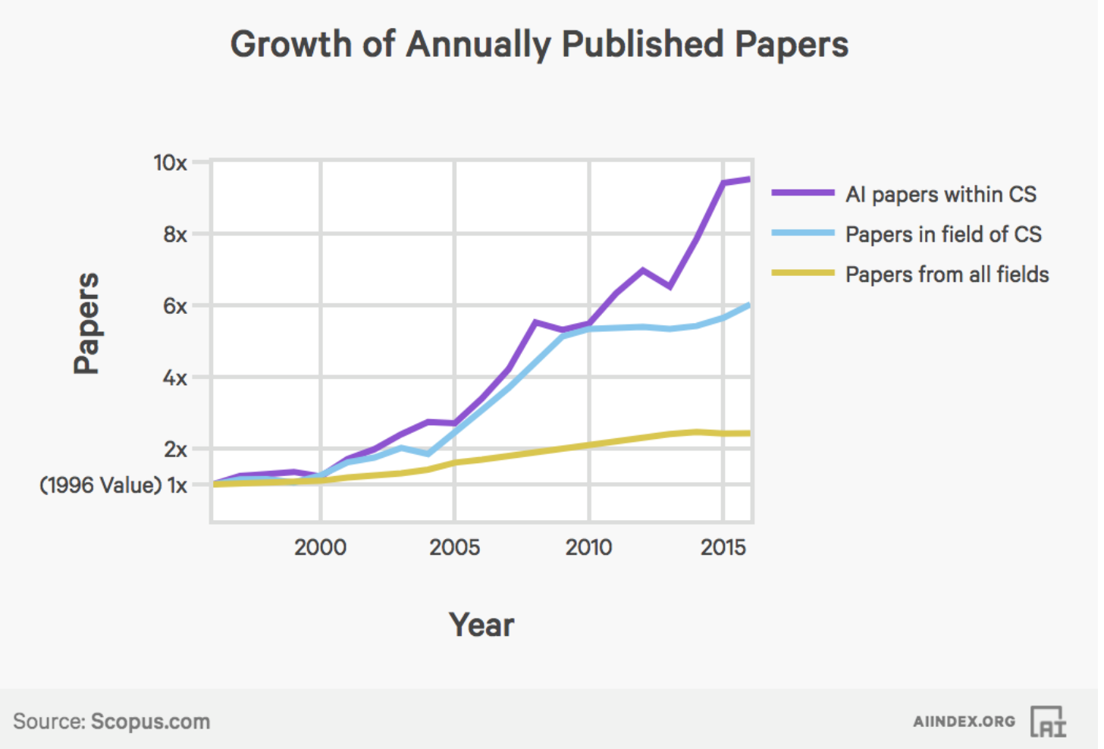

Slide 32
Position: Physician augmentation with AI/ML
Think of AI techniques as ways to reduce or eliminate mundane tasks
If a problem does not seem routine or mundane to you, it will most likely not be replaced with AI soon
Not guaranteed – AI advances and implications are difficult to predict
AI requires data
Preferably with labels
The more the better
The “cleaner” the better
Data is gold

Slide 33
Conclusion
Most AI application papers (engineering, medicine, science) are using AI research algorithms published in 2012-2013
Excellent research to be had via collaboration
Needs: data + domain expert + AI expert
Excellent AI products through collaboration
Needs: data + domain experts + AI experts + engineers

