Slide 1
Gradient-Based Optimization

Slide 2

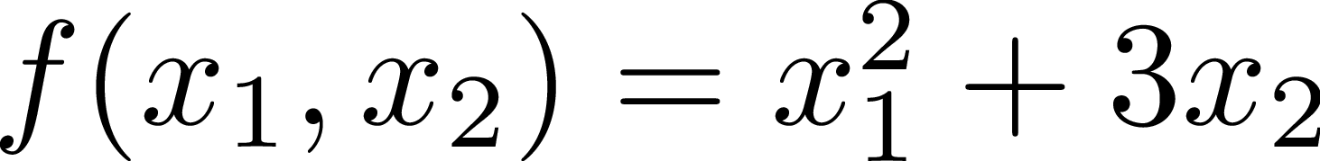
Gradient refresher
The gradient of a function is a vector of partial derivatives. It is a multi-variable generalization of the derivative.
Ex.

Slide 3
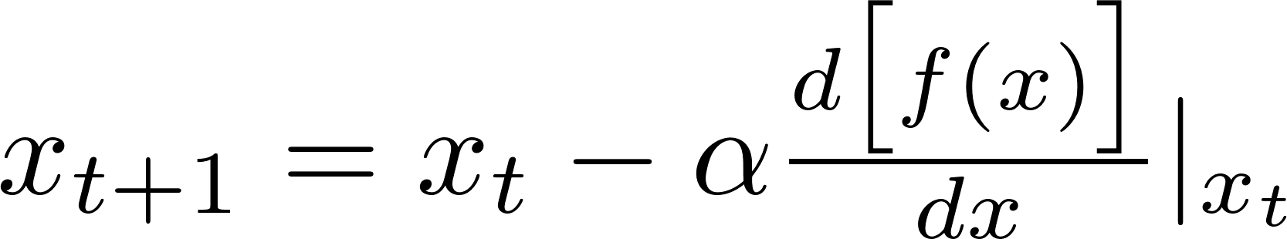
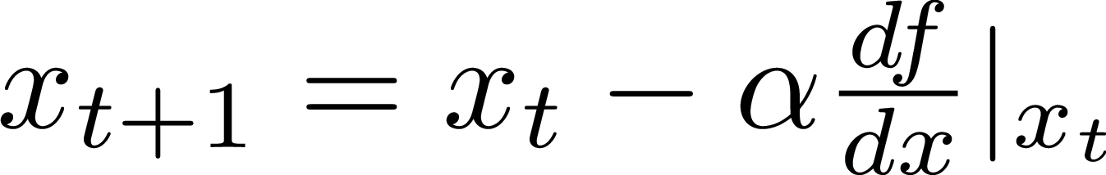
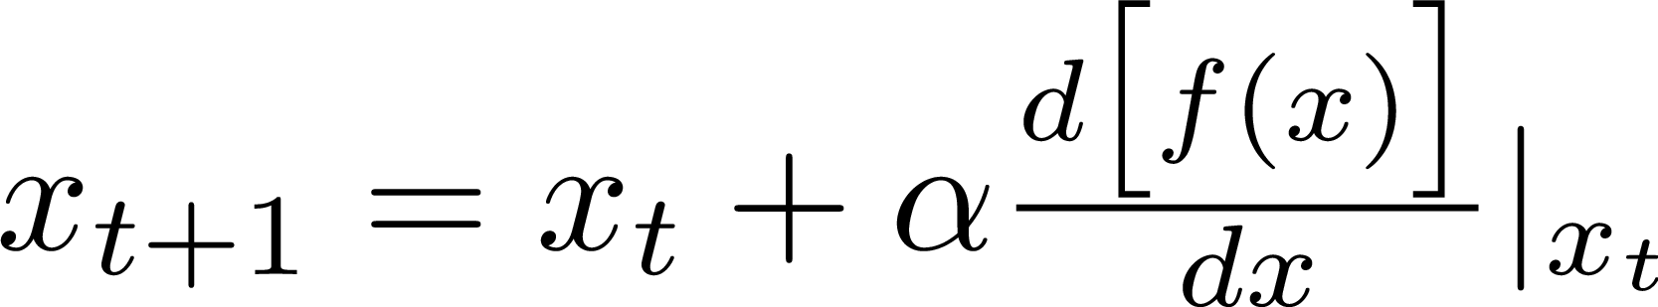
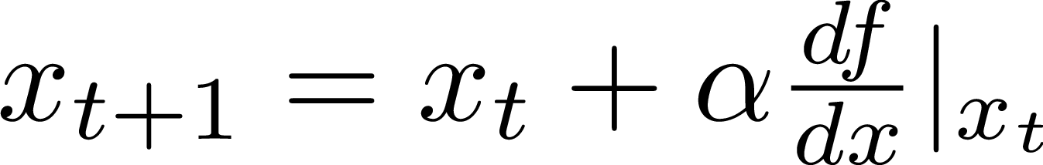
Gradient-based optimization
Iterative optimization algorithms for finding local minimum or maximum of a function.
Gradient descent finds minimum.
Gradient ascent finds maximum.

Slide 4

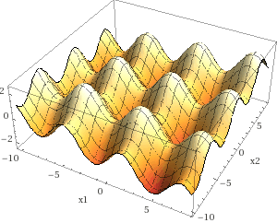
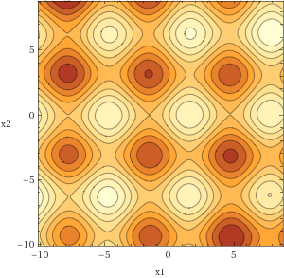
Gradient-based optimization only finds a local minima or maxima when is non-convex
Ex.

Slide 5
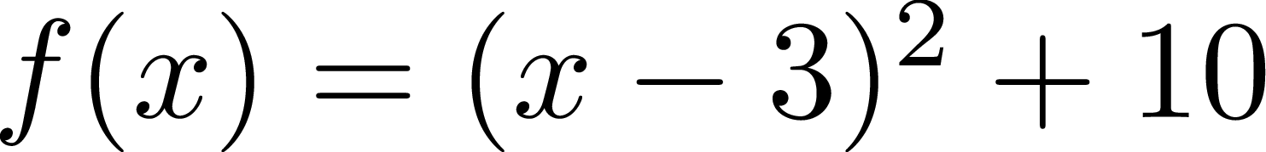

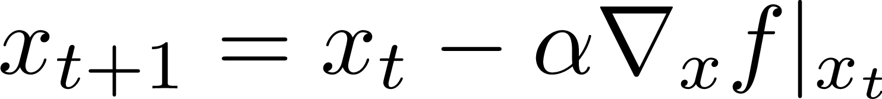
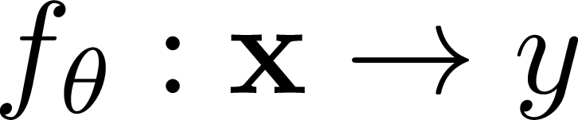



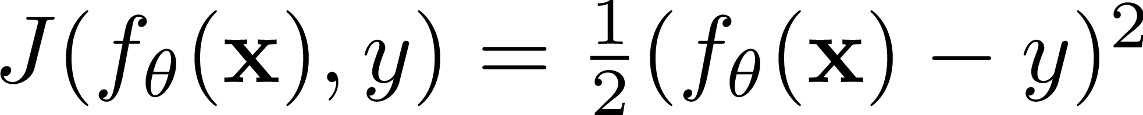
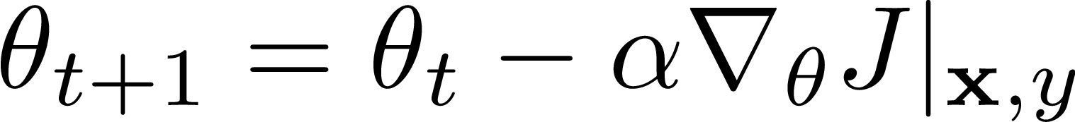
Using gradient for finding parameters
Jupyter Notebook found which minimized :
What if we want to fit a model to predict targets, given features?
Ex.
Hold and fixed and use gradient descent to find parameters :

Slide 6

Using gradient for finding parameters
Approximating function:
Objective (AKA cost, AKA loss) function:
Gradient of objective w.r.t. parameters:
Ex.

Slide 7
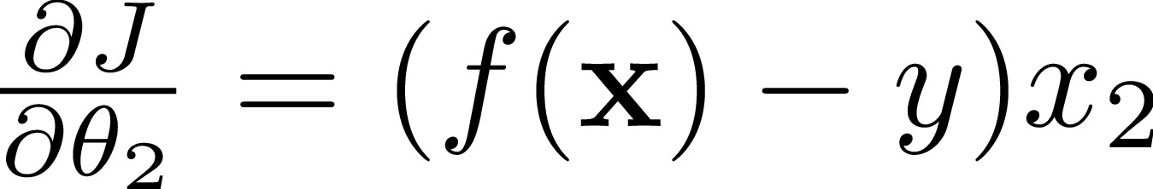
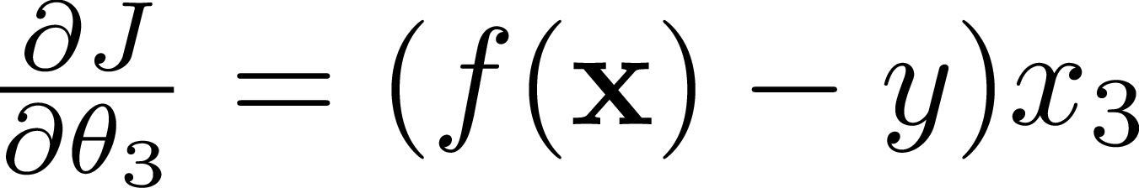
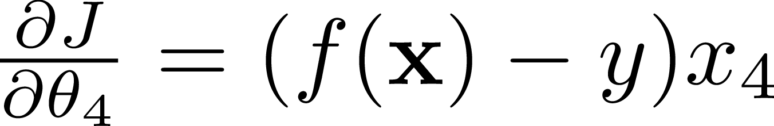
Using gradient for finding parameters

Slide 8


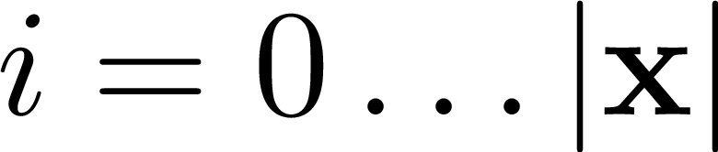
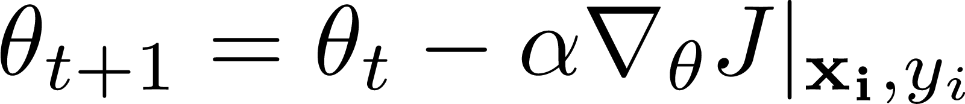
Stochastic Gradient Descent
Given “features” and labels
for number of epochs
for

Slide 9
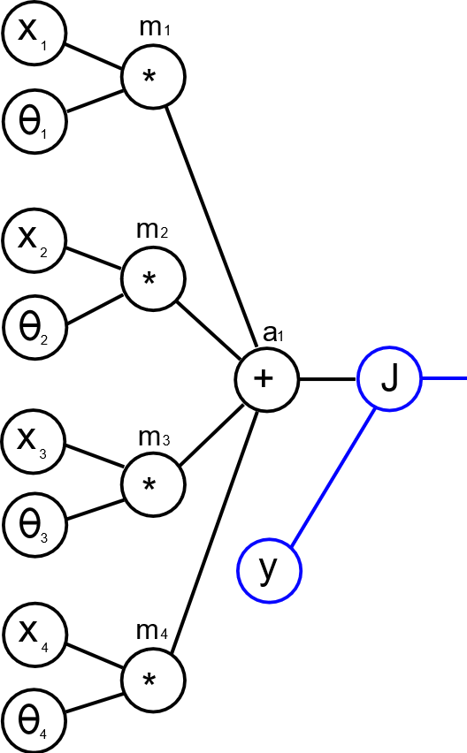
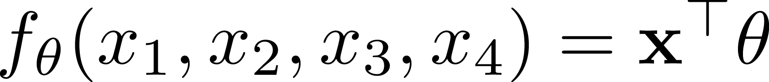
Graphical representation
Functions can be represented as directed graphs.
May help for building intuition and deriving formulas.
Ex.

Slide 10




