Slide 1
Multi Attentional Neural Factorization Machines: A State of Art Model for Click Through Rate Prediction By Batuhan Ozgur Basal

Slide 2
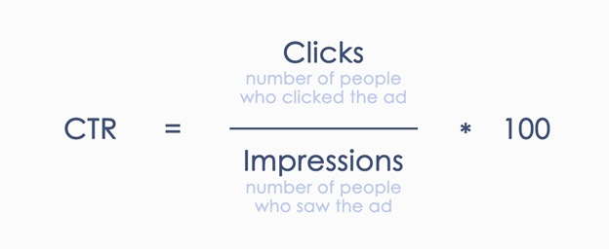
What Do We Mean By CTR ?
CTR = Click Through Rate
The proportion between the number of interactions an advertising receives and the number of views it receives is known as the click through rate (CTR)

Slide 3
What Do We Mean By CTR Prediction ?

Slide 4
What are the Problems?
High dimensional sparse features
2) Modeling Feature interactions
1 | 0 | 0 | 0 | 0 | 0 | 0 | 0 | 0 | 0
0 | 0 | 0 | 0 | 0 | 0 | 0 | 0 | 0 | 0
0 | 0 | 1 | 0 | 0 | 0 | 0 | 0 | 0 | 1
0 | 0 | 0 | 0 | 0 | 0 | 0 | 0 | 0 | 0
Customers in a younger age group may engage with action games advertising more frequently than customers in other age categories, so, customer-age and advertisement-category are two captured features

Slide 5
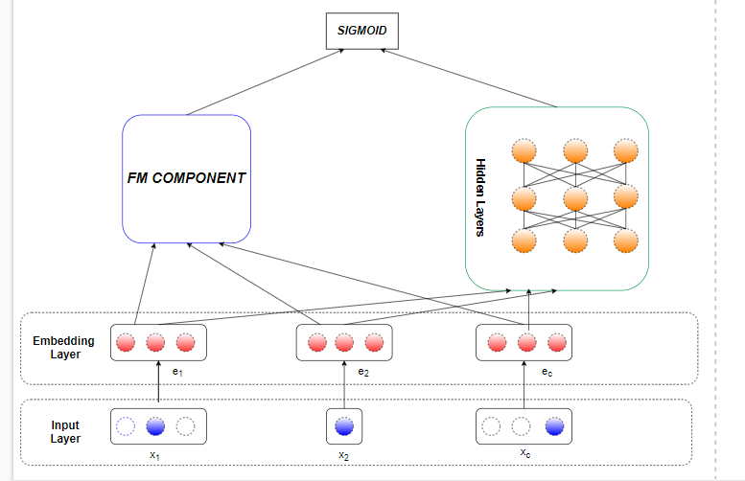
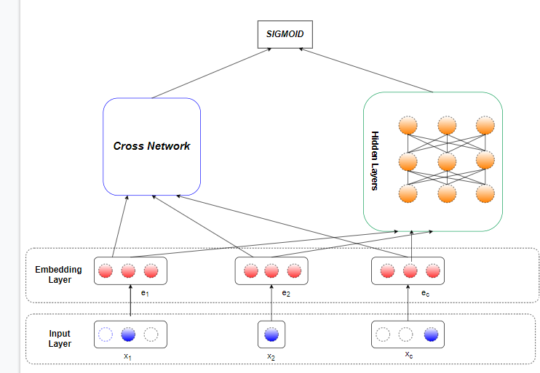
How Can We Solve It?
Manual Feature Engineering
2) Building End-to-end model
DeepFM model
Cross Network Model

Slide 6
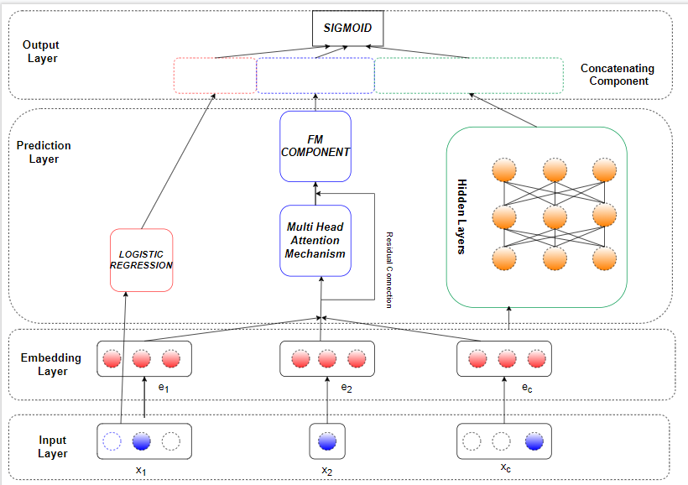
OUR MODEL

Slide 7
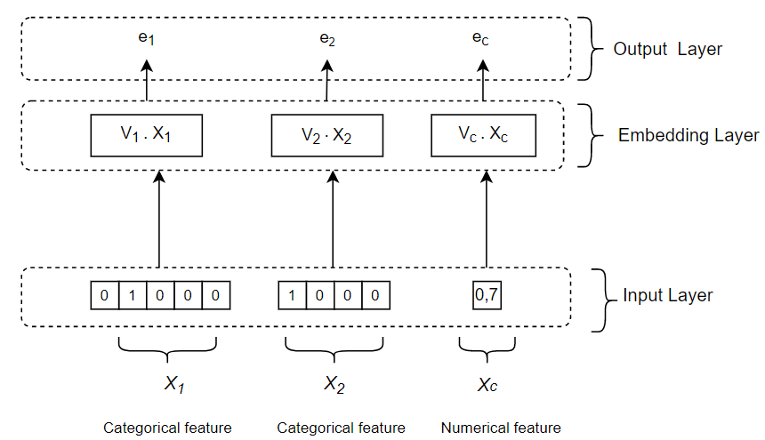
1) Input Layer and Embedding Layer

Slide 8

2) PREDICTION LAYER
2.1) Logistic Regression

Slide 9
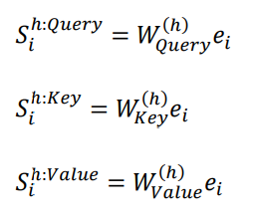
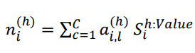

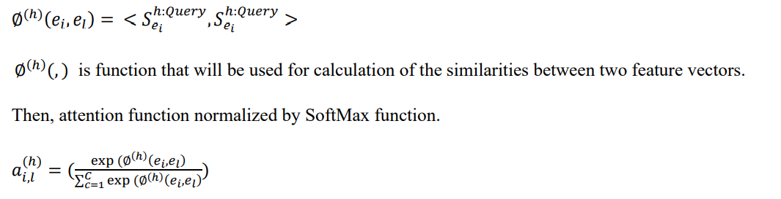

2.2) Multi-head Attention Mechanism
1)
4)
5)
2)
6)
3)

Slide 10




2.3) Element-wise Factorization Machines
1)
2)
3)
4)

Slide 11



2.4) Multi Layer Perceptron
1)
2)
3)

Slide 12

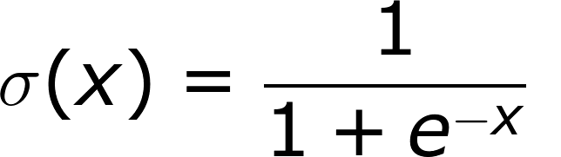
3) Concatenating Layer

Slide 13
PERFORMANCE COMPARISONS
 | Criteo Dataset |  | Avazu Dataset
Model | AUC | Logloss | AUC | Logloss
LR | 0.7658 | 0.4748 | 0.7414 | 0.3954
FM | 0.7698 | 0.4718 | 0.7532 | 0.3894
IFM | 0.7778 | 0.4556 | 0.7664 | 0.4025
NFM | 0.7891 | 0.4543 | 0.7646 | 0.3907
AutoInt | 0.7921 | 0.4531 | 0.7743 | 0.3989
DeepFM | 0.7926 | 0.4529 | 0.7726 | 0.3999
Wide & Deep | 0.7928 | 0.4527 | 0.7733 | 0.3790
DCN | 0.7929 | 0.4529 | 0.7733 | 0.3795
FNN | 0.7934 | 0.4530 | 0.7732 | 0.3790
FwFM | 0.7935 | 0.4526 | 0.7735 | 0.3793
MANFM* | 0.7940 | 0.4523 | 0.7757 | 0.3776
* Our model

Slide 14
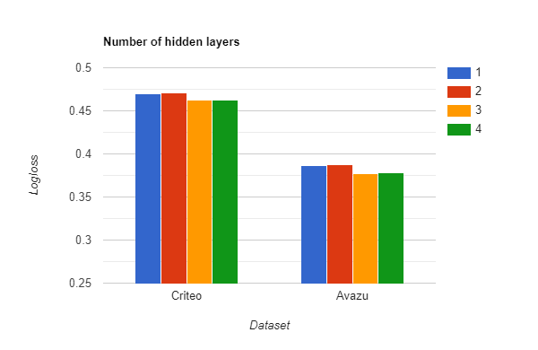
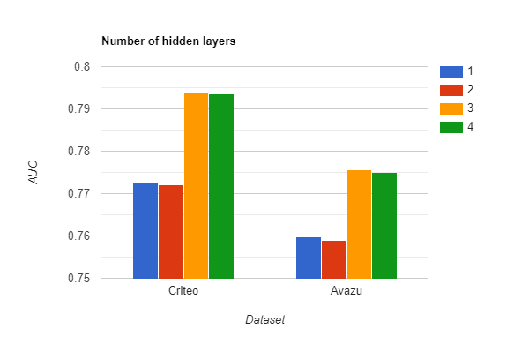

Slide 15
 | Criteo Dataset |  | Avazu Dataset
Type of Product | AUC | Logloss | AUC | Logloss
Inner | 0.7939 | 0.4524 | 0.7753 | 0.3785
Elementwise | 0.7940 | 0.4523 | 0.7757 | 0.3776
 | Criteo Dataset |  | Avazu Dataset
Model | AUC | Logloss | AUC | Logloss
MANFM | 0.7940 | 0.4523 | 0.7757 | 0.3776
MANFM w/o | 0.7629 | 0.4529 | 0.7747 | 0.3782
 | Criteo Dataset |  | Avazu Dataset
Batch Normalization | AUC | Logloss | AUC | Logloss
True | 0.7943 | 0.4522 | 0.7757 | 0.3776
False | 0.7940 | 0.4523 | 0.7744 | 0.3786
 | Criteo Dataset |  | Avazu Dataset
Activation Function | AUC | Logloss | AUC | Logloss
Tanh | 0.7861 | 0.4603 | 0.7666 | 0.3832
ReLU | 0.7940 | 0.4523 | 0.7747 | 0.3783

Slide 16
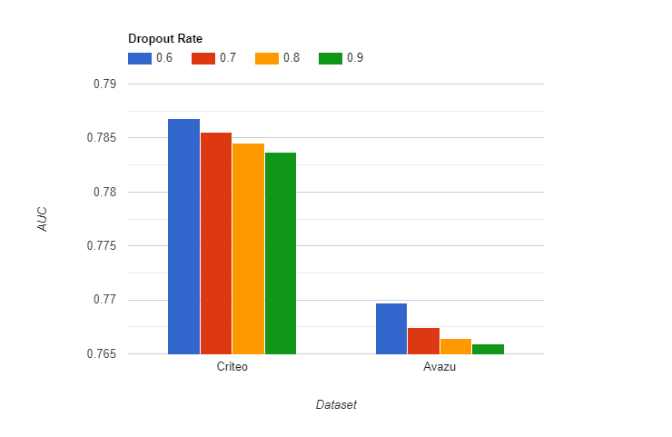
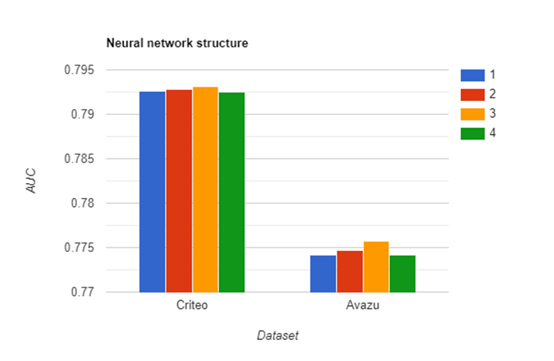

Slide 17
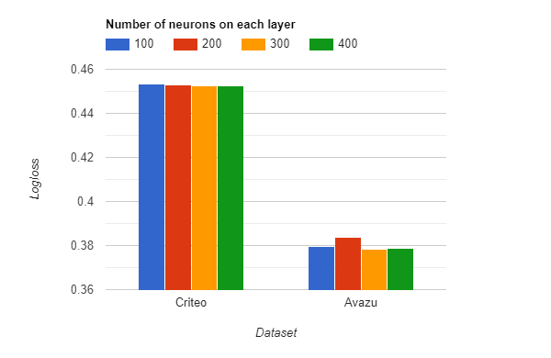
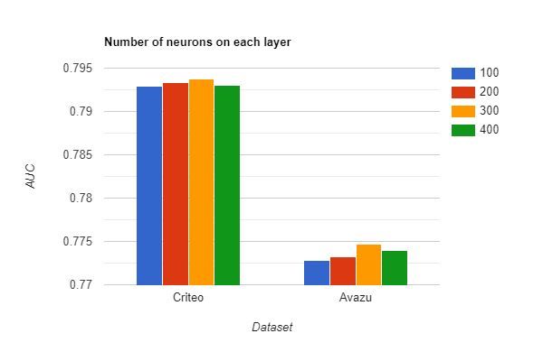

Slide 18
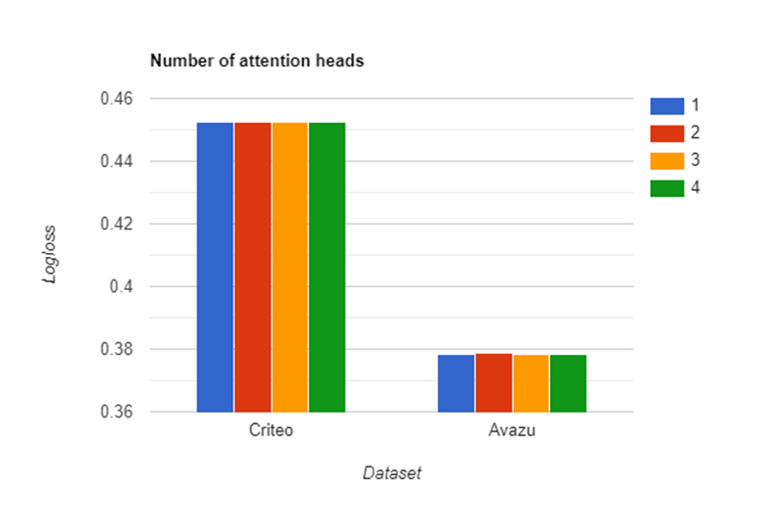
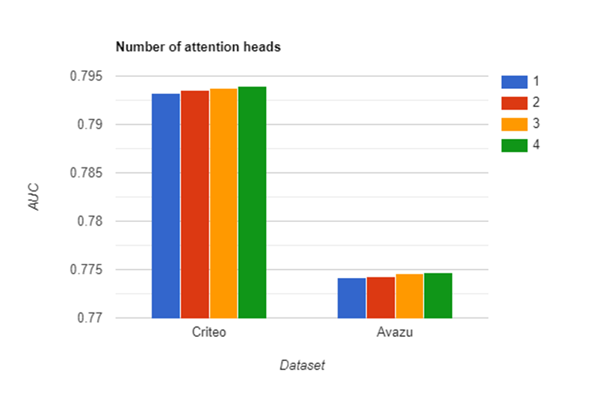

Slide 19



Slide 20

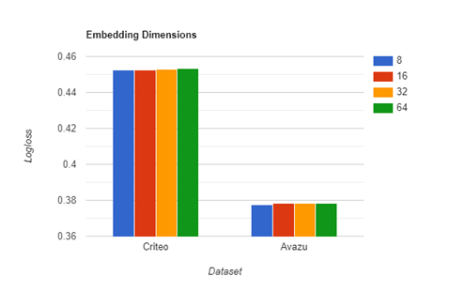

Slide 21
Feature Interaction Order |  |  | Avazu Dataset
First Order | Second Order | Higher order | AUC | Logloss
Logistic Regression | Multi head attention + Element wise FM | Deep Neural Network | 0.7757 | 0.3776
Logistic Regression | Multi head attention + Element wise FM | Cross Network | 0.7651 | 0.3840
Logistic Regression | Multi head attentio + Element wise FM | Multi-head Attention Mechanism | 0.7654 | 0.3838

Slide 22
Conclusions and What We Have Learned
According to the results obtained after the experiments in this study for CTR estimation, the model that gave the lowest performance was the Logistic Regression model.
it was discovered that the datasets used in this study have many features. One of them is that both contain a lot of categorical features. This situation pushes us to use one hot encoding or label encoding.
Model structures are divided into two as parallel and serial, according to the results obtained, models installed in parallel achieve better performance
The performance of the Factorization Machines model and the models using FM in its content is obviously higher than LR, because it can capture both first order and second order feature interactions.
The Attention Mechanism can capture multiple order feature interactions such as DNN. That's why it was used in the AutoInt model. Since the performance of the AutoInt model is much better than the majority, we preferred to use the attention mechanism in our model.
Our model was the best performer model in the experiment.

Slide 23
QUESTIONS?

Slide 24
References:
[1] Huifeng Guo, Ruiming Tang, Yunming Ye, Zhenguo Li, and Xiuqiang He. 2017. DeepFM: a factorization-machine based neural network for CTR prediction. In Proceedings of the 26th International Joint Conference on Artificial Intelligence. AAAI Press, 1725–1731 (2017)
[2] Wang, R., Fu, B., Fu, G., & Wang, M. (2017). Deep & Cross Network for Ad Click Predictions. Proceedings of the ADKDD’17.
[3] Kumar, Rohit & Naik, Sneha & Naik, Vani & Shiralli, Smita & V.G, Sunil & Husain, Moulahusain. (2015). Predicting Clicks: CTR Estimation of Advertisements using Logistic Regression Classifier. 10.1109/IADCC.2015.7154880.
[4] Wang, Q., Liu, F., Zhao, X. et al. Session interest model for CTR prediction based on self-attention mechanism. Sci Rep 12, 252 (2022). https://doi.org/10.1038/s41598-021-03871-y
[5] Rendle, Steffen. “Factorization Machines.” 2010 IEEE International Conference on Data Mining (2010): 995-1000.
[6] Zhang, W., Du, T., & Wang, J. (2016). Deep Learning over Multi-field Categorical Data - - A Case Study on User Response Prediction. ECIR.
[7] Song, W., Shi, C., Xiao, Z., Duan, Z., Xu, Y., Zhang, M., & Tang, J. (2019). AutoInt: Automatic Feature Interaction Learning via Self-Attentive Neural Networks. Proceedings of the 28th ACM International Conference on Information and Knowledge Management.
[8] He, X., & Chua, T. (2017). Neural Factorization Machines for Sparse Predictive Analytics. Proceedings of the 40th International ACM SIGIR Conference on Research and Development in Information Retrieval.
[9] Yantao Yu, Zhen Wang, and Bo Yuan. 2019. An input-aware factorization machine for sparse prediction. In Proceedings of the 28th International Joint Conference on Artificial Intelligence (IJCAI'19). AAAI Press, 1466–1472.

