Slide 1
Data Stage Basics

Slide 2
ETL Overview
ETL is the process by which data is extracted from a data source, transformed to meet the needs of the business, and loaded into a target – often to achieve data integration for a data warehouse while it is also applicable for data migration and synchronization.
EXTRACTION
Sourcing
Change data capture
Extracting
TRANSFORMATION
Data model translation
Data profiling
Data cleansing
Data conformance
-Data validation
Data calculation
LOADING
Bulk Loading
Auditing
Logging
Surrogate key creation
Real-time partitioning
Parallelizing
Pipelining
Scheduling
Monitoring
Failure Recovery
Problem escalation
METADATA
Notes:
ETL is used in both DW and operational context
Data consolidation
Data migration
Data synchronization (cover differences from replication)

Slide 3
What is IBM DataStage?
IBM InfoSphere DataStage delivers four core capabilities:
Connectivity to a wide range of mainframe, legacy, and enterprise applications, databases, file formats, and external information sources.
Prebuilt library of more than 300 functions including data validation rules and very complex transformations.
Maximum throughput using a parallel, high-performance processing architecture.
Enterprise-class capabilities for development, deployment, maintenance, and high-availability.
It leverages metadata for analysis and maintenance. It also operates in batch, real time, or as a Web service.

Slide 4
Types of DataStage jobs
DataStage supports a few types of jobs:
Server jobs- basic jobs written on an Informix framework, they use DataStage hash files and DataStage basic routines.
Parallel jobs - A parallel job is an executable DataStage program, created using a graphical user interface in DataStage Designer and scheduled, executed and monitored in DataStage Director.
Jobs sequences - jobs that control execution of other jobs. Sequences can be made of both server and parallel jobs.
MVS Edition Jobs – Mainframe Edition Jobs for mainframes.

Slide 5
IBM DataStage Enterprise Edition Components
The DataStage client components are:
Administrator:
Administers DataStage projects and conducts housekeeping on the server
Add/delete projects, set defaults
Designer :
Creates DataStage jobs that are compiled into executable programs
Import meta data, backup projects
Assemble jobs, compile, and execute
Director :
Used to run and monitor the DataStage jobs
Execute jobs, examine job run logs
IBM Web Sphere Console : Managing and Creating DataStage Users
Notes:
5
DataStage 8.0.1 have two different edition depending upon the processing :
1 . Server Edition
Parallel Edition
But Both the Edition have same client components.

Slide 6
IBM InfoSphere Architecture

Slide 7
Architecture overview
InfoSphere® DataStage® is part of a larger suite of products called InfoSphere Information Server, which is a comprehensive, unified platform for enterprise information architectures. You install InfoSphere Information Server product modules, including InfoSphere DataStage, in logical tiers.

Slide 8
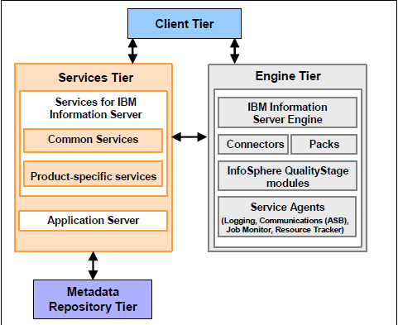
Client/Server Tiers
Client Tier
Service Tier
Metadata Repository ( Default DB2 Database, named as Xmeta)
Engine Tier

Slide 9
IBM InfoSphere Runtime Parallel Architecture

Slide 10

Parallel processing
A parallel DataStage job incorporates two basic types of parallel processing — pipeline and partitioning. Both of these methods are used at runtime by the Information Server engine.
To the DataStage developer, this job would appear the same on your Designer canvas, but you can optimize it through advanced properties.
Pipeline parallelism :
All stages run concurrently, even in a single-node configuration. As data is read from the Oracle source, it is passed to the Transformer stage for transformation, where it is then passed to the DB2 target. Instead of waiting for all source data to be read, as soon as the source data stream starts to produce rows, these are passed to the subsequent stages. This method is called pipeline parallelism, and all three stages in our example operate simultaneously regardless of the degree of parallelism of the configuration file. The Information Server Engine always executes jobs with pipeline parallelism.
Partition parallelism :
Partition parallelism is accomplished at runtime, instead of a manual process that would be required by traditional systems. The DataStage developer only needs to specify the algorithm to partition the data, not the degree of parallelism or where the job will execute. Incase of Partition Parallelism All the stage doesn’t run concurrently, all the data read from one stage then it will pass to the next stage for processing.

Slide 11
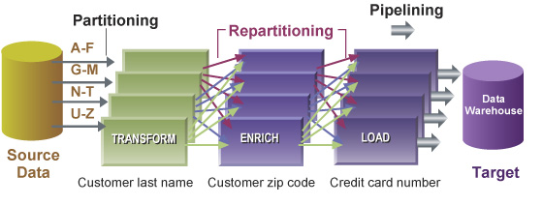
Cont…

Slide 12
Types of Partitioning :
(Auto). InfoSphere DataStage attempts to work out the best partitioning method depending on execution modes of current and preceding stages and how many nodes are specified in the Configuration file.
Hash. The records are hashed into partitions based on the value of a key column or columns selected from the Available list.
Modulus. The records are partitioned using a modulus function on the key column selected from the Available list. This is commonly used to partition on tag fields.
Random. The records are partitioned randomly, based on the output of a random number generator.
Round Robin. The records are partitioned on a round robin basis as they enter the stage.
Same. Preserves the partitioning already in place.

Slide 13
Types of Collection Methods:
(Auto). This is the default collection method for Difference stages. Normally, when you are using Auto mode, InfoSphere DataStage will eagerly read any row from any input partition as it becomes available
Ordered. Reads all records from the first partition, then all records from the second partition, and so on.
Round Robin. Reads a record from the first input partition, then from the second partition, and so on. After reaching the last partition, the operator starts over.
Sort Merge. Reads records in an order based on one or more columns of the record. This requires you to select a collecting key column from the Available list.

Slide 14
Configuration File

Slide 15
The Datastage configuration file is a master control file.
The configuration file provides hardware configuration.
DataStage understands the architecture of the system through this file.
The main outcome from having the configuration file is to separate software and hardware configuration from job design.
A sample configuration file is located in Configurations directory under the Server directory of your installation, and is called default.apt.
This section contains the following subsections:
The default path and the APT_CONFIG_FILE
Syntax
Node Names
options
Node pools and default node pool.
Disk and scratch disk pools and their defaults.
Buffer Scratch Disk Pools

Slide 16
File can be found under
<>\IBM\InformationServer\Server\Configurations folder with the name default.apt
{ node “node1″ { fastname “SVR1″ pools “” resource disk “C:/IBM/InformationServer/Server/Datasets/Node1″ {pools “”} resource scratchdisk “C:/IBM/InformationServer/Server/Scratch/Node1″ {pools “} } node “node2″ { fastname “SVR1″ pools “” resource disk “C:/IBM/InformationServer/Server/Datasets/Node1″ {pools “”} resource scratchdisk “C:/IBM/InformationServer/Server/Scratch/Node1″ {pools “”} } node “node3″ { fastname “SVR2″ pools “” “sort” resource disk “C:/IBM/InformationServer/Server/Datasets/Node1″ {pools “”} resource scratchdisk “C:/IBM/InformationServer/Server/Scratch/Node1″ {pools ”" } }
}

Slide 17
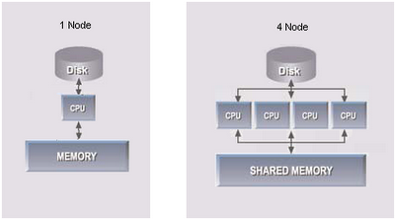

Slide 18
DataStage Designer Overview

Slide 19
DataStage Designer
The DataStage Designer allows you to use familiar graphical point-and-click techniques to develop processes for extracting, cleansing, transforming, integrating and loading data into warehouse tables.
The Designer provides a “visual data flow” method to easily interconnect and configure reusable components.
Node Configuarations
Resource Estimation
Run & Compile the job
Notes:
19

Slide 20
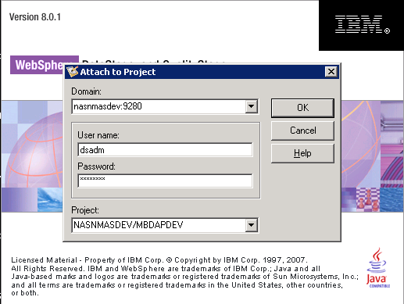
Logging on to DataStage Client Tools
We will have similar window for logging to DataStage Designer, Director, Administrator as below
We need to give :
Domain Name( Server Name with Port)
DataStage User Id and Password
Project Name

Slide 21
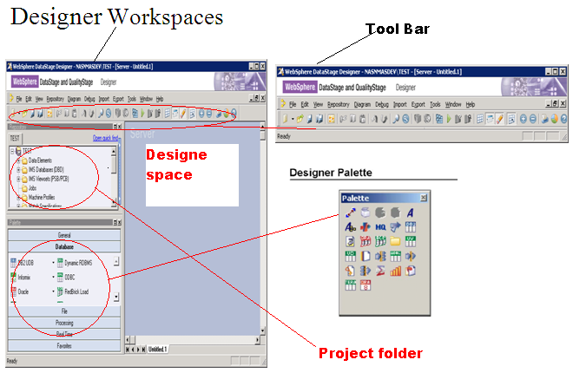
DataStage Designer Interface
Notes:
21

Slide 22
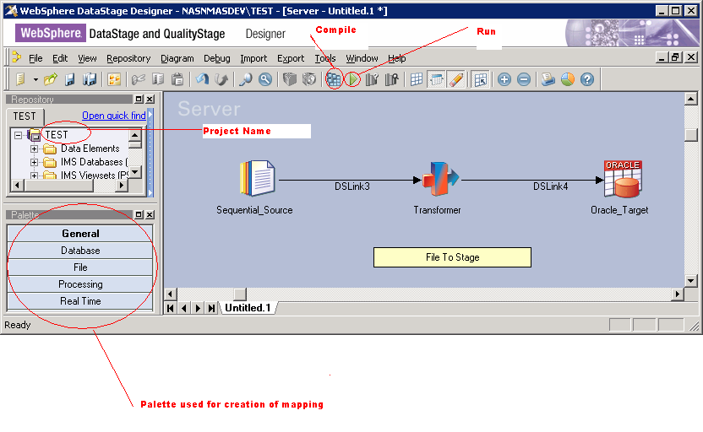
Example of a simple DataStage Job on designer
Notes:
22

Slide 23
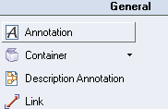
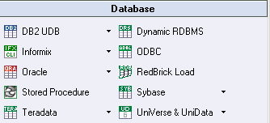

DataStage Stages
General
Annotation
Container
link
Database
DB2UDB
Oracle
ODBC
Stored Procedure
File
Folder
Sequential File
Complex Flat File
Hash File

Slide 24
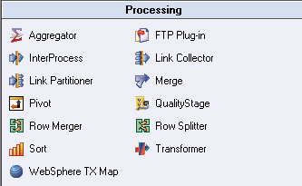
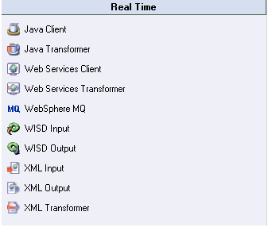
DataStage Stages Continue…….
Processing
Aggregator
Row Generator
Joiner
SCD
Merge
Sort
Transformer
Real Time
Java Client
XML Input
XML Output

Slide 25
DataStage Director Overview

Slide 26
DataStage Director
DataStage Director is used to run a job or to Schedule a job.
This is also used to view the log of each job during debug.
DataStage director have 3 types of views
Log View: Shows job run and status of job
Job View: Shows the job name, status, time
Status View: Warning Messages, Event Messages, Program Generated Messages.

Slide 27
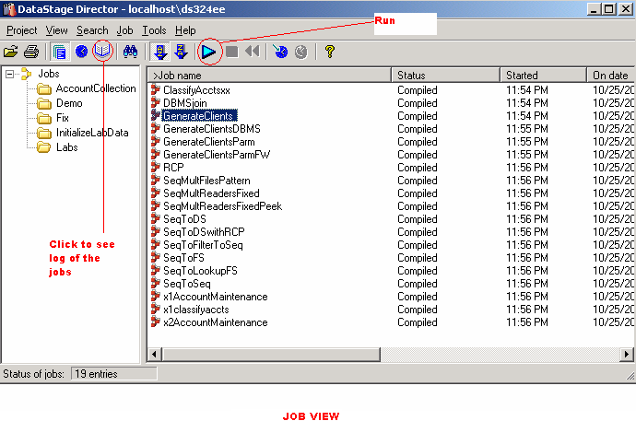
DataStage Director Interface
Notes:
27
Use the Director to validate, run, schedule, and monitor your DataStage jobs. You can also gather statistics as the job runs.

Slide 28
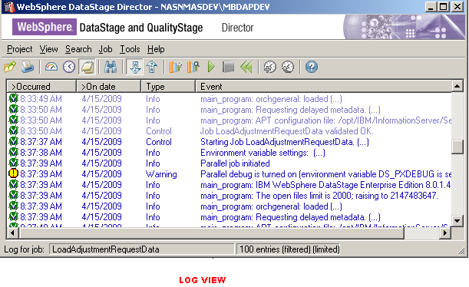
DataStage Director Interface Cont…

Slide 29
Thank You

