Slide 1

Udemy Testing Project
1
Course Code: SE 2226-Software Quality Assurance and Testing
Lecturer: Assoc. Prof. Dr. Korhan Karabulut
Prepared By:
Yağmur Pazı – 23070006066
Demir Demirdöğen – 23070006036
Batuhan Salcan – 22070006040
Egemen Üner – 23070006051
Efe Bırık – 22070006075

Slide 2




2
Test Application Analysis
2. Black-box Testing Methods
O V E R V I E W
3. Automated Testing
4. Errors and Result Evaluation

Slide 3

3
Udemy is an online learning platform offering a wide range of courses.
https://tr.m.wikipedia.org/wiki/Dosya:Udemy_logo.svg

Slide 4
4
Boundary Value Analysis
E1: 1 ≤ length(title) ≤ 100 U1: length(title) = 0 or negative U2: length(title) > 100
# | Classes Covered | Input (Title Length) | Input Example | Expected Output
1 | U1 | -1 | null / undefined | Invalid – System error or empty input
2 | U1 | 0 | "" (empty string) | Invalid – Title required
3 | E1 | 1 | "J" | Valid – Title accepted
4 | E1 | 100 | "Java Programming Language Complete Beginner to Advanced Full Stack Masterclass With Real Projects" | Valid – Title accepted
5 | U2 | 101 | 100-char title + "X" | Invalid – Title too long
4 out of 5 tests passed (80 % success rate) - tested with DiscUdemyTestBot.

Slide 5
Equivalence Partitioning
5
# | Classes Covered | Input | Expected Result
1 | E1 | "python" | Courses related to Python are shown
2 | E1 | "excel" | Courses related to Excel are shown
3 | E2 | "web development" | Courses about web development are shown
4 | U1 | "" | No results or error message shown
5 | U2 | "@#$" | No results or error message shown
6 | U3 | "x" | No or very few results displayed
7 | U4 | "a".repat(50) | No results or system limit warning
8 | U5 | "buy now click here free course" | No results or flagged as spam
Valid keywords return relevant
courses in search bar
Normal keywords
Multi-word terms
Empty input
Random symbols
Very short or long text
Spammy phrases
6 out of 6 tests passed (100 % success rate)
tested with DiscUdemyTestBot.

Slide 6
6
Use Case Testing : Submit a Course Rating and Review
# | Scenario | User Logged In | Navigate to “My Learning” | Select a course which has been started | Submit review | Rate | System Display the review. | Edit review | Expected output
1 | N1-user submit a review. | Yes | Yes | “python” | “Very understandable ” | 4 | Yes | No | System displays a confirmation message.
2 | A1- User gives only star rating | Yes | Yes | “python” | “” | 3 | Yes | No | System displays a confirmation message.
3 | A2- User changes rating and rewrites | Yes | Yes | “python” | “Helped my learning!” | 5 | Yes | Yes | System changes the review.
4 | E1-User tries to submit a review without choosing a star rating | Yes | Yes | “python” | “Very understandable ” | No | No | No | System sends an error message.
5 | E2-User attempts to submit a second review | Yes | Yes | “python” | “Very good lesson ” | 5 | Yes | No | The system blocks duplicate reviews and guides the user to edit their existing feedback instead.
5 out of 5 tests passed (100 % success rate)

Slide 7
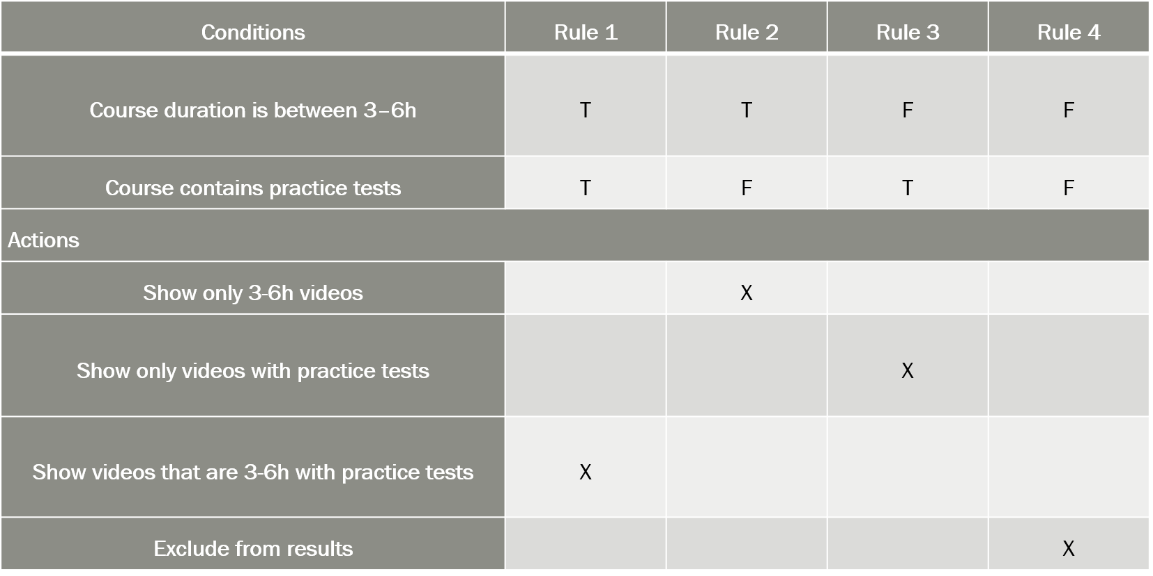
Decision Table
7
Course Duration+ Practice Test
X
3 out of 4 tests passed (75 % success rate) - an error was found.

Slide 8
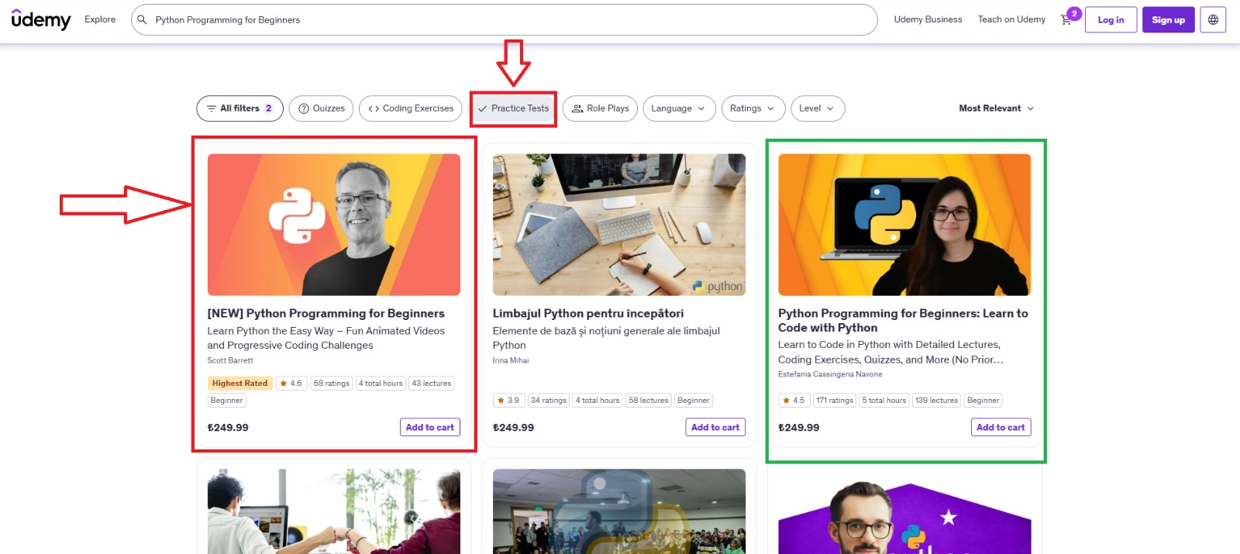
Filtering Error
8
https://www.udemy.com/courses/search/?src=ukw&q=python+programming+for+beginners&features=has_practice_test&duration=medium

Slide 9
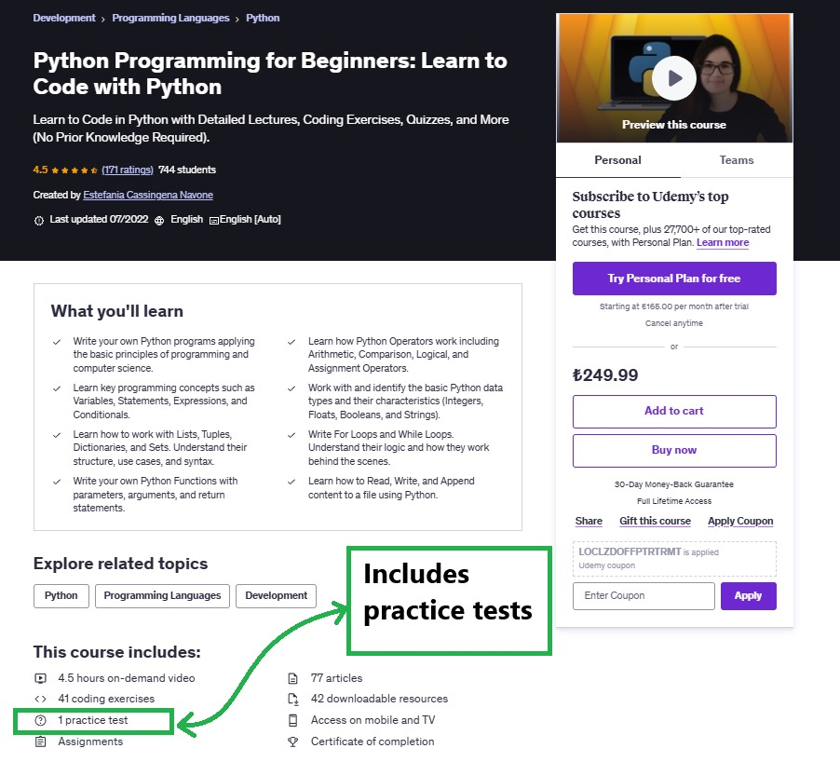
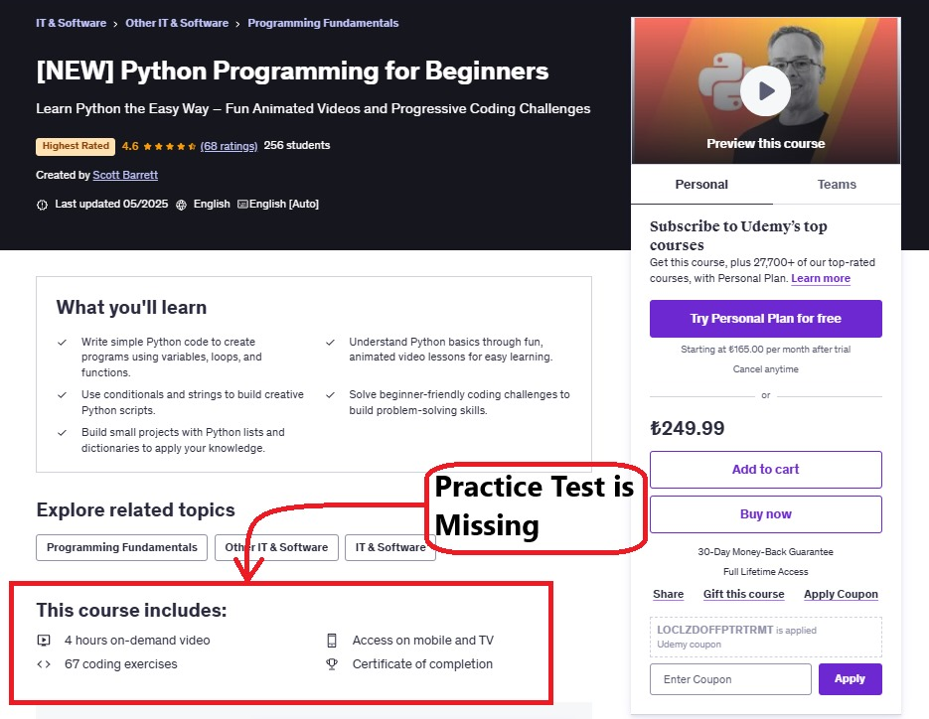
9
Filtering Error
https://www.udemy.com/course/python-programming-for-beginners-learn-to-code-with-python/?couponCode=LOCLZDOFFPTRCTRL
https://www.udemy.com/course/mastering-python-basics-a-beginners-guide/?couponCode=LOCLZDOFFPTRCTRL

Slide 10
Overall Automated Test Results
10
Total Test Cases: 47
Automated Cases: 20
Coverage: ≈ 45% of all test cases
Automated executions: 65
Passed tests: 49
Failed tests: 16
Pass rate: 75.38 %

Slide 11
11
THANK YOU FOR LISTENING

Slide 12
Additional Information
12

Slide 13
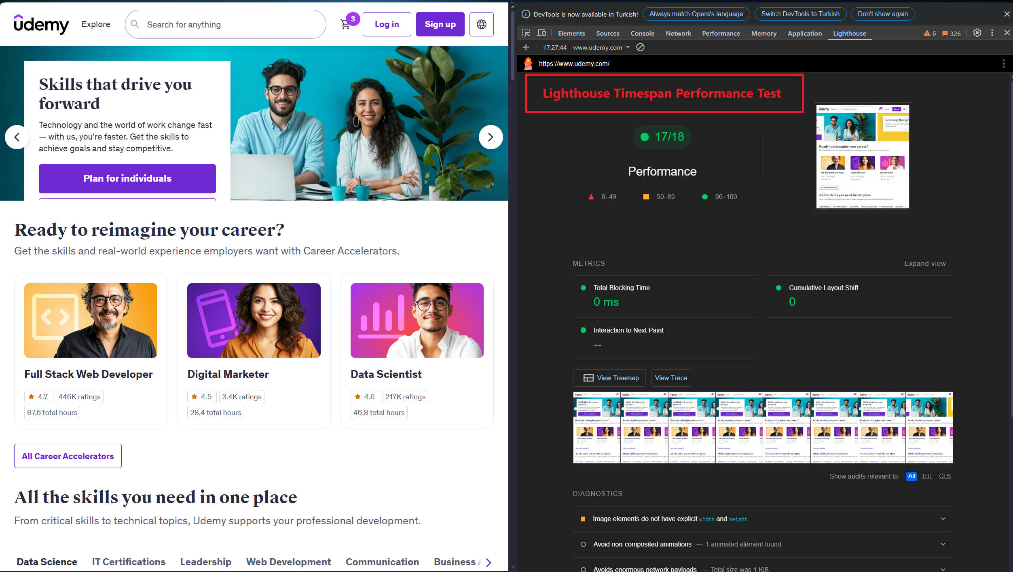
Lighthouse Timespan Performance Test
13
Lighthouse Timespan mode records every scroll and click after a page loads to reveal how the site performs during real user interactions.
Udemy Home Page Screenshot with Google Lighthouse
https://www.udemy.com

Slide 14
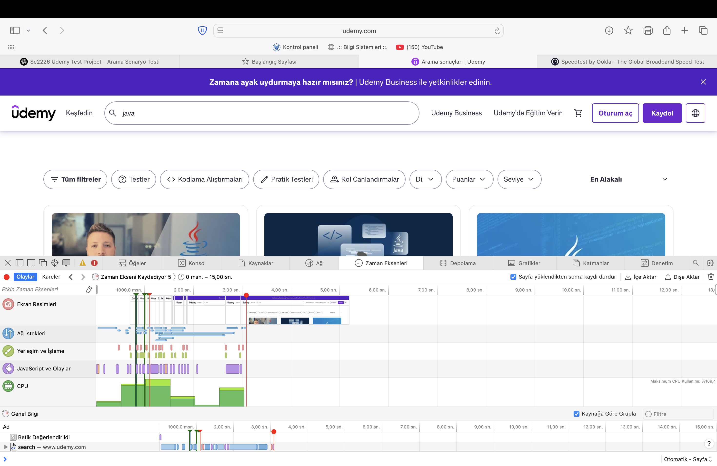

Network Load Time Analysis
14
Our connection stats during the test
www.speedtest.net/
Udemy Search Result Page Screenshot
https://www.udemy.com/courses/search/?src=ukw&q=java

Slide 15
Our Test Bots
15
DiscUdemyTestBot
Keyword-searches DiscUdemy, scrapes course titles, and prints how many it found.
SauceDemoTestBot
Logs into SauceDemo, walks through add-to-cart and checkout, then verifies item + tax totals.
UdemyTestBot
Runs the same keyword-search/title-scrape on Udemy, but can be stopped by Cloudflare.

Slide 16
Automated JUnit Bot Test Classes
16
Test ID | Test Technique | Description
TC-EP-S1 | Equivalence Partitioning | Valid / invalid keywords checked for relevance in course search results.
TC-BVA-S1 | Boundary Value Analysis | Verifies keyword length: 0, 1, 100, 101 characters.
TC-BVA-TITLE1 | Boundary Value Analysis | Tests course-title length boundaries: 0 (invalid), 1–100 (valid), 101.
TC-EP-TITLE1 | Equivalence Partitioning | Ensures course titles contain only valid characters (letters / spaces).
TC-EP-TITLE2 | Equivalence Partitioning | Searches with forbidden characters (! @ # $ % *) must return no results.
TC-UC-CAT1 | Use-Case Testing | Navigates through multiple category buttons successfully.
TC-SC-01 | Use-Case Testing | Adds item to cart; tests login-required and duplicate adds.
TC-SC-02 | Use-Case Testing | Removes courses under various scenarios: normal, guest, multi-remove.
TC-SC-03 | Equivalence Partitioning | Tests adding valid, duplicate, invalid, and guest-course scenarios.
TC-SC-04 | Boundary Value Analysis | Validates cart behavior at limits: empty → full → overflow.
TC-EP-CHECK1 | Equivalence Partitioning | Verifies cart and checkout contents match (valid / invalid partitions).
TC-EP-CHECK2 | Equivalence Partitioning | Ensures total = item total + tax; checks unexpected-total or zero-tax cases.
TC-DT-CHECK3 | Decision-Table Testing | Tests 8 rules combining cart / checkout mismatch and total errors.
TC-UC-F1 | Use-Case Testing | Simulates full purchase flow: login → select → cart → checkout.

Slide 17
End Of Additional Information Section
17

