Slide 1

Batwa
Team Muhasib
Ahmed Atif
Sameer Jaipal
Shehryar Amin
Zain Usmani

Slide 2
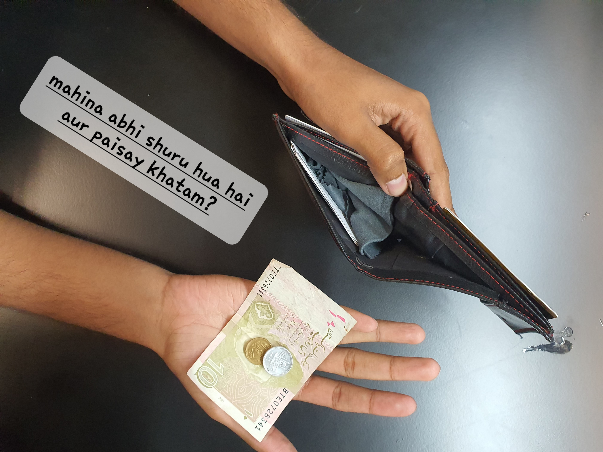

Slide 3
Overview
Problem: the need for an everyday expense tracker

Slide 4
the need for an everyday expense tracker
Existing solutions
Google Forms
Online excel sheet
Expense tracking apps
Too cluttered
Only accessible on phone

Slide 5
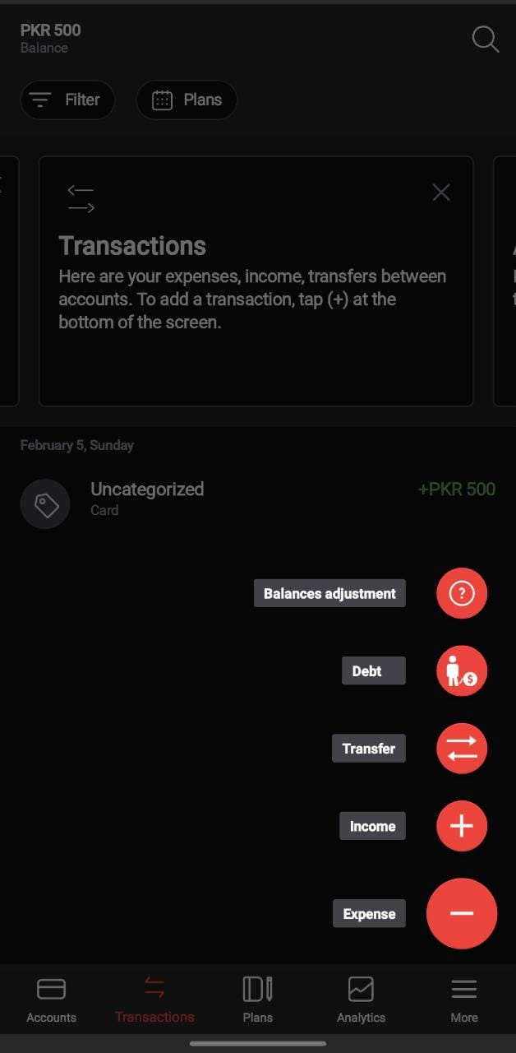
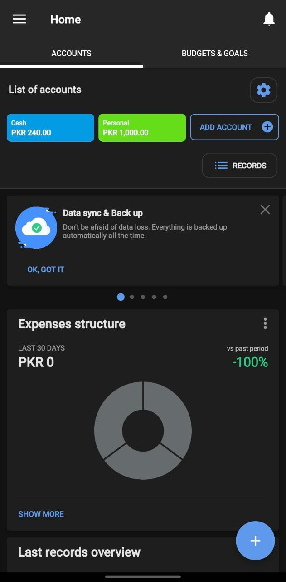
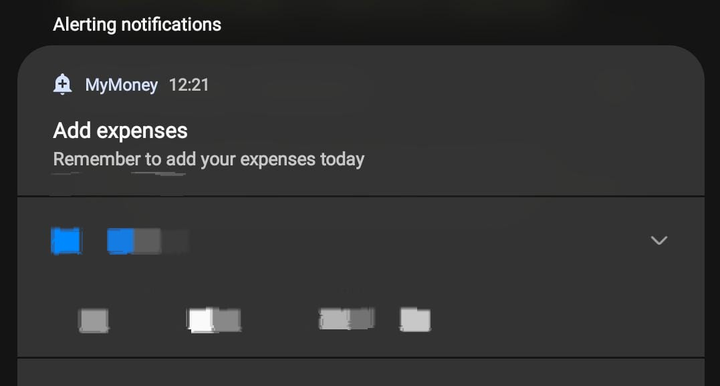
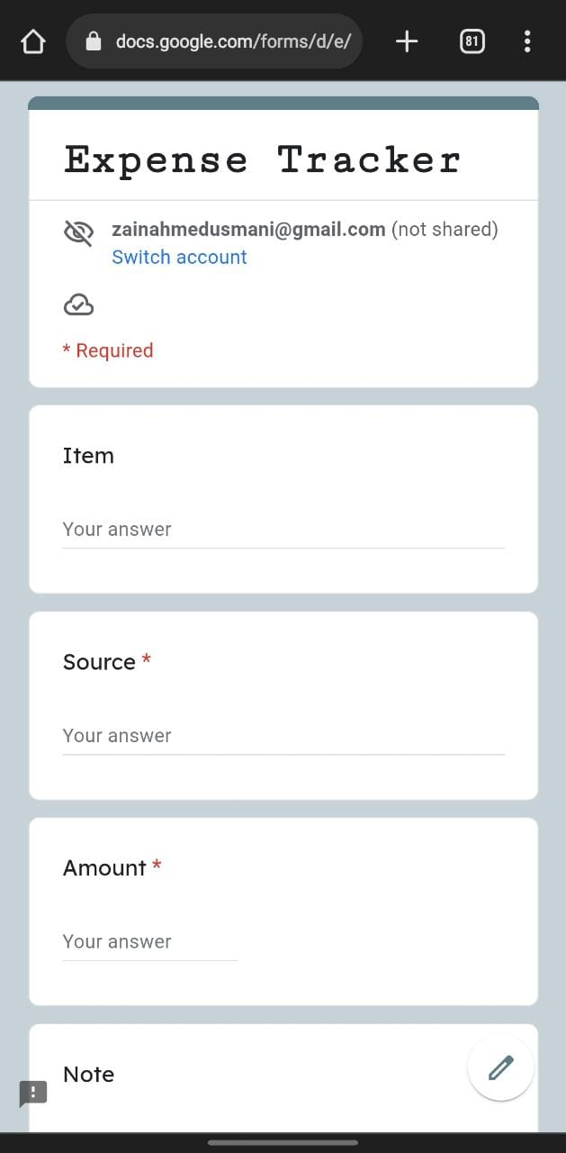
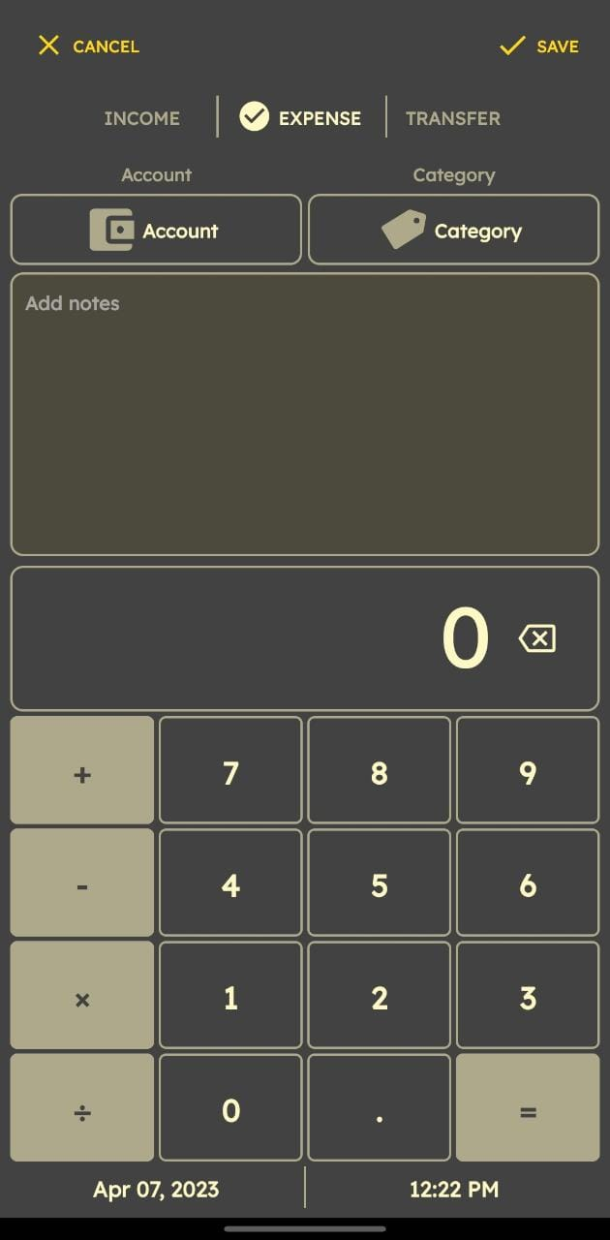
the need for an everyday expense tracker

Slide 6
the need for an everyday expense tracker

Slide 7
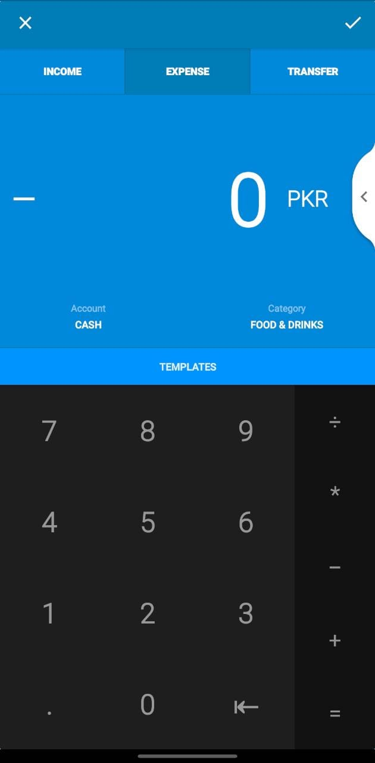
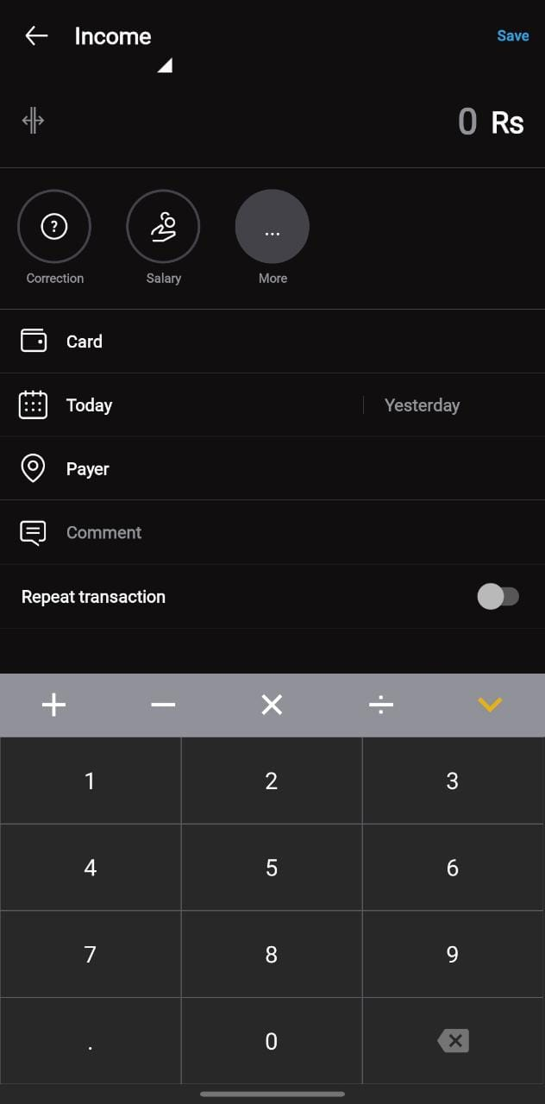

Slide 9
Overview
Problem: the need for an everyday expense tracker
Jira
Product backlog
Burndown
Wireframes (UI tentative– iterative design)
Github usage
Django-branch
pythonanywhere or okteto

Slide 10
