Slide 1
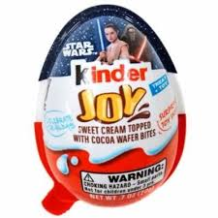
Project: KinderEggFigureClassification

Slide 2
Project: KinderEggFigureClassification
Group project
Coordination by project lead
Development groups for different functionalities (app, classification)
Data group
(Internal) customer project owner: Dr. Groß
(Internal) customer business approver: Prof. Klenk

Slide 3
Situation
Miniature figure production line.
Kinder eggs needs to be sorted into different categories for packaging
We want to control the number of special figures in each batch.
You can change the image detection situation.

Slide 4
Requirements:
We would like to compare different classification algorithms. We want to decide which one to use at a later stage.
We would like to grow our figure image database over time.
We need a GUI that we can share with non-programmers.
Well-documented code.

Slide 5
App Requirements:
Classification
Use at least two different algorithms
kNN
..
GUI
All functionality accessible via app interface
Classification (automatic + manual)
Image Data
Create new images including classification data
Load existing images and classification data
Provide suitable data for classification
Image data acquisition
Optional: train classifier models

Slide 6
Working groups
Project lead
Git
Interfaces
Usability
GUI
Allows
Automatic Classification
Manual adding to the image database
Data
Classification algorithms (1 each)
kNN (k-nearest neighbor)
e.g.., deepLearning
Image acquisition
acquisition
storage
access

Slide 7
Each working group
Coordination
Work with product lead to define interface to other code
Technical product
Demonstrate functionality
Provide sufficient inline commentary
Presentation
Explain code to group

