Slide 1
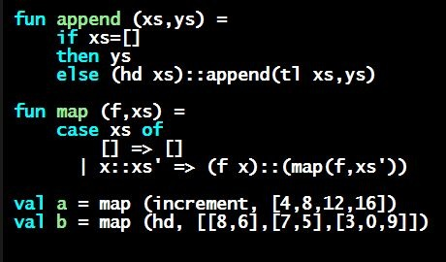
Programming Languages Dan Grossman 2013
Map and Filter

Slide 2
Map (see the course logo)
fun map (f,xs) =
case xs of
[] => []
| x::xs’ => (f x)::(map(f,xs’))
val map : ('a -> 'b) * 'a list -> 'b list
Map is, without doubt, in the “higher-order function hall-of-fame”
The name is standard (for any data structure)
You use it all the time once you know it: saves a little space, but more importantly, communicates what you are doing
Similar predefined function: List.map
But it uses currying (coming soon)

Slide 3
Filter
fun filter (f,xs) =
case xs of
[] => []
| x::xs’ => if f x
then x::(filter(f,xs’))
else filter(f,xs’)
val filter : ('a -> bool) * 'a list -> 'a list
Filter is also in the hall-of-fame
So use it whenever your computation is a filter
Similar predefined function: List.filter
But it uses currying (coming soon)

