Slide 1
AGGREGATE SUPPLY AND THE
SHORT-RUN TRADEOFF BETWEEN INFLATION AND UNEMPLOYMENT
S. Aguey, PhD
Macroeconomics II
African School Of Economics
Chapter 5
Notes:
This chapter sets up the IS-LM model, which chapter 3 then uses extensively to analyze the effects of policies and economic shocks.
This chapter also introduces students to the Keynesian Cross and Liquidity Preference models, which underlie the IS curve and LM curve, respectively.
If you would like to spend less time on this chapter, you might consider omitting the Keynesian Cross, instead using the loanable funds model from Chapter 3 to derive the IS curve. Advantage: students are already familiar with the loanable funds model, so skipping the KC means one less model to learn. Additionally, the KC model is not used anywhere else in this textbook. Once it’s used to derive IS, it disappears for good.
However, there are some good reasons for NOT omitting the KC model:
1) Many principles textbooks (though not Mankiw’s) cover the KC model; students who learned the KC model in their principles class may benefit from seeing it here, as a bridge to the new material on the IS curve.
2) The KC model is of historical importance. One could argue that anybody graduating from college with a degree in economics should be familiar with the KC model.

Slide 2
In this chapter, you will learn:
two models of aggregate supply in which output depends positively on the price level in the short run
about the short-run tradeoff between inflation and unemployment known as the Phillips curve

Slide 3
Introduction
In previous chapters, we assumed the price level P was “stuck” in the short run.
  This implies a horizontal SRAS curve.
Now, we consider two prominent models of aggregate supply in the short run:
  Sticky-price model
  Imperfect-information model
3

Slide 4
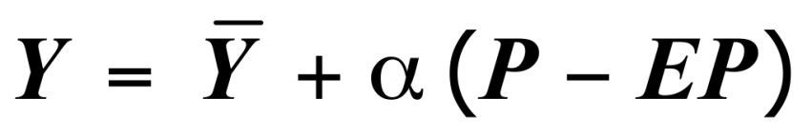
Introduction
Both models imply:
aggregate
output
expected price level
a positive parameter
natural rate of output
actual price level
Other things equal, Y and P are positively related, so the SRAS curve is upward-sloping.
4

Slide 5
The sticky-price model
Reasons for sticky prices:
  long-term contracts between firms and customers
  menu costs
  firms not wishing to annoy customers with frequent price changes
Assumption:
  Firms set their own prices
  (e.g., as in monopolistic competition).
5
Notes:
If you don’t like the appearance of the term “monopolistic competition” in this slide, just change the parenthetical comment to “(i.e. firms have some market power)” or something to that effect.

Slide 6
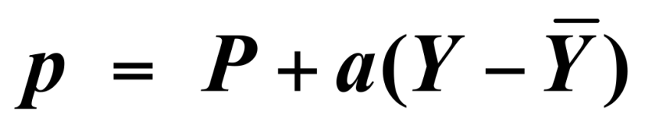
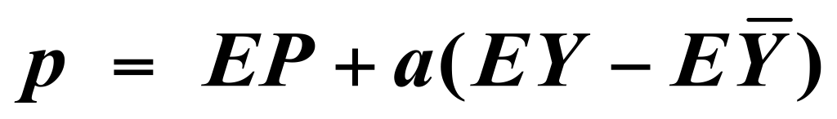
The sticky-price model
An individual firm’s desired price is:
where a > 0.
Suppose two types of firms:
firms with flexible prices, set prices as above
firms with sticky prices, must set their price before they know how P and Y will turn out:
6
Notes:
Interpretation of the first equation:
If output is at its natural rate, then each firm’s optimal price is the same as the overall price level. When the economy is weak (output below its natural rate), firms set their prices lower, and in a boom when demand is high, firms set their prices higher.
Remind your students that “E” is the expectation operator introduced in Chapter 4.
Hence, EP is the expected price level and (EY – EYbar) is the expected deviation of output from its natural, full-employment level.

Slide 7
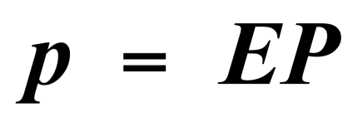
The sticky-price model
Assume sticky price firms expect that output will equal its natural rate. Then,
To derive the aggregate supply curve,
first find an expression for the overall price level.
s = fraction of firms with sticky prices.
Then, we can write the overall price level as…
7

Slide 8
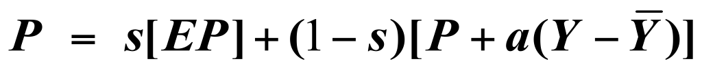
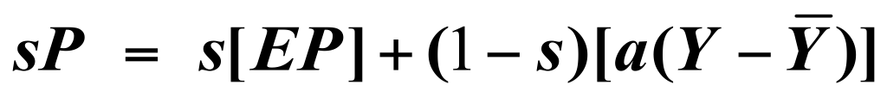
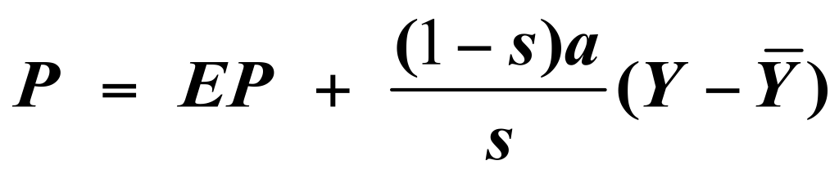
The sticky-price model
price set by sticky price firms
price set by flexible price firms
Subtract (1−s)P from both sides:
Divide both sides by s :
8

Slide 9
The sticky-price model
High EP ⇒ High P
If firms expect high prices, then firms that must set prices in advance will set them high.
Other firms respond by setting high prices.
High Y ⇒ High P
When income is high, the demand for goods is high. Firms with flexible prices set high prices.
The greater the fraction of flexible price firms,
the smaller is s and the bigger is the effect of ΔY
on P.
9

Slide 10
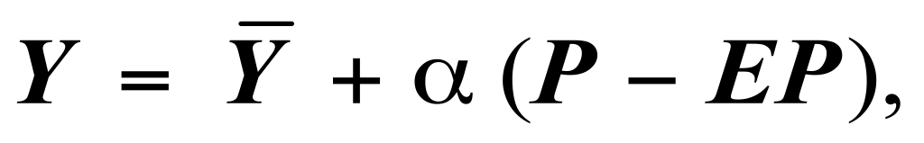
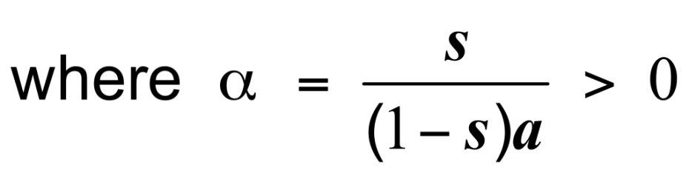
The sticky-price model
Finally, derive AS equation by solving for Y :
10

Slide 11
The imperfect-information model
Assumptions:
  All wages and prices are perfectly flexible,
  all markets clear.
  Each supplier produces one good, consumes many goods.
  Each supplier knows the nominal price of the good she produces, but does not know the overall price level.
11

Slide 12
The imperfect-information model
Supply of each good depends on its relative price: the nominal price of the good divided by the overall price level.
Supplier does not know price level at the time she makes her production decision, so uses EP.
Suppose P rises but EP does not.
  Supplier thinks her relative price has risen,
  so she produces more.
  With many producers thinking this way,
  Y will rise whenever P rises above EP.
12

Slide 13
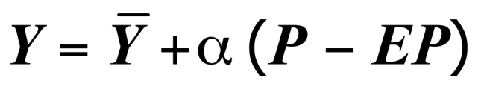




Summary & implications
P
LRAS
Both models of aggregate supply imply the relationship summarized by the SRAS curve & equation.
SRAS
Y
13
Notes:
The following is not in the text, but you and your students may find it worthwhile:
There are good reasons to believe that the SRAS curve is bow-shaped in the real world; that is, the curve is steeper at high levels of output than at low levels of output. And there are good reasons why we should care about this.
Why the SRAS curve is bow-shaped:
At low levels of output, there are lots of unutilized and under-utilized resources available, so it is not terribly costly for firms to increase output, and therefore firms do not require a big increase in prices to make them willing to increase output by a given amount. In contrast, at very high levels of output, when unemployment is below the natural rate and capital is being used at higher than normal intensity levels, it is relatively costly for firms to increase output further. Hence, a larger increase in prices is required to make firms willing to increase their output.
Why the curvature matters:
When policymakers increase aggregate demand, output rises (good) and prices rise (not good). An important question arises: how much of the bad thing (higher prices) must we tolerate to get some of the good thing (higher output)? The answer depends on how steep the SRAS curve is.
When President Reagan cut taxes in the early 1980s, the economy was just coming out of a severe recession, and was on the flatter part of the SRAS curve; hence, the tax cuts affected output a lot and inflation very little. In contrast, when taxes are cut during normal or boom times, when we’re on the steeper part of the SRAS curve, tax cuts would likely be inflationary.

Slide 14
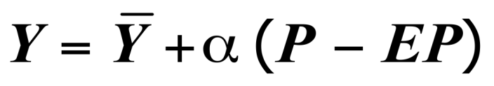
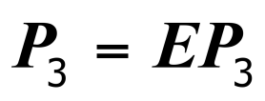

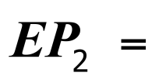
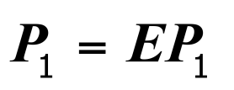

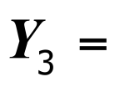
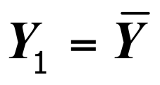
Summary & implications
Suppose a positive AD shock moves output above its natural rate and
P above the level people had expected.
SRAS equation:
P
LRAS
SRAS₂
SRAS₁
Over time,
EP rises,
SRAS shifts up,
and output returns
to its natural rate.
AD₂
AD₁
Y
14
Notes:
This graph has two lessons for students:
First, changes in the expected price level shift the SRAS curve (this should be clear from the equation, as should the fact that a change in the natural rate of output will shift the SRAS curve).
The second lesson concerns the adjustment of the economy back to full-employment output.

Slide 15
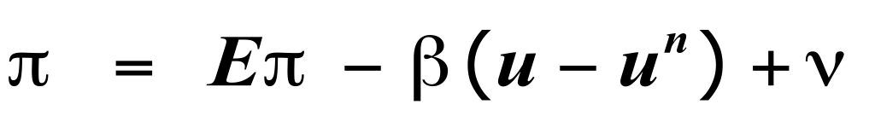
Inflation, Unemployment, and the Phillips Curve
The Phillips curve states that Π depends on
  expected inflation, EΠ.
  cyclical unemployment: the deviation of the actual rate of unemployment from the natural rate
  supply shocks, ν (Greek letter “nu”).
where β > 0 is an exogenous constant.
15
Notes:
β measures the responsiveness of inflation to cyclical unemployment.

Slide 16
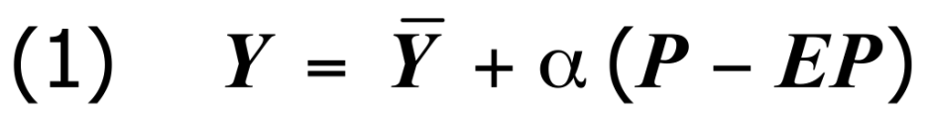
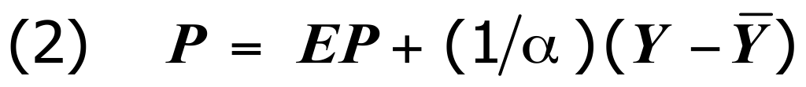
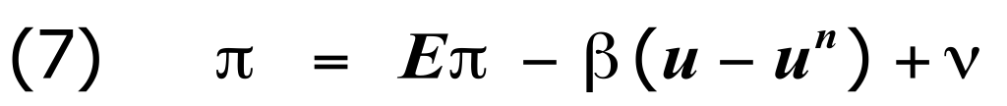
Deriving the Phillips Curve from SRAS
16
Notes:
Explain each equation briefly before displaying the next. Here are the explanations:
Equation (1) is the SRAS equation.
Solve (1) for P to get (2).
To get (3), add the supply shock term to (2).
To get (4), subtract last year’s price level (P₋₁) from both sides.
To get (5), write π in place of (P- P₋₁) and π^{e} in place of (P^{e}- P₋₁). Note that the change in the price level is not exactly the inflation rate, unless we interpret P as the natural log of the price level.
Equation (6) captures the relationship between output and unemployment from Okun’s law (chapter 2): the deviation of output from its natural rate is inversely related to cyclical unemployment.
Substituting (6) into (5) gives (7), the Phillips curve equation introduced on the preceding slide.

Slide 17
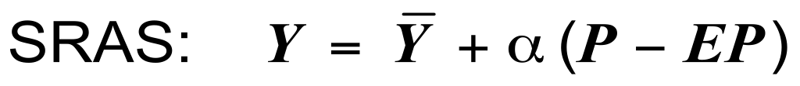
Comparing SRAS and the Phillips Curve
SRAS curve:
Output is related to its natural rate and unexpected movements in the price level.
Phillips curve:
Inflation is related to expected inflation and
cyclical movements in unemployment.
17

Slide 18
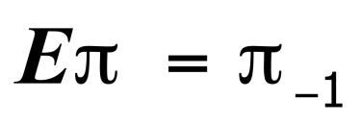
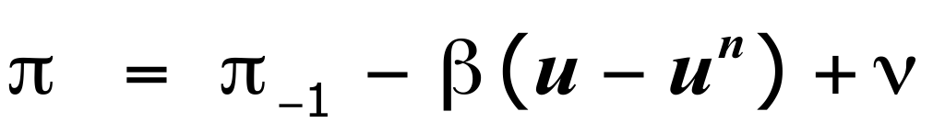
Adaptive expectations
Adaptive expectations: an approach that assumes people form their expectations of future inflation based on recently observed inflation.
A simple version:
Expected inflation = last year’s actual inflation
Then, P.C. becomes
18

Slide 19
Inflation inertia
In this form, the Phillips curve implies that inflation has inertia:
  In the absence of supply shocks or
  cyclical unemployment, inflation will
  continue indefinitely at its current rate.
  Past inflation influences expectations of current inflation, which in turn influences
  the wages & prices that people set.
19

Slide 20
Two causes of rising & falling inflation
cost-push inflation:
inflation resulting from supply shocks
Adverse supply shocks typically raise production costs and induce firms to raise prices,
“pushing” inflation up.
demand-pull inflation:
inflation resulting from demand shocks
Positive shocks to aggregate demand cause unemployment to fall below its natural rate,
which “pulls” the inflation rate up.
20
Notes:
Of course, a favorable supply shock that lowers production costs will “push” inflation down, and a negative demand shock which raises cyclical unemployment will “pull” inflation down.

Slide 21
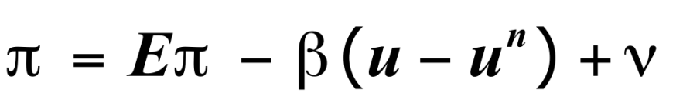




Graphing the Phillips curve
In the short
run, policymakers face a tradeoff between Π and u.
Π
The short-run Phillips curve
u
21
Notes:
Here, the “short run” is the period until people adjust their expectations of inflation.

Slide 22
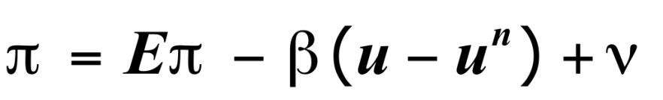
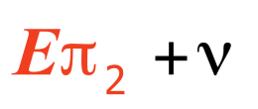
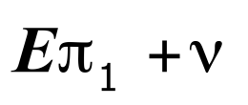

Shifting the Phillips curve
People adjust their expectations over time,
so the tradeoff only holds in the short run.
Π
E.g., an increase
in EΠ shifts the short-run P.C. upward.
u
22
Notes:
After displaying this slide, you might consider giving your students an exercise using the P.C. curve. One possibility would be to ask them to draw a graph of the PC curve, then show what happens to it in the face of an adverse supply shock or an increase in the natural rate of unemployment, giving intuition for each.
The intuition for why an increase in the natural rate shifts the PC upward (or rightward) is as follows:
At any given value of actual unemployment, an increase in the natural rate implies a decrease in cyclical unemployment, which increases inflation by increasing pressures for wages to rise. Thus, each value of unemployment has a higher value of inflation than before.

Slide 23
The sacrifice ratio
To reduce inflation, policymakers can
contract aggregate demand, causing
unemployment to rise above the natural rate.
The sacrifice ratio measures
the percentage of a year’s real GDP
that must be foregone to reduce inflation
by 1 percentage point.
A typical estimate of the ratio is 5.
23

Slide 24
The sacrifice ratio
Example: To reduce inflation from 6 to 2 percent, must sacrifice 20 percent of one year’s GDP:
  GDP loss = (inflation reduction) x (sacrifice ratio)
  20 = 4 x 5
This loss could be incurred in one year or spread over several, e.g., 5% loss for each of four years.
The cost of disinflation is lost GDP.
One could use Okun’s law to translate this cost into unemployment.
24

Slide 25
Rational expectations
Ways of modeling the formation of expectations:
  adaptive expectations:
  People base their expectations of future inflation on recently observed inflation.
  rational expectations:
  People base their expectations on all available information, including information about current and prospective future policies.
25
Notes:
A good example to illustrate the difference between adaptive and rational expectations.
Suppose the Fed announces a shift in priorities, from maintaining low inflation to maintaining low unemployment w/o regard to inflation; this shift will start affecting policy next week.
If expectations are adaptive, then expected inflation will not change, because it is based on past inflation. The Fed’s announcement pertains to the future, and has no impact on past inflation.
If expectations are rational, then expected inflation will increase right away, as people factor this announcement into their forecasts.

Slide 26
Painless disinflation?
Proponents of rational expectations believe
that the sacrifice ratio may be very small:
Suppose u = u^{n} and Π = EΠ = 6%,
and suppose the Fed announces that it will
do whatever is necessary to reduce inflation
from 6 to 2 percent as soon as possible.
If the announcement is credible,
then EΠ will fall, perhaps by the full 4 points.
Then, Π can fall without an increase in u.
26
Notes:
Here’s an interesting and important implication:
Central banks that are politically independent are typically more credible than those that are “puppets” to elected officials. Hence, in countries with central banks that are NOT politically independent, it is usually far costlier to reduce inflation. A very worthwhile reform, therefore, would be for governments to give their central banks independence.

Slide 27
Calculating the sacrifice ratio for the Volcker disinflation
1981: Π = 9.7%
1985: Π = 3.0%
Total disinflation = 6.7%
year | u | u ^{n} | u−u ^{n}
1982 | 9.5% | 6.0% | 3.5%
1983 | 9.5 | 6.0 | 3.5
1984 | 7.4 | 6.0 | 1.4
1985 | 7.1 | 6.0 | 1.1
Total 9.5%
27
Notes:
The natural rate of unemployment is assumed to be 6.0% during the early 1980s.

Slide 28
Calculating the sacrifice ratio for the Volcker disinflation
From previous slide: Inflation fell by 6.7%,
total cyclical unemployment was 9.5%.
Okun’s law:
1% of unemployment = 2% of lost output.
So, 9.5% cyclical unemployment
= 19.0% of a year’s real GDP.
Sacrifice ratio = (lost GDP)/(total disinflation)
= 19/6.7 = 2.8 percentage points of GDP were lost for each 1 percentage point reduction in inflation.
28

Slide 29
The natural rate hypothesis
Our analysis of the costs of disinflation, and of economic fluctuations in the preceding chapters, is based on the natural rate hypothesis:
Changes in aggregate demand affect output
and employment only in the short run.
In the long run, the economy returns to
the levels of output, employment,
and unemployment.
29
Notes:
The natural rate hypothesis allows us to study the long run separately from the short run.

Slide 30
An alternative hypothesis: Hysteresis
Hysteresis: the long-lasting influence of history on variables such as the natural rate of unemployment.
Negative shocks may increase u^{n},
so economy may not fully recover.
30

Slide 31
Hysteresis: Why negative shocks may increase the natural rate
The skills of cyclically unemployed workers may deteriorate while unemployed, and they may not find a job when the recession ends.
Cyclically unemployed workers may lose
their influence on wage-setting;
then, insiders (employed workers)
may bargain for higher wages for themselves.
Result: The cyclically unemployed “outsiders”
may become structurally unemployed when the recession ends.
31

Slide 32
Chapter Summary
1. Two models of aggregate supply in the short run:
  sticky-price model
  imperfect-information model
Both models imply that output rises above its natural rate when the price level rises above the expected price level.

Slide 33
Chapter Summary
2. Phillips curve
  derived from the SRAS curve
  states that inflation depends on
    expected inflation
    cyclical unemployment
    supply shocks
  presents policymakers with a short-run tradeoff between inflation and unemployment

Slide 34
Chapter Summary
3. How people form expectations of inflation
  adaptive expectations
    based on recently observed inflation
    implies “inertia”
  rational expectations
    based on all available information
    implies that disinflation may be painless

Slide 35
Chapter Summary
4. The natural rate hypothesis and hysteresis
  the natural rate hypotheses
    states that changes in aggregate demand can only affect output and employment in the short run
  hysteresis
    states that aggregate demand can have permanent effects on output and employment

