Slide 1
A global reference for human genetic variation
The 1000 Genomes Project Consortium
(2008 -) 2015

Slide 2
Overview
Launched 2008, multiple institutes from around the world
Goal to establish most detailed catalogue of human genetic variation
Whole genome sequencing of diverse set of populations
2’504 individuals from 26 population
Finished in 2015

Slide 3
Strategies
All individuals were sequenced with:
whole genome sequencing (mean 7.4x)
targeted exome sequencing (mean 65.7x)
additional SNP microarrays of individuals and available first degree relatives
Deep complete genomics data (mean 47x) of 427 individuals to evaluate variant discovery power

Slide 4
Results 1
88 million variant sites discovered (most new variants in South Asia/Africa)
Power to discover variants
E.g. SNPs of 0.5% frequency 95%, Indels of 0.5% frequency 80%
More common variants can be discovered with higher power
Typical genome
4.1 - 5 million variant sites against reference genome
>99.9% SNPs and short indels
Rest structural variants which affect more bases

Slide 5
Results 2
Greates numbers of variant sites in African populations (AoA)
Other populations show amount of variants roughly proportional to their degree of genomic ancestry to African populations

Slide 6
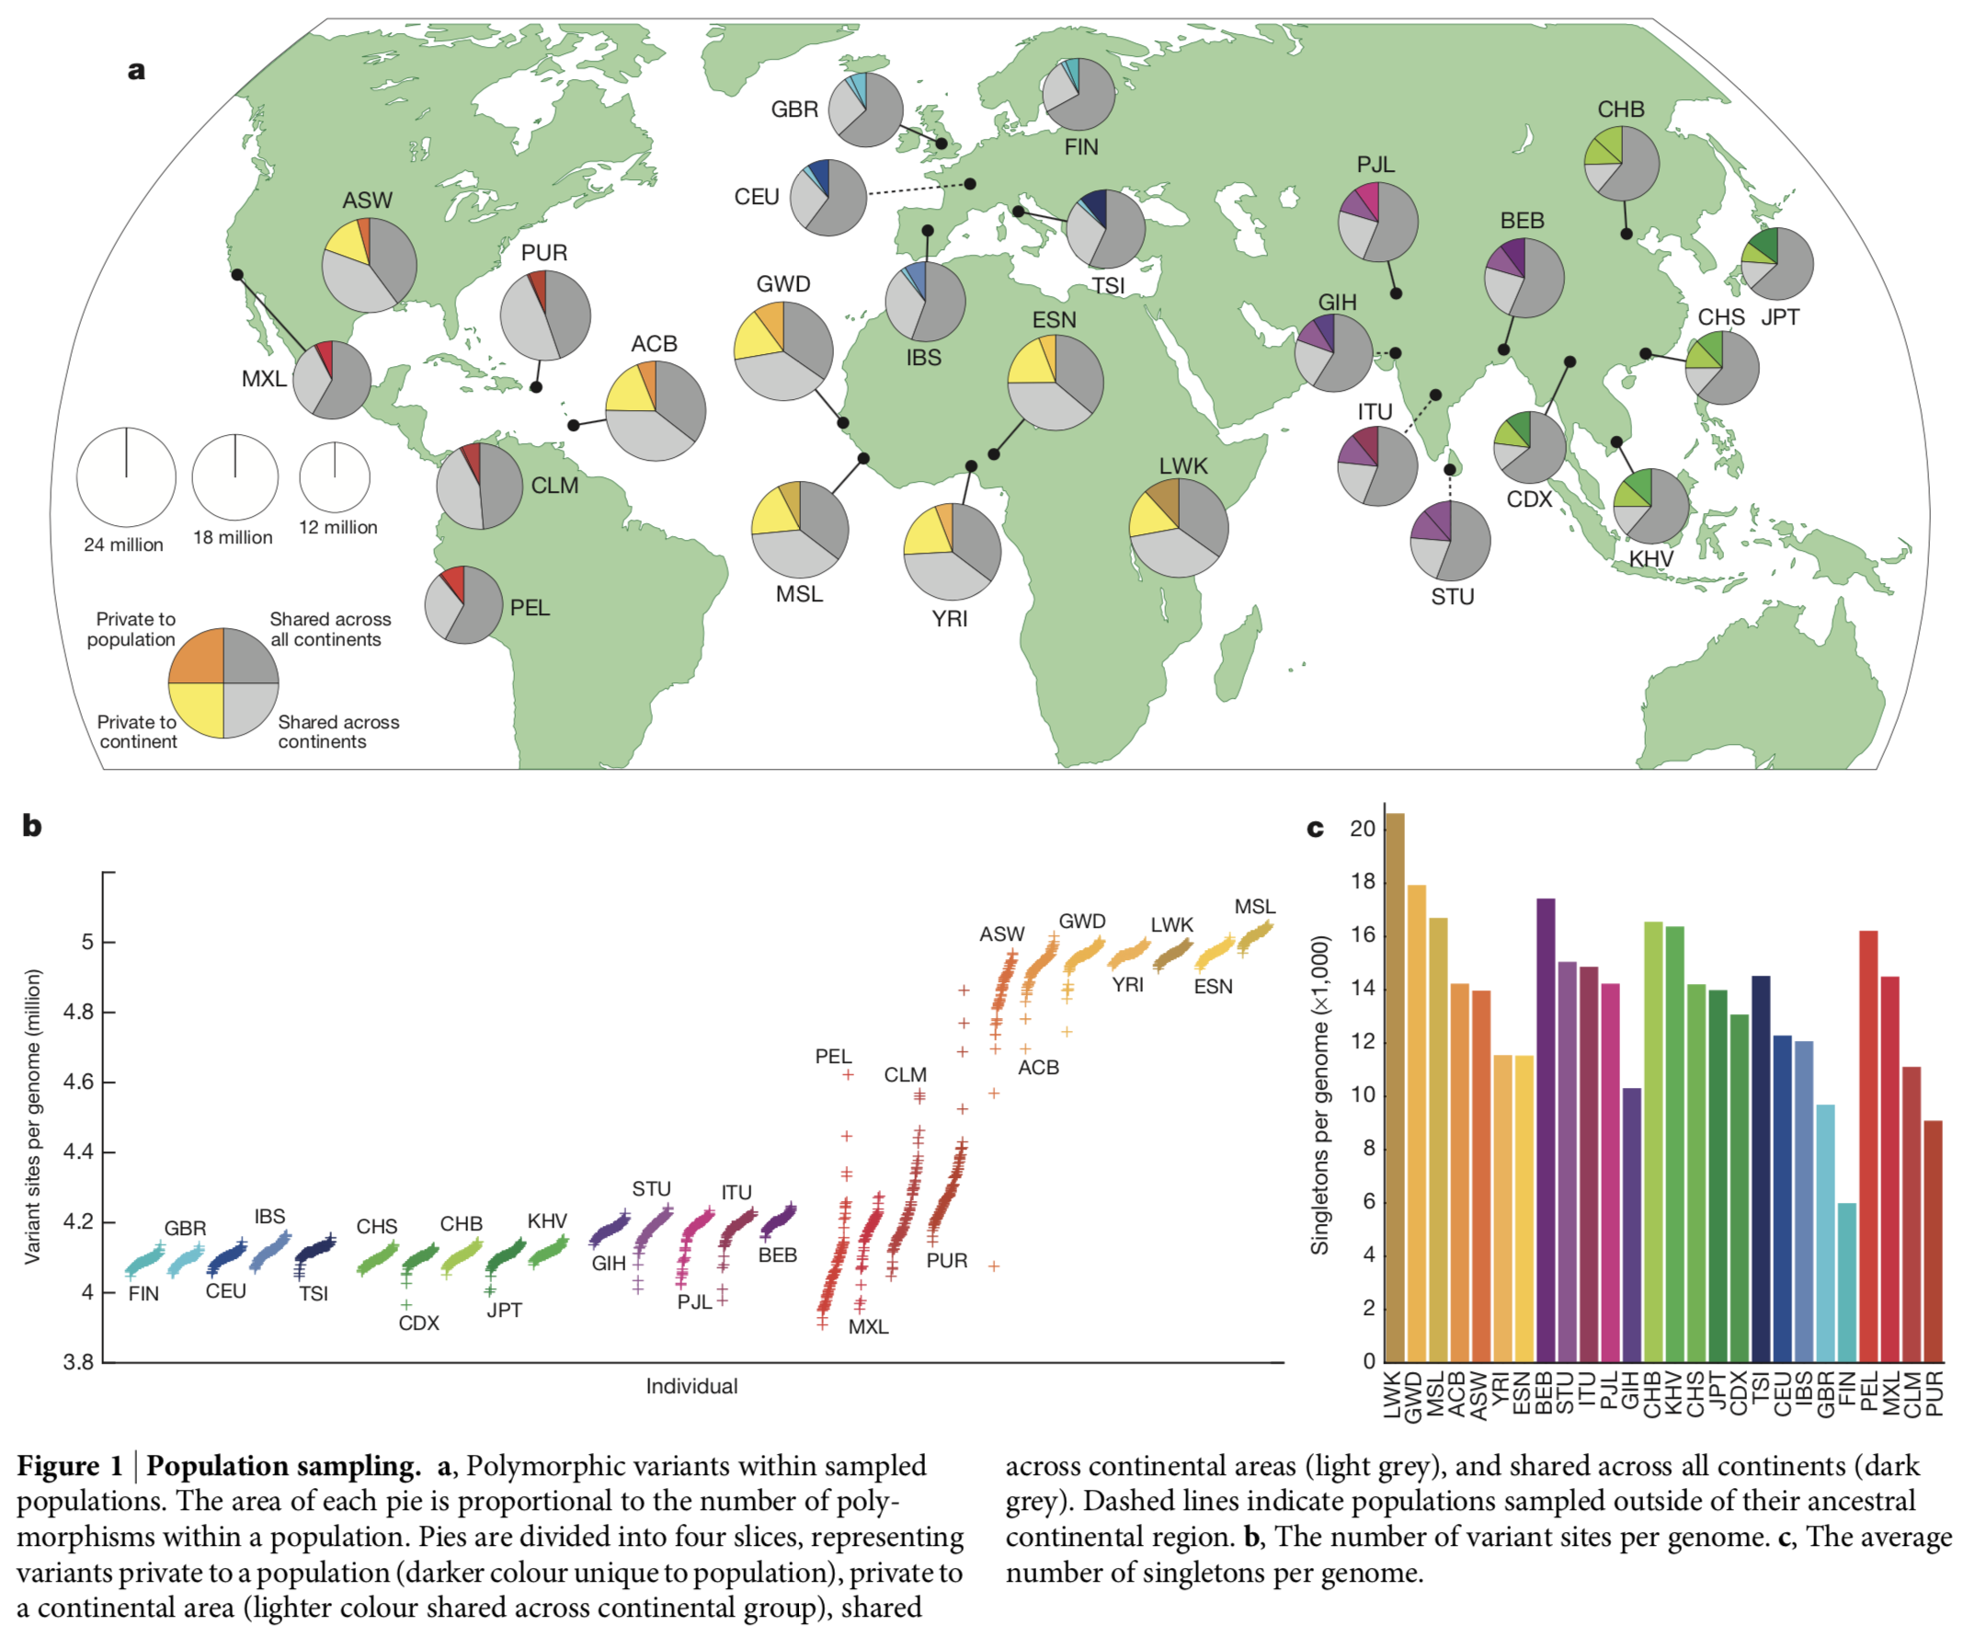

Slide 7
Results 3
The majority of variants in the data set are rare (<0.5%)
The majority of variants (96 – 99%) in single genome are common (>0.5%)
Most common variants are shared across the world
Rarer variants are typically restricted to closely related populations

Slide 8
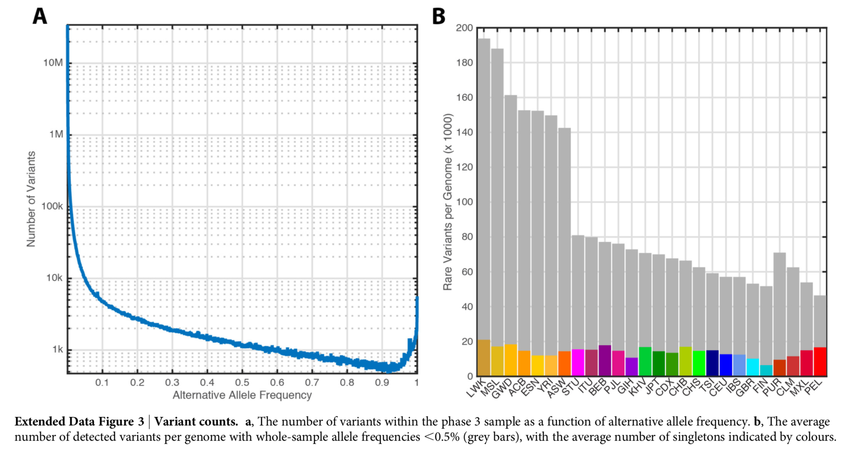

Slide 9
Insights about demography
East-west clines visible between Africa and East Asia
North-south cline visible in Europe
Shared demographic history for all humans ~150’000 – 200’000 ya
Asian and American bottlenecks < 1’500 individuals ~ 15’000 – 20’000 ya
African bottleneck > 4’250 individuals

