Slide 1
Mutational landscape of metastatic cancer revealed from prospective clinical sequencing of 10’000 patients

Slide 2
Introduction
Standard practice to profile tumors for recurrent targetable mutations
NGS too complex to perform tumor genomic profiling for large number of individuals
MSK-IMPACT is a hybridization capture-based NGS panel
Wanted to predict response to new therapies
Notes:
Focused on patients with advanced metastatic cancer, who are most likely to benefit from mutational profiling

Slide 3
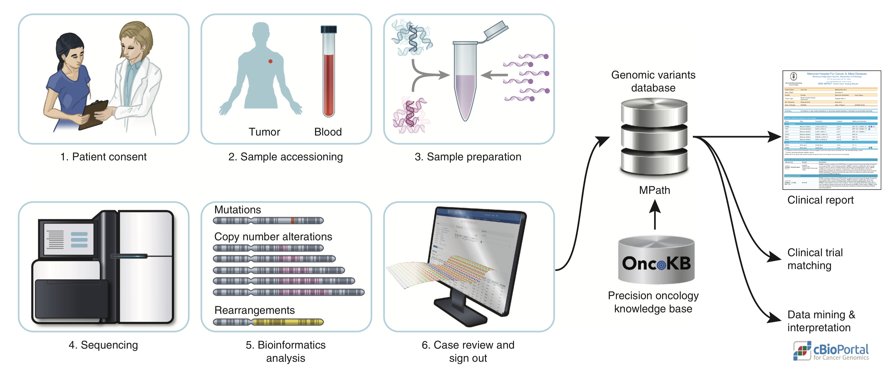
MSK-IMPACT workflow
Notes:
Blood
410-gene panel >> didn’t look at the whole genom ….
OncoKB
Shared with public

Slide 4
Results – MSK-IMPACT…
More mutations compared to WES
Captures the promotor of TERT
Results are highly consistent with TCGA studies
Significant mutations in TCGA are more frequently mutated
Found more alterations in genes than TCGA
97% of the genes in the 410-gene panel were mutated
Capable of revealing mutation signatures
Notes:
WES promotor NO
More fusions
TP53
AR, ESR1 blabla
Mutation signatures = combis of mutation types arising from specific mutagenesis processes… (UV)
Immune checkpoint inhibitors
Mutation signatures inform about etiology & predict the likelihood of response to new therapies
Checked with other patients (1 year ago)

Slide 5
Discussion
Method is achievable in a turnaround time
Advantage of “normalization” with normal DNA from blood
Not completed

Slide 6
What is the advantage of MSK-IMPACT compared to WGS?

