Slide 1
Emergency Hospital Locator
Hongbin Sun, Morgan Rose, Aaron Bauer

Slide 2
The Problem
A lot of user input required for “Google Maps” to search urgent care – if there’s an emergency, you want the least amount of input to get what you want to know
You also want family/spouse to know there was an issue, but what if a stranger/friend is helping you and doesn’t know this information?

Slide 3

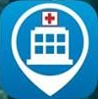
Similar Apps
ICE - in case of emergency
Has Emergency Contact List and medical information, but doesn’t locate hospital
Find Help
Very nice for locating nearest hospitals/dentist/pharmacies, but does not send information to emergency contact and not default accessible from lock screen

Slide 4
What does ours do?
Searches for the nearest location of “Urgent Care” in Google Maps
Directs user to this location
Is able to send this information to the phone owner’s emergency contact
Is accessible from the Lock Screen for emergency use
Shows patient history

Slide 5
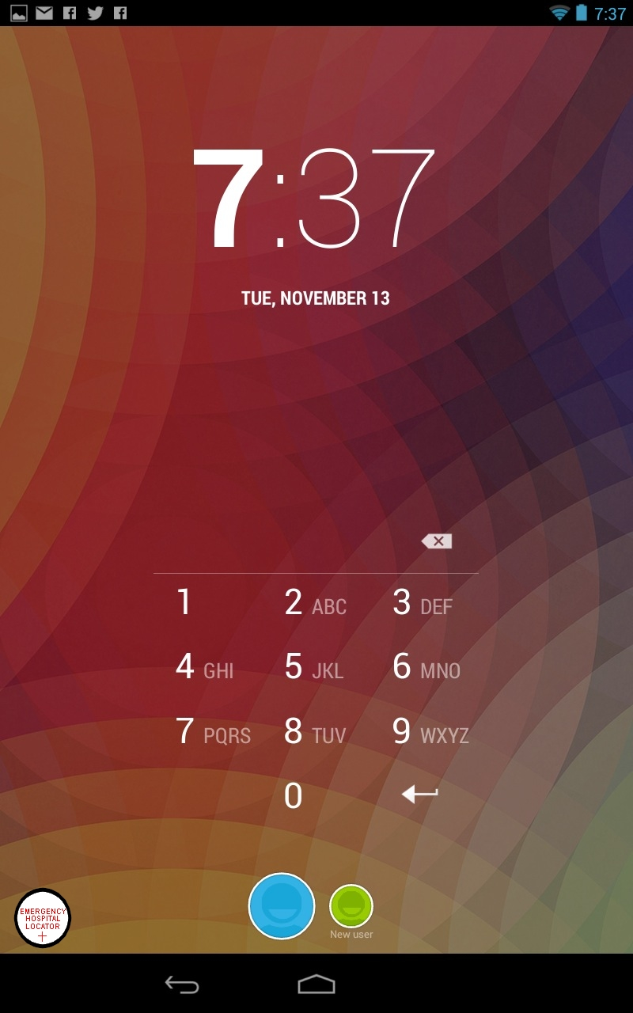

Accessibility From Lock Screen
Easily accessible, especially if there’s a problem with the user
Intended as well for friends/passerby if they notice an issue with the phone-owner, as they don’t need to enter the lock-code

Slide 6
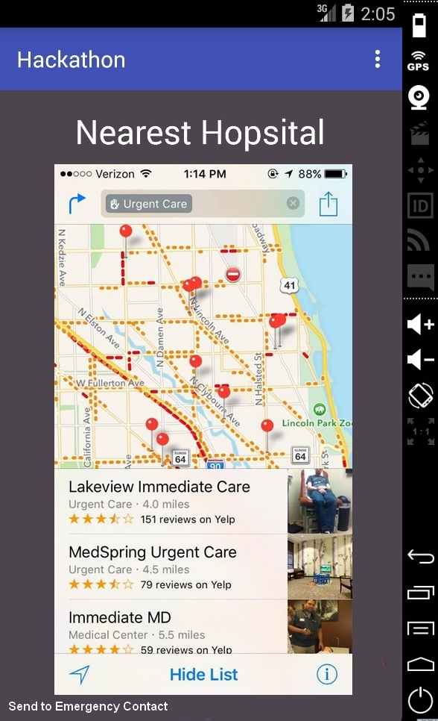
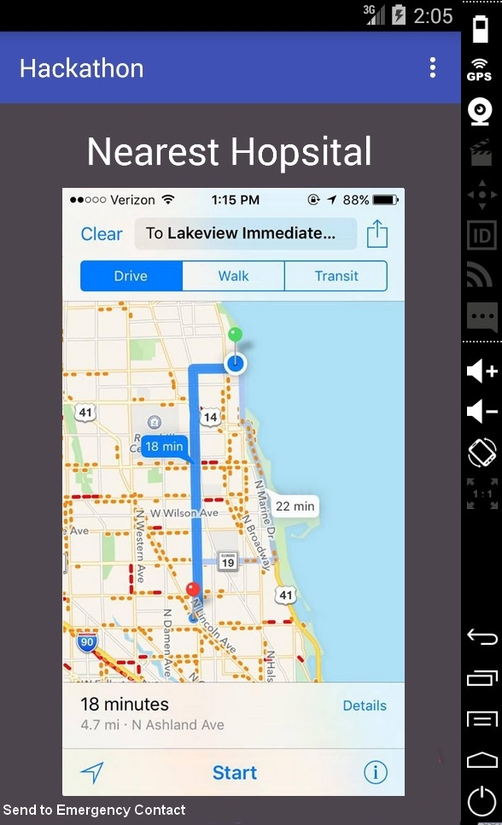
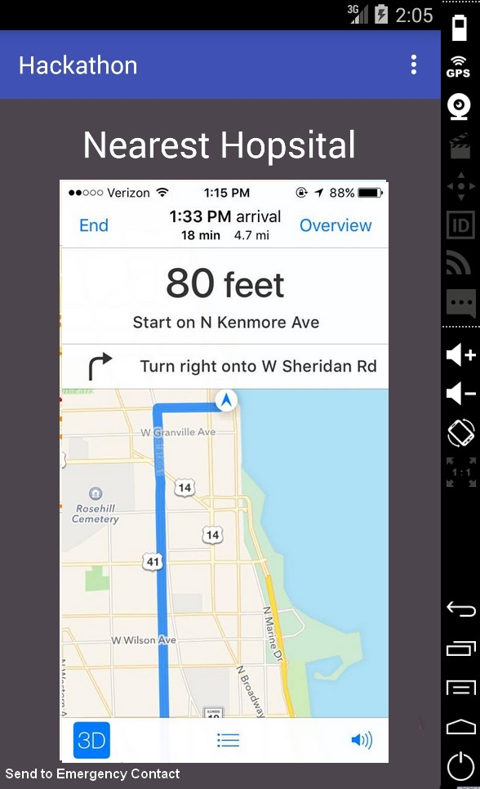
Visual Concept – Nearest Hospital
1
2
3

Slide 7
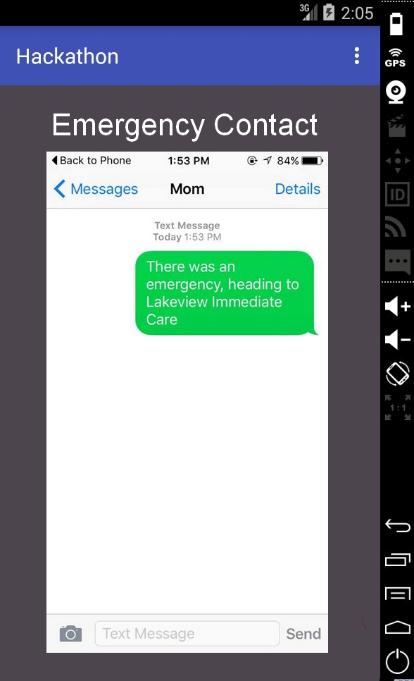
Visual Concept – Emergency Contact
By clicking the “Send to Emergency Contact” button, a pre-written message will be sent to the first emergency contact the phone has on file that includes the name of the hospital that has been chosen by the user

Slide 8
Issues
With Google Maps Android API v2, you can embed maps into an activity as a fragment with a simple XML snippet (http://developer.android.com/training/maps/index.html).
Trouble with Emulator – including “Google Play Services”, despite downloading SDK
Needed more time to make the actual interfaces

