Slide 1
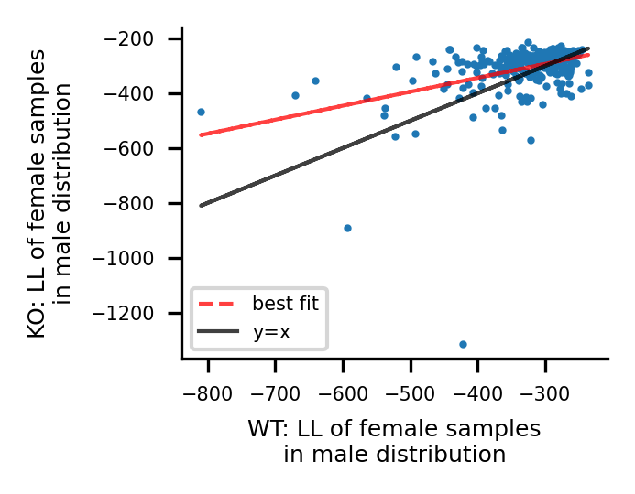
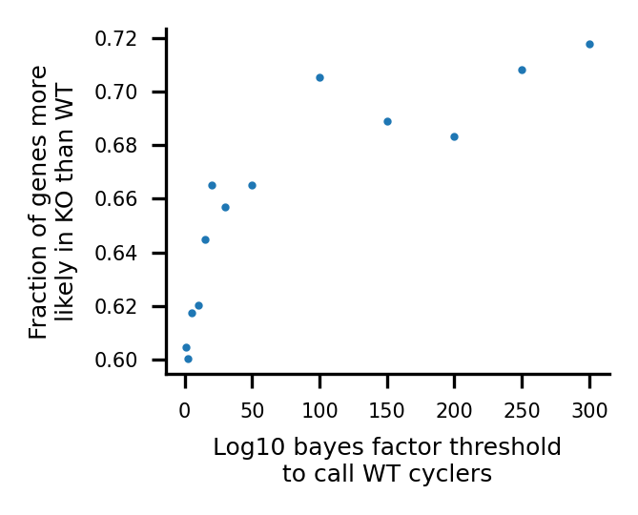
SMC
a
Male
Female
Esr1
Hspa1a
Mcm6
Plat
Apoe
b
c

Slide 2
macrophages
a
Male
Female
Ascending SMC
Serpine1
Ace
b
Male
Female
Cdkn1a
Ccr2

Slide 3
“Feminization” analysis of KO’s – make this a supp fig
Log10 BF thresh: 100
Frac genes more likely in KO: 0.7158
a
b
Figure caption
Supplementary Figure {XXX}: Assessing similarity between confident cycling gene expression in males and females, in the Bmal1 WT and KO SMCs. a) Posterior likelihood of female WT posterior samples in male posterior WT distributions, using the union of confident cycling (log10 bayes factor threshold of 100) genes in the male and female WT (X-axis) vs. posterior likelihood of female KO posterior samples in male posterior KO distributions (y-axis). b) The fraction of confident cycling genes with more similar likelihood between the sexes in the KO conditions over the WT conditions, at various log10 bayes factor thresholds used to call confident circadian cyclers.

Slide 4
Male SMC
Female SMC
Hspa1b
Jun (ascending)
b
Fos (ascending)

