Slide 1
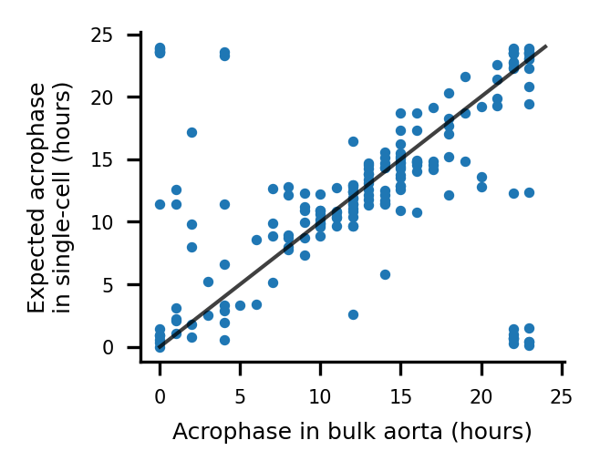
a
b
c
d
SMC
Fibroblast
EC
Macrophage

Slide 2
SMC
Fibroblast
EC
Macrophage

Slide 3
a
b
Up-up
c
d
Down-down

Slide 4
Supp: SMC subtypes
SMC0
SMC1
SMC2
SMC3
SMC4

Slide 5
Supp: acrophase distributions

