Slide 1
Machine Learning: Feature Selection
Fran Ernesto Romero

Slide 2
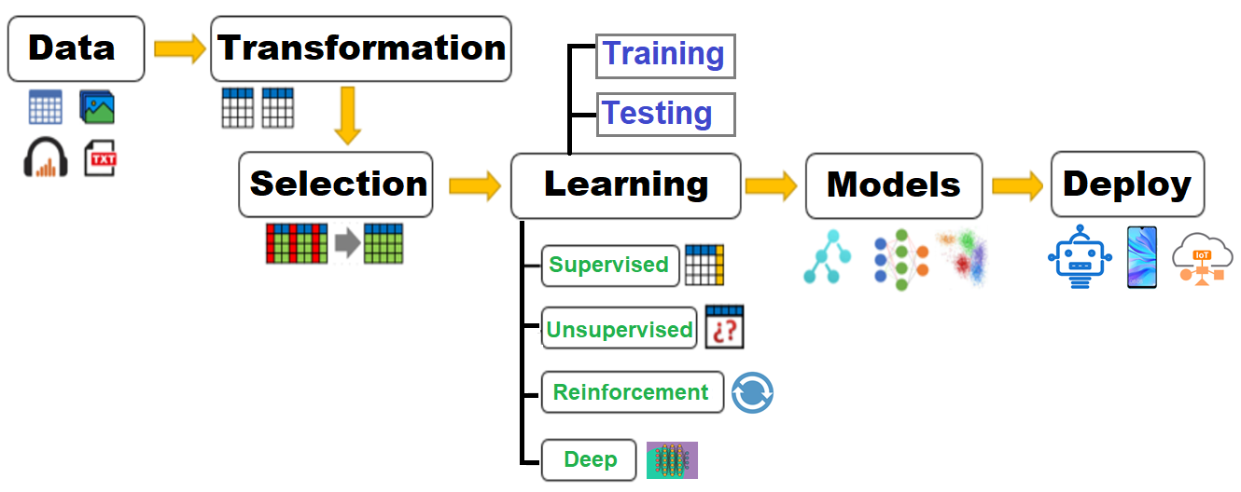
Machine Learning Pipeline

Slide 3
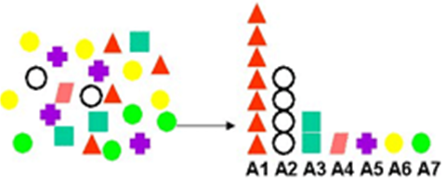
Feature Selection Goals
Discard redundant or irrelevant attributes, reducing the computational cost of the analysis and the generated model.
Discard attributes that generate learning noise, improving model accuracy.

Slide 4
Feature Selection Output
Attribute subset:
{age, weight, size, height, occupation, brothers} →
{weight, size, height}
Attribute ranking:
1. weight 4. age
2. size 5. occupation
3. height 6. brothers

Slide 5
Feature Selection: Wrapper Methods
Feature Selection
Decision Trees, Random Forrest…
Accuracy, F1, Precision, Recall
Learning Algorithm
Subset
Evaluation
{Attribute Subset}
Search Algorithm
{Final Attribute Subset}
Greedy: Take the best attribute, then the best couple, then the best triad, until there is no improvement.
Exhaustive: Take all possible subsets of attributes.
Random
Genetic Search

Slide 6
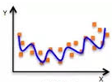
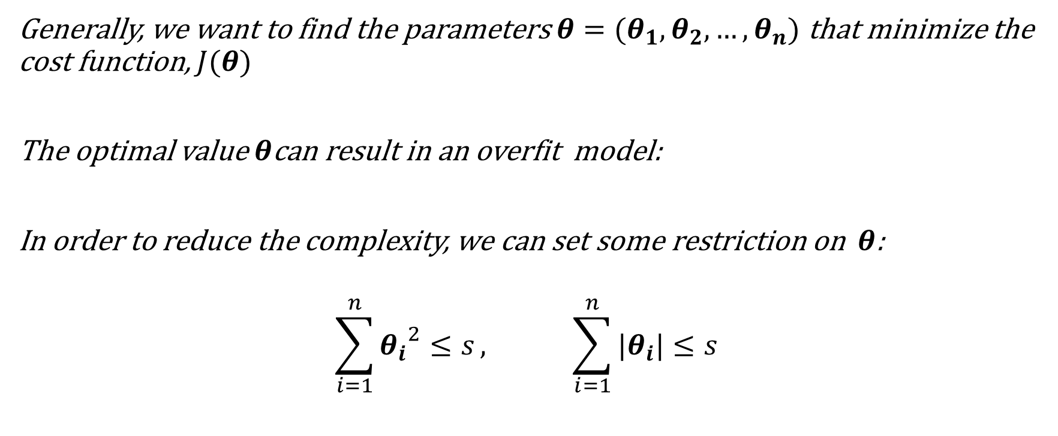
Feature Selection: Embedded Methods
Generally, we want to find the parameters$θ=(θ_{1},θ_{2}, …,θ_{n})$ that minimize the cost function, $J(θ)$
The optimal value$θ$can result in an overfit model:
In order to reduce the complexity, we can set some restriction on $θ$:
$$\sum_{i=1}^{n}{{θ_{i}}^{2}≤s}, \sum_{i=1}^{n}{|θ_{i}|≤s}$$

Slide 7
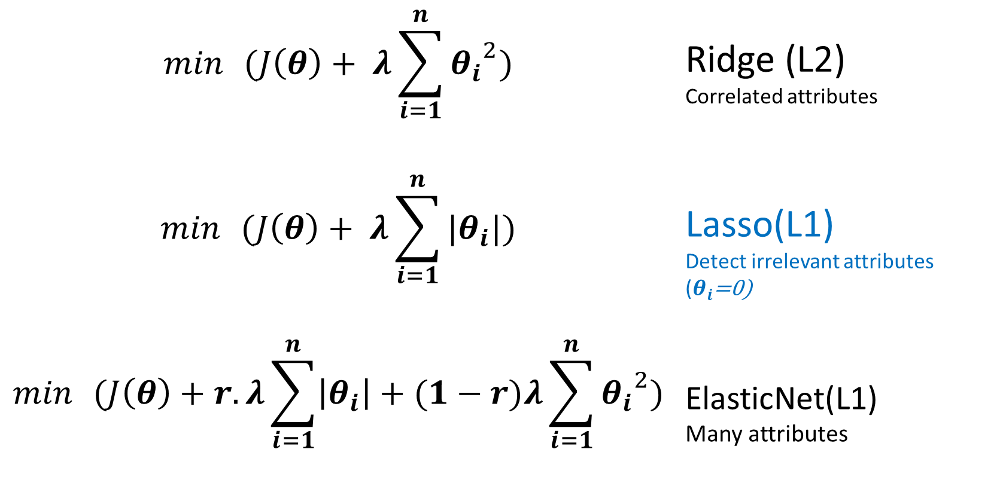
Feature Selection: Embedded Methods
$$\min{ }(J\left(θ\right)+ λ\sum_{i=1}^{n}{{θ_{i}}^{2}})$$ | Ridge (L2) Correlated attributes
$$\min{ }(J\left(θ\right)+ λ\sum_{i=1}^{n}{|θ_{i}|})$$ | Lasso(L1) Detect irrelevant attributes ($θ_{i}$=0)
$$\min{ }(J\left(θ\right)+r. λ\sum_{i=1}^{n}{\left|θ_{i}\right|}+(1−r)λ\sum_{i=1}^{n}{{θ_{i}}^{2}})$$ | ElasticNet(L1) Many attributes

Slide 8
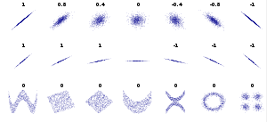
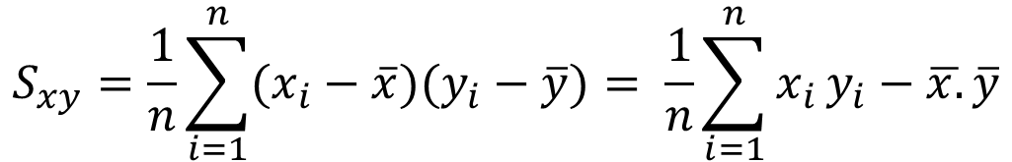
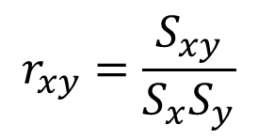
Feature Selection: Filter Methods
Covariance:
$$S_{xy}=\frac{1}{n}\sum_{i=1}^{n}{{(x}_{i}}−\overline{x})(y_{i}−\overline{y})= \frac{1}{n}\sum_{i=1}^{n}{x_{i}}y_{i}−\overline{x.}\overline{y}$$
Sxy > 0: there is a direct positive dependence; At higher x-values, higher y-values
Sxy = 0: there isn’t dependence
Sxy < 0: there is a inverse dependence; At higher x-values of x, lower y- values
Correlation:
$$r_{xy}=\frac{S_{xy}}{S_{x}S_{y}}$$
Sx, Sy: Standard deviation

