Slide 1
Introduction To Machine Learning
Fran Ernesto Romero

Slide 2

Linear Regression
We have a set I of observations (instances):
$$I=\{\left(x_{1},y_{1}\right),\left(x_{2},y_{2}\right), …,(x_{N},y_{N})\}$$
We want to find the linear model that best fits -describe- to I:
$$\hat{Y}=aX+b$$

Slide 3
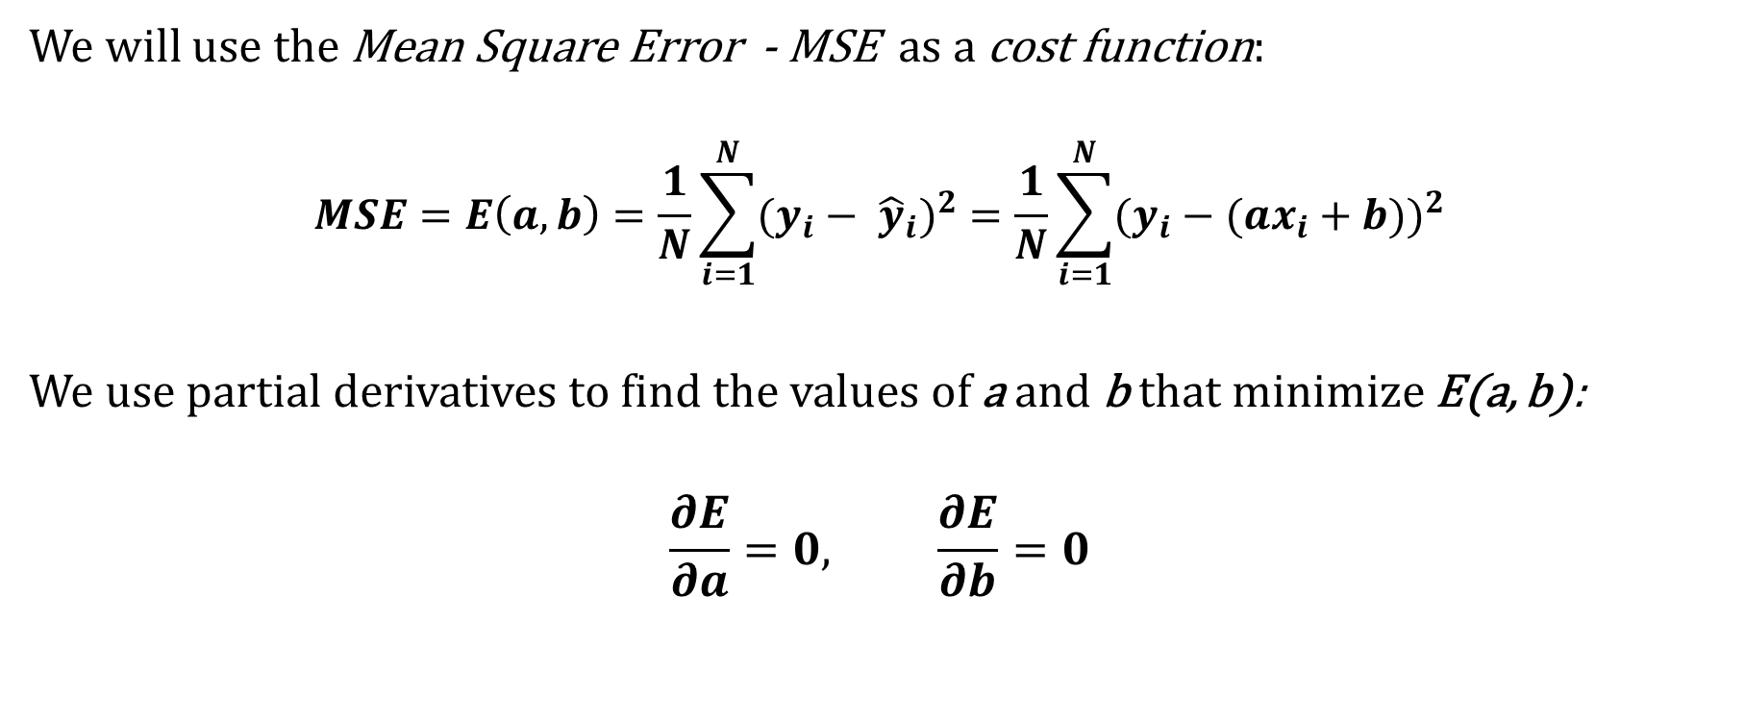
Linear Regression
We will use the Mean Square Error - MSE as a cost function:
$$MSE=E\left(a,b\right)=\frac{1}{N}\sum_{i=1}^{N}{{(y_{i}− {\hat{y}}_{i})}^{2}}=\frac{1}{N}\sum_{i=1}^{N}{{(y_{i}−(ax_{i}+b))}^{2}}$$
We use partial derivatives to find the values of a and b that minimize E(a, b):
$$\frac{∂E}{∂a}=0, \frac{∂E}{∂b}=0$$

Slide 4
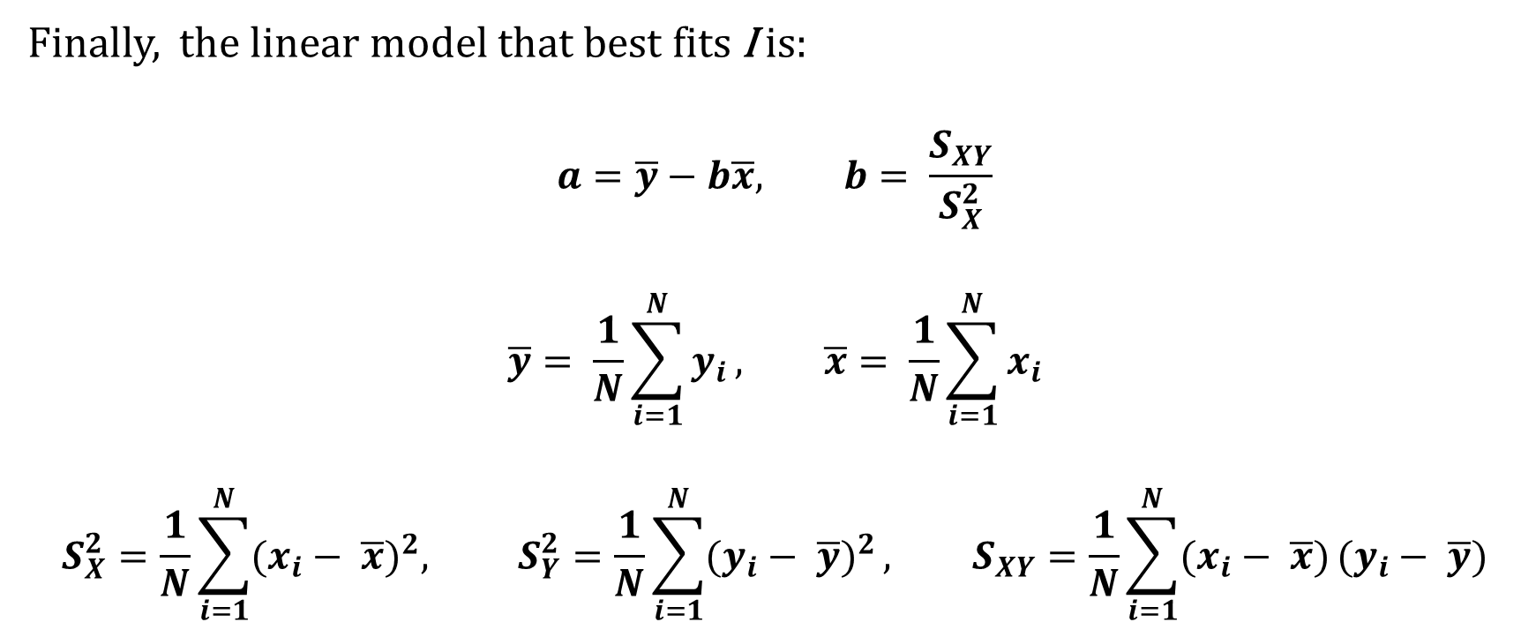
Linear Regression
Finally, the linear model that best fits I is:
$$a=\overline{y}−b\overline{x}, b= \frac{S_{XY}}{S_{X}^{2}}$$
$$\overline{y}= \frac{1}{N}\sum_{i=1}^{N}{y_{i}}, \overline{x}= \frac{1}{N}\sum_{i=1}^{N}{x_{i}}$$
$$S_{X}^{2}=\frac{1}{N}\sum_{i=1}^{N}{{(x_{i}− \overline{x})}^{2}, S_{Y}^{2}=\frac{1}{N}\sum_{i=1}^{N}{{(y_{i}− \overline{y})}^{2}}}, S_{XY}=\frac{1}{N}\sum_{i=1}^{N}{(x_{i}− \overline{x})}(y_{i}− \overline{y})$$

Slide 5
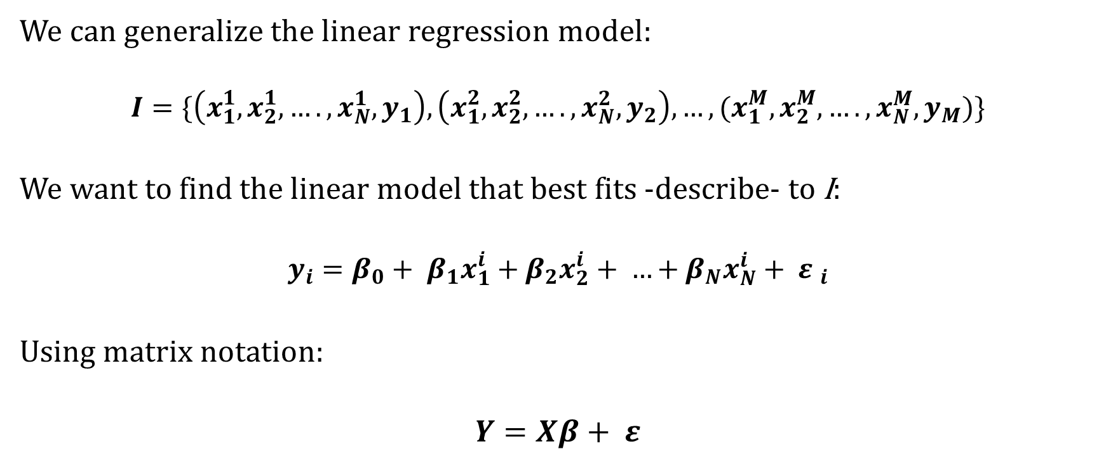
Multiple Linear Regression
We can generalize the linear regression model:
$$I=\{\left(x_{1}^{1},x_{2}^{1},….,x_{N}^{1},y_{1}\right),\left(x_{1}^{2},x_{2}^{2},….,x_{N}^{2},y_{2}\right), …,(x_{1}^{M},x_{2}^{M},….,x_{N}^{M},y_{M})\}$$
We want to find the linear model that best fits -describe- to I:
$$y_{i}=β_{0}+ β_{1}x_{1}^{i}+β_{2}x_{2}^{i}+ …+β_{N}x_{N}^{i}+ {ε }_{i}$$
Using matrix notation:
$$Y=Xβ+ ε$$

Slide 6
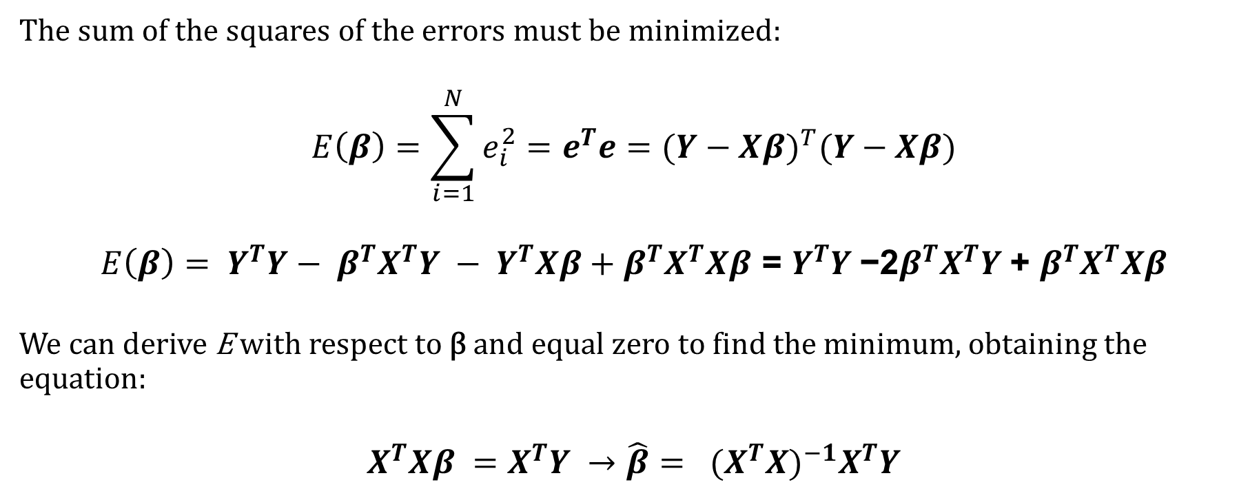
Multiple Linear Regression
The sum of the squares of the errors must be minimized:
$$E\left(β\right)=\sum_{i=1}^{N}{e_{i}^{2}}=e^{T}e={(Y−Xβ)}^{T}(Y−Xβ)$$
$$E\left(β\right)= Y^{T}Y− β^{T}X^{T}Y − Y^{T}Xβ+β^{T}X^{T}Xβ\text{ = }Y^{T}Y \text{−2}β^{T}X^{T}Y \text{+ }β^{T}X^{T}Xβ$$
We can derive E with respect to β and equal zero to find the minimum, obtaining the equation:
$$X^{T}Xβ =X^{T}Y →\hat{β}= {(X^{T}X)}^{−1}X^{T}Y$$

Slide 7
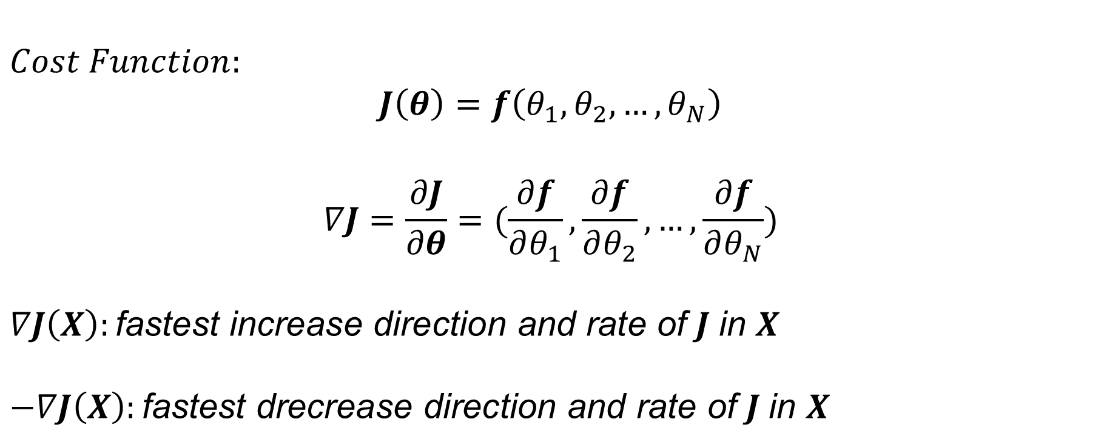
Gradient Descent Algorithm
$$Cost Function:$$
$$J\left(θ\right)=f\left(θ_{1}, θ_{2}, …, θ_{N}\right)$$
$$∇J=\frac{∂J}{∂θ}=(\frac{∂f}{∂θ_{1}},\frac{∂f}{∂θ_{2}}, …,\frac{∂f}{∂θ_{N}})$$
$$∇J\left(X\right):\text{fastest} \text{increase} \text{direction} \text{and} \text{rate} \text{of} J \text{in} X$$
$$−∇J\left(X\right):\text{fastest} \text{drecrease} \text{direction} \text{and} \text{rate} \text{of} J \text{in} X$$

Slide 8

Gradient Descent Algorithm
$1. Initilize: θ=\left(θ_{1}, θ_{2}, …, θ_{N}\right), α=0.01, Epochs=1000$
$2. Repeat Epochs times$:
$$2.1. θ← θ −α\frac{∂J}{∂θ}$$

Slide 9
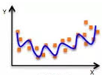
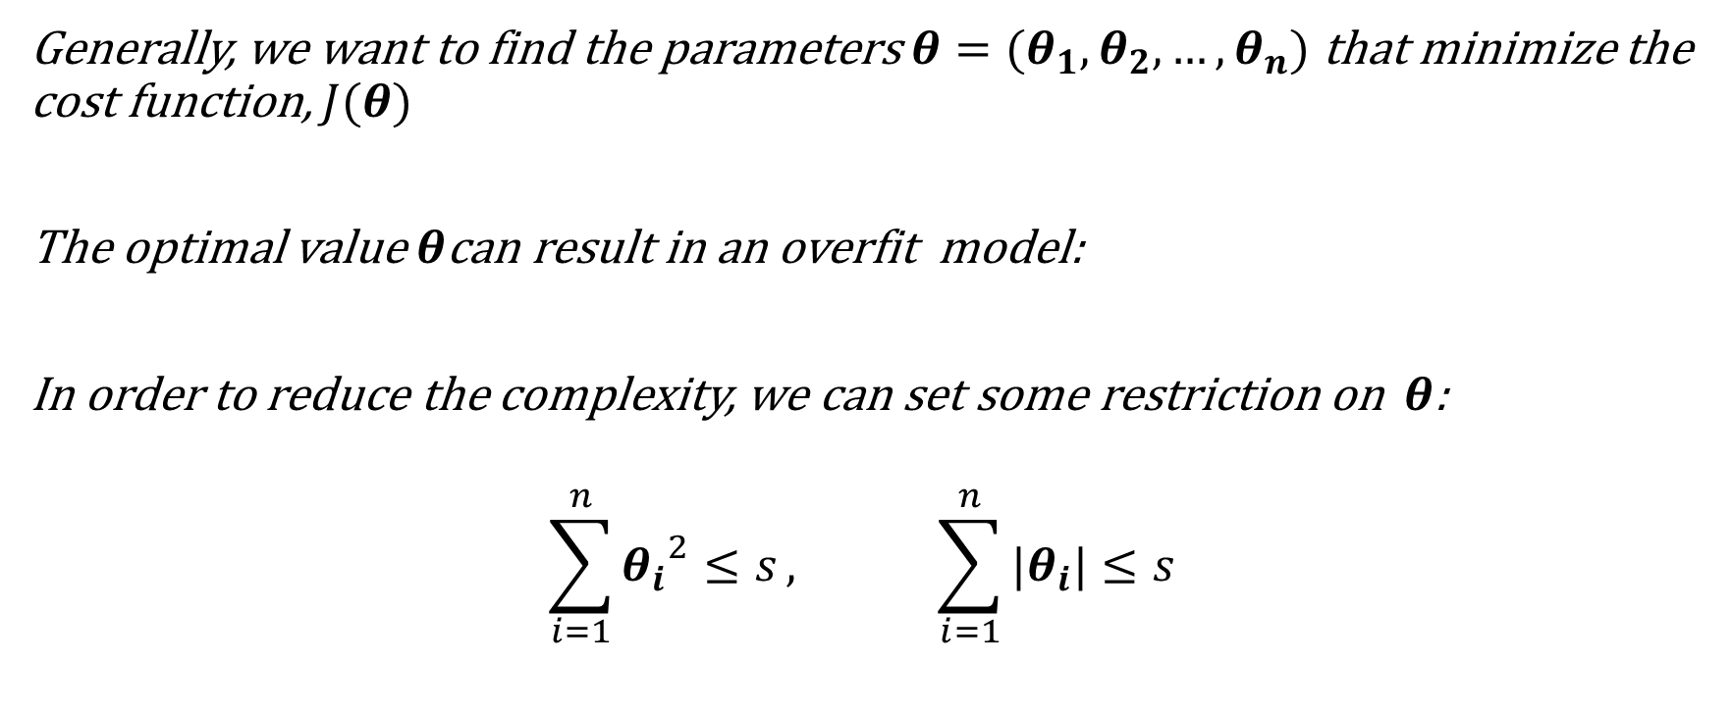
Regularization
Generally, we want to find the parameters$θ=(θ_{1},θ_{2}, …,θ_{n})$ that minimize the cost function, $J(θ)$
The optimal value$θ$can result in an overfit model:
In order to reduce the complexity, we can set some restriction on $θ$:
$$\sum_{i=1}^{n}{{θ_{i}}^{2}≤s}, \sum_{i=1}^{n}{|θ_{i}|≤s}$$

Slide 10

Regularization
$$\min{ }J\left(θ\right)$$
$$subject to:\sum_{i=1}^{n}{{θ_{i}}^{2}≤s}$$
Using Lagrange Multipliers:
$$\min{ }(J\left(θ\right)+ λ\sum_{i=1}^{n}{{θ_{i}}^{2}})$$

Slide 11
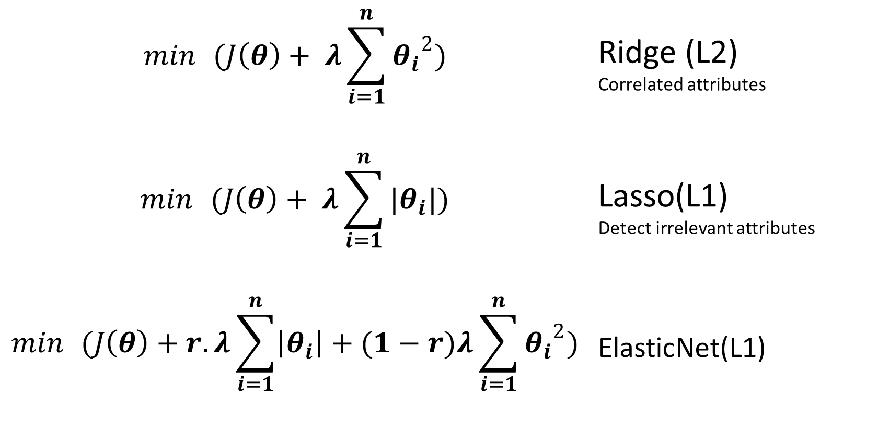
Regularization
$$\min{ }(J\left(θ\right)+ λ\sum_{i=1}^{n}{{θ_{i}}^{2}})$$ | Ridge (L2) Correlated attributes
$$\min{ }(J\left(θ\right)+ λ\sum_{i=1}^{n}{|θ_{i}|})$$ | Lasso(L1) Detect irrelevant attributes
$$\min{ }(J\left(θ\right)+r. λ\sum_{i=1}^{n}{\left|θ_{i}\right|}+(1−r)λ\sum_{i=1}^{n}{{θ_{i}}^{2}})$$ | ElasticNet(L1)
Many attributes

Slide 12
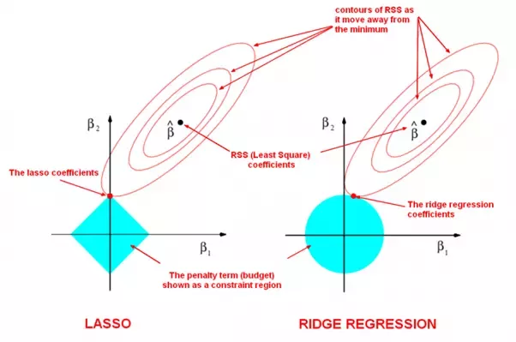
Regularization

