Slide 1
Machine Learning: Classifiers
Fran Ernesto Romero

Slide 2
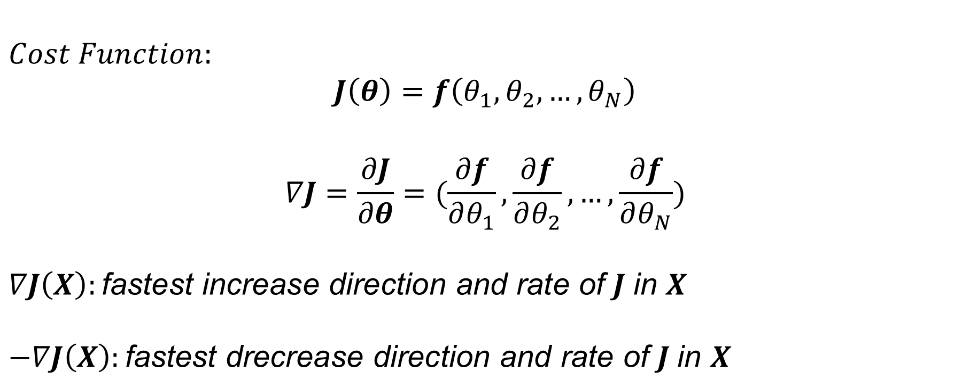
Gradient Descent Algorithm
$$Cost Function:$$
$$J\left(θ\right)=f\left(θ_{1}, θ_{2}, …, θ_{N}\right)$$
$$∇J=\frac{∂J}{∂θ}=(\frac{∂f}{∂θ_{1}},\frac{∂f}{∂θ_{2}}, …,\frac{∂f}{∂θ_{N}})$$
$$∇J\left(X\right):\text{fastest} \text{increase} \text{direction} \text{and} \text{rate} \text{of} J \text{in} X$$
$$−∇J\left(X\right):\text{fastest} \text{drecrease} \text{direction} \text{and} \text{rate} \text{of} J \text{in} X$$

Slide 3

Gradient Descent Algorithm
$1. Initilize: θ=\left(θ_{1}, θ_{2}, …, θ_{N}\right), α=0.01, Epochs=1000$
$2. Repeat Epochs times$:
$$2.1. θ← θ −α\frac{∂J}{∂θ}$$

Slide 4
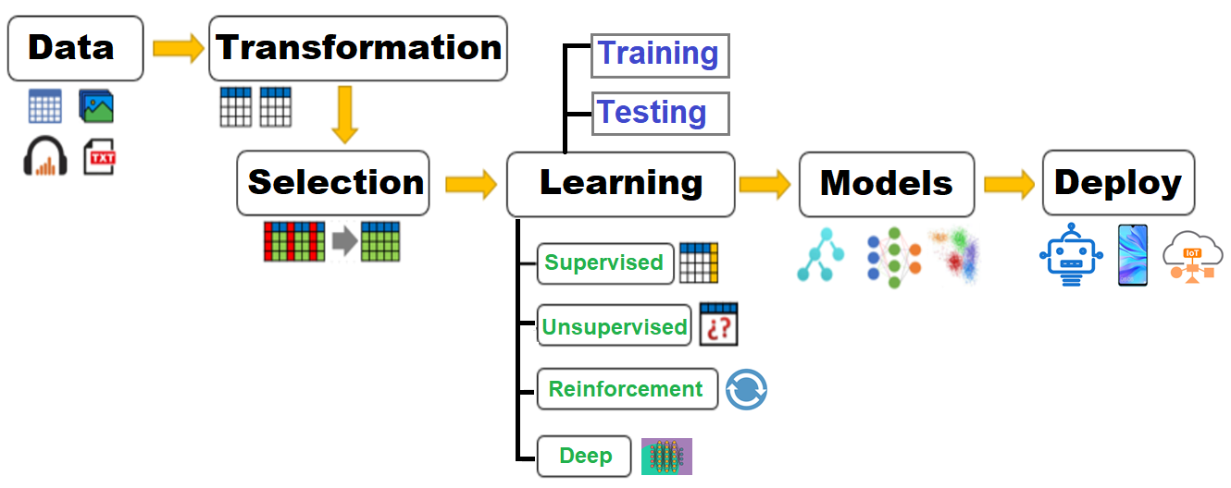
Machine Learning Pipeline

Slide 5
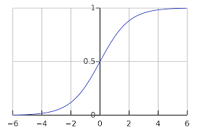
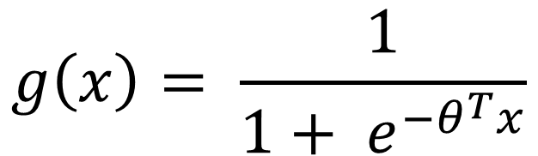
Logistic Regression
Logistic function:
$$g\left(x\right)= \frac{1}{1+ e^{−θ^{T}x}}$$

Slide 6
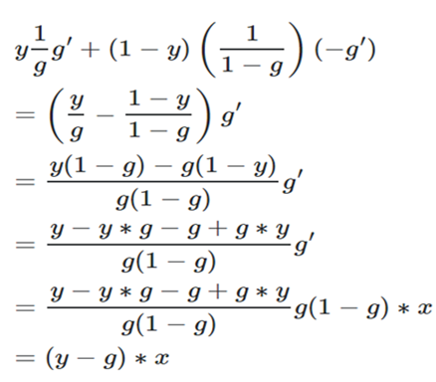
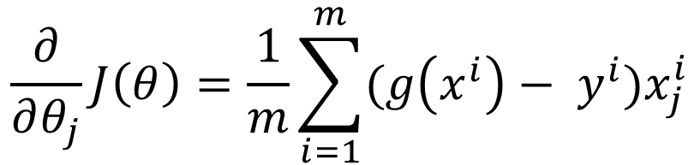
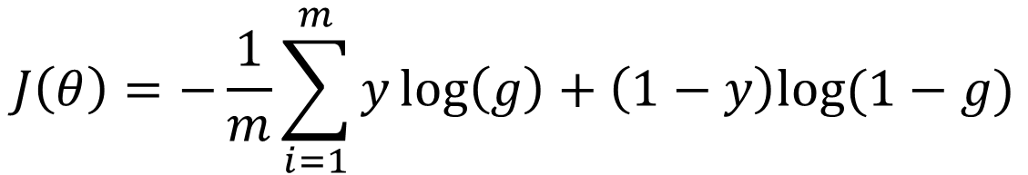

Logistic Regression
Using cross-entropy as cost function:
$$J\left(θ\right)=−\frac{1}{m}\sum_{i=1}^{m}{y\log\left(g\right)+\left(1−y\right)log⁡(1−g)}$$
$$g\left(x^{i}\right)=p(y^{i})$$
Calculating the gradient in cost function:
$$\frac{∂}{∂θ_{j}}J\left(θ\right)=\frac{1}{m}\sum_{i=1}^{m}{(g\left(x^{i}\right)− y^{i}})x_{j}^{i}$$

Slide 7
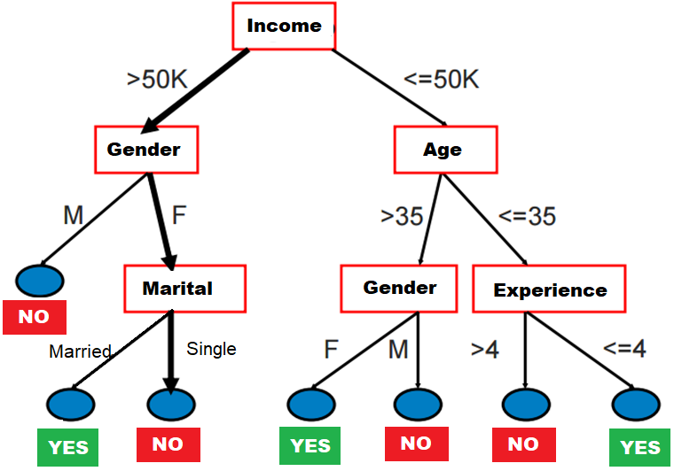
Decision Trees

Slide 8
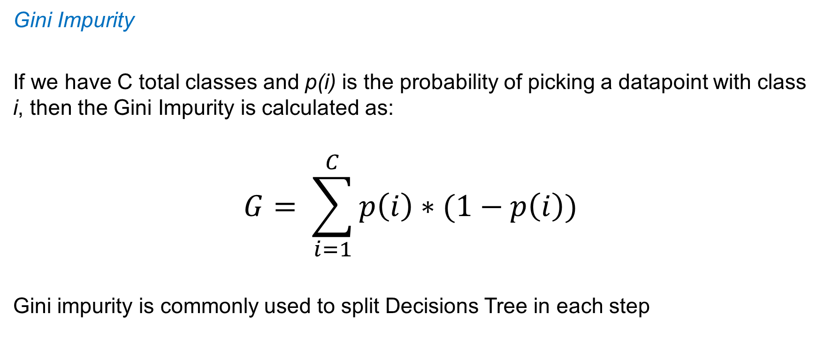
ID3 Algorithm (Gini)
Gini Impurity
If we have C total classes and p(i) is the probability of picking a datapoint with class i, then the Gini Impurity is calculated as:
$$G= \sum_{i=1}^{C}{p\left(i\right)∗(1−p\left(i\right))}$$
Gini impurity is commonly used to split Decisions Tree in each step

Slide 9
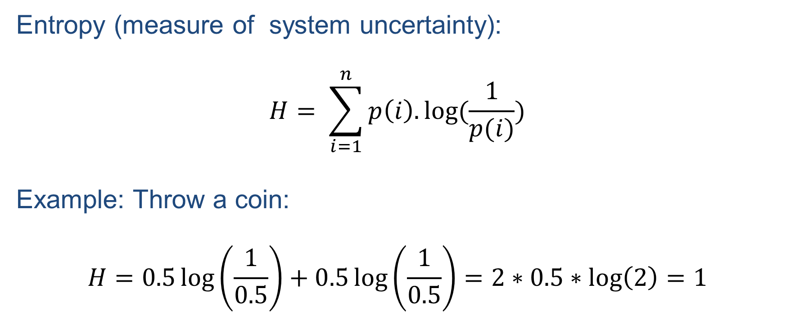
ID3 Algorithm
Entropy (measure of system uncertainty):
$$H= \sum_{i=1}^{n}{p\left(i\right).log⁡(\frac{1}{p(i)}})$$
Example: Throw a coin:
$$H=0.5\log\left(\frac{1}{0.5}\right)+0.5\log\left(\frac{1}{0.5}\right)=2∗0.5∗\log\left(2\right)=1$$

Slide 10
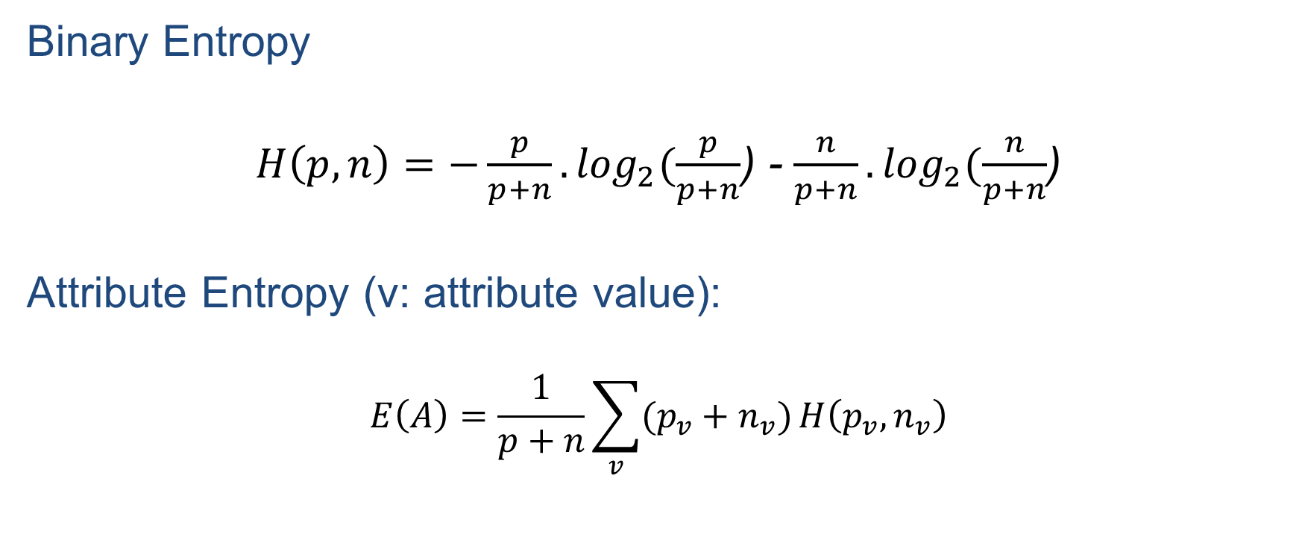
ID3 Algorithm
Binary Entropy
$H\left(p, n\right)=−\frac{p}{p+n}.\log_{2}⁡(\frac{p}{p+n}$) - $\frac{n}{p+n}.\log_{2}⁡(\frac{n}{p+n}$)
Attribute Entropy (v: attribute value):
$$E\left(A\right)=\frac{1}{p+n}\sum_{v}{(p_{v}+n_{v})}H\left(p_{v}, n_{v}\right)$$

Slide 11
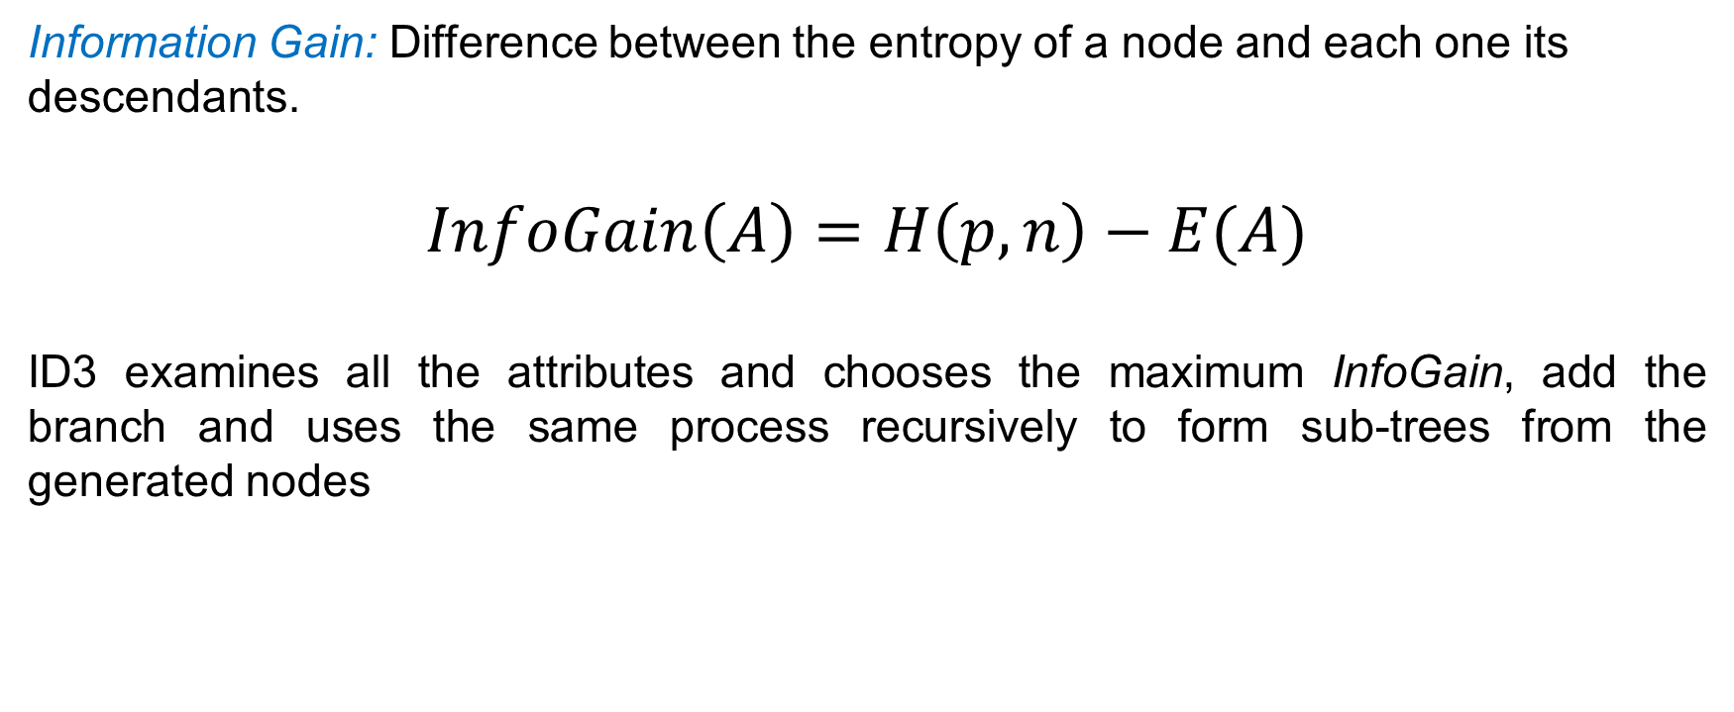
ID3 Algorithm
Information Gain: Difference between the entropy of a node and each one its descendants.
$$InfoGain\left(A\right)=H\left(p, n\right)−E(A)$$
ID3 examines all the attributes and chooses the maximum InfoGain, add the branch and uses the same process recursively to form sub-trees from the generated nodes

Slide 12
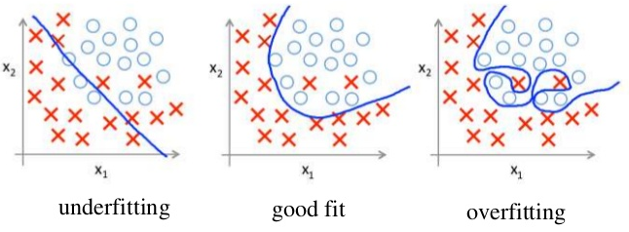
Random Forrest
Decision Trees May suffer from overfitting

Slide 13
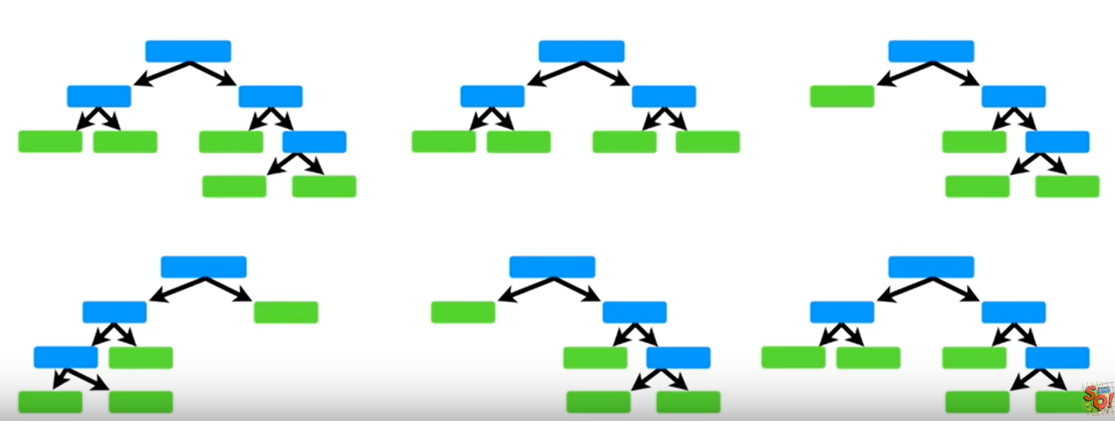
Random Forrest
We can build many decision trees…

Slide 14
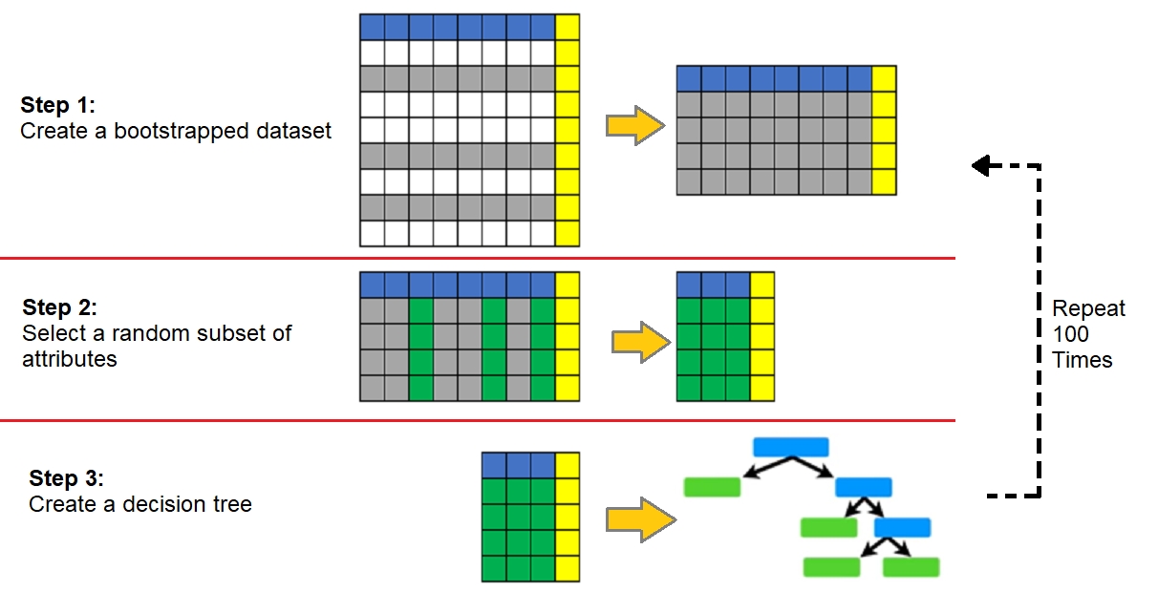
Random Forrest
For a new instance, evaluate each tree and select the most frequent class

