Slide 1

Association Rules Discovery Machine Learning

Slide 2
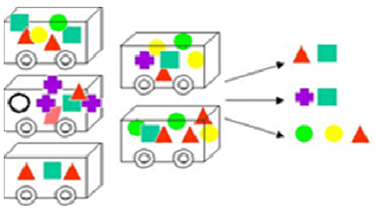
Association Rules
An association rule is a statement of the type:
If {Conditions} Possibly {Consequences} [support = x%, confidence = y%]

Slide 3
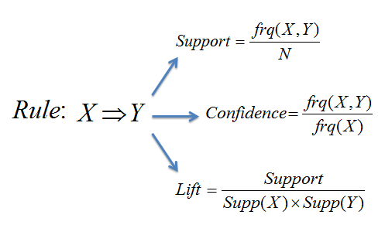
Support, Confidence and Lift
If X={cond1, …, condN} Possibly Y={consq1, …, consqM}
[support = x%, confidence = y%]
Lift | Explanation
1 | X is independent of Y
> 1 | There is a dependency of X with Y (good)
< 1 | The presence of X has a negative effect on the presence of Y, and vice versa.

Slide 4
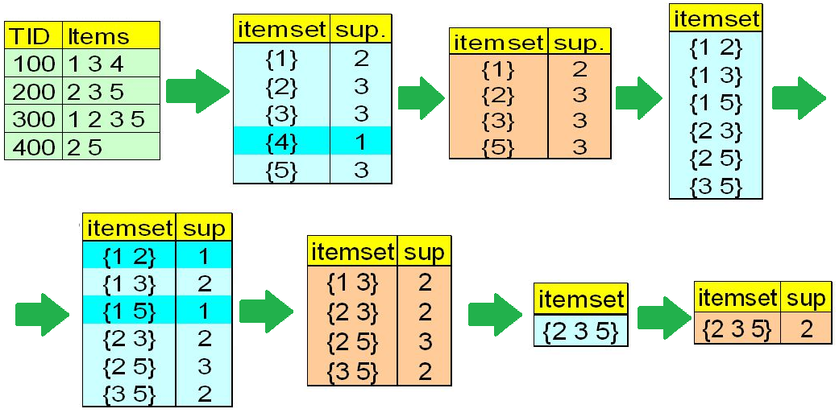
Apriori algorithm
Apriori is the algorithm commonly used to obtain association rules. Identify frequent individual items and extend them iteratively.
Apriori works on Categorical or Discretized data sets.

Slide 5
Attribute Discretization
Association rules work with nominal attributes. To convert a continuous attribute into a discrete one, discretization techniques are used.
Interval discretization
Frequency discretization
Discretization by entropy

