Slide 1
Machine Learning: Performance Metrics Fran Ernesto Romero

Slide 2
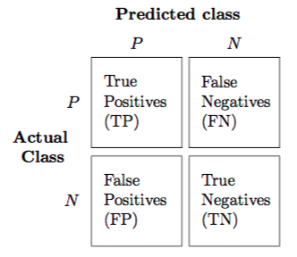
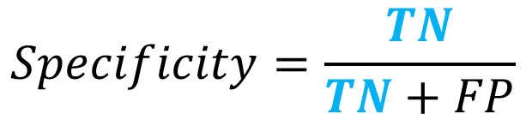
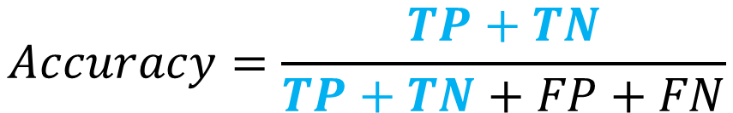
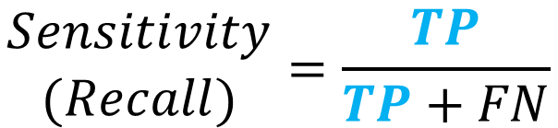
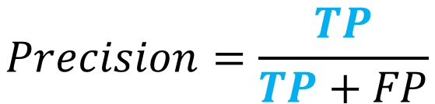
Confusion Matrix, Sensitivity, Specificity and Precision
$$\begin{matrix}Sensitivity \\ (Recall)\end{matrix}=\frac{TP}{TP+FN}$$
$$Specificity=\frac{TN}{TN+FP}$$
$$Precision=\frac{TP}{TP+FP}$$
$$Accuracy=\frac{TP+TN}{TP+TN+FP+FN}$$

Slide 3
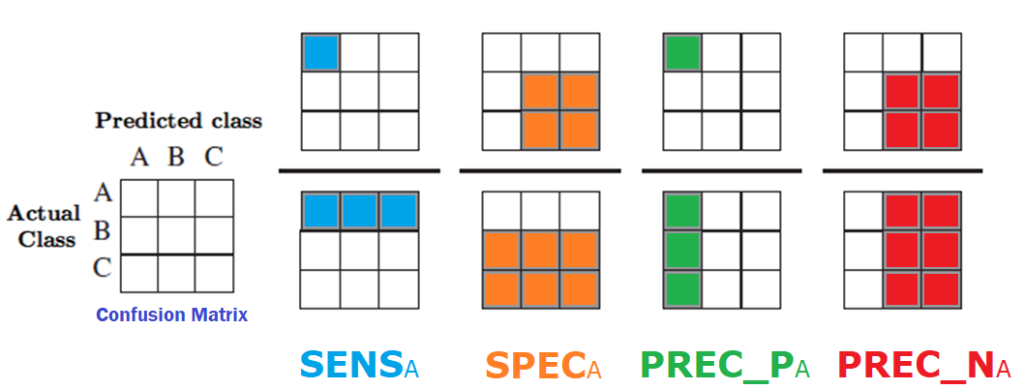
Confusion Matrix, Sensitivity, Specificity and Precision

Slide 4
Sensitivity and Specificity
If correctly identifying positives is the most important thing to do with the data, we should choose a method with higher Sensitivity
If correctly identifying negatives is more important, than we should put more emphasis on Specificity

Slide 5
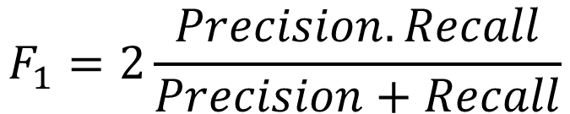
F1 Metric
$$F_{1}=2\frac{Precision.Recall}{Precision+Recall}$$
If the data set is balanced, F1 does not provide more information.
If the data set is unbalanced and both classes are important, the classifier with the highest F1 score for both classes is selected.
If the data set is unbalanced but one class is more important than the other, the classifier with the highest F1 score in the interest class is chosen.

Slide 6
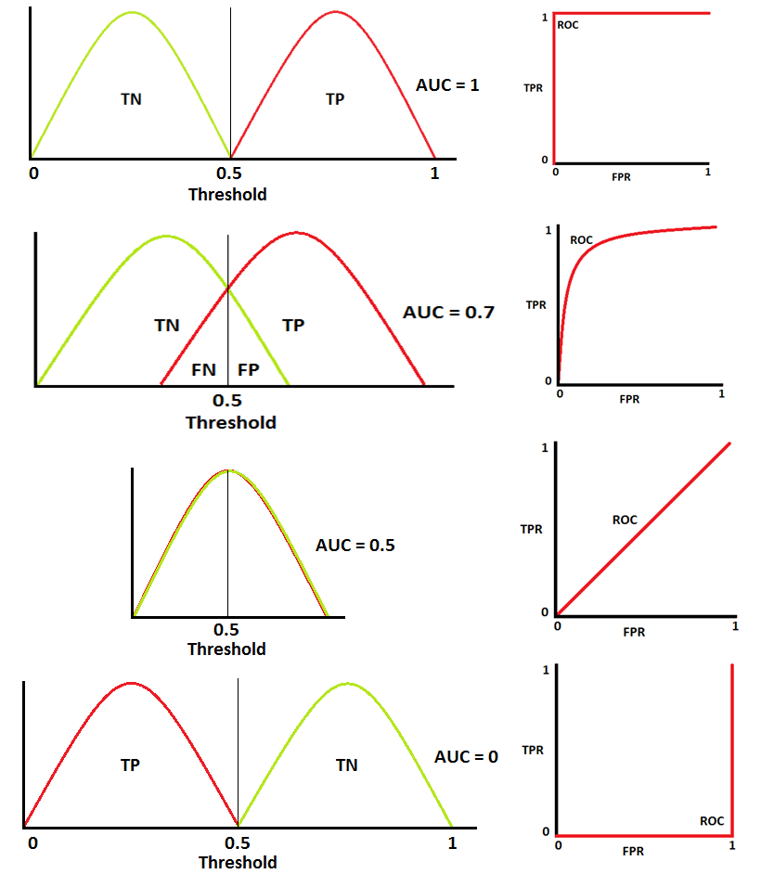
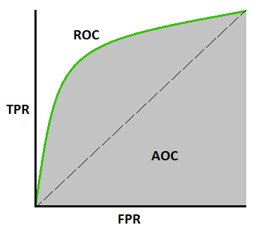
Receiver Operating Characteristics
Image source: https://towardsdatascience.com/understanding-auc-roc-curve-68b2303cc9c5

